Slide 1
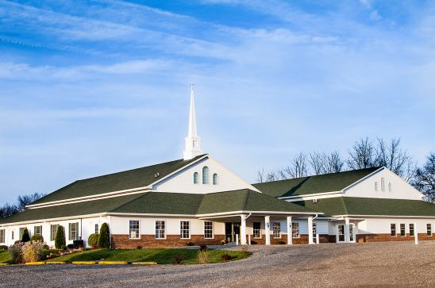
The Doctrine of the Church
The Organization and Officers of the Church

Slide 2
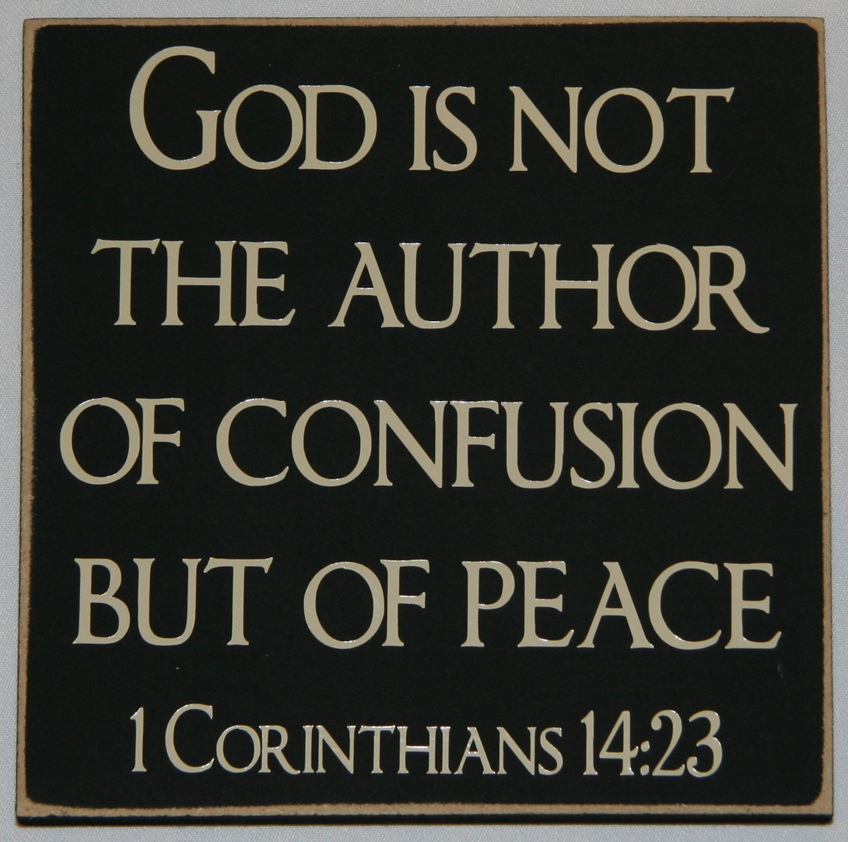
The Organization of the Church

Slide 3
There have been groups and individuals who have taught that the Scriptures give no warrant for our present-day organized church. It is held that believers should get together, observe the Lord’s Supper, study God’s Word, and cooperate in Christian service without anything resembling a formal organization.

Slide 4
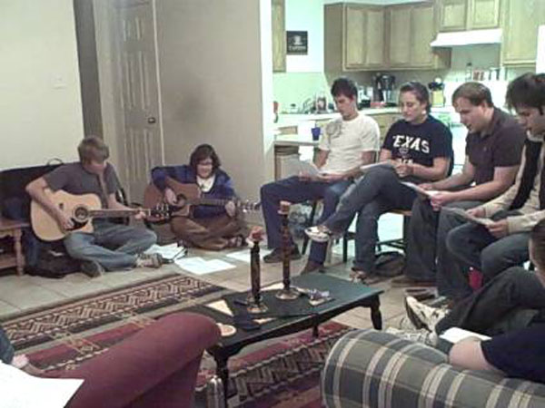

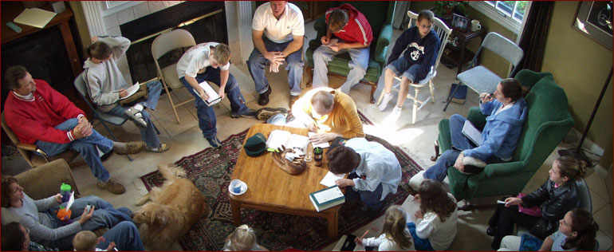

Slide 5
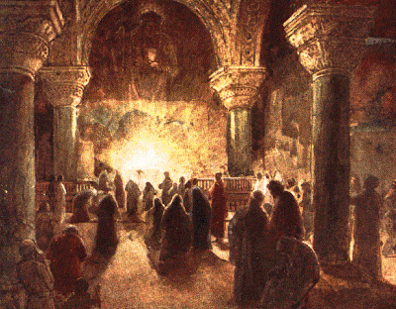
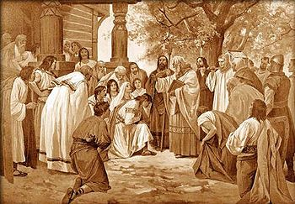
The First Church at Jerusalem
There was a simple form of organization in the Church at Jerusalem.
This is clearly evident from a number of things.

Slide 6
The believers adhered to a definite doctrinal standard (Acts 2:42)
They met for teaching, spiritual fellowship and united in prayer (Acts 2:42)
They practiced baptism (Acts 2:41)
They observed the Lord’s Supper (Acts 2:42, 46)
They kept account of the membership (Acts 2:14, 41; 4:4)
They met faithfully for public worship (Acts 2:46)
They provided material help for the needy of their fellowship (Acts 2:44-45)

Slide 7
The Apostles were the first ministers (Pastors) in this Church, and they soon added the seven men (Deacons) to take care of the physical needs of the church body (Acts 6:1-7)
On the day of Pentecost they were assembled in ‘the upper room’ (Acts 1:13; 2:1)
They first met in the temple for service until driven out (Acts 2:46; 3:1)
They then met in homes of fellow Christians (Acts 2:46)
All these factors indicate that even from the beginning the church had a form of organization.

Slide 8
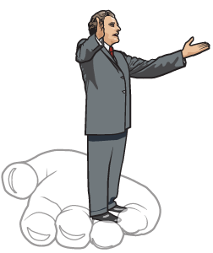
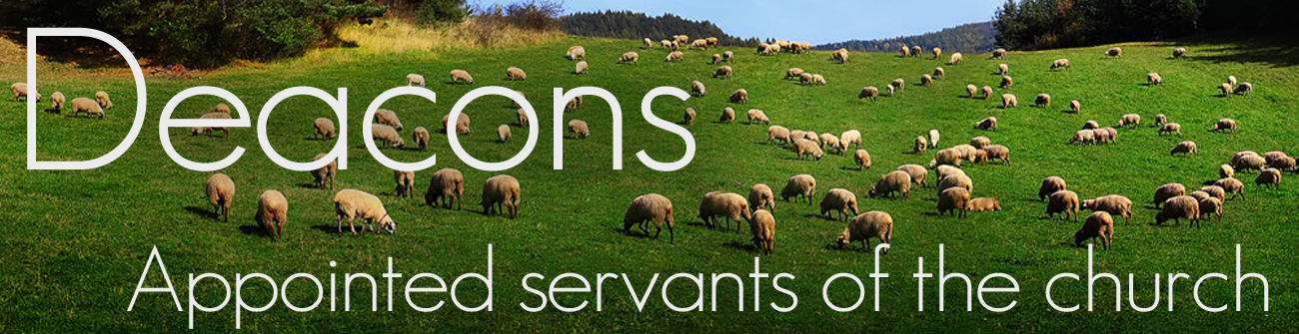
The New Testament Church had Officers
(Philippians 1:1) “Paul and Timotheus, the servants of Jesus Christ, to all the saints in Christ Jesus which are at Philippi, with the bishops and deacons.”

Slide 9

The Role of the Pastor

Slide 10
  The pastor is your Shepherd – Eph. 4:12; Jeremiah 3:15; Acts 20:28-31; I Pet. 5:1-4
  The pastor is The pastor is your Shepherd – Eph. 4:12; Jeremiah 3:15; Acts 20:28-31; I Pet. 5:1-4 your Shepherd – Eph. 4:12; Jeremiah 3:15; Acts 20:28-31; I Pet. 5:1-4
  The Pastor as a Shepherd
  (Eph. 4:12; Jeremiah 3:15;
  Acts 20:28-31; I Pet. 5:1-4)
Jesus Christ is the “Great Shepherd of the sheep” and in John 10:1-18 Jesus is called “the good shepherd”- The Pastor then is the “Under Shepherd” of Jesus Christ – Christ is the head of the church!
Following the example of Jesus Christ in John 10:1-18 a “good shepherd” has the following responsibility concerning his flock –

Slide 11
1. Know the sheep – “…he calleth his own sheep by name…”
2. Lead the sheep – “…he leadeth them out. And when he putteth forth his own sheep, he goeth before them…”
3. Train the sheep – “…and the sheep follow him: for they know his voice. A stranger will they not follow, but will flee from him: for they know not the voice of strangers…”
4. Feed the sheep – “…and shall go in and out and find pasture…”

Slide 12
5. Protect the sheep – John 10:8-13
  Thieves and robbers (false teachers)
  Wolves (world, flesh and the devil)
6. Love the sheep – “…the good shepherd giveth his life for the sheep…”
Note: The pastor is not to pastor out of - compulsion but voluntarily / He is not to pastor for - filthy lucre sake but out of a ready mind / He is not to - Lord over the flock but lead by personal example I Peter 5:2-4

Slide 13
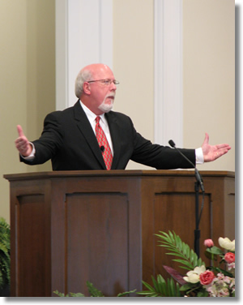
Speaking Ministry of the Pastor

Slide 14
[ 1 ] Admonish (niytgetei) - I Thessalonians 5:12
To warn or caution against specific faults; to inform or remind by way of warning; to reprove or counsel
[ 2 ] EDIFY (oikodomeo) - I Corinthians 14:3
To build up; to instruct and improve morally or spiritually
[ 3 ] EXHORT (paraklaleo) - I Corinthians 14:3
To urge or incite to good works; to encourage through advice or counsel that which is commendable

Slide 15
[ 4 ] Comfort (paraklesis) - I Corinthians 14:3
To come along side of to help; to ease from worry or pain; to console
[ 5 ] preach (kataggello) - Colossians 1:28
To tell thoroughly; to cry or proclaim as a herald; to speak forcefully
[ 6 ] warning (nou) - Colossians 1:28
To protest strongly; to testify against
[ 7 ] teaching (didasko) - Colossians 1:28
To provide with knowledge; to give lessons or instruction; to explain how to do something

Slide 16
[ 8 ] reprove (elegcho) - II Timothy 4:2
To convict; to point out error; to find fault with; to condemn; to speak with disapproval
[ 9 ] Rebuke (epitimao) - II Timothy 4:2
To set a weight upon; to chide with; to strike blame upon; to convince of wrong doing; to address in sharp and severe disapproval; to force back; to beat down; to bruise
[10] charge (paraggello) - I Timothy 1:3
To tell apart; to bear down upon; to give a command

Slide 17
[11] counsel (Hebrew - tachbuloth) - Proverbs 11:14
To give wise advice; to exhort, warn, admonish, or instruct
[12] doctrine (didaskalia) - Titus 1:9
The act of teaching or instruction
[13] correction (epanorihasis) - II Timothy 3:16
To set aright according to just standards of truth; to point out error
[14] instruction (paideia) - II Timothy 3:16
To nourish (feed) with knowledge

Slide 18
The Pastor must Preach in order to
(Heb. 13:20-21)
> Perfect the sheep – “make you perfect in every good work…”
> Exhort the sheep -
  Be obedient to the Lord – “…to do his will…”
  Sensitive to the Holy Spirit – “…working in you…”
  Live a life well pleasing to God – “…that which is well pleasing in his sight…”
  Glorify God – “…to whom be glory forever and ever…”

Slide 19
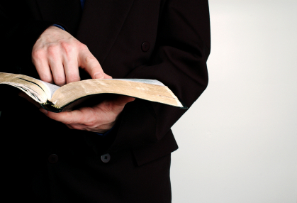
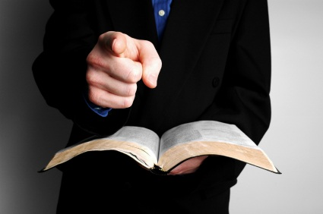
The Pastor as a Teacher
(Eph. 4:11-12)

Slide 20
The qualifications of a pastor – Read (I Tim. 3:1-7) “…apt to teach…” (see II Tim. 2:24)
It is imperative that a pastor not only be able to “preach” - (motivational)
Hebrews 13:20-21 Exhorting his people to – 1. Be obedient to the Lord 2. Sensitive to the Holy Spirit 3. Live a life well pleasing to God 4. Glorify God in their lives
He must also be able to “teach” (instructional) – Acts 15:35 speaks of “Preaching and Teaching the Word of God…”

Slide 21
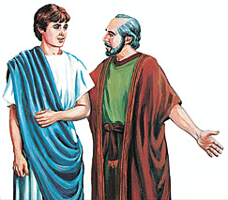
Paul told young
Pastor Timothy
“Give attendance to reading, to exhortation, to doctrine…take heed unto thyself and unto the doctrine; continue in them: for in doing this thou shalt both save thyself and them that hear thee…”

Slide 22
“The things that thou hast heard of me among many witnesses, the same commit thou to faithful men, who shall be able to teach others also…”

Slide 23
The Pastor as an Elder
(I Tim. 5:17, Titus 1:5)
The word “elder” refers to the “maturity required to hold the office of a pastor” - “…Not a novice…”
Pastors are to have the conduct of elders – Titus. 1:5-9, I Tim. 3:1-6 read
Pastors are to have the conviction of elders – “Holding fast the faithful word…”
c. Pastors are to have the compassion of elders – “…comforting every one of you as a father doth his children…”
d. Pastors are to have the courage of elders – “…they spoke the word of God with boldness…”

Slide 24
The Pastor as a Bishop
(Phil. 1:1)
Bishop means “overseer” = The pastor is to have the oversight of every aspect of the ministry – “Let the elders that rule…”
The word rule means “one set or place over” as the one place in authority he is to – Titus 1:5 “set things in order…”
In most of our evangelical churches it is not the “Pastor” the is the “ruling bishop” it is – a board / committee / or some headstrong individual that is running the church.

Slide 25
Three things you will not find in the Bible that you will find in most
Baptist Churches
Deacon or elder boards
Business meetings
Majority rule
(God never ruled through a majority vote)

Slide 26

Pastor/Shepherd = Design of the office
Teacher = Duty of the office
Elder = Dignity of the office
Bishop = Demand of the office

Slide 27
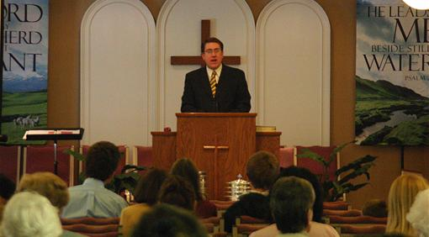
Your Responsibility towards your Pastor

Slide 28
1. Treat him as your Shepherd (Pastor) – Ephesians 4:12; Jeremiah 3:15
Listen to his voice (teachings) – John 10:1-18; Hebrews 2:1-4
Follow his leadership – Hebrews 13:7
2. Treat him as an Elder – I Timothy 5:17
Honor him – “Double honor”
Do not rebuke him – I Timothy 5:1
Do not speak evil against him – Exodus 22:28
3. Treat him as an Overseer – Acts 20:28
Submit to his authority – Hebrews 13:17

Slide 29
Keep him informed – I Timothy 3:1
Ask his permission – I Timothy 3:5
4. Treat him very highly in love – I Thessalonians 5:12-13
Respect his work – I Thessalonians 5:13
Love him – I Corinthians 13:1-8
Love his wife – Ephesians 5:28
Love his children – Titus 1:6
Support him financially – I Corinthians 9:7-14
Avoid a challenging spirit towards him – I Peter 2:13-18
Pray for him – Ephesians 6:18-19
Work with him – I Corinthians 3:9

Slide 30
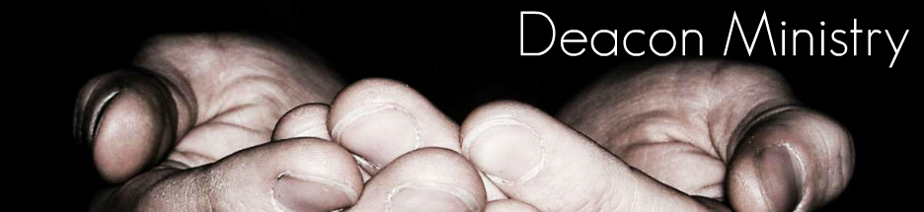
The Office of a Deacon

Slide 31
The Ministry of Deacons
(Acts 6:1-7)
“And in those days, when the number of the disciples was multiplied, there arose a murmuring of the Grecians against the Hebrews, because their widows were neglected in the daily ministration. Then the twelve called the multitude of the disciples unto them, and said, It is not reason that we should leave the word of God, and serve tables. Wherefore, brethren, look ye out among you seven men of honest report, full of the Holy Ghost and wisdom, whom we may appoint over this business. But we will give ourselves continually to prayer, and to the ministry of the word.

Slide 32
And the saying pleased the whole multitude: and they chose Stephen, a man full of faith and of the Holy Ghost, and Philip, and Prochorus, and Nicanor, and Timon, and Parmenas, and Nicolas a proselyte of Antioch: Whom they set before the apostles: and when they had prayed, they laid their hands on them. And the word of God increased; and the number of the disciples multiplied in Jerusalem greatly; and a great company of the priests were obedient to the faith.”

Slide 33
The meaning of the word diakonos = servant (Vine's - one who renders free service)
Pastors are to be paid by the Church if possible - I Corinthians 9:9-14; I Timothy 5:17-18.
Deacons however are unpaid willing servants, serving only for eternal reward.
These men are to have four character qualities -
1. Honest men
2. Spirit filled men (humble)
3. Wise men
4. Serving men - The word diakonos (deacon) is only found three times in scripture. The words diakonia (serve) and diakoneo (servant) appear 103 times and always refer to the physical service.

Slide 34
Qualifications of a Pastor
(I Tim. 3:1-7)
He must be a male
Blameless = without reproach; unrebukeable
Husband of one wife = not divorced and remarried
Vigilant = watchful; alert (spiritual danger and temptations)
Sober = sound-minded
Good Behavior = orderly
Given to Hospitality = friendly

Slide 35
Able to Teach = capable teacher
Not given to wine = not beside wine
Not a Striker = not violent
Not Greedily of Money = not temporal valued
Patient = enduring
Not a Brawler = not a fighter
Not Covetous = does not seek worldly pleasures, possessions, power or recognition
Not self-willed = not stubborn; not arrogant
Not Easily Angered = not quick tempered; not hotheaded
Lover of Good Men = godly friendships

Slide 36
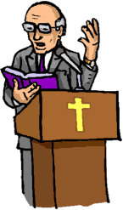
Just = honest; upright; fair
Holy = morally pure
Rule his own house = manages his household well
Children must be in Subjection = yielded to the father's headship
Not a Novice = spiritually mature
Not Lifted up with Pride = humble
Good Report
Without Reproach

Slide 37


Slide 38
Qualifications of a Deacon
(I Timothy 3:8-13; Acts 6:1-6)
Grave = respect; dignified
Not Doubled-tongued = truthful
Not Given to Much Wine = not addicted
Not Greedy of Filthy Lucre = not temporal valued
Blameless = without reproach
Servants Spirit - Acts 6:2-3
Grave = respect; dignified
Not Slanderous = "not an accuser"; false witness; malicious gossip - James 3:2-12

Slide 39
Sober = sound-minded; spiritually alert
Faithful in all Things = dependable; servant to her husband, children, and church
Husband of one wife = "one woman man. . . "; (not divorced and remarried)
Control of His Family = ". . . ruling [his] children and [his] own houses well." (children under subjection)
Firm in Biblical Convictions - "Holding the mystery of the faith. . . "
Full of the Holy Spirit = spirit-filled
Wisdom = ability to see life from God's perspective (men strong in the Word - I John 2:13-14)

Slide 40


