Slide 1
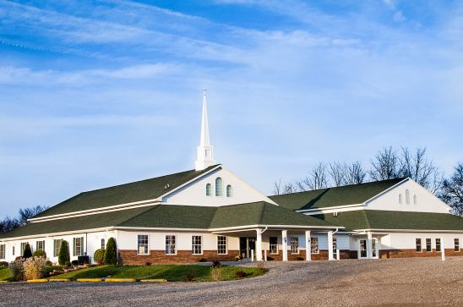
The Doctrine of the Church
(Part 3)
The Nature of the Church
“The characteristics and inherent features of the Church”

Slide 2
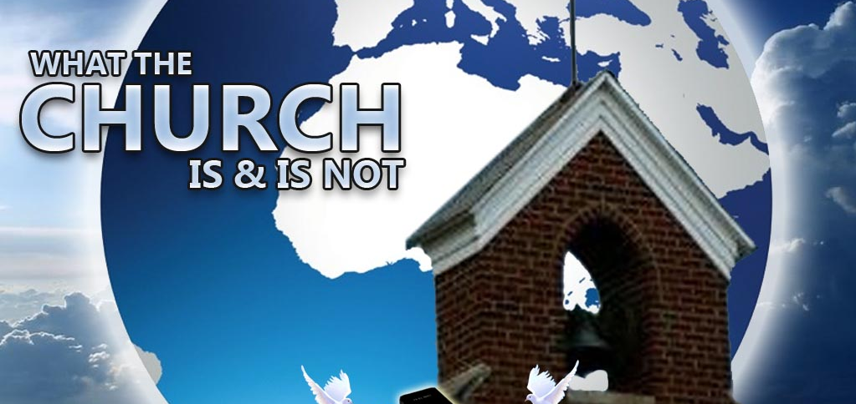

Slide 3


Slide 4
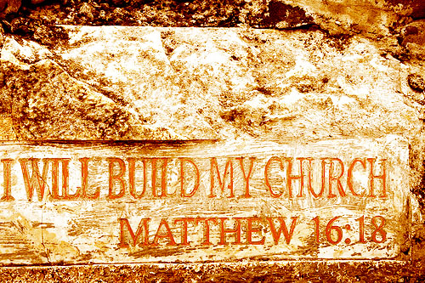

Slide 5
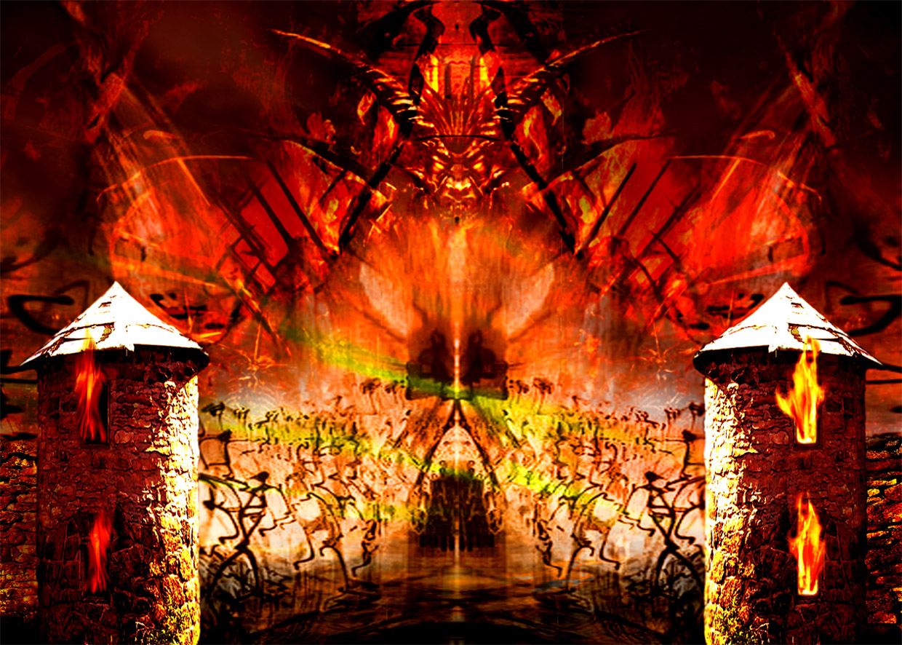
“…and the gates of hell shall not prevail against it.”

Slide 6
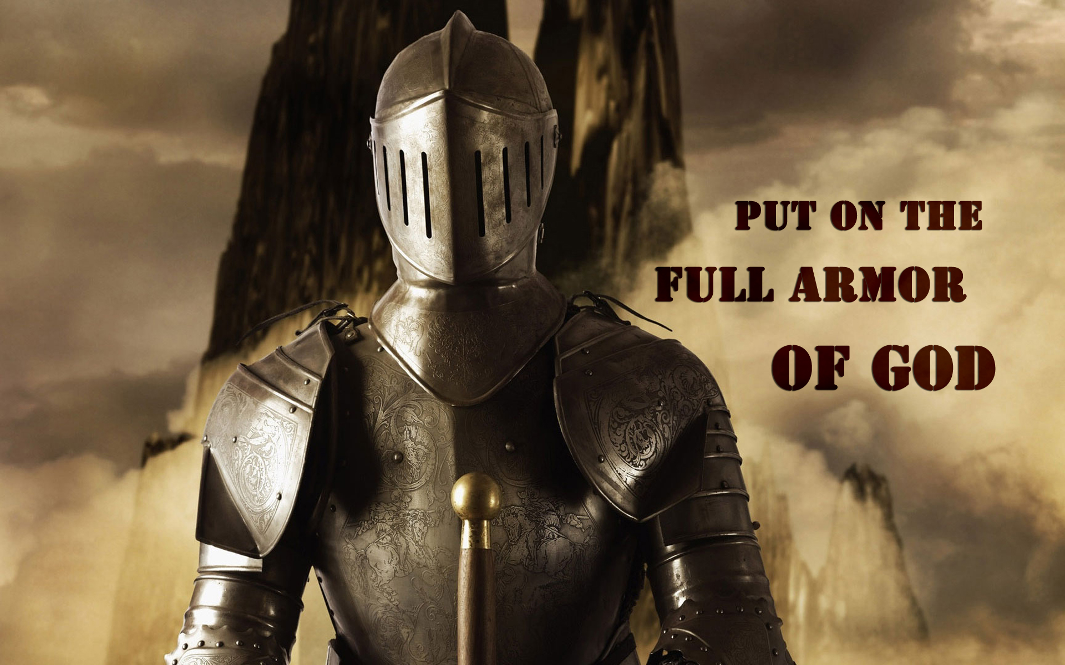

Slide 7

“According to the grace of God which is given unto me, as a wise masterbuilder, I have laid the foundation, and another buildeth thereon. But let every man take heed how he buildeth thereupon.”
(I Cor. 3:10)

Slide 8
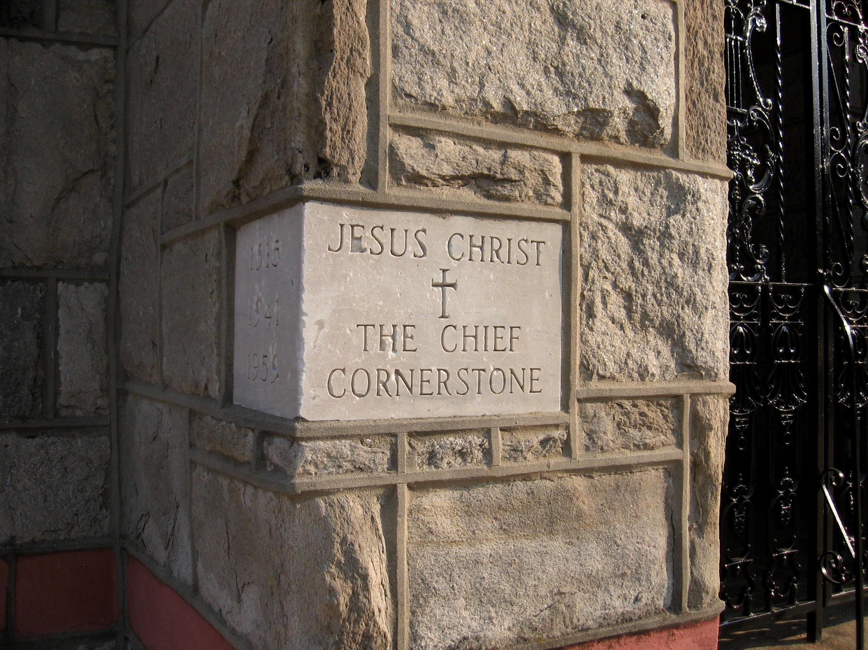
“And are built upon the foundation of the apostles and prophets, Jesus Christ himself being the chief corner stone.” (Eph 2:20)

Slide 9
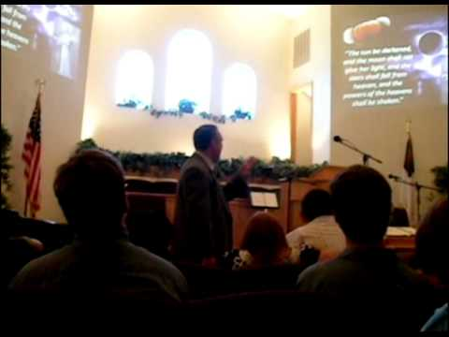
The Meaning of the Word "Church."
Thus, the literal meaning is - a call out assembly.
A called out Assembly of Baptized Believers gathered together for – Acts2:42; Phil. 3:3
1. Doctrine
2. Fellowship
3. Breaking of Bread
4. Prayers
5. Worship

Slide 10
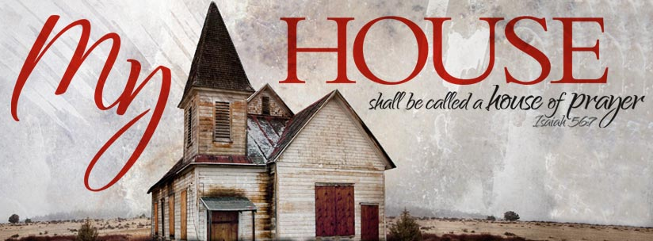
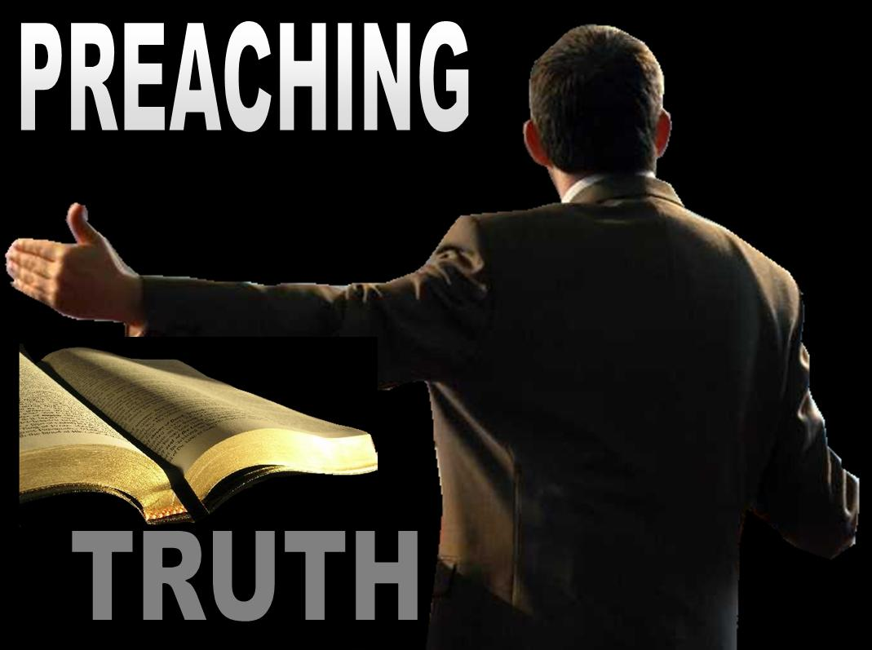
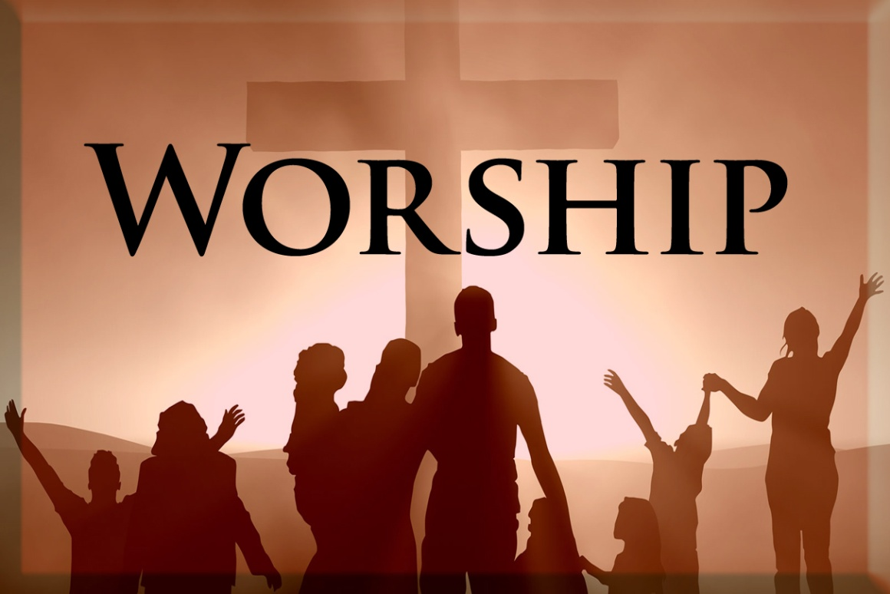

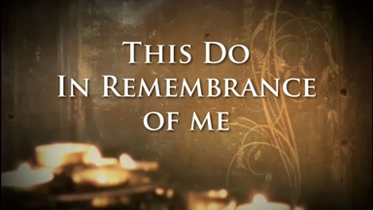

Slide 11
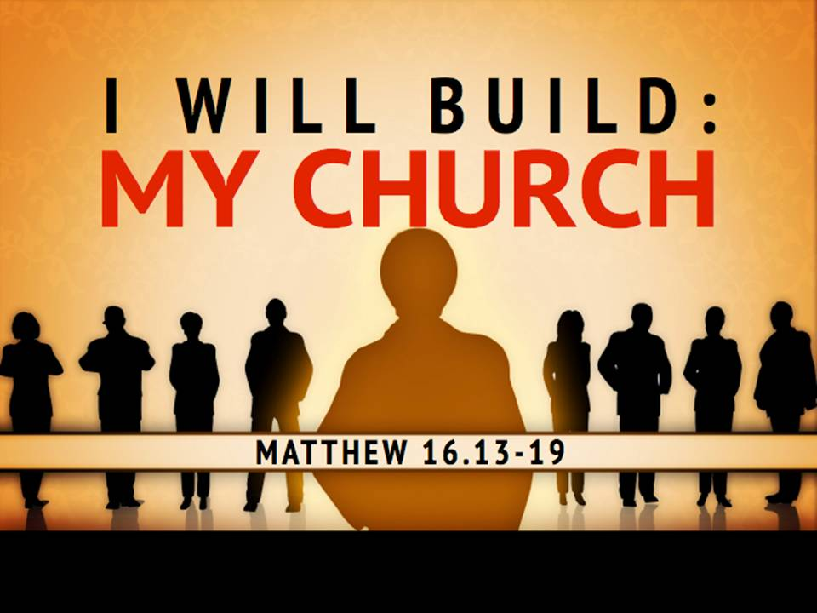
The Origin of the Church
“When and where did the church actually begin?”

Slide 12

Several different views

Slide 13
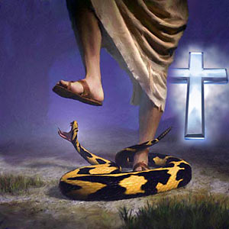
The Church begin with Adam
Genesis 3
In this view it is taught that Adam and Eve believed the promise of God that the seed of the serpent would indeed bruise the heel of the woman, but that the woman’s seed would crush the serpent’s head...then it may be asserted that they constituted the first Christian church.

Slide 14
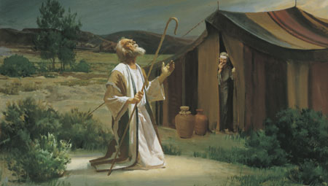
The Church began with Abraham Genesis 12
This is the position is held by covenant theologians. The logic behind this view is the belief that as Israel once functioned as God’s church in the Old Testament, so the church now functions as God’s Israel in the New Testament.
Covenant theology teaches that the church has become God’s elect people, as Israel once was.

Slide 15
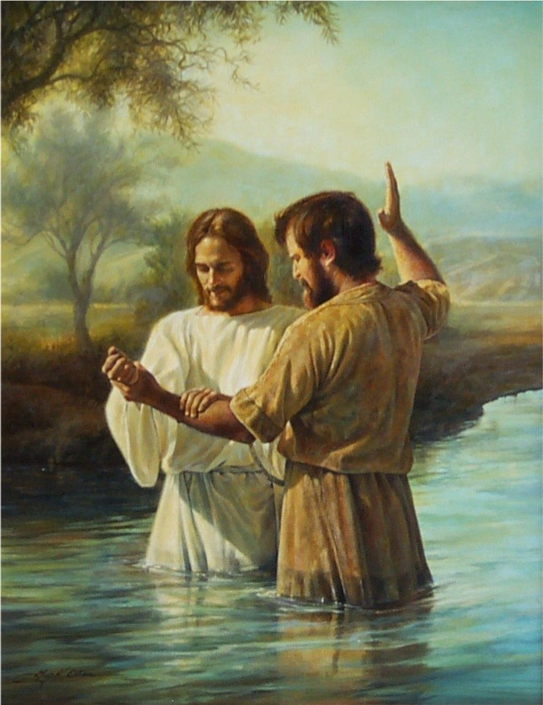
The Church began with John the Baptist Matthew 3

Slide 16
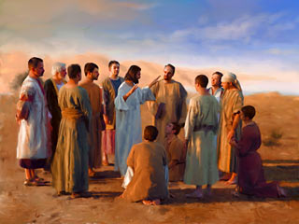
The Church began with Christ
There four different time periods are advocated by those who believe it began with the Savior.

Slide 17
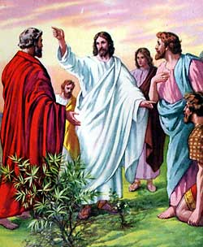
1# At the call of the twelve apostles in Matthew 10
“And are built upon the foundation of the apostles and prophets, Jesus Christ himself being the chief corner stone.” Eph. 2:20

Slide 18
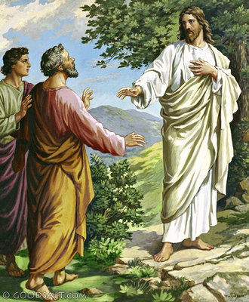
2# At Peter’s confession
Matthew 16
Advocates of this position place the church at this point for the simple reason that it is first mentioned by Christ here.
(See Matt. 16:18)

Slide 19
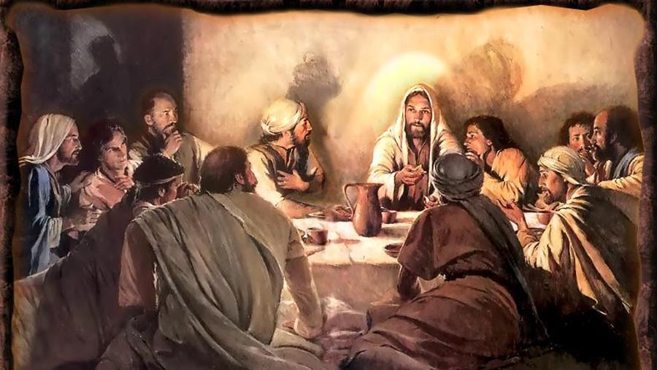
3# At the Last Supper
Matthew 26
Those who defend this view point out that it was at this time that Christ instituted the ordinance of the Lord’s Supper, indicating the church now existed.

Slide 20
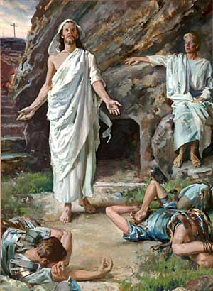
4# At the resurrection of Jesus Christ

Slide 21
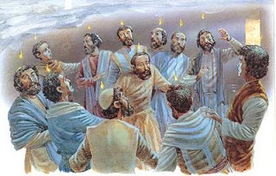
The Church begin on the
Day of Pentecost

Slide 22
The Nature of the Church
“The characteristics and inherent features of the Church”

Slide 23
The Church considered from a negative viewpoint.
(What the Church is not)

Slide 24
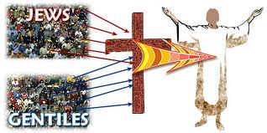
It is not a new name for Israel – (I Corinthians 10:32) “Give none offence, neither to the Jews (Israel), nor to the Gentiles, nor to the church of God.”
Covenant theologians teach that the church has become God’s elect people, as Israel once was.
This is not the case, as seen by the following arguments.

Slide 25
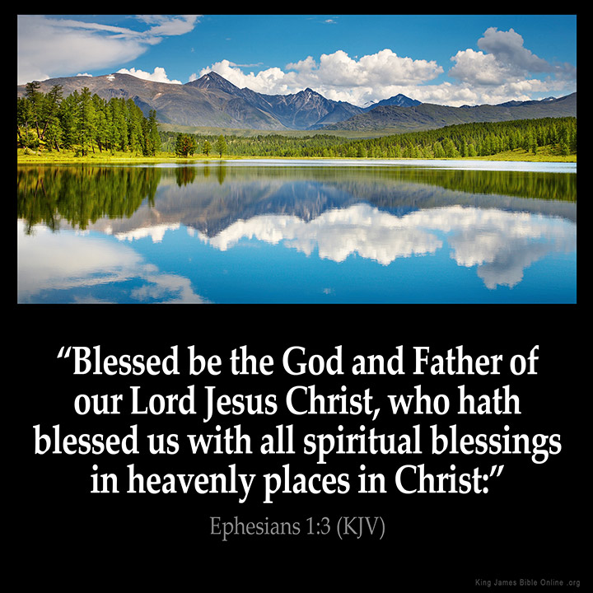
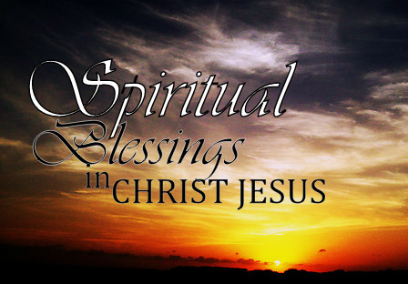
1. The promises are different.
The promises and provisions concerning Israel were basically earthly in scope (see Exod. 15:26; Deut. 28)
The promises concerning the Church are basically heavenly in scope (see Eph. 1:3; Col. 3:1-3)

Slide 26
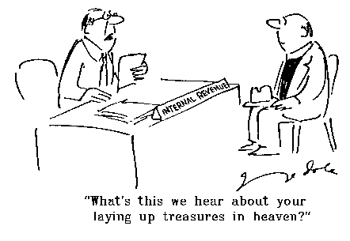

Slide 27
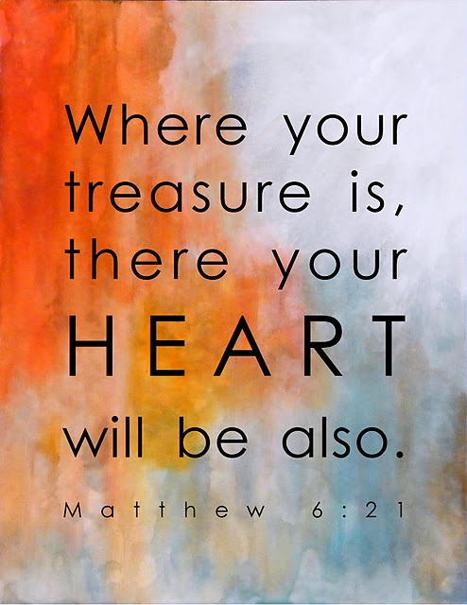

Slide 28
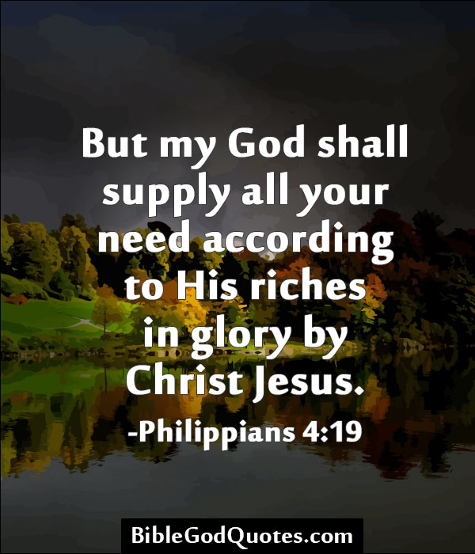

Slide 29
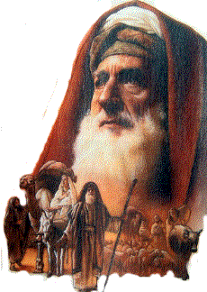
2. The seed is different.
Abraham’s physical seed refers to Israel (Rom. 9:7)
Abraham’s spiritual seed refers to the church (Gal.)
Rom. 4:16 “Therefore it is of faith, that it might be by grace; to the end the promise might be sure to all the seed; not to that only which is of the law, but to that also which is of the faith of Abraham; who is the father of us all.”
Gal. 3:7-8 “Know ye therefore that they which are of faith, the same are the children of Abraham. And the scripture, foreseeing that God would justify the heathen through faith, preached before the gospel unto Abraham, saying, In thee shall all nations be blessed.”

Slide 30
(Romans 4:1-5)
“What shall we say then that Abraham our father, as pertaining to the flesh, hath found? For if Abraham were justified by works, he hath whereof to glory; but not before God. For what saith the scripture? Abraham believed God, and it was counted unto him for righteousness. Now to him that worketh is the reward not reckoned of grace, but of debt. But to him that worketh not, but believeth on him that justifieth the ungodly, his faith is counted for righteousness.”

Slide 31
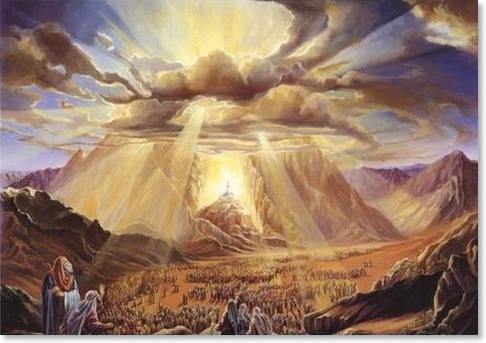
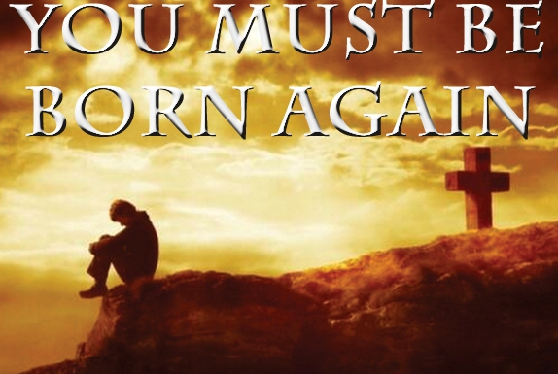
3. The births are different.
Israel celebrated its birthday (Shavuot) at the base of Mt. Sinai (Exod. 19-20) where they were given the Law and became a nation committed to serving God.
The Church celebrated its birthday at Pentecost (Acts 2)
Israelites became what they were by physical birth.
Believers become what they are by spiritual birth.

Slide 32
The author of Hebrews brings out the great contrast between these two.
(Hebrews 12:18-24)
“For ye are not come unto the mount that might be touched, and that burned with fire, nor unto blackness, and darkness, and tempest, And the sound of a trumpet, and the voice of words; which voice they that heard intreated that the word should not be spoken to them any more: For they could not endure that which was commanded, And if so much as a beast touch the mountain, it shall be stoned, or thrust through with a dart: And so terrible was the sight, that Moses said, I exceedingly fear and quake:

Slide 33
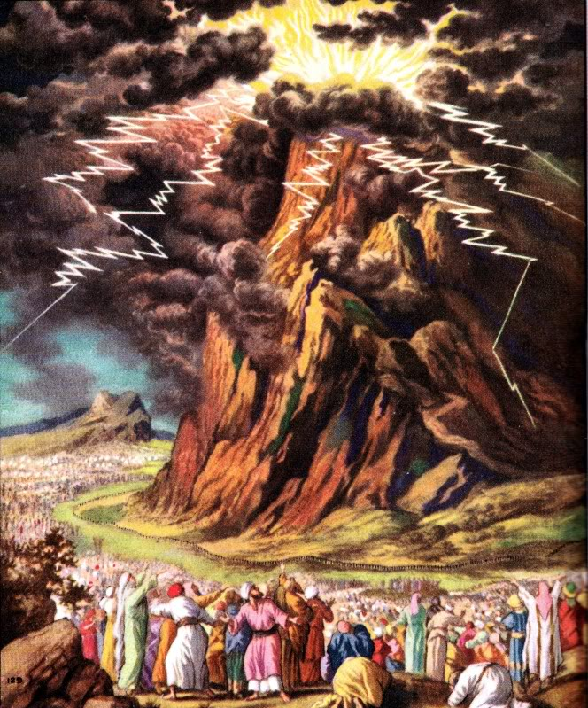

Slide 34
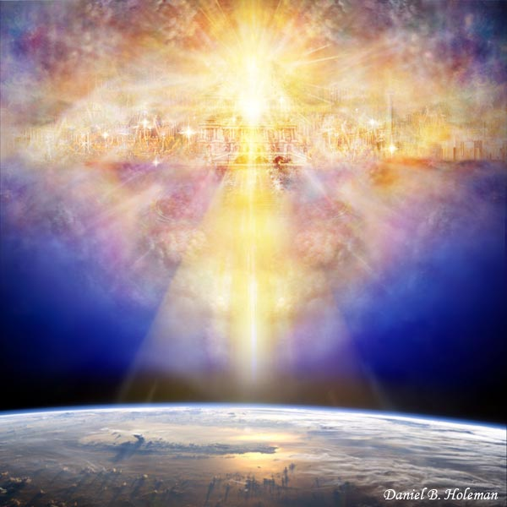
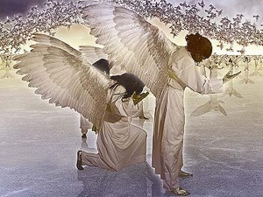
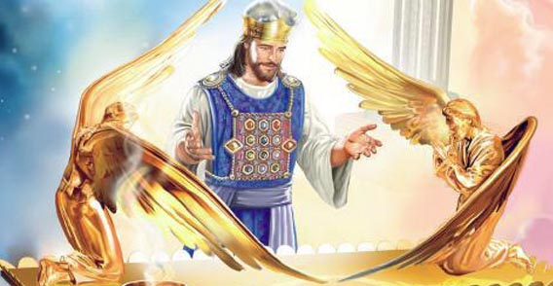
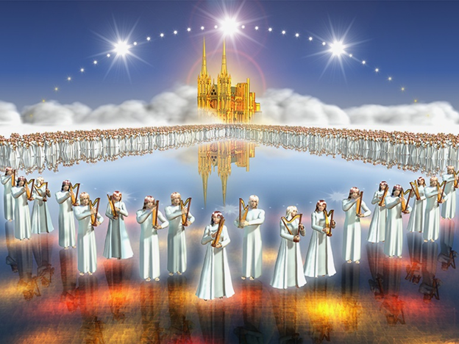
“But ye are come unto mount Sion, and unto the city of the living God, the heavenly Jerusalem, and to an innumerable company of angels, To the general assembly and church of the firstborn, which are written in heaven, and to God the Judge of all, and to the spirits of just men made perfect, And to Jesus the mediator of the new covenant, and to the blood of sprinkling, that speaketh better things than that of Abel.”

Slide 35
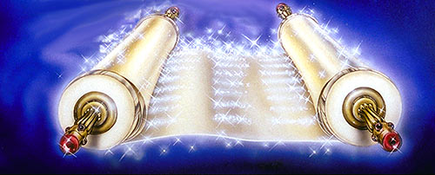
4. The nationality is different.
Israel belonged to this earth and this world.
The church is composed of all nations and has no citizenship down here, but its members are strangers and pilgrims - (I Pet. 2:11)
Phil. 3:20 “For our conversation (citizenship) is in heaven; from whence also we look for the Saviour, the Lord Jesus Christ.”
Luke 10:20 “…rejoice, because your names are written in heaven.”

Slide 36
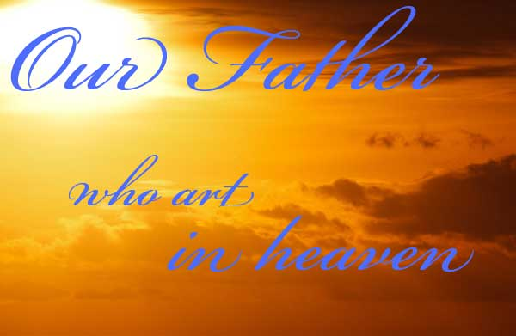
5. The relationship with the Father is different.
God is never presented as the Father of individual Israelites in the Old Testament.
God is presented as the Father of all New Testament believers - (Rom. 8:15; I John3:1)

Slide 37
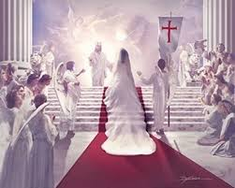
6. The relationship with the Son is different.
Israel is pictured as an unfaithful wife (Isa. 54:1-17; Jer. 3:1, 14, 20; Ezek. 16:1-59; Hosea 2:1-23)
The Church is pictured as a chaste virgin bride yet to be married in heaven (II Cor. 11:2; Rev. 19:7-9)

Slide 38
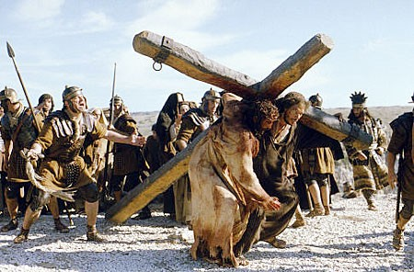
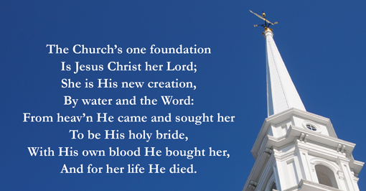
Christ was a stumbling stone to Israel (I Cor. 1:23; I Pet. 2:8)
Christ is the Foundation and Chief Cornerstone of the Church (Eph. 2:20-22; I Pet. 2:4-5)
John 1:11 “He came unto his own, and his own received him not.”

Slide 39
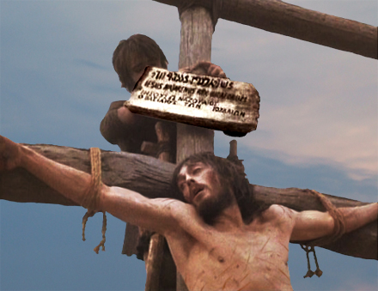
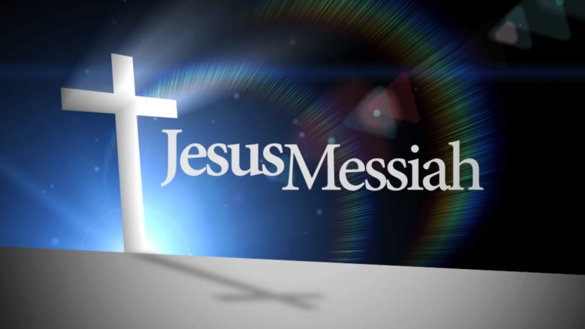
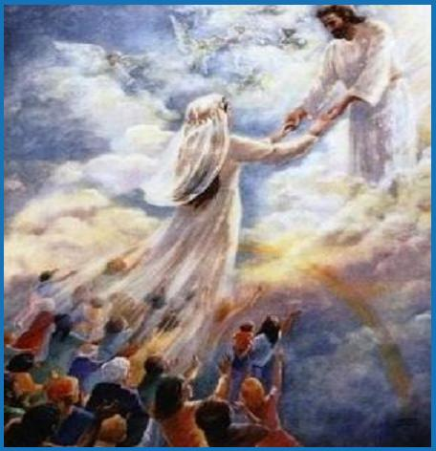
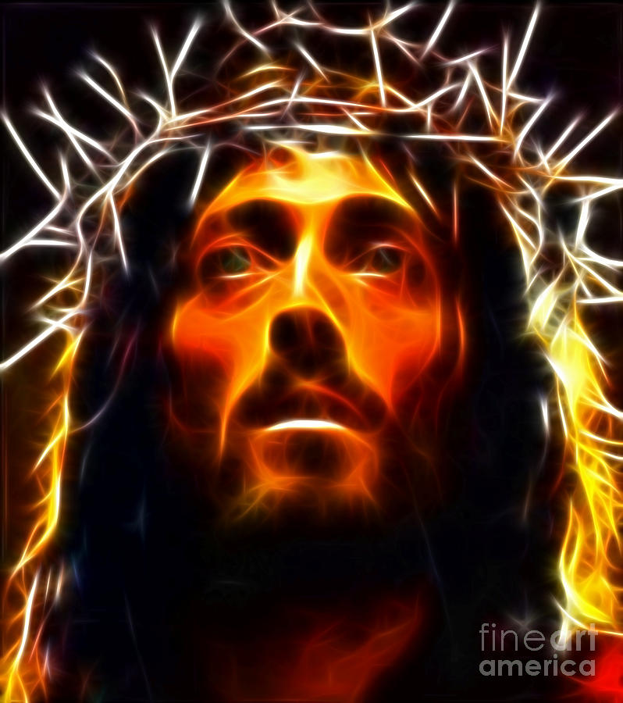

Christ is Israel’s Messiah and King (John 1:49)
Christ is the Church’s Savior, Bridegroom, and Head (Eph. 5:23)

Slide 40
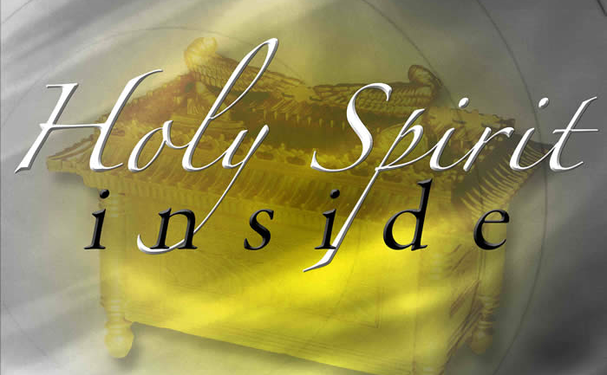
7. The relationship with the Holy Spirit is different.
The Holy Spirit rarely came upon individual Old Testament Israelites – (Psalm 51:11)
The Holy Spirit actually lives inside each New Testament believer - (I Cor. 6:19)

Slide 41
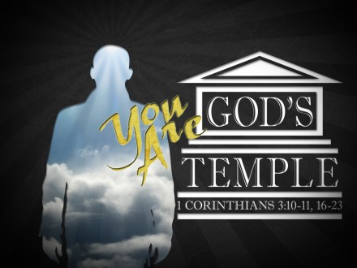
8. The temple is different.
Israel had a Temple - (Exod. 25:8)
The church is a temple - (Eph. 2:21)

Slide 42
These contrasts should make it clear that the church is not Israel.

Slide 43
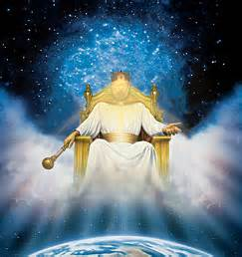
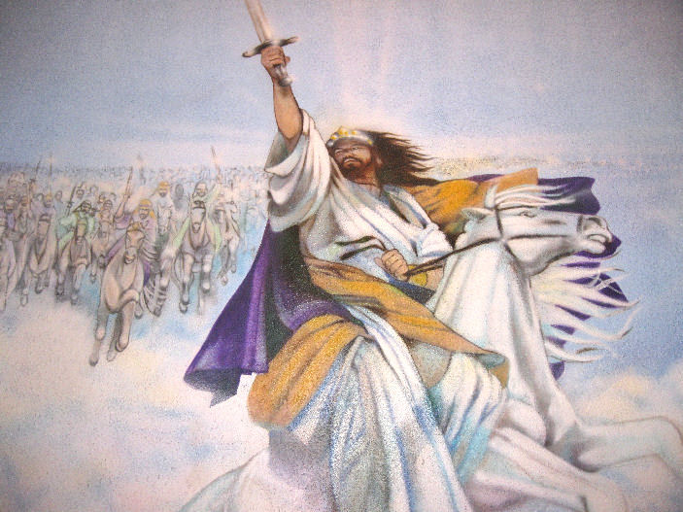
The Church is not the Kingdom
The Church is being built at this present time - (Eph. 4:12)
The Kingdom will be set up at a future time - (Acts 15:16; Rev. 11:15)

Slide 44
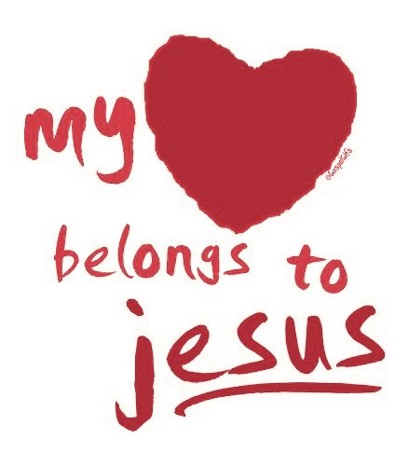
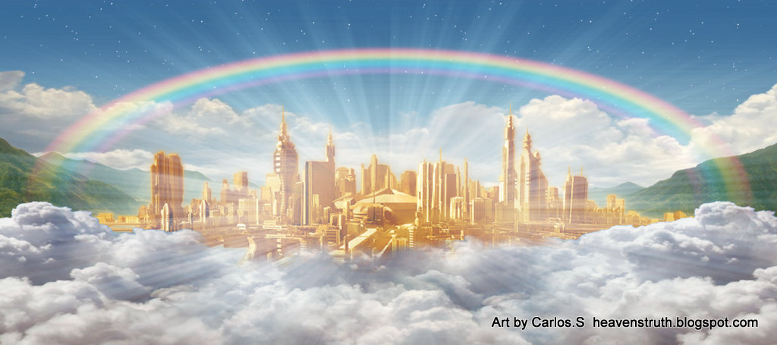

Luke 17:21 “Neither shall they say, Lo here! or, lo there! for, behold, the kingdom of God is within you.”
Matt. 5:20 “For I say unto you, That except your righteousness shall exceed the righteousness of the scribes and Pharisees, ye shall in no case enter into the kingdom of heaven.”
Luke 11:2 “And he said unto them, When ye pray, say, Our Father which art in heaven, Hallowed be thy name. Thy kingdom come. Thy will be done, as in heaven, so in earth.”

Slide 45


Slide 46
The Church is not a building structure composed of wood, bricks, nails, and mortar.
“If so be ye have tasted that the Lord is gracious. To whom coming, as unto a living stone, disallowed indeed of men, but chosen of God, and precious, Ye also, as lively stones, are built up a spiritual house, an holy priesthood, to offer up spiritual sacrifices, acceptable to God by Jesus Christ. Wherefore also it is contained in the scripture, Behold, I lay in Sion a chief corner stone, elect, precious: and he that believeth on him shall not be confounded.”
(I Peter 2:3-6)

Slide 47
The Importance of the Local Church
The word “Church” appears 114 times in the New Testament
Greek (ekklesia) = “An assembly of people called out”
99 times the word “Church” is used in reference to particular local churches
7 times in reference to the “Universal Church”
8 times in reference to the “Local Church” in general not a particular church
107 Local / 7 Universal

Slide 48
The Church considered from a positive viewpoint.
(What the Church is)

Slide 49

The Church is the Body of Christ
I Cor. 12:27 “Now ye are the body of Christ, and members in particular.
Eph. 4:12 “For the perfecting of the saints, for the work of the ministry, for the edifying of the body of Christ.”

Slide 50

Christ is the head of the Church
Eph. 5:23 “For the husband is the head of the wife, even as Christ is the head of the church: and he is the saviour of the body.”

Slide 51


The Word of God is to be the Churches only rule of faith and practice!

Slide 52



Conventions-Fellowships
Associations-Denominations

Slide 53



The Church is the Pillar and Ground of the Truth
I Tim. 3:15 “But if I tarry long, that thou mayest know how thou oughtest to behave thyself in the house of God, which is the church of the living God, the pillar and ground of the truth.”
Pillar = base; post; support
Ground = support; basis

Slide 54
Jesus Christ alone is to have the Preeminence in His Church
Col. 1:18 “And he is the head of the body, the church: who is the beginning, the firstborn from the dead; that in all things he might have the preeminence.”
Preeminence = surpassing all others in superiority, supremacy, greatness, excellence, distinction, prominence.
Eph. 3:21 “Unto him be glory in the church by Christ Jesus throughout all ages, world without end. Amen.”

Slide 55

Does Christ have the
Preeminence in your life?

Slide 56



“Your glorying is not good. Know ye not that a little leaven leaveneth the whole lump?” I Cor. 5:6

Slide 57

Rom. 12:5 “…every one members one of another.”
Eph. 4:25 “…for we are members one of another.”
I Cor. 12:13-31

Slide 58

Next week

