Slide 1
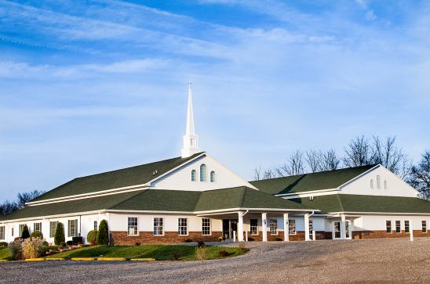
The Doctrine of the Church
(Part 4)
The Purpose of the Church

Slide 2


Slide 3
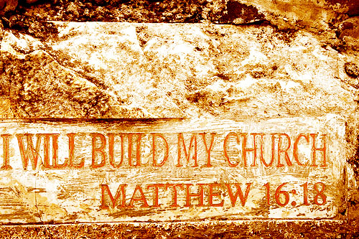

Slide 4
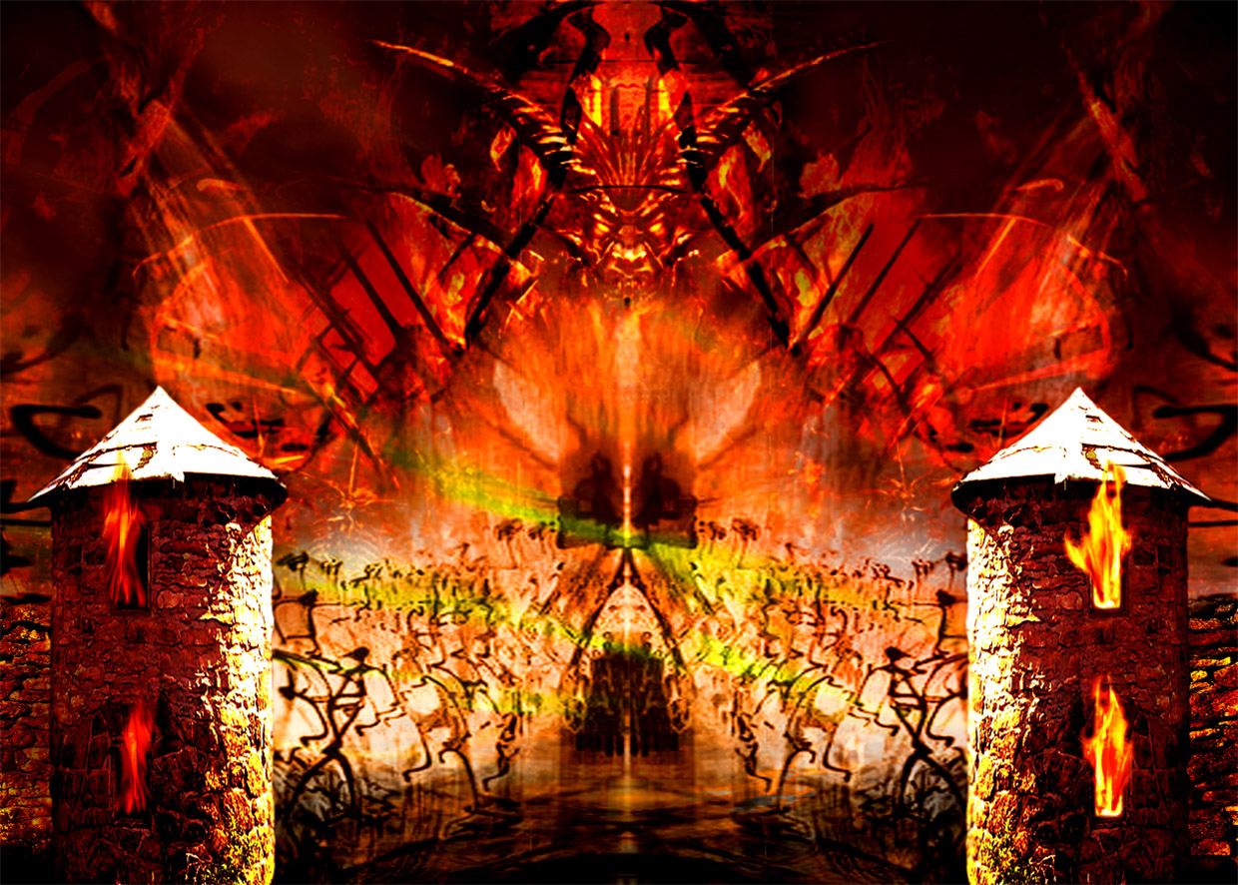
“…and the gates of hell shall not prevail against it.”

Slide 5
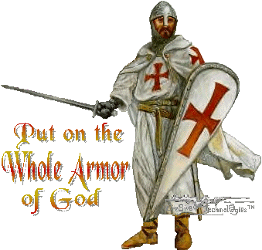

Slide 6

“Except the LORD build the house, they labor in vain that build it.” (Psalm 127:1)

Slide 7
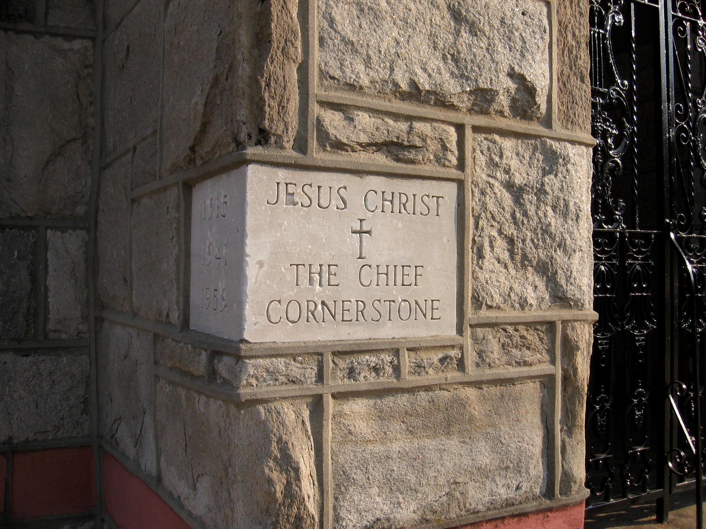
“And are built upon the foundation of the apostles and prophets, Jesus Christ himself being the chief corner stone.” (Eph 2:20)

Slide 8
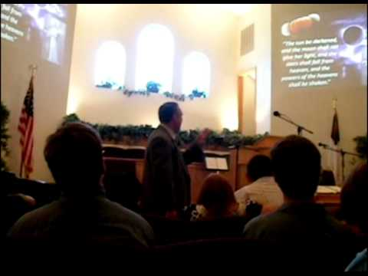
The Meaning of the Word "Church."
Thus, the literal meaning is - a call out assembly.
A called out Assembly of Baptized Believers gathered together for – Acts2:42; Phil. 3:3
1. Doctrine
2. Fellowship
3. Breaking of Bread
4. Prayers
5. Worship

Slide 9

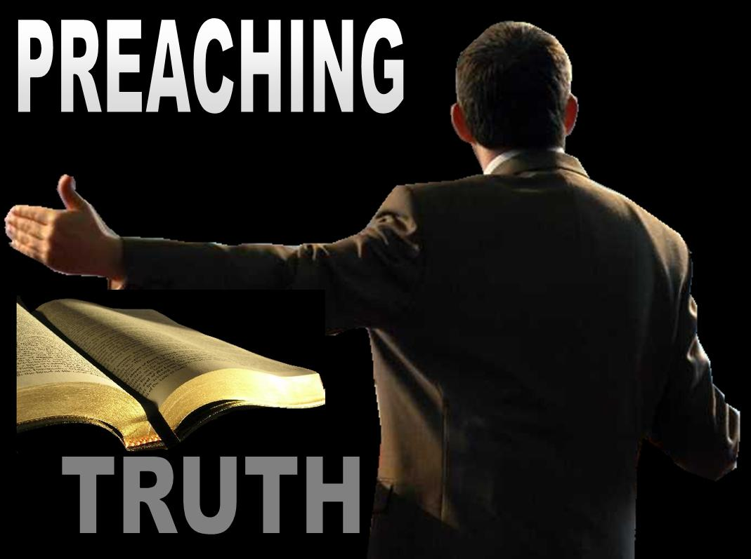


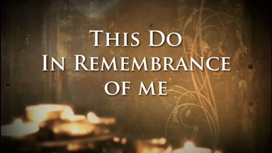

Slide 10

The Origin of the Church
“When and where did the church actually begin?”

Slide 11

Several different views

Slide 12
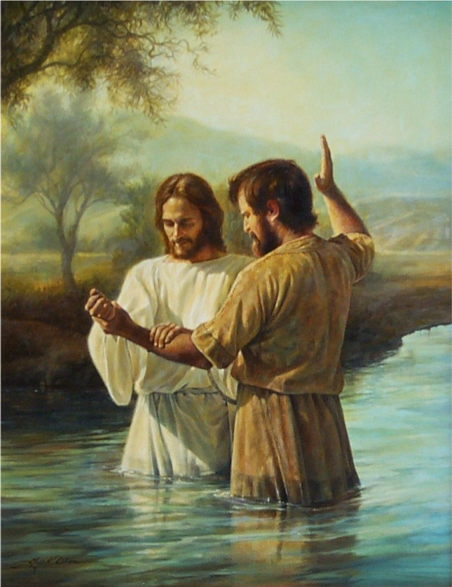
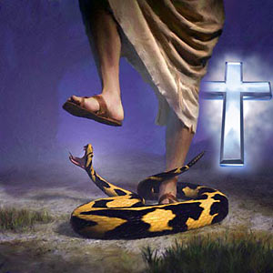
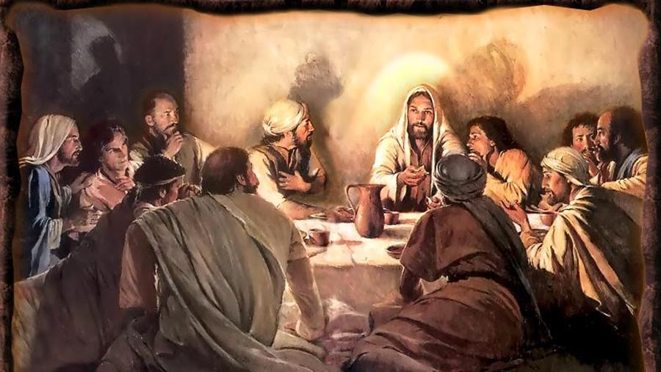
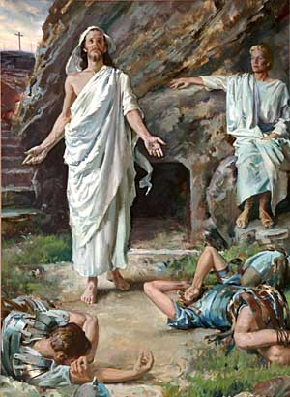
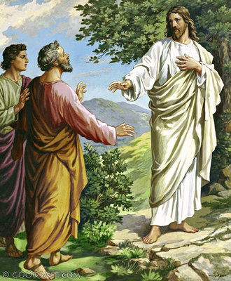
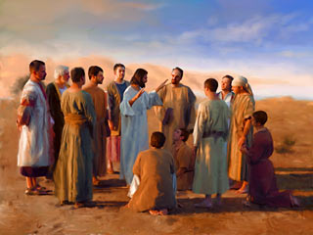
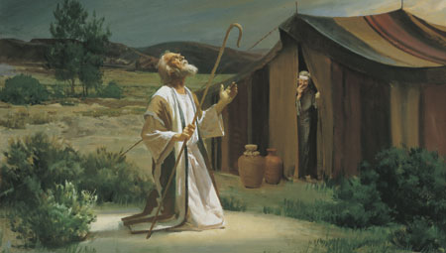

Slide 13
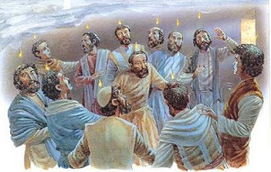
The Church begin on the
Day of Pentecost

Slide 14
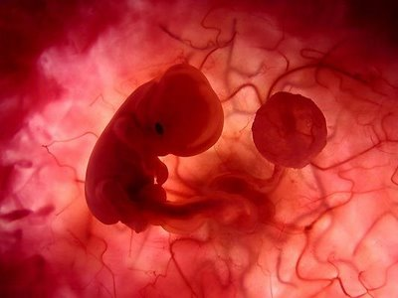

“And when it was day, he called unto him his disciples: and of them he chose twelve, whom also he named apostles.”
(Luke 6:13)
“And when the day of Pentecost was fully come, they were all with one accord in one place. And suddenly there came a sound from heaven as of a rushing mighty wind, and it filled all the house where they were sitting.” (Acts 2:1-2)

Slide 15







Slide 16
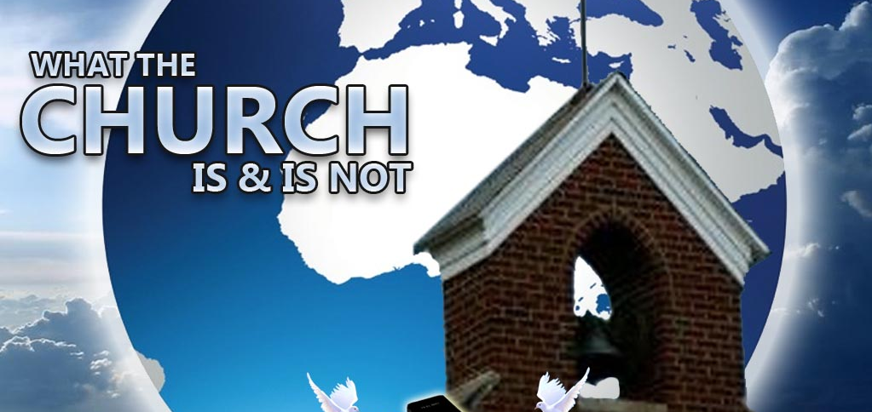
The Nature of the Church
“The characteristics or inherent features of the Church”

Slide 17
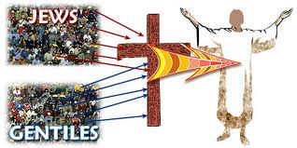
The Church is not Israel
(I Corinthians 10:32) “Give none offence, neither to the Jews (Israel), nor to the Gentiles, nor to the church of God.”
Covenant theologians teach that the church has become God’s elect people, as Israel once was.

Slide 18
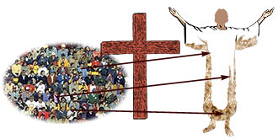
The Church is the Body of Christ
I Cor. 12:27 “Now ye are the body of Christ, and members in particular.
Eph. 4:12 “For the perfecting of the saints, for the work of the ministry, for the edifying of the body of Christ.”

Slide 19
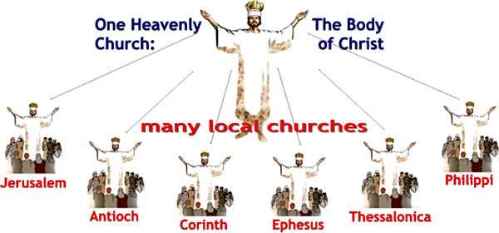

Slide 20

Christ is the head of the Church
Eph. 5:23 “For the husband is the head of the wife, even as Christ is the head of the church: and he is the saviour of the body.”

Slide 21
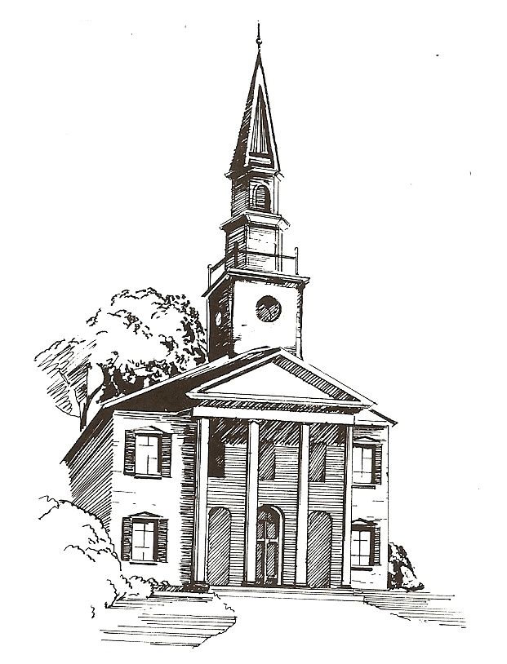

The Word of God is to be the Churches only rule of faith and practice!

Slide 22



The Church is the Pillar and Ground of the Truth
I Tim. 3:15 “But if I tarry long, that thou mayest know how thou oughtest to behave thyself in the house of God, which is the church of the living God, the pillar and ground of the truth.”
Pillar = base; post; support
Ground = support; basis

Slide 23
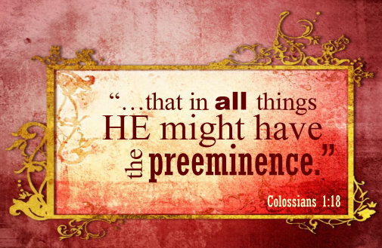
Jesus Christ alone is to have the Preeminence in His Church

Slide 24


Slide 25


Slide 26
The ekklesia (Church) of the New Testament refers to a organize band of baptized believers who regularly assemble for Doctrine, Fellowship, Breaking of Bread, Prayers and Worship. The Church is led by pastors, served by deacons, and attended by members for the following purposes.

Slide 27

The purpose of the Church considered from a negative viewpoint.

Slide 28
The main focus or purpose of the Church is not to win souls resulting in the saving of the world.
Covenant theology teaches that the leaven of Matthew 13:33 as a picture of the gospel permeating and purifying society, thus turning it into the golden age of the millennium.
To the contrary, leaven always represents sin – (I Cor. 5:5-8)
The world is going to become much worse before it gets better - (II Tim. 3:1-7; II Pet. 3:1-5)

Slide 29

The church is never going to fulfill the Great Commission and thus usher in the millennial Kingdom of Christ.

Slide 30



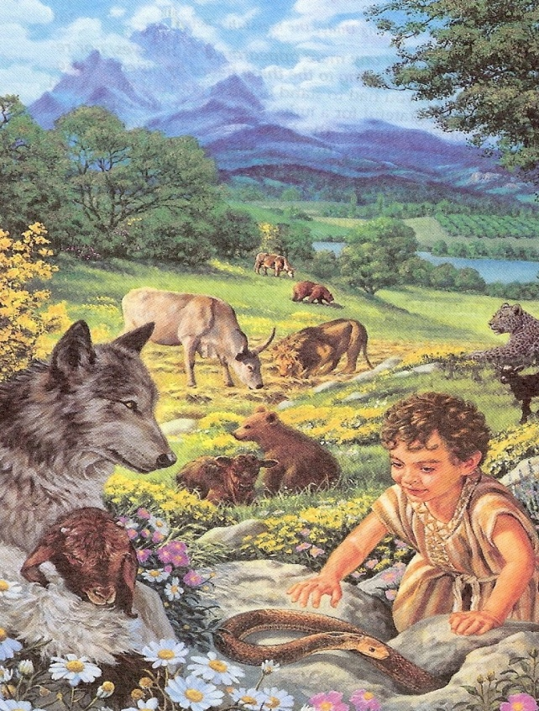
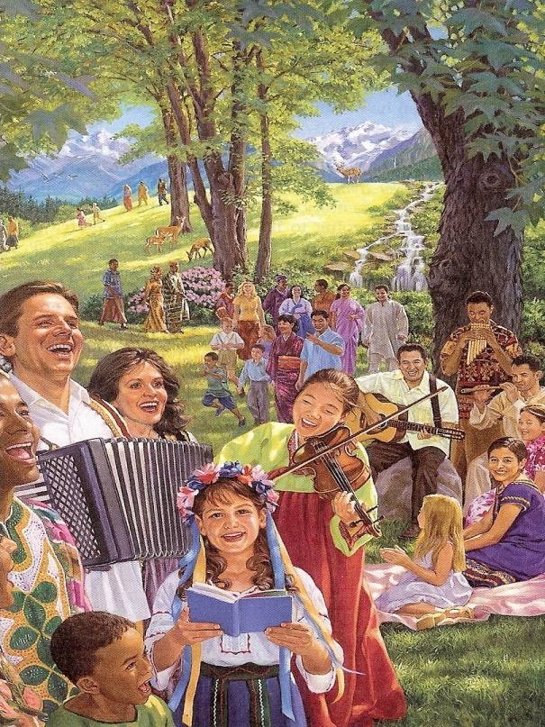

“And he shall judge among the nations, and shall rebuke many people: and they shall beat their swords into plowshares, and their spears into pruninghooks: nation shall not lift up sword against nation, neither shall they learn war any more.” Isa. 2:4

Slide 31
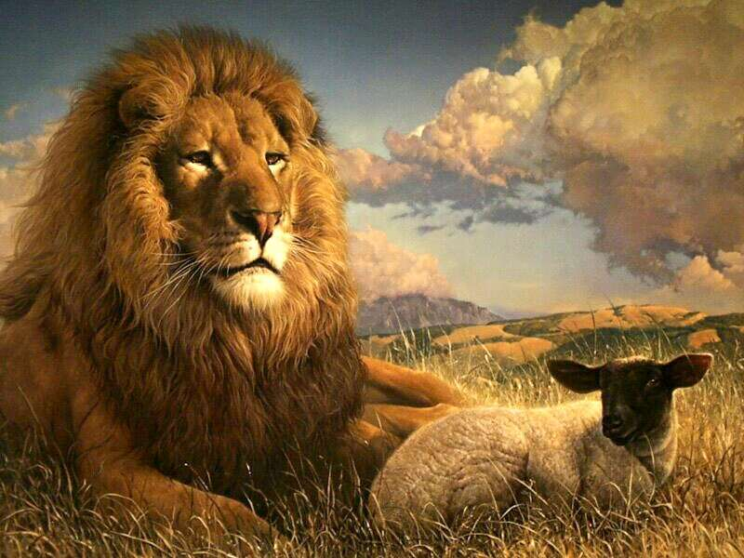
“The wolf also shall dwell with the lamb, and the leopard shall lie down with the kid; and the calf and the young lion and the fatling together; and a little child shall lead them. And the cow and the bear shall feed; their young ones shall lie down together: and the lion shall eat straw like the ox.” Isa.11:6

Slide 32


“The wilderness and the solitary place shall be glad for them; and the desert shall rejoice, and blossom as the rose.” Isa. 35:1

Slide 33
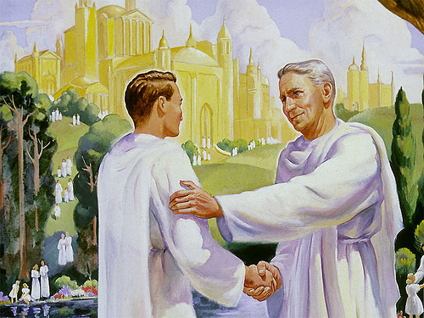
“Do ye not know that the saints shall judge the world?” I Cor. 6:2

Slide 34
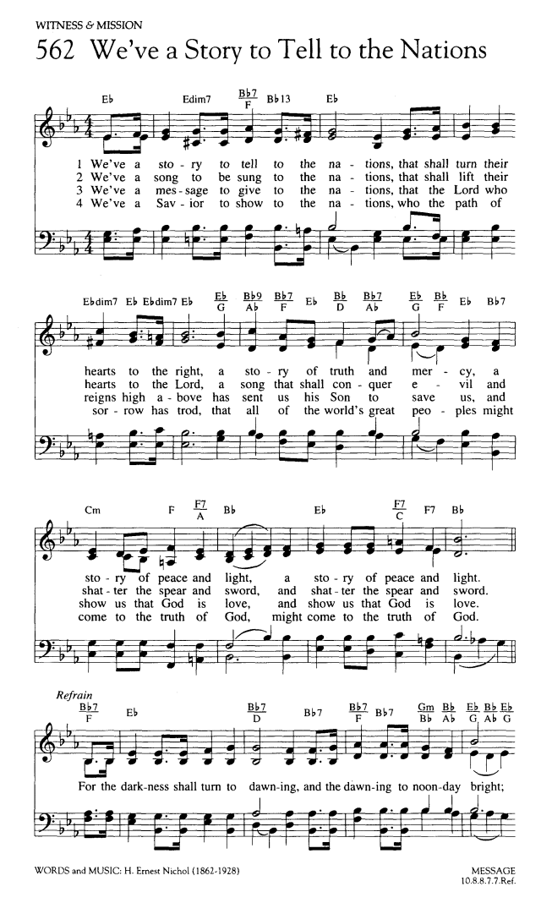

Slide 35

Great Commission is the Mission of the Church but it is not the Main Purpose of the Church

Slide 36
The main purpose of the church is not to serve the world.
Nowhere in the New Testament is the Church told to lobby for stronger pollution laws, march for civil rights, stage protest against the government and unrighteous laws, or seek to eradicate hunger and poverty, etc. – (Psalm 82:3)
The Church should preach against the sins of society but this is not to be its main focus – (II Tim. 4:1-4)
This is not, of course, to say that individual believers cannot be involved in social action which are supported and encouraged by their Church.
The Church and Believers should be Salt and Light – (Matt. 5:13-14)

Slide 37
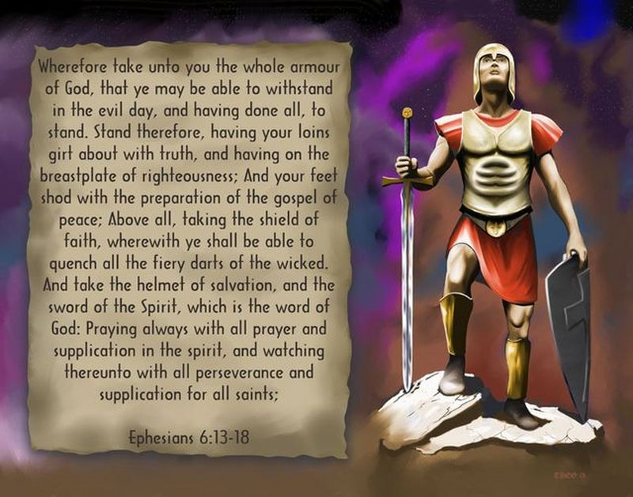
The main purpose of the Church is not to fight the world.
There are occasions when local Churches simply must stand up and thunder out against immorality and sin (Prophets).
The Church’s main ministry is not to expend all its energies and resources fighting all the ills of the world – (Eph. 6:10-18)
I Tim. 6:12 “Fight the good fight of faith, lay hold on eternal life, whereunto thou art also called, and hast professed a good profession before many witnesses.”

Slide 38
The main purpose of the Church is not to imitate the world.
The idea that the Church must become like the world to reach the world is WRONG!
I John 2:15 “Love not the world, neither the things that are in the world. If any man love the world, the love of the Father is not in him.”
John 15:19 “If ye were of the world, the world would love his own: but because ye are not of the world, but I have chosen you out of the world, therefore the world hateth you.”

Slide 39
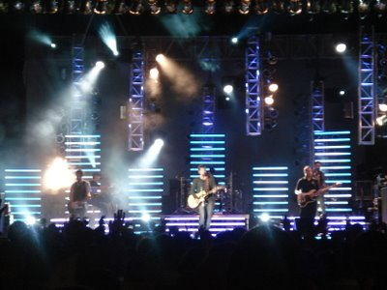
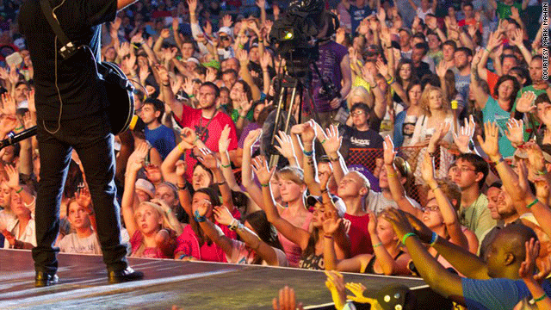
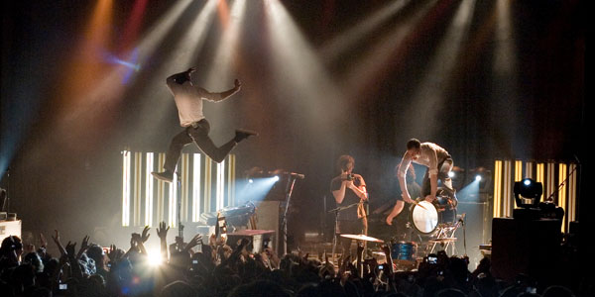
II Cor. 6:17 “Wherefore come out from among them, and be ye separate, saith the Lord, and touch not the unclean thing; and I will receive you.”

Slide 40
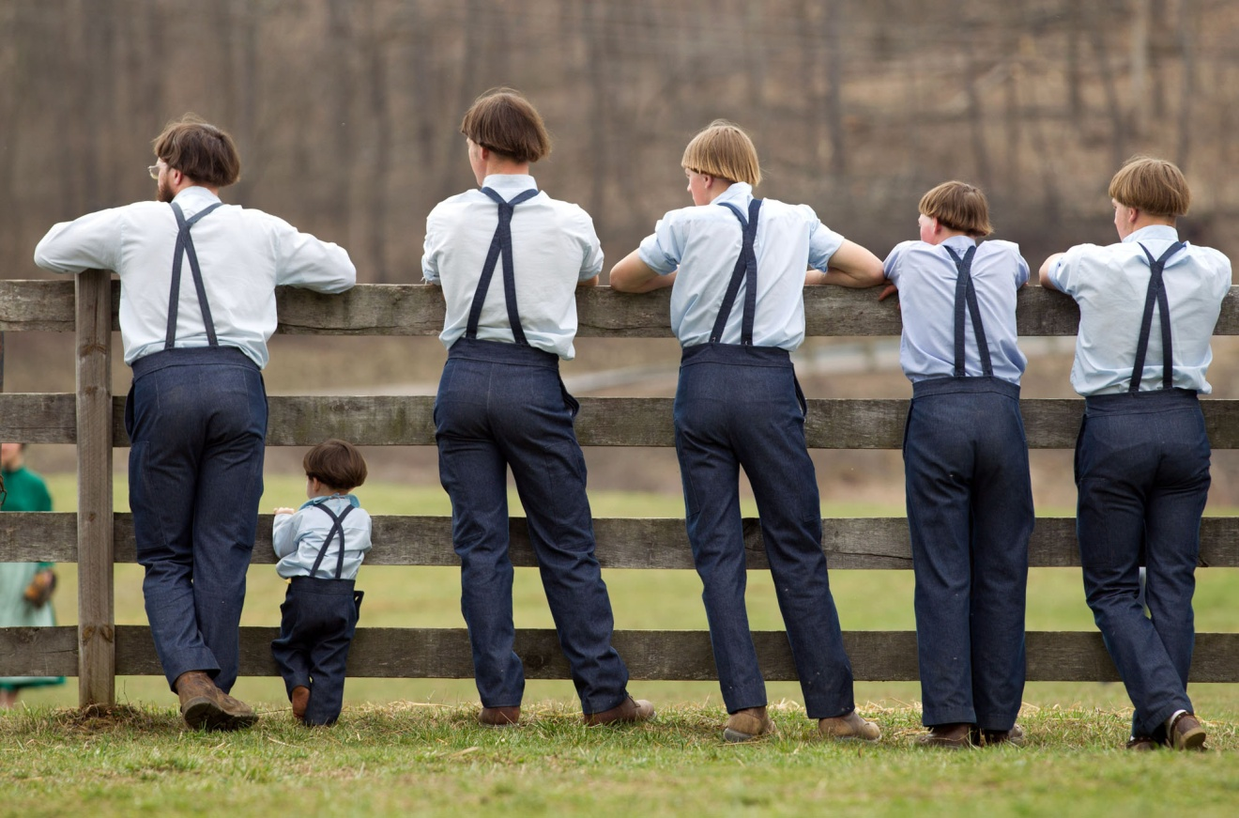
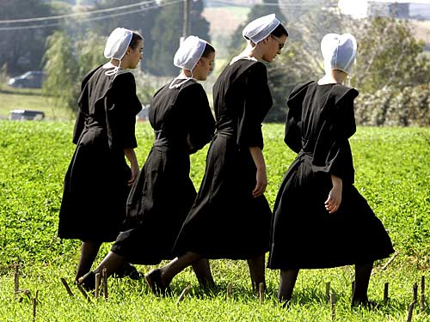
The main purpose of the Church is not to isolate itself from the world.

Slide 41
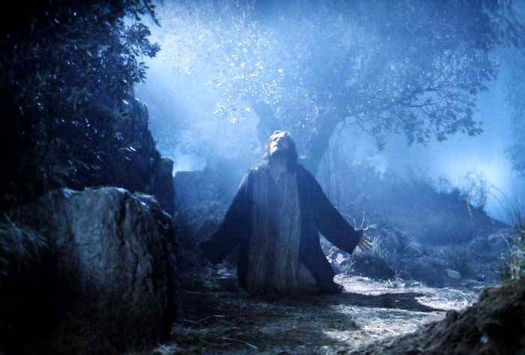
“I have given them thy word; and the world hath hated them, because they are not of the world, even as I am not of the world. I pray not that thou shouldest take them out of the world, but that thou shouldest keep them from the evil. They are not of the world, even as I am not of the world. Sanctify them through thy truth: thy word is truth. As thou hast sent me into the world, even so have I also sent them into the world. And for their sakes I sanctify myself, that they also might be sanctified through the truth.”
(John 17:14-19)

Slide 42

The purpose of the Church considered from a positive viewpoint.

Slide 43
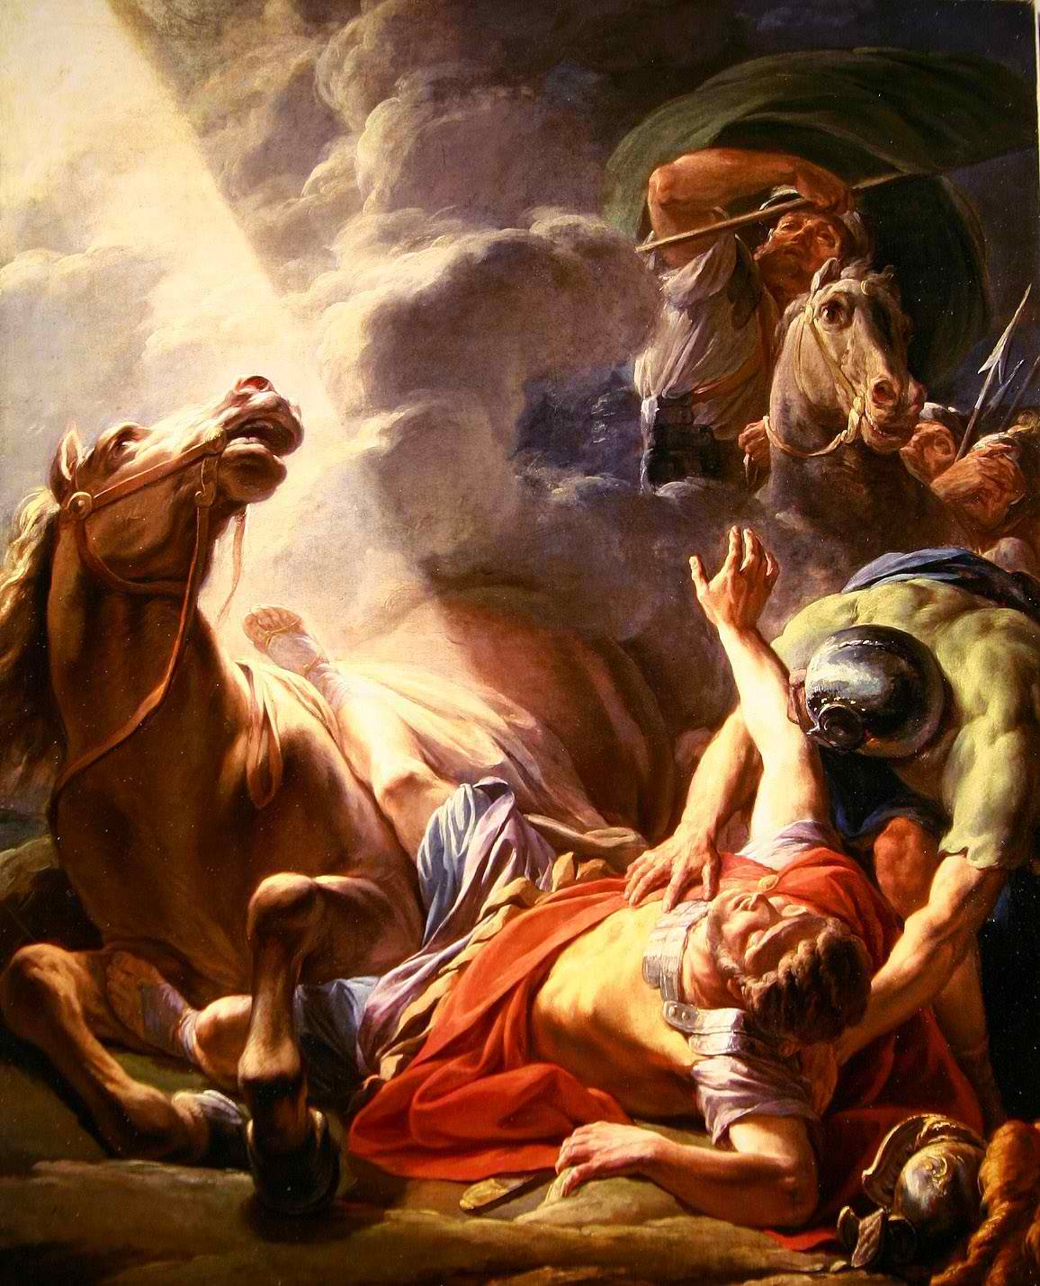
The Passion of the Apostle Paul
“Planting Local Churches”
The driving force behind his evil actions prior to conversion was to destroy every single local church (Acts 8:3)
The burning purpose after his salvation was to start local churches (Acts 14:23)

Slide 44
The reason for his second missionary trip was to establish the Churches he started on his first missionary trip (Acts 15:36, 41; 16:5)
His heaviest burden was for the welfare of those local churches (II Cor. 11:28)
Of his thirteen known New Testament epistles, nine are directly written to local churches, and three to pastors of local churches.
In his epistles he gave detailed instruction concerning the worship services (I Cor. 11:1-16), communion (I Cor. 11:17-34), use of spiritual gifts (I Cor. 12), the responsibilities of pastors, deacons and church members (I Tim. 3; Titus 1) ect.

Slide 45
The facts are that Christ has literally loaded down His Church with many responsibilities and tasks.

Slide 46
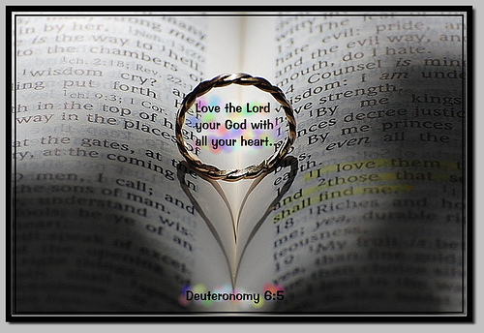
The church is to love the Lord with all it’s heart
“Jesus said unto him, Thou shalt love the Lord thy God with all thy heart, and with all thy soul, and with all thy mind. This is the first and great commandment.” (Matt. 22:37-38)
"Nevertheless I have somewhat against thee, because thou hast left thy first love" (Rev. 2:4)

Slide 47


The church is to display God’s wisdom to angels and His grace to the lost
(Eph. 2:7; 3:10; I Pet. 2:9)

Slide 48
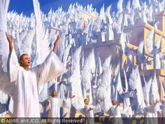
I Peter 1:12
“Unto whom it was revealed, that not unto themselves, but unto us they did minister the things, which are now reported unto you by them that have preached the gospel unto you with the Holy Ghost sent down from heaven; which things the angels desire to look into.”

Slide 49
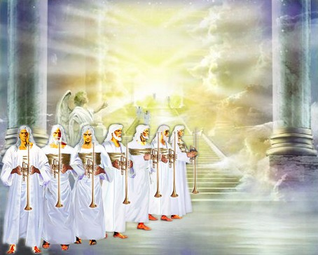
Ephesians 2:7
“That in the ages to come he might shew the exceeding riches of his grace in his kindness toward us through Christ Jesus.”

Slide 50
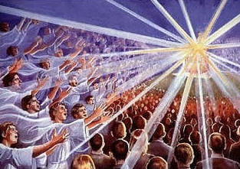
Ephesians 3:10
“To the intent that now unto the principalities and powers in heavenly places might be known by the church the manifold wisdom of God.”

Slide 51


Slide 52

The church is to evangelize the world
(Matt. 28:19, 20; Mark 16:15; Luke 24:47; John 20:21; Acts 1:8)

Slide 53

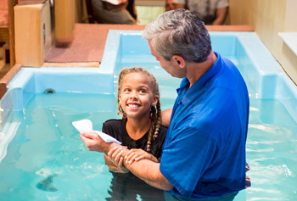
The church is to baptize believers
(Matt. 28:19)

Slide 54





The church is to instruct believers
(Matt. 28:19; Phil. 4:8-9; I Tim. 4:6;
5:17; II Tim. 2:2, 24-25)

Slide 55
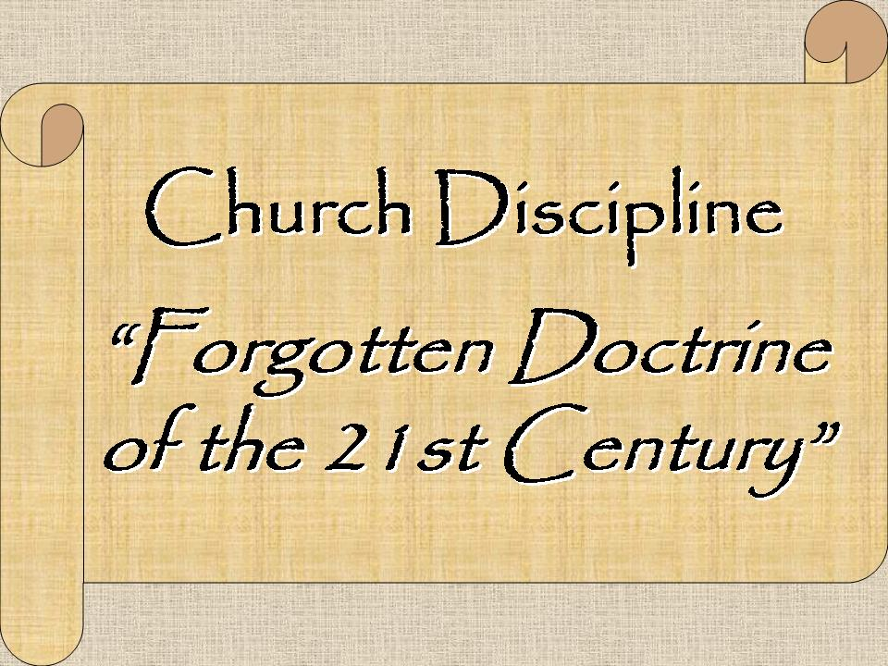
The church is to discipline members
(Matt. 18:17; Rom. 16:17; I Cor. 5:1-13; Gal. 6:1; II Thess. 3:6, 14; Titus 3:10, 11; II John 1:10)

Slide 56
The church is to provide fellowship for believers (Acts 2:42; I Cor. 1:9; 2 Cor. 8:4; 13:14; Gal. 2:9; Phil. 1:5; 2:1; I John 1:3, 6-7)
The basis of Christian fellowship—the Person of Christ (I John 1:3)
The nature of Christian fellowship—sharing (Acts 2:44-47; 4:32, 34-35)
The dangers of losing Christian fellowship—sin/disunity (I Cor. 10:16, 21)

Slide 57


Slide 58
Confess our faults (Jas. 5:16)
Rebuke sin in each other (Eph. 5:11; I Tim. 5:20)
Forgive one another (II Cor. 2:6, 8; Eph. 4:32; Col. 3:13)
Restore one another (Gal. 6:1)
Bear one another’s burdens (Gal. 6:2)
Prefer the weaker brother (Rom. 14:13; 15:1)
Comfort and exhort each other (I Thess. 4:18; 5:11)
Pray one for another (Jas. 5:16)
Edify one another (Rom. 14:19; Heb. 10:24)
Admonish one another (Rom. 15:14; Col. 3:16)

Slide 59
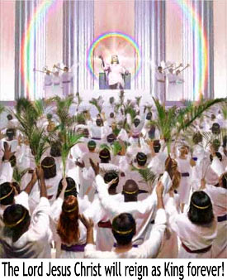
The church is to prepare rulers for the millennial kingdom
(Rom. 8:17; II Tim. 2:12)

Slide 60


The church is to act as a restraining and enlightening force in this present world
(Matt. 5:13-16; 2 Thess. 2:6-7;
Gen. 18:22-23; 19:12-25)

Slide 61

What is the Main
Purpose for the Church

Slide 63


Slide 64

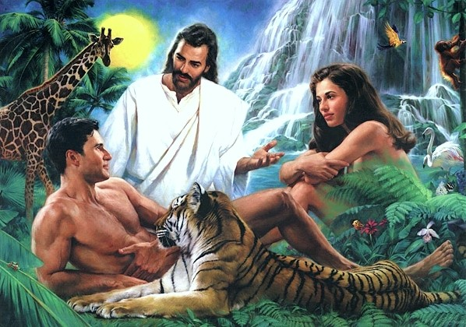
Why did God create man?

Slide 65
Why did God create the church?

Slide 66
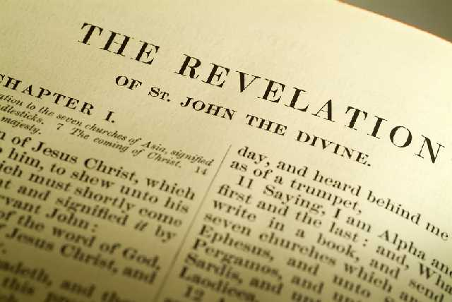
“Thou art worthy, O Lord, to receive glory and honour and power: for thou hast created all things, and for thy pleasure they are and were created.” (Rev. 4:11)

Slide 67
“Furthermore then we beseech you, brethren, and exhort you by the Lord Jesus, that as ye have received of us how ye ought to walk and to please God, so ye would abound more and more.” (I Thess. 4:1)

Slide 68
“But without faith it is impossible to please him: for he that cometh to God must believe that he is, and that he is a rewarder of them that diligently seek him.” (Heb. 11:6)

Slide 69
“No man that warreth entangleth himself with the affairs of this life; that he may please him who hath chosen him to be a soldier.” (II Tim. 2:4)

Slide 70
“For do I now persuade men, or God? or do I seek to please men? for if I yet pleased men, I should not be the servant of Christ.”
(Gal. 1:10)

Slide 71
“So then they that are in the flesh cannot please God.” (Rom. 8:8)

Slide 72
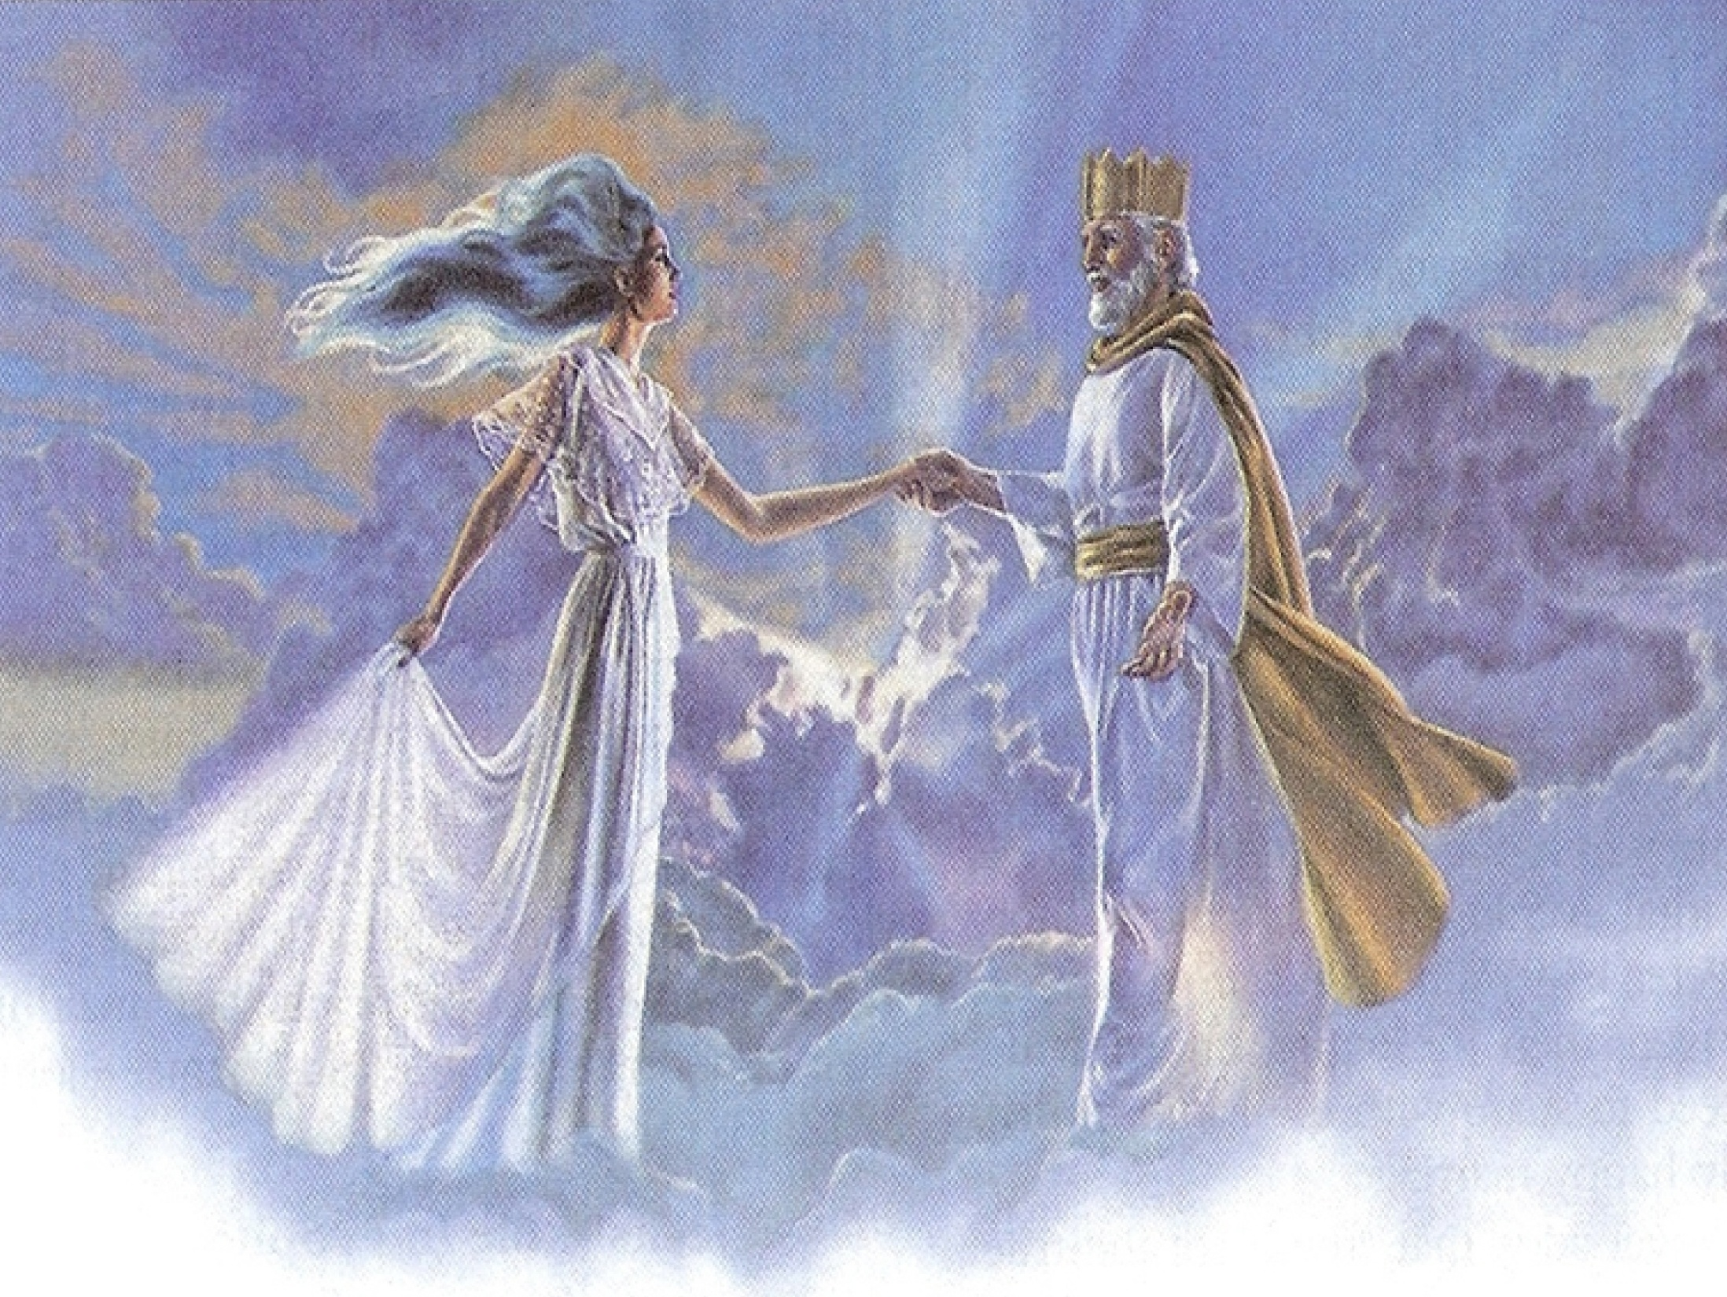
“She that is married careth for the things of the world, how she may please her husband.”
(I Cor. 7:34)

Slide 73
How do we bring pleasure to God?

Slide 74
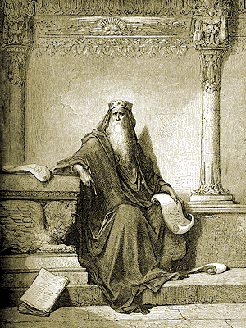
“Let us hear the conclusion of the whole matter: Fear God, and keep his commandments: for this is the whole duty of man.” (Eccl. 12:13)
“For God shall bring every work into judgment, with every secret thing, whether it be good, or whether it be evil.”(Eccl. 12:14)

Slide 75

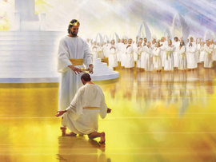

Slide 76
“Unto him be glory in the church by Christ Jesus throughout all ages, world without end. Amen.” (Eph 3:21)
“And he is the head of the body, the church: who is the beginning, the firstborn from the dead; that in all things he might have the preeminence.” (Col 1:18)

Slide 77


