Slide 1

The inherent characteristics, quality's
and features of God
(Part 10)

Slide 2
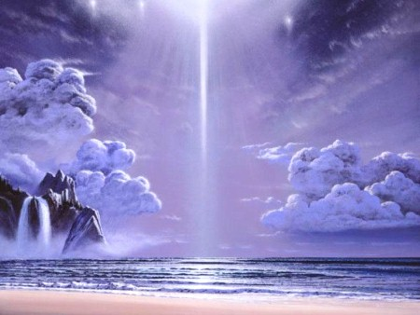
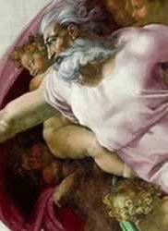
21 Attributes / Perfections of God

Slide 3
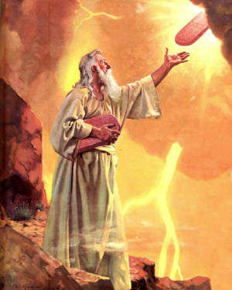
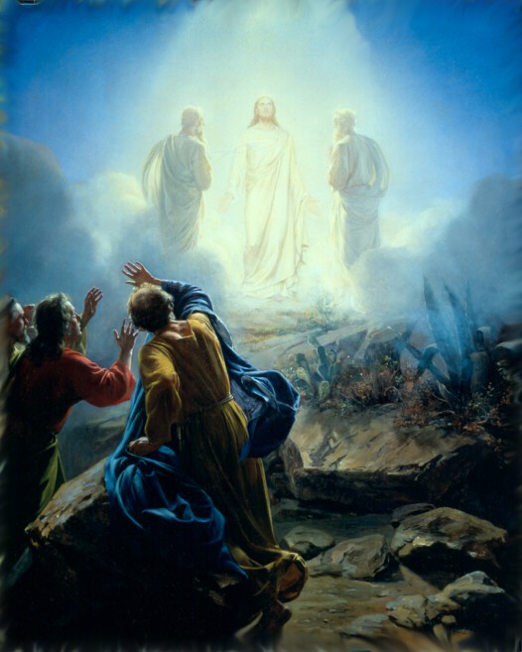
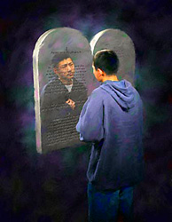
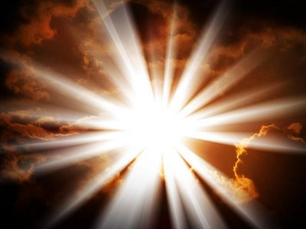
“But we all, with open face beholding as in a glass the glory of the Lord, are changed into the same image from glory to glory, even as by the Spirit of the Lord.” II Cor. 3:18

Slide 4
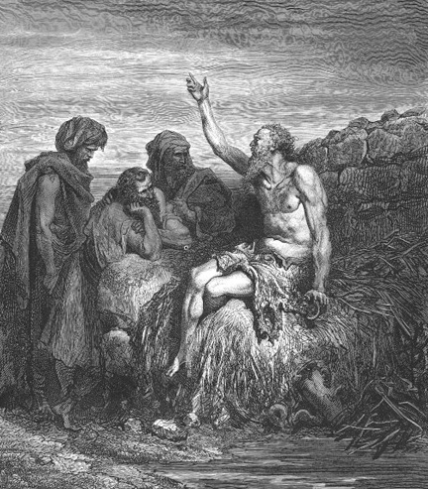
God is incomprehensible
“Canst thou by searching find out God? canst thou find out the Almighty unto perfection? It is as high as heaven; what canst thou do? deeper than hell; what canst thou know? The measure thereof is longer than the earth, and broader than the sea.” Job 11:7-9

Slide 5
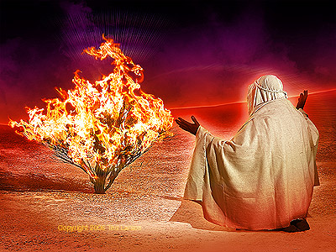
God is self-existent
"And Moses said unto God, Behold, when I come unto the children of Israel, and shall say unto them, The God of your fathers hath sent me, What is his name? What shall I say unto them? And God said unto Moses, I AM THAT I AM: and he said, Thus shalt thou say unto the children of Israel, I AM hath sent me unto you.”
Exodus 3:13-14

Slide 6
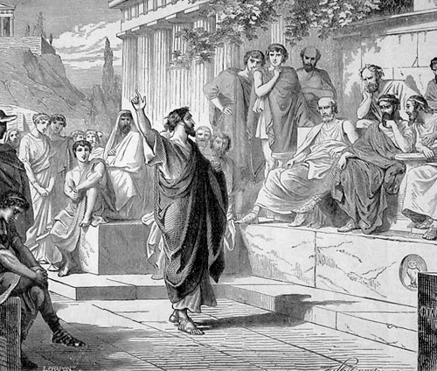
God is self-sufficient
“Neither is worshipped with men's hands, as though he needed any thing, seeing he giveth to all life, and breath, and all things.” Acts 17:25

Slide 7
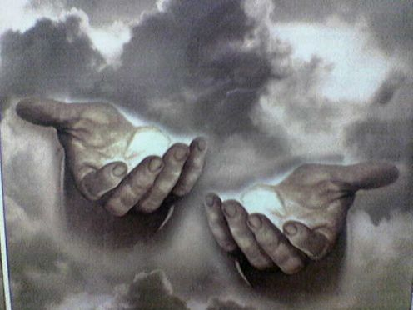
God is eternal
"The eternal God is thy refuge, and underneath are the everlasting arms: and he shall thrust out the enemy from before thee.” Deuteronomy 33:27

Slide 8
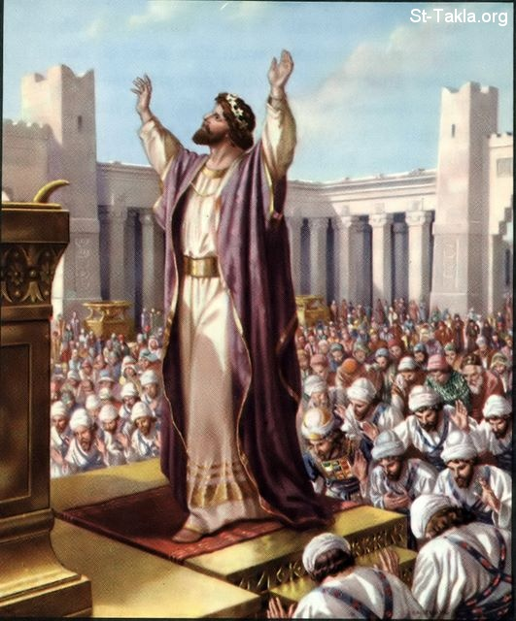
God is infinite
"And Solomon stood before the altar of the Lord in the presence of all the congregation of Israel, and spread forth his hands toward heaven: And he said…Behold, the heaven and heaven of heavens cannot contain thee; how much less this house that I have builded?”
I Kings 8:22, 23, 27

Slide 9
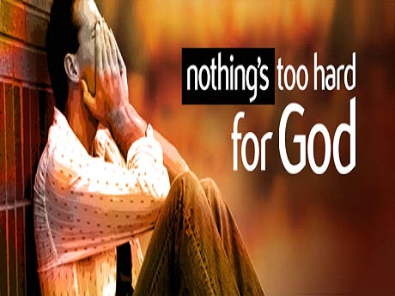
God is omnipotent
"Is any thing too hard for the Lord?” (Genesis 18:14)

Slide 10
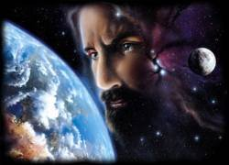
God is omnipresent
"Whither shall I go from thy spirit? or whither shall I flee from thy presence? If I ascend up into heaven, thou art there: if I make my bed in hell, behold, thou art there. If I take the wings of the morning, and dwell in the uttermost parts of the sea; even there shall thy hand lead me, and thy right hand shall hold me.”
Psalm 139:7-11

Slide 11
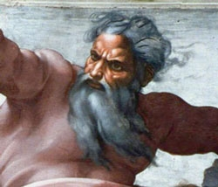
God is omniscient
"Great is our Lord, and of great power: his understanding is infinite.“ Psalm 147:5

Slide 12
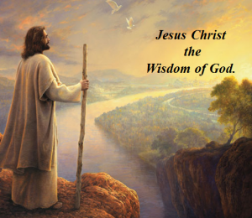
God is all wise
"To the only wise God our Saviour, be glory and majesty, dominion and power, both now and ever. Amen.” Jude 1:25

Slide 13
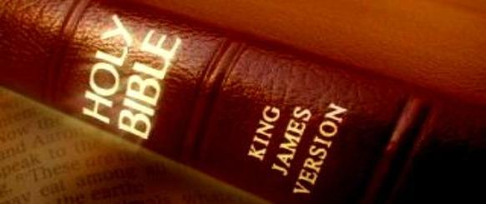
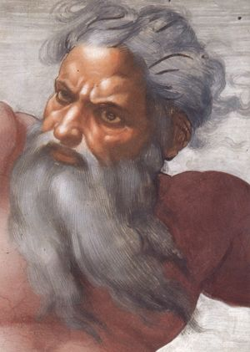
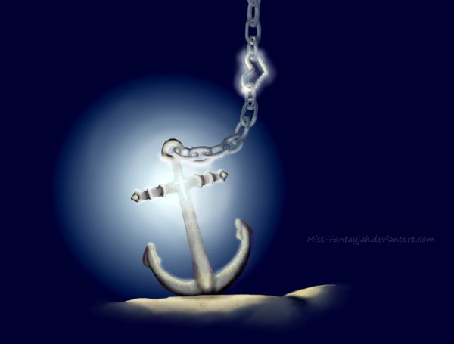
God is immutable
“For I am the Lord, I change not.” Malachi 3:6
Hebrews 6:17-18

Slide 14
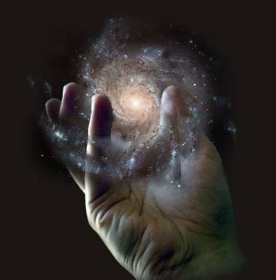
God is sovereign
"Remember the former things of old: for I am God, and there is none else; I am God, and there is none like me, declaring the end from the beginning, and from ancient times the things that are not yet done, saying, My counsel shall stand, and I will do all my pleasure: yes, I have spoken it, I will also bring it to pass; I have purposed it, I will also do it.” Isaiah 46:9-11

Slide 15
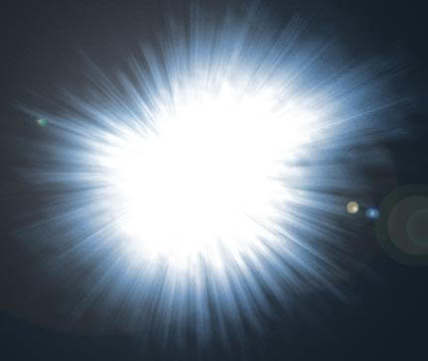
God is light
"This then is the message which we have heard of him, and declare unto you, that God is light, and in him is no darkness at all…But if we walk in the light, as he is in the light, we have fellowship one with another, and the blood of Jesus Christ his Son cleanseth us from all sin.” I John 1:5,7

Slide 16
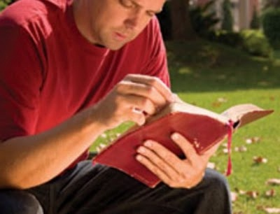
God is inscrutable
“For my thoughts are not your thoughts, neither are your ways my ways, saith the LORD. For as the heavens are higher than the earth, so are my ways higher than your ways, and my thoughts than your thoughts.”
Isa. 55:8-9

Slide 17
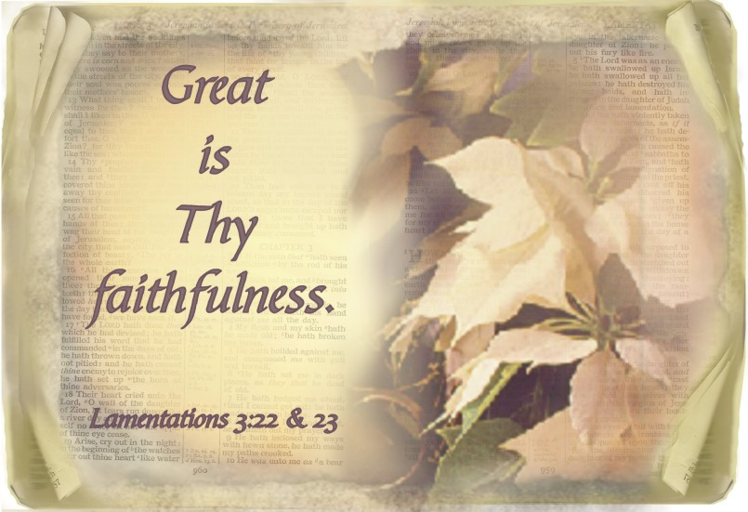
God is faithful

Slide 18
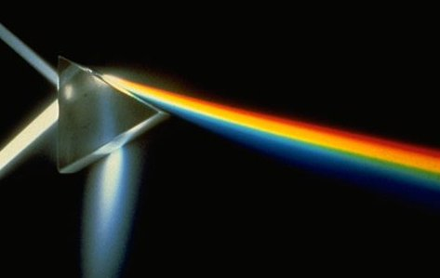
God is holy
God
wise, immutable, sovereign, inscrutable, light, faithful, incomprehensible, self-existence, self-sufficient, eternal, infinite, omnipotent, omnipresent, omniscient, righteousness, just, true, good, merciful, gracious, love
Holiness

Slide 19
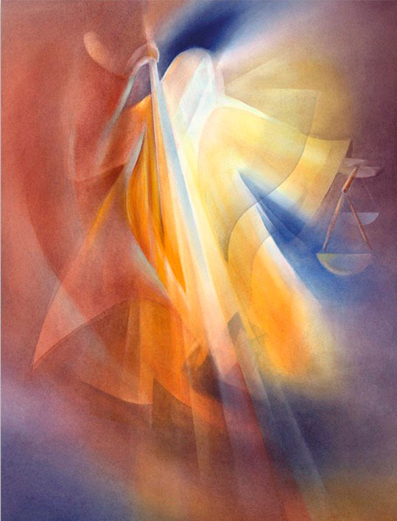
God is just and righteous
“There is no God else beside me; a just God and a Saviour; there is none beside me.”
Isa. 45:21
“For the righteous God trieth the hearts and reins.”
Psalm 7:9

Slide 20
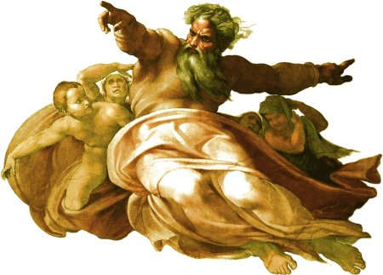
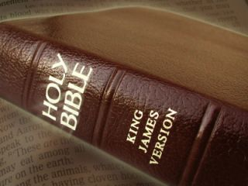
God is true
"And this is life eternal, that they might know thee the only true God, and Jesus Christ, whom thou hast sent.”
John 17:3
“Sanctify them through thy truth: thy word is truth.” John 17:17

Slide 21
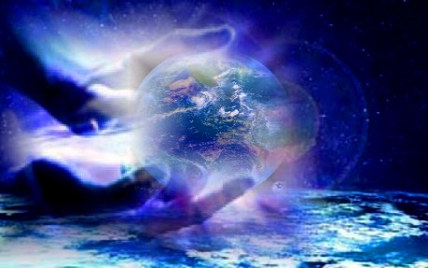
God is good
"Oh that men would praise the
Lord for his goodness, and
for his wonderful works to
the children of men!”
Psalm 107:8

Slide 22
God is incomprehensible
God is self-existence
God is self-sufficient
God is eternal
God is infinite
God is omnipotent
God is omnipresent
God is omniscient
God is all wise
God is immutable
God is sovereign
God is light
God is inscrutable
God is faithful
God is holy
God is just and righteous
God is true
God is good

Slide 23
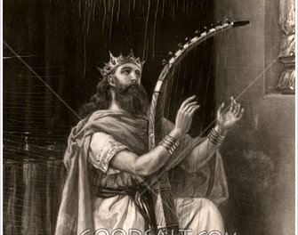
God is merciful
Ps 136:1 O give thanks unto the LORD; for he is good: for his mercy endureth for ever.
Ps 136:2 O give thanks unto the God of gods: for his mercy endureth for ever.
Ps 136:3 O give thanks to the Lord of lords: for his mercy endureth for ever.
Ps 136:4 To him who alone doeth great wonders: for his mercy endureth for ever.
Ps 136:5 To him that by wisdom made the heavens: for his mercy endureth for ever.
Ps 136:6 To him that stretched out the earth above the waters: for his mercy endureth for ever.
Ps 136:7 To him that made great lights: for his mercy endureth for ever:
Ps 136:8 The sun to rule by day: for his mercy endureth for ever:
Ps 136:9 The moon and stars to rule by night: for his mercy endureth for ever.
Ps 136:10 To him that smote Egypt in their firstborn: for his mercy endureth for ever:
Ps 136:11 And brought out Israel from among them: for his mercy endureth for ever:
Ps 136:12 With a strong hand, and with a stretched out arm: for his mercy endureth for ever.
Ps 136:13 To him which divided the Red sea into parts: for his mercy endureth for ever:
Ps 136:14 And made Israel to pass through the midst of it: for his mercy endureth for ever:
Ps 136:15 But overthrew Pharaoh and his host in the Red sea: for his mercy endureth for ever.
Ps 136:16 To him which led his people through the wilderness: for his mercy endureth for ever.
Ps 136:17 To him which smote great kings: for his mercy endureth for ever:
Ps 136:18 And slew famous kings: for his mercy endureth for ever:
Ps 136:19 Sihon king of the Amorites: for his mercy endureth for ever:
Ps 136:20 And Og the king of Bashan: for his mercy endureth for ever:
Ps 136:21 And gave their land for an heritage: for his mercy endureth for ever:
Ps 136:22 Even an heritage unto Israel his servant: for his mercy endureth for ever.
Ps 136:23 Who remembered us in our low estate: for his mercy endureth for ever:
Ps 136:24 And hath redeemed us from our enemies: for his mercy endureth for ever.
Ps 136:25 Who giveth food to all flesh: for his mercy endureth for ever.
Ps 136:26 O give thanks unto the God of heaven: for his mercy endureth for ever.
Psalm 136
“His mercy endureth forever…”

Slide 24
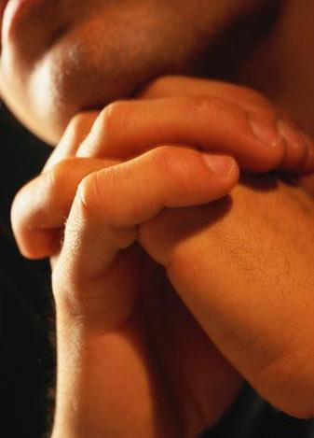
Mercy = God withholding from us what we rightly deserve!
“Have mercy upon us, O LORD, have mercy upon us: for we are exceedingly filled with contempt (base, worthless, disobedient, disrespectful, despised, shameful).” Psalm 123:3

Slide 25
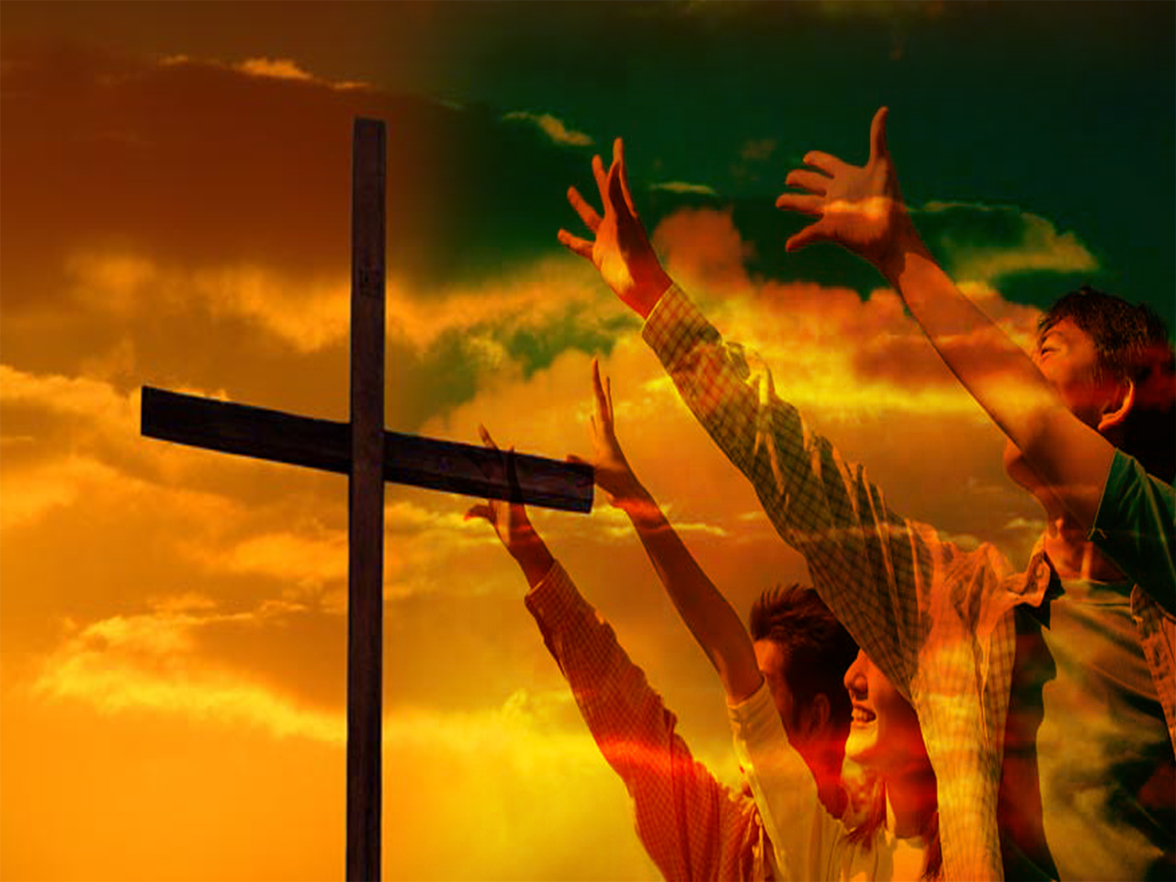
Romans 3:9-31

Slide 26
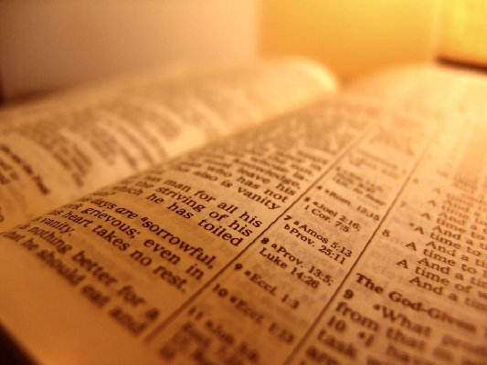
This perfection of the Divine character God is greatly to be praised
“It is of the LORD'S mercies that we are not consumed, because his compassions fail not. They are new
every morning: great is
thy faithfulness.”
Lamentations 3:22-23

Slide 27
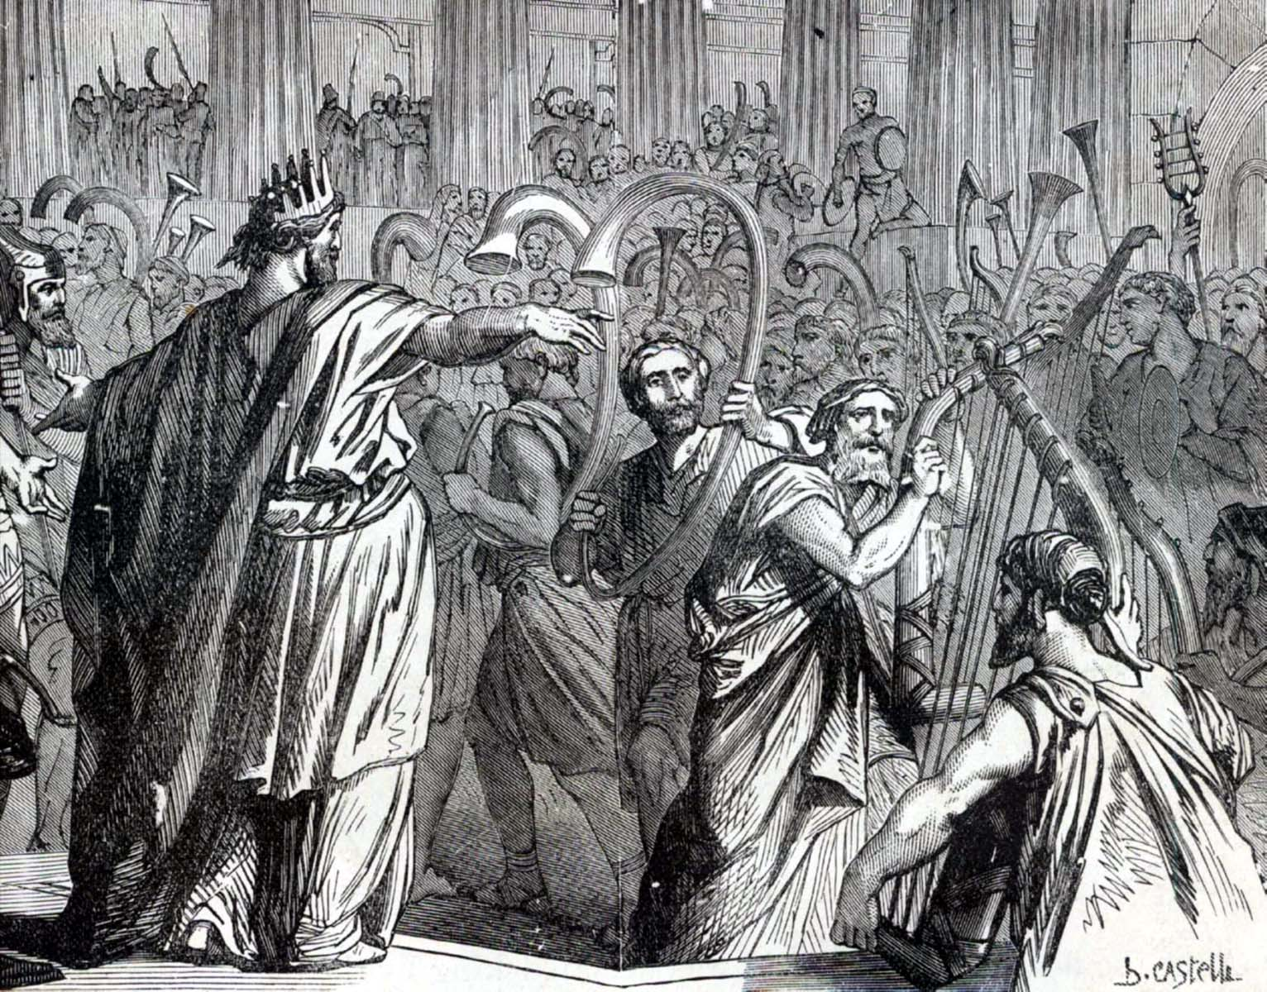
“And when he (Jehoshaphat) had consulted with the people, he appointed singers unto the LORD, and that should praise the beauty of holiness, as they went out before the army, and to say, Praise the LORD; for his mercy endureth for ever.” II Chor. 20:21

Slide 28
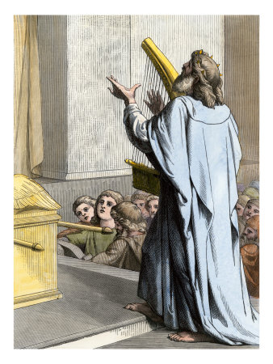
God’s mercy is…
"great" (I Kings 3:6)
"plenteous" (Psalm 86:5)
"tender" (Luke 1:78)
"abundant" (I Peter 1:3)
"from everlasting to everlasting" (Psalm 103:17)
"I will sing aloud of Thy mercy" (Psalm 59:16)

Slide 29
In endeavoring to study the mercy of God as it is set forth in Scripture, a threefold distinction needs to be made.

Slide 30
First, there is a general mercy of God, which is extended to His entire creation: "His tender mercies are over all His works." (Psalm 145:9)
“While the earth remaineth, seedtime and harvest, and cold and heat, and summer and winter, and day and night shall not cease.” Gen. 8:22
“God, who at sundry (variously) times and in divers (many ways) manners spake in time past unto the fathers by the prophets, Hath in these last days spoken unto us by his Son, whom he hath appointed heir of all things, by whom also he made the worlds; Who being the brightness of his glory, and the express image of his person, and upholding all things by the word of his power.” Heb. 1:1-3

Slide 31
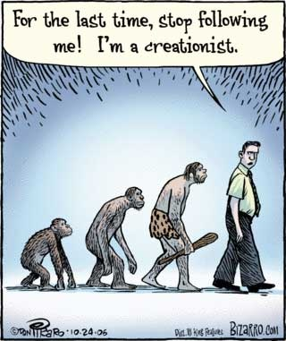

Slide 32
2. Second, there is the mercy of God, which is exercised towards all the children of men - "He giveth to all life, and breath, and all things." (Acts 17:25)
Aiding and helping and them, regardless of their sins – “To the Lord our God belong mercies and forgivenesses, though we have rebelled against him.” (Dan. 9:9) “For he saith to Moses, I will have mercy on whom I will have mercy, and I will have compassion on whom I will have compassion.” (Rom. 9:15)
To mankind God communicates all the necessities of life - “For He maketh His sun to rise on the evil and on the good, and sendeth rain on the just and on the unjust." (Matt. 5:45)

Slide 33
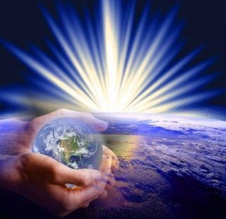
Praise the LORD; for his mercy endureth for ever

Slide 34
3. Third, there is a sovereign mercy which is reserved for the heirs of salvation
Salvation - "Not by works of righteousness which we have done, but according to His mercy He saved us." (Titus 3:5)
“Who redeemeth thy life from destruction; who crowneth thee with lovingkindness and tender mercies.” (Psalm 103:4)
“But God, who is rich in mercy, for his great love wherewith he loved us, Even when we were dead in sins, hath quickened us together with Christ, by grace ye are saved.” (Ephesians 2:4-5)

Slide 35
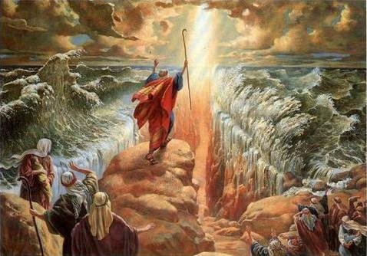
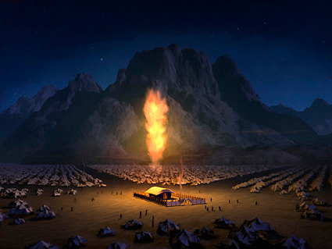
Israel – “Yet thou in thy manifold mercies forsookest them not in the wilderness: the pillar of the cloud departed not from them by day, to lead them in the way; neither the pillar of fire by night, to shew them light, and the way wherein they should go. …Nevertheless for thy great mercies' sake thou didst not utterly consume them, nor forsake them; for thou art a gracious and merciful God.” (Ne 9:19, 31)

Slide 36
Church – “Blessed be the God and Father of our Lord Jesus Christ, which according to his abundant mercy hath begotten us again unto a lively hope by the resurrection of Jesus Christ from the dead, To an inheritance incorruptible, and undefiled, and that fadeth not away, reserved in heaven for you.” (I Peter 1:3-4)
“What if God, willing to shew his wrath, and to make his power known, endured with much longsuffering the vessels of wrath fitted to destruction: And that he might make known the riches of his glory on the vessels of mercy, which he had afore prepared unto glory, Even us, whom he hath called, not of the Jews only, but also of the Gentiles.” (Romans 9:22-23)

Slide 37
Backslider –
“But though he cause grief (backslider), yet will he have compassion according to the multitude of his mercies.” (Lam. 3:32)
“Go and proclaim these words toward the north, and say, Return, thou backsliding Israel, saith the LORD; and I will not cause mine anger to fall upon you: for I am merciful, saith the LORD, and I will not keep anger for ever.” (Jer. 3:12)

Slide 38
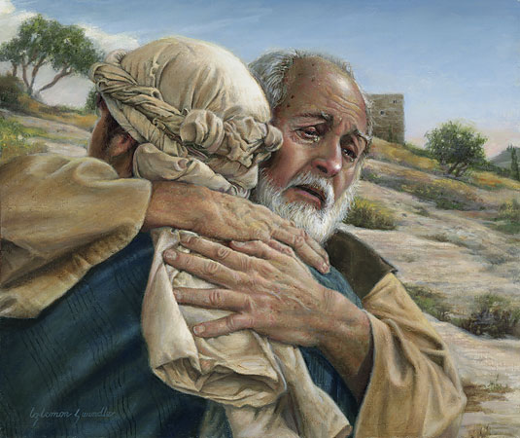

Slide 39
Application of this attribute of God in our own personal lives
Rom. 12:1 “I beseech you therefore, brethren, by the mercies of God, that ye present your bodies a living sacrifice, holy, acceptable unto God, which is your reasonable service.”
Col. 3:12 “Put on therefore, as the elect of God, holy and beloved, bowels of mercies, kindness, humbleness of mind, meekness, longsuffering…”
II Cor. 1:3-4 “Blessed be God, even the Father of our Lord Jesus Christ, the Father of mercies, and the God of all comfort; Who comforteth us in all our tribulation, that we may be able to comfort them which are in any trouble, by the comfort wherewith we ourselves are comforted of God.”

Slide 40
Heb. 4:16 “Let us therefore come boldly unto the throne of grace, that we may obtain mercy, and find grace to help in time of need.”
II Cor. 4:1 “Therefore seeing we have this ministry, as we have received mercy, we faint not.”
Phil. 2:1-4 “If there be therefore any consolation in Christ, if any comfort of love, if any fellowship of the Spirit, if any bowels and mercies, Fulfil ye my joy, that ye be likeminded, having the same love, being of one accord, of one mind. Let nothing be done through strife or vainglory; but in lowliness of mind let each esteem other better than themselves.”

Slide 41
“He hath shewed thee, O man, what is good; and what doth the LORD require of thee, but to do justly, and to love mercy, and to walk humbly with thy God?” Micah 6:8
“Keep yourselves in the love of God, looking for the mercy of our Lord Jesus Christ unto eternal life.” Jude 1:21
“He that followeth after righteousness and mercy findeth life.” Prov. 21:21
“O give thanks unto the God of gods: for his mercy endureth for ever.” Psalm 136:2

Slide 42
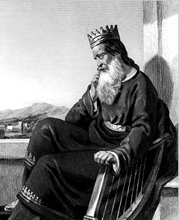
David’s prayer for forgiveness
(Psalm 51)

Slide 43
“Have mercy upon me, O God, according to thy lovingkindness: according unto the multitude of thy tender mercies blot out my transgressions. Wash me throughly from mine iniquity, and cleanse me from my sin. For I acknowledge my transgressions: and my sin is ever before me. Against thee, thee only, have I sinned, and done this evil in thy sight: that thou mightest be justified when thou speakest, and be clear when thou judgest. Behold, I was shapen in iniquity; and in sin did my mother conceive me…

Slide 44
Behold, thou desirest truth in the inward parts: and in the hidden part thou shalt make me to know wisdom. Purge me with hyssop, and I shall be clean: wash me, and I shall be whiter than snow. Make me to hear joy and gladness; that the bones which thou hast broken may rejoice. Hide thy face from my sins, and blot out all mine iniquities. Create in me a clean heart, O God; and renew a right spirit within me. Cast me not away from thy presence; and take not thy holy spirit
from me. Restore unto me the joy of thy salvation;
and uphold me with thy free spirit. Then will I
teach transgressors thy ways; and sinners
shall be converted unto thee.”

Slide 45
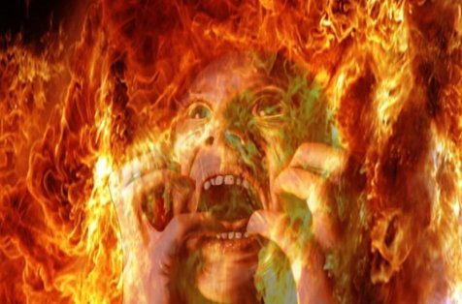
How many people say, I do not believe that God will ever cast me into Hell;
He is too merciful
“For great is thy mercy toward me: and thou hast delivered my soul from the lowest hell.” Psalm 86:13

Slide 46
God is a God of justice as well as mercy, and He has expressly declared that He will "by no means clear the guilty" (Exod. 34:7)
"The wicked shall be turned into hell, all the nations that forget God" (Psalm 9:17)
God shows mercy to the truly repentant, but not to the unrepentant - (see Luke 13:3).
"For as the heaven is high above the earth, so great is His mercy toward them that fear Him" (Psalm 103:11)
“For he shall have judgment without mercy.” (James 2:13)
“And death and hell were cast into the lake of fire. This is the second death. And whosoever was not found written in the book of life was cast into the lake of fire.” (Rev. 20:14-15)

Slide 47
"The Lord is merciful and gracious, slow to anger, and plenteous in mercy. He will not always chide: neither will he keep his anger for ever. He hath not dealt with us after our sins; nor rewarded us according to our iniquities. For as the heaven is high above the earth, so great is his mercy toward them that fear him. As far as the east is from the west, so far hath he removed our transgressions from us. Like as a father pitieth his children, so the Lord pitieth them that fear him. For he knoweth our frame; he remembereth that we are dust. As for man, his days are as grass; as a flower of the field, so he flourisheth. For the wind passeth over it, and it is gone; and the place thereof shall know it no more. But the mercy of the Lord is from everlasting to everlasting upon them that fear him, and his righteousness unto children’s children.”
Psalm 103:8-17

