Slide 1





How to Provide Protection for your Son
(Part 1)

Slide 2
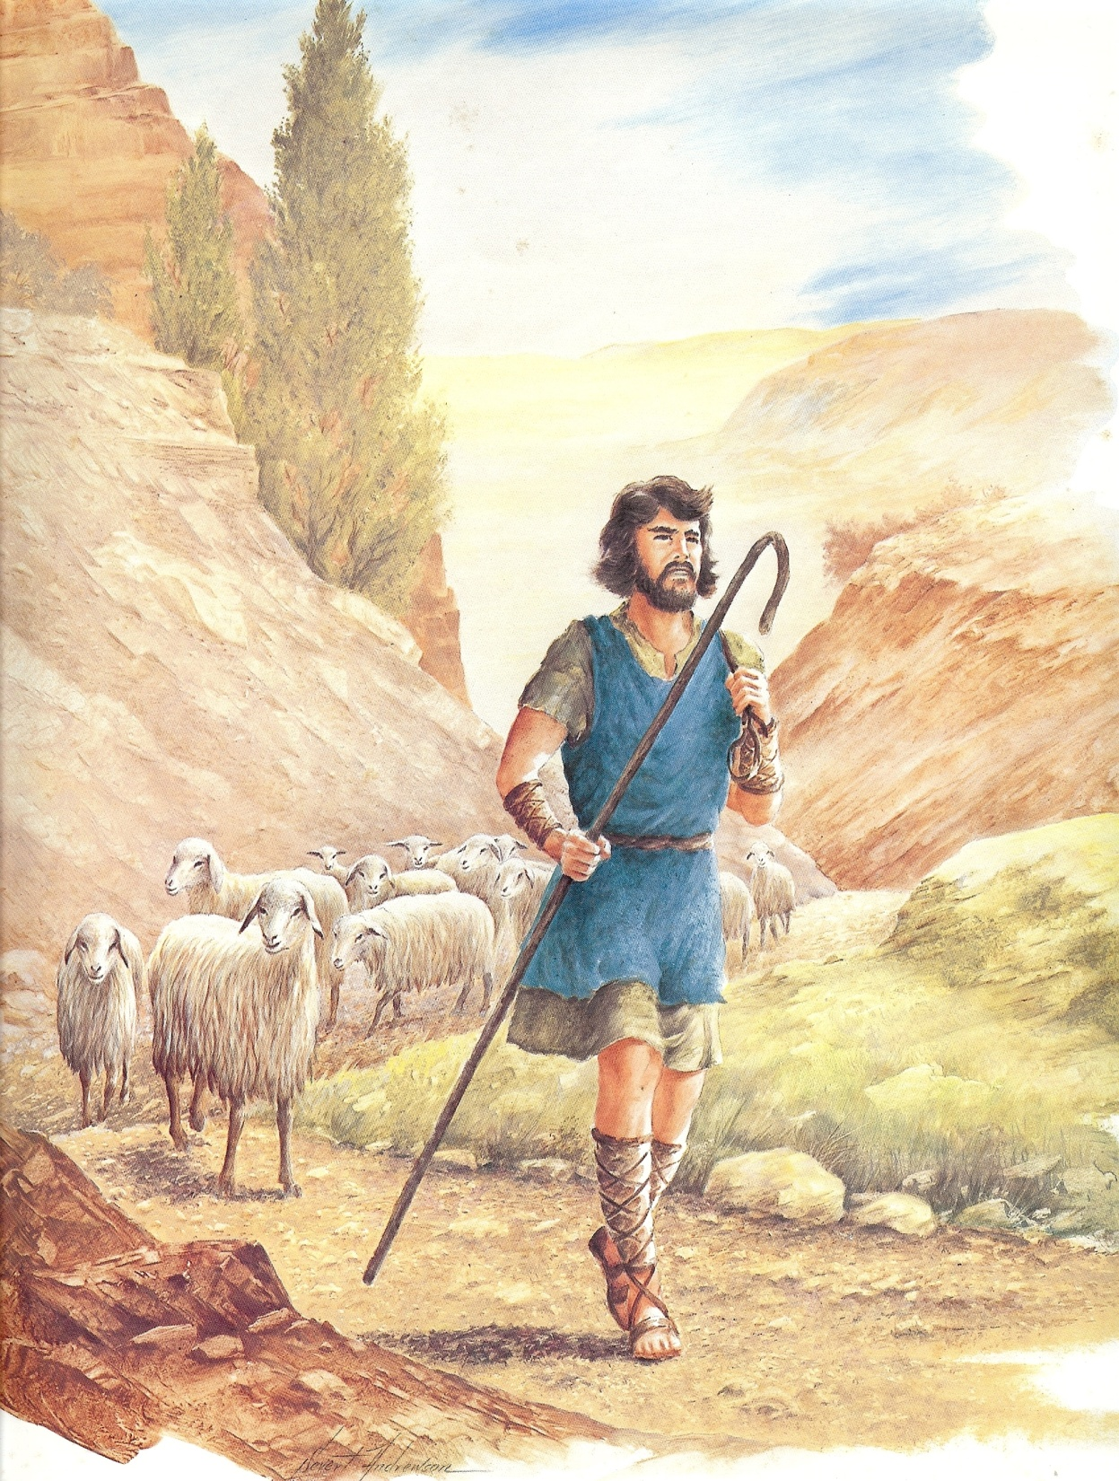
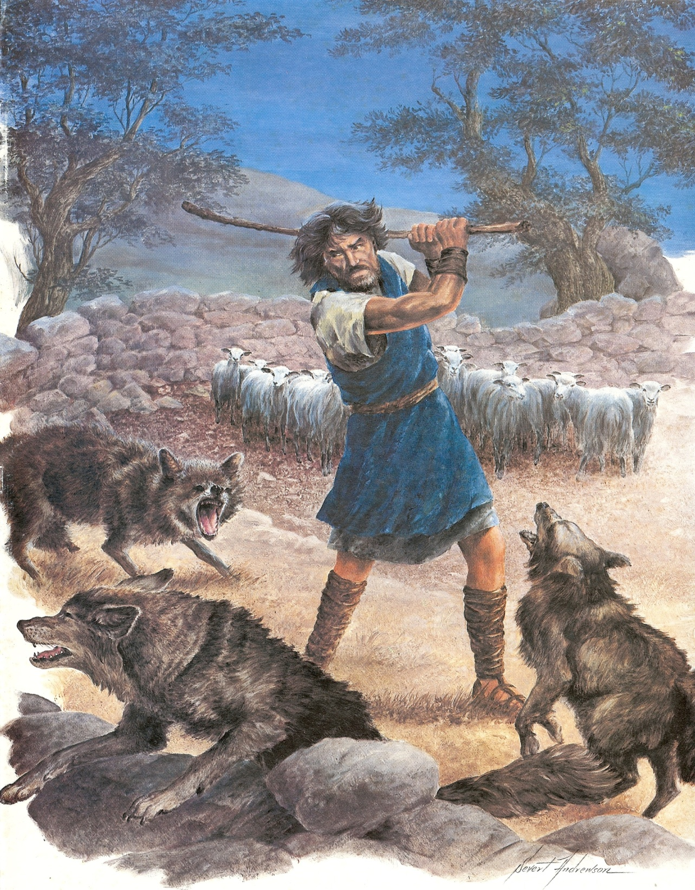
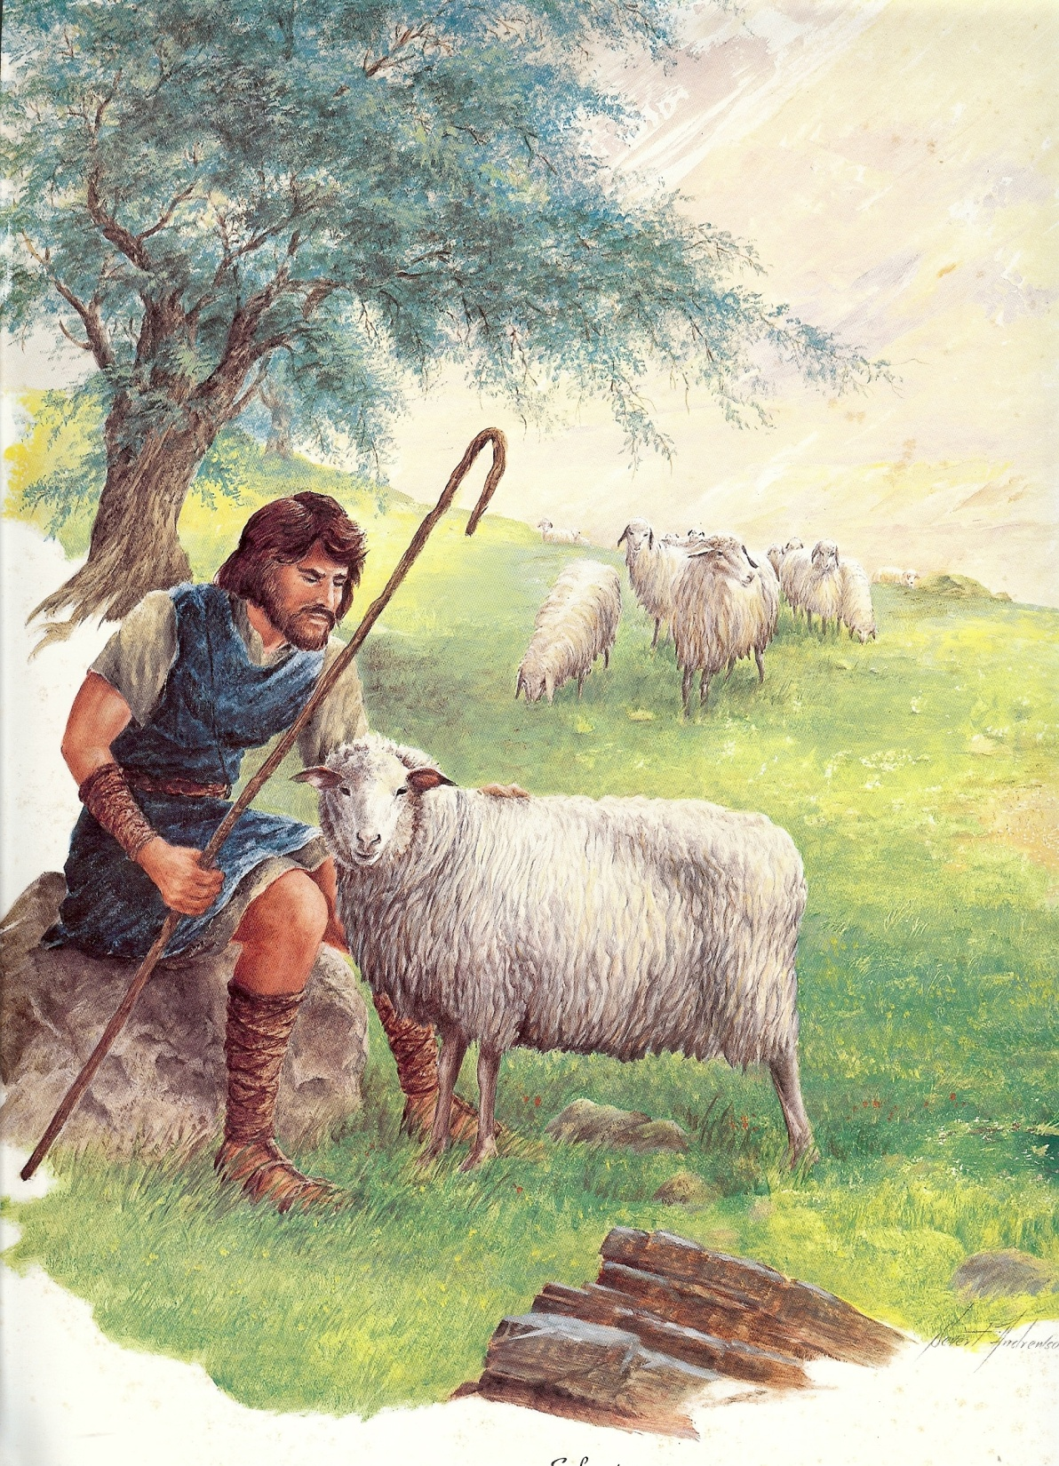

Slide 3
Pr 1:8 My son, hear the instruction of thy father, and forsake not the law of thy mother:
Pr 1:10 My son, if sinners entice thee, consent thou not.
Pr 1:15 My son, walk not thou in the way with them; refrain thy foot from their path:
Pr 2:1 My son, if thou wilt receive my words, and hide my commandments with thee;
Pr 3:1 My son, forget not my law; but let thine heart keep my commandments:
Pr 3:11 My son, despise not the chastening of the LORD; neither be weary of his correction:
Pr 3:21 My son, let not them depart from thine eyes: keep sound wisdom and discretion:
Pr 4:10 Hear, O my son, and receive my sayings; and the years of thy life shall be many.
Pr 4:20 My son, attend to my words; incline thine ear unto my sayings.
Pr 5:1 My son, attend unto my wisdom, and bow thine ear to my understanding:
Pr 5:20 And why wilt thou, my son, be ravished with a strange woman, and embrace the bosom of a stranger?

Slide 4
Pr 6:1 My son, if thou be surety for thy friend, if thou hast stricken thy hand with a stranger,
Pr 6:3 Do this now, my son, and deliver thyself, when thou art come into the hand of thy friend; go, humble thyself, and make sure thy friend.
Pr 6:20 My son, keep thy father's commandment, and forsake not the law of thy mother:
Pr 7:1 My son, keep my words, and lay up my commandments with thee.
Pr 19:27 Cease, my son, to hear the instruction that causeth to err from the words of knowledge.
Pr 23:15 My son, if thine heart be wise, my heart shall rejoice, even mine.
Pr 23:19 Hear thou, my son, and be wise, and guide thine heart in the way.
Pr 23:26 My son, give me thine heart, and let thine eyes observe my ways.
Pr 24:13 My son, eat thou honey, because it is good; and the honeycomb, which is sweet to thy taste:
Pr 24:21 My son, fear thou the LORD and the king: and meddle not with them that are given to change:
Pr 27:11 My son, be wise, and make my heart glad, that I may answer him that reproacheth me.
Pr 31:2 What, my son? and what, the son of my womb? and what, the son of my vows?

Slide 5
In two separate studies, one by the University of Michigan and the other by Peen State University, it was stated that the average American father spends between 7-11 minutes in conversation with his children each week.
Notes:
At

Slide 6


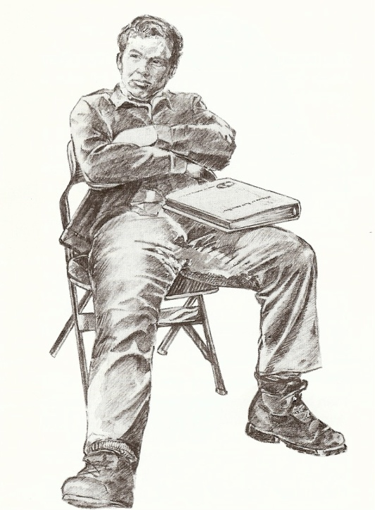


With this lack of interaction between fathers and their children it should be no surprise to us that our homes are in the condition
that they are!

Slide 7

The Father Son Relationship is Critical to the Raising of Godly Children
(Ephesians 6:1-4, 10-18)
Practical ways to protect your sons
from the “wiles of the devil…”

Slide 8
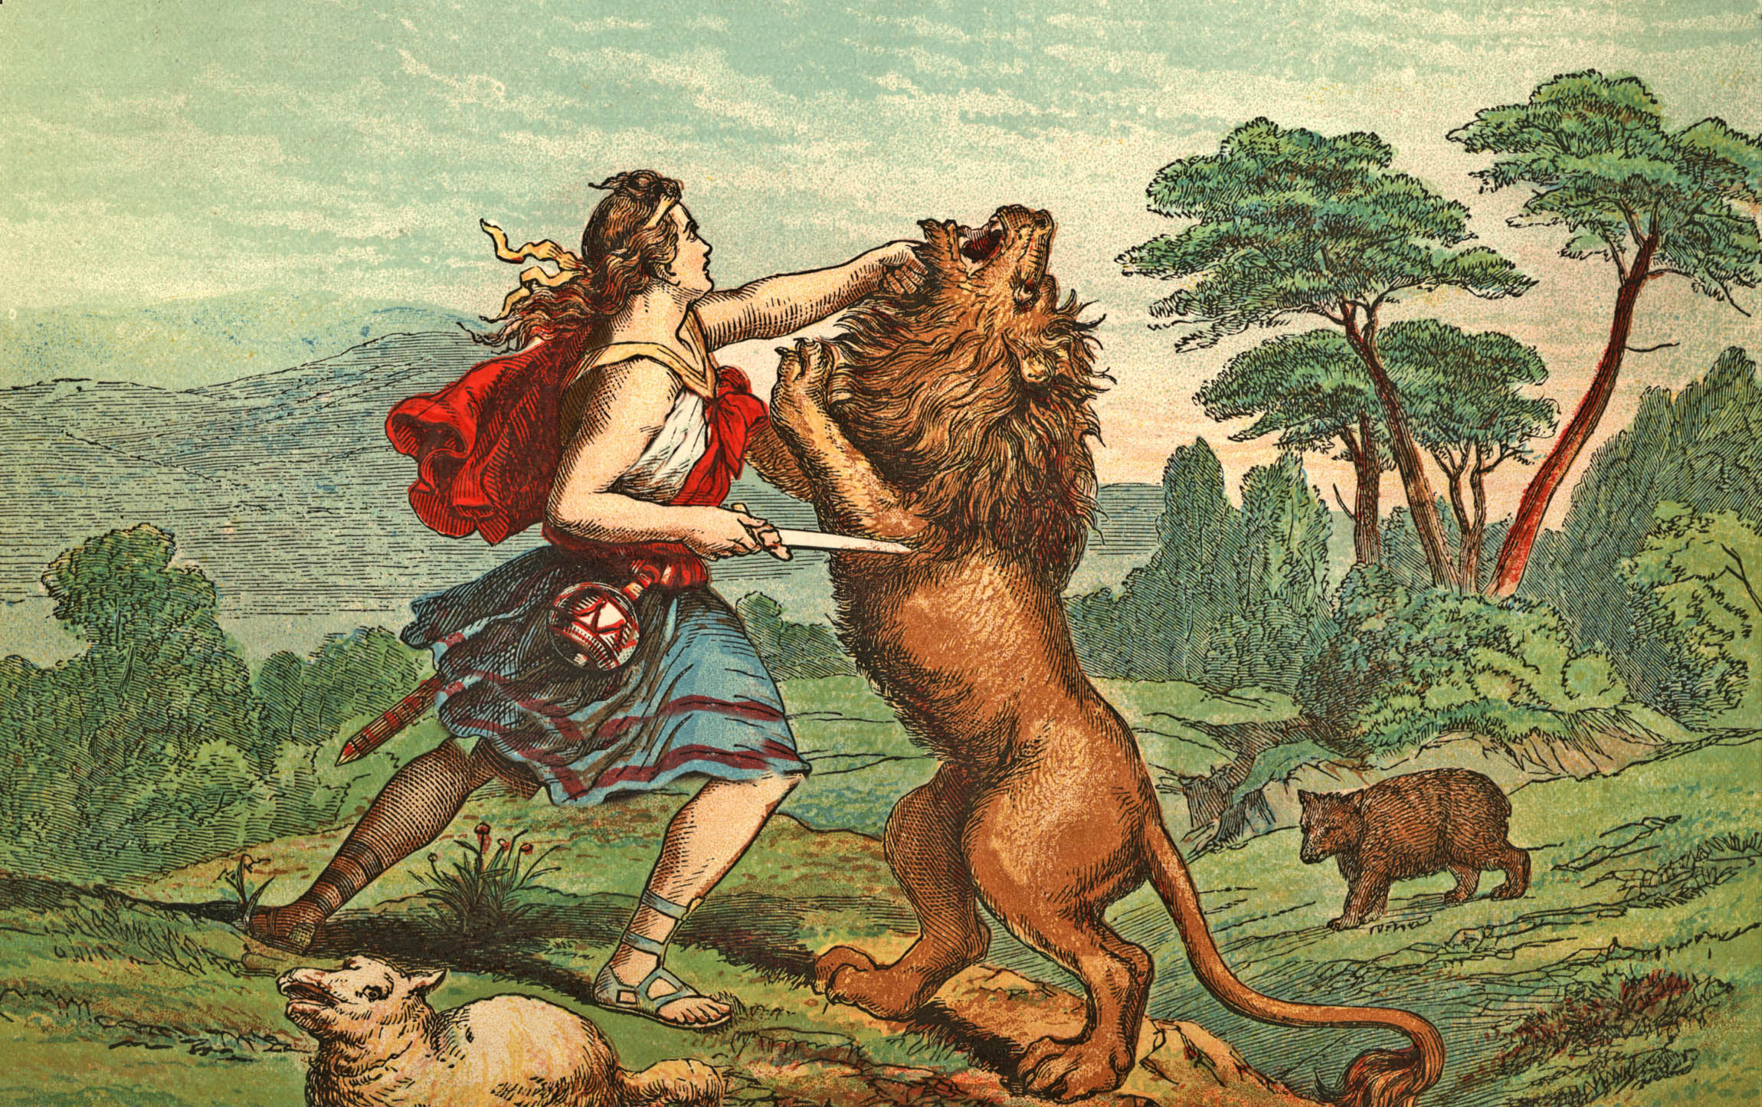
Fathers are to be the Shepherds of their Flocks (family)
“…take heed to yourself (your own personal life), and to all the flock (members of your family)…” (Acts 20:28-30)
Fathers are responsible to oversee their families.
Fathers are given the responsibility to guard their families from being drawn away.
Fathers are responsible to lead and feed their families – I Peter 5:1-4

Slide 9
Lead your son to personal salvation – Rom.10:9-10
Dedicate your son to God – Ps. 127-128
Make sure that you are overcoming sin and temptation – Rom. 6-8
Challenge each son to total dedication – Rom. 12:1-2
Instill in your son the fear of the Lord – Prov. 1:7
Help him to see the consequences of sin
Help him to memorize verses on the “Fear of the Lord”
6. Train each son to recognize and resist the Devil – James 4:7-10

Slide 10
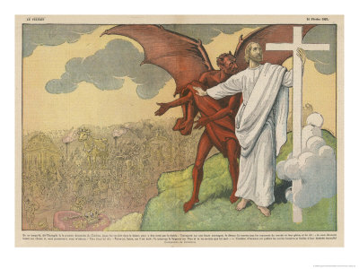
The sixfold progression of Satan’s temptations
through the lust of the flesh
(James 1:13-16)

Slide 11
1. Desire - “...But every man is tempted when he is drawn away in his own lust...”
2. Deception - “... But every man is tempted when he is drawn away in his own lust and enticed...”
3. Deliberation - “... Then when lust is conceived...”
4. Disobedience - “... Then when lust [is] conceived, it bringeth forth sin:...”
5. Development - “... and sin, when it is finished...”
6. Destruction - “... and sin, when it is finished, bringeth forth death....”
APPLICATION: “... Do not err, my beloved
brethren.”

Slide 12
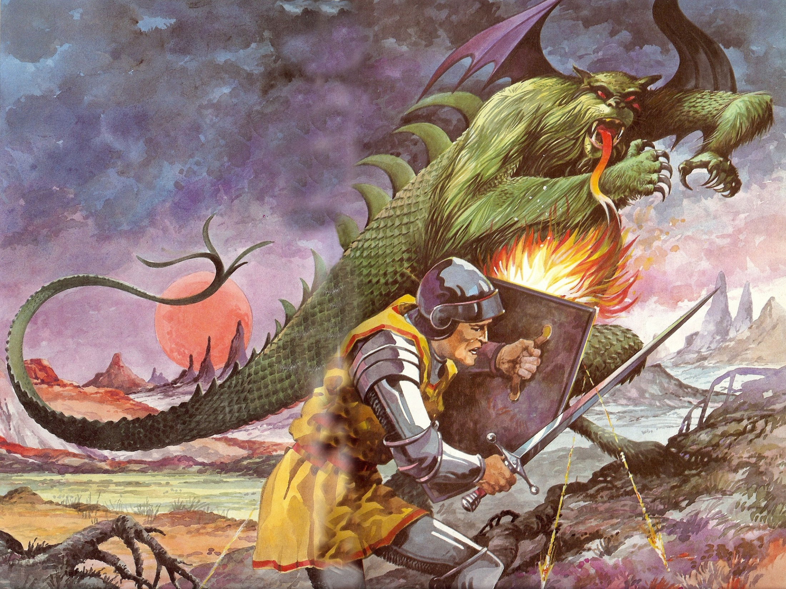
7. Teach your son how Satan works –
Weapons
Strongholds

Slide 13


Satan’s Greatest Weapons
Deception – Rev. 12:9
Temptation – I Thess. 3:5
When we believe Satan’s lies and yield to his temptations we give him ground (place in our soul) upon which he builds his strongholds.
From “Strongholds” Satan seeks to conquer and control every area of our soul.

Slide 14
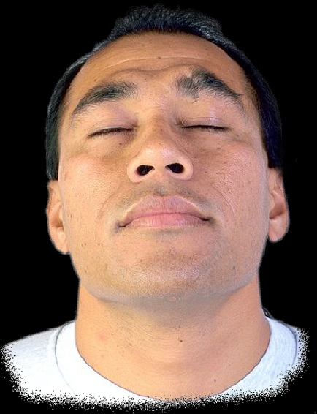


SOUL - Hebrews 4:12
Mind
Will
Emotions

Slide 15
Will
(Hebrews 10:26)
Mind
(Romans 8:7)
Soul
(Hebrews 4:12)
Emotion
(II Corinthians 6:11-13)

Slide 16
2. GROUND - Jurisdictional area (place in our soul) - Ephesians 4:27
NOTE: * Bitterness - Hebrews 12:15,
* Temporal values - I Timothy
6:6-10; Luke 12:15,
* Immorality - I Thessalonians
4:1-8
Satan gains "ground” areas of
jurisdiction in our soul.

Slide 17



Three Ways “Ground” is Surrendered to Satan
Immorality
Temporal Values
Bitterness

Slide 18



Lust of the flesh = Immorality (I Tim. 5:1-2, 22; II Tim. 2:22; Prov. 2, 5-7)
Lust of the eyes = Temporal values (Exod. 20:17; I Tim. 6:10; Heb. 13:5; Col. 3:1-2)
Pride of life = Bitterness (Prov. 13:10; Heb. 12:15; I Tim. 2:13-14)

Slide 19
3. STRONGHOLDS - Satan's greatest weapons
are deception - Revelation 12:9 and temptation - I Thessalonians 3:5
Note: When we believe the lies of Satan and yield to his temptations we give
ground (place in our soul) to Satan, upon this ground Satan builds a Stronghold
from which he seeks to control every area
of our lives - mind, will, and emotions.
4. PRINCIPALITY - Evil ruler over a jurisdictional
area - Ephesians 6:12

Slide 20
Understanding Strongholds
“Casting down imaginations, and every high thing that exalteth itself against the knowledge of God, and bringing into captivity every thought to the obedience of Christ; And having in a readiness to revenge all disobedience, when your obedience is fulfilled.”
(II Corinthians 10:3-6)
“For though we walk in the flesh, we do not war after the flesh: For the weapons of our warfare are not carnal, but mighty through God to the pulling down of strong holds.”

Slide 21


II Corinthians 10:3-6
Stronghold
“False Ideas” (John 8:44)
Ground
Surrendered (Eph. 4:27)
Pride of Life

Slide 22
II Corinthians 10:3-6
Stronghold
“False Ideas”
(John 8:44)
Ground
Surrendered
(Eph. 4:27)
Pride of Life
Immorality
(I Thess. 4:1-8)
Bitterness
(Heb. 12:15)
Temporal Values
(I Tim. 6:10)

Slide 23
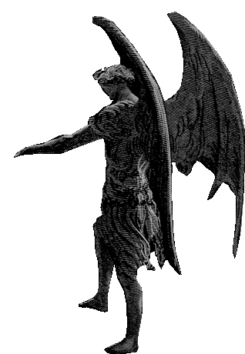
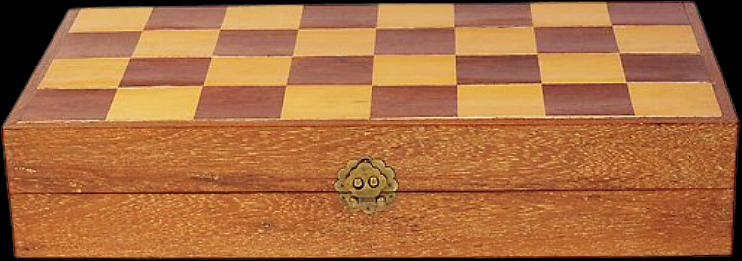
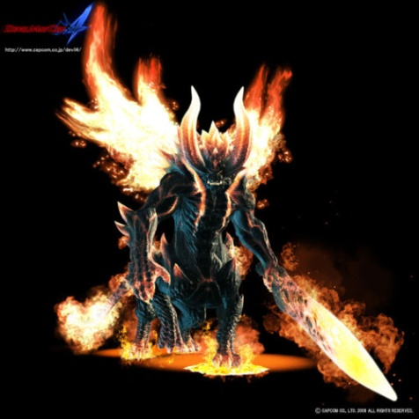
Principality
(Eph.6:12)
Stronghold
“False Ideas”
(II Cor. 10:3-6)
Ground
Surrendered
(Eph. 4:26-27)
Immorality
Bitterness
Temporal Values
Strife
Music
Discontent
Dress
Friends
Judging
Lying
Anger
Money
Depression
Worry
Drugs
Jealousy
Stealing
Fear
Hurt
Rebellion
Lust
Tormentors – Matthew 18:34

Slide 24
How to Gain Back Ground that has Been Given over to Satan

Slide 25

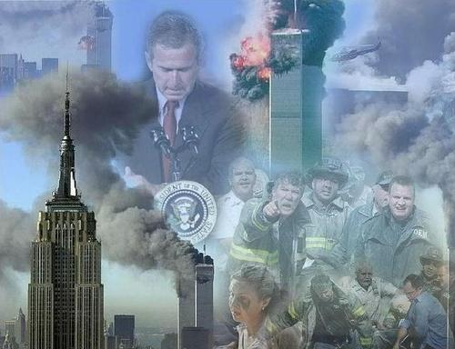

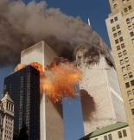
Three Enemies
“And you hath he quickened, who were dead in trespasses and sins; Wherein in time past ye walked according to the course of this world, according to the prince of the power of the air, the spirit that now worketh in the children of disobedience: Among whom also we all had our conversation in times past in the lusts of our flesh, fulfilling the desires of the flesh and of the mind; and were by nature the
children of wrath, even as others.”
(Ephesians 2:1-3)

Slide 26


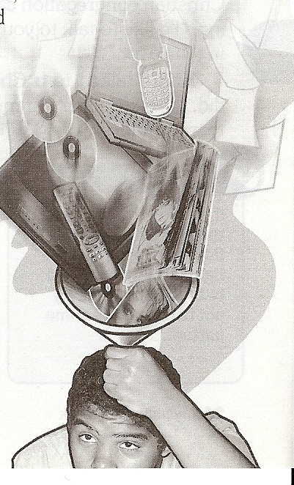

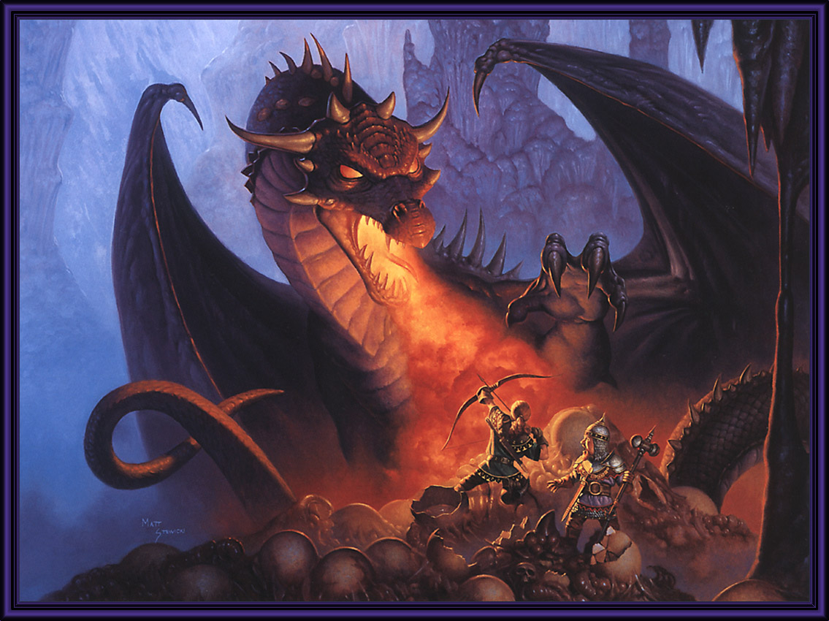







World
“For we wrestle not against flesh and blood, but against principalities, against powers, against the rulers of the darkness of this world, against spiritual wickedness in high places.”
Devil
Flesh

Slide 27
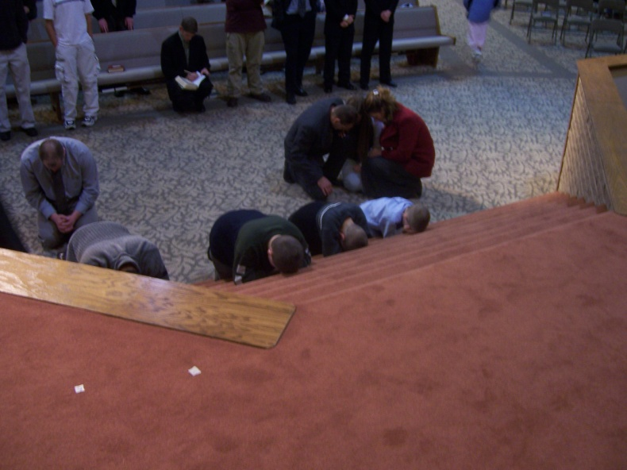
Steps to Regain Surrendered Ground
Confess and repent of each sin (surrendered ground) that God brings to your mind – Prov. 28:13
Do not minimize – II Cor. 10:12
Do not deny – Mal. 3:8
Do not blame – Gen. 3:14
Do not justify - Luke 16:15
REPENT!

Slide 28



2. Claim the blood of Christ for cleansing and victory over those sins – I John 1:9; Rev. 12:9
3. Ask God to take back the ground surrendered to Satan – Ps. 23:3; Rom. 6
4. Tear down strongholds (false ideas) with the truth of Scripture – II Cor. 10:4-5; John 17:17

Slide 29
5. Transform your mind with the truth of God’s Word – Rom. 12:1-2
6. Fully forgive your offenders – Matt. 6:10-15
7. Revenge all disobedience – II Cor. 10:6-7
Clear your conscience – Acts 24:16
Make restitution – Luke 19:1-10
Ask forgiveness – “Forgive me this wrong…” (II Cor. 12:13)

Slide 30
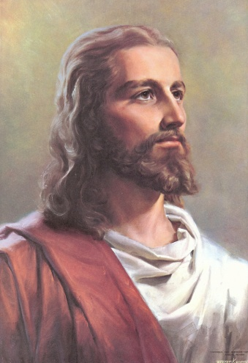
Stronghold
“Truth of Scripture”
(John 17:17)
Romans 6-8
Ground
Surrendered
(Rom. 6:16-19)
Humility
Holiness
(I Thess. 4:1-8)
Forgiveness
(Matt. 6:14)
Sacrificial Giving
(Luke 6:38)

