Slide 1





Needs of a Husband

Slide 2

How a Wife Destroys Her
Husbands Manliness
(Eph. 5:22-24, 33)
Expecting him to know what kind of protection you need – I Tim. 5:8
Physical
Emotional
Spiritual
Mental
Tell your husband how he can protect you!

Slide 3


2. Being financial independent – II Cor. 11:3
Love is killed by self-sufficiency
Whoever controls the money controls the home
Center your work and ministry in your home – ( see Proverbs 31)

Slide 4

3. Greater loyalty and respect for others – I Cor. 14:34-35
Friends
Family
Co-workers
Church leaders
Other men and women
Bring your needs and questions to your husband.

Slide 5


4. Resisting his decisions (leadership) – I Pet. 3:1-6
A wife’s spirit can control her husband’s ambitions
A wife’s spirit can destroy her husband’s self-worth
A wife’s spirit can change her husbands decisions
Learn how to lovingly and wisely appeal to your husband!

Slide 6


5. Resisting his physical affection – I Cor. 7:1-5
Crushes a man’s spirit
Creates deep resentment and bitterness
Causes great temptation – Prov. 5-7

Slide 7
6. Taking matters into your own hands – Col. 3:18
When a wife intrudes into her husband’s area of responsibility, her husband often surrenders it and other responsibilities as well
A wife may avoid temporary consequences, but cause ultimate destruction - Prov. 14:1
Don’t become your husband’s conscience -
* Give him room to fail
* Remain supportive
* Wisely appeal wrong decisions

Slide 8
A Husband Needs a Wife Who Will Accept Him as Her God-given Leader
(Eph. 5:23)
Believe in his God-given responsibilities – Gen. 3:16
Reassure him that his authority comes from God – I Pet. 3:1
Submit to his leadership – Col. 3:18
Express to your husband that God will lead you through him – I Cor. 11:3
Show confidence that God is working through him – Heb. 13:7, 17

Slide 9
God works through a man’s decisions whether they are good or bad – Rom. 8:28
Bad decisions reveal a man’s need to allow his wife to appeal to him and express her cautions – Gal. 6:1-2
Demonstrate loyalty when mistakes are made – Prov. 31:10-12
The more a wife shows trust in her husband, the more careful he will be in giving her direction.
6. Praise him for godly character, righteousness standards and Biblical convictions – Ps. 15; I Tim. 3:2-8

Slide 10
7. Encourage him not to give up on his God given goals – Eph. 4:29
8. Express enthusiasm for his achievements – Gen. 2:18
Rejecting his achievements is perceived as a rejection of him
Share his excitement
9. Show attentiveness when he is talking – I Cor. 13:5
Look at your husband when he talks to others, as this will inspire their respect
Let him take the lead in conversations

Slide 11

Be Supportive

Slide 12

A Husband Needs a Wife that Will Continue to Develop Inward and Outward Beauty
(Prov. 31:10-31)
Continue to grow in your walk and relationship with the Lord – Heb. 5:11-14
Prayer
Bible reading and study
Godly music
Servants spirit
Church ministry

Slide 13

2. Attractive hair style (symbol of being under authority) – I Cor. 11:10-15
Woman’s hair is her glory
Woman’s hair style should reflect a Biblical standard
Femininity not masculinity
Neatness not sloppiness
Submission not pride
Softness not hardness
Woman’s hair should please her husband – Eph. 5:24

Slide 14

Attractive and modest dress – I Tim. 2:9; Prov. 31:22
Modesty is always in style!
Dress like a woman – Deut. 22:5
Dress should draw attention to your countenance not your body – Prov. 15:13

Slide 15



Weight control – Gal. 5:22-23
God is concerned about overeating, overweight and an unhealthy life style – Prov. 23:2
Physical issues can produce overweight
Emotional problems can produce overweight
“And put a knife to thy throat, if thou be a man given to appetite.”

Slide 16
* Dedicate your body to God – Rom. 12:1-2
* Let your husband know that you care about your weight
* Work on achievable goals together
* Accept yourself – Ps. 139
5. Develop a meek and quiet spirit – I Pet. 3:1-7
Meekness = submission and yield rights
Quiet spirit = conquering fear and worry

Slide 17
A Husband Needs a Wife Who Will Allow Him the Freedom to Getaway Without Being Possessive
Time to be alone with God – II Chron. 16:5
Adam walked with God before Eve was created – Gen. 1:26-2:18
A man’s success in life is based on seeking after the Lord – Josh. 1:9-11
The richer a man’s fellowship with God, the sweeter a man’s relationship will be with his wife and family – Ps. 32:1-5
Every man needs a “Bethel” – Gen. 31:13

Slide 18
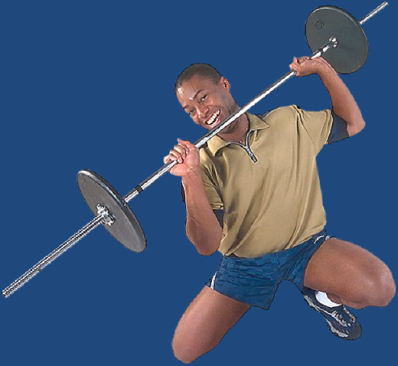






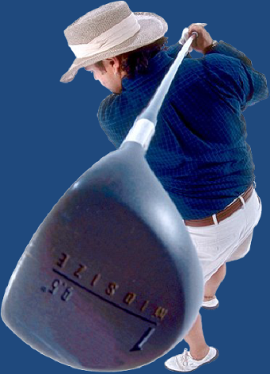
2. Time to getaway and do the things he enjoys – Mark 6:31
Hunting
Fishing
Golf
Sports
Hobbies
Mission trips
Work projects
Etc.

Slide 19

A Husband Needs a Wife who
Expresses Gratefulness
(I Thess. 5:18)
1. Give your expectations to God because expectations destroy gratefulness – Ps. 62:5
Gratefulness produces happiness and an unhappy wife is a rebuke to her husband – Ps. 100:4
Men are highly attracted to grateful women!
Learn contentment – I Tim. 6:6
Set your affections on things above – Col. 3:1

Slide 20

List all the things your husband does for you and on a daily basis and thank him for those things – Phil. 3:7-8
List all the wise decisions your husband has made that has positively effected your life and praise him for those decisions – Prov. 27:2

Slide 21
A Husband Needs a Wife Who is Well Respected by Others
(Prov. 31:31)
Respected for her values – I Thess. 5:12-13
Respected for her morals – Titus 2:5
Respected for her discretion – Titus 2:4
Respected for her wisdom – Prov. 31:26
Respected for her meek and quiet spirit – I Pet. 3:1-7
Respected by her children – Prov. 31:28
Respected by her church family – Rom. 16:1

Slide 22

8. Respected for her character – I Tim. 5:10-16
Servants spirit
Diligence
Thriftiness
Kindness
Generosity
Hospitality
Faithfulness
Patience
Love for her husband
Love for her children
Love for others
Love for the Lord

Slide 23


