Slide 1

Why Husbands React to their Wives

Slide 2

Effect
Cause
When a wife takes over the spiritual leadership of the family – I Cor. 11:3
When a wife is not grateful for all her husband is doing to meet her needs – Col. 3:15
When a wife does not go to her husband with spiritual questions –
I Cor. 14:34-35
Her husband relinquishes his spiritual responsibility.
Her husband will stop trying to please her.
Her husband is not motivated to seek the Lord.

Slide 3
When a wife withholds physical affection – I Cor. 7:1-5
When a wife takes matters into her own hands – Eph. 5:24
When a wife is not content with what the husband can provide – I Tim. 5:8
When a wife does not praise her husband – Prov. 27:2
Her husband is attracted to other women.
Her husband will become resentful towards her and allow her to make the decisions.
Her husband will feel inadequate and will work two jobs or send his wife to work.
Her husband will seek approval from others.

Slide 4
Her husbands feels insecure.
Her husband feels inferior and becomes jealous.
Her husband looses trust in her and blames her for financial pressures.
Her husband resents having to come to her and blames their financial problems on her.
Her husband stops trying to please her.
When a wife compares her husband with other men – II Cor. 10:12
When a wife admires other men – Prov. 5-7
When a wife does not use money wisely – Luke 16:10-11
When a wife controls the money – I Peter 3:5-7
When a wife nags her husband – Prov. 27:15

Slide 5

When a wife never disciplines, disciplines in anger or leaves all discipline up to her husband – Heb. 12:5-11
When a wife is not submissive to her husband – Eph. 5:22-24
When a wife is bitter towards her husband – I Cor. 11:5
Her husband takes up an offense for he children and blames his wife for rebellious children.
Her husband will not listen to her cautions.
Her husband closes off his spirit to her.

Slide 6
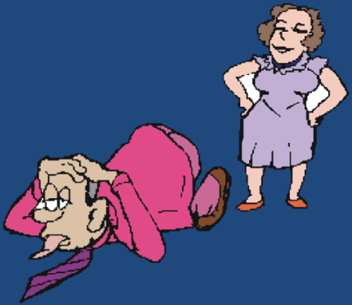
When a wife does not have a meek and quiet spirit – I Peter 3:1-4
When a wife argues with her husband in public – I Peter 3:1-4
When a wife does not reverence her husband – Eph. 5:33
When a wife does not respect and follow her husband’s decisions and leadership – Col. 3:18
Her husband becomes defensive.
Her husband is embarrassed and is attracted to women who do give him respect.
Her husband’s self worth (manliness) is greatly damaged.
Her husband stops communication with her.

Slide 7
When a wife looks to others for counsel – I Cor. 14:34-35
When a wife neglects personal neatness in appearance – Prov. 31:22
When a wife is not a good house keeper – I Tim. 5:14
When a wife is not respected by others – Prov. 31:23, 31
When a wife is unhappy – I John 1:4
Her husband becomes bitter toward her and her counselors.
Her husband feels unloved and unimportant to her.
Her husband looses respect for her.
Her husband feels that he is not respected by others.
Her husband feels unable to meet her needs and stops trying.

Slide 8
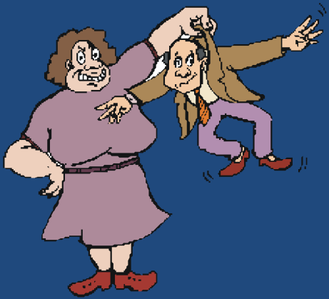
Why Wives React to their Husbands

Slide 9
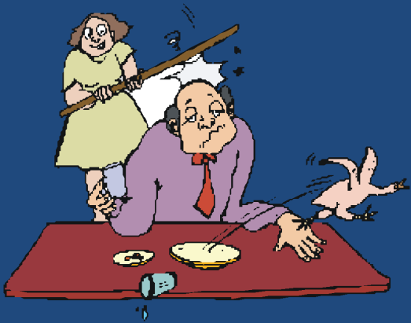
Cause
Effect
When a husband fails to be a spiritual leader – I Cor. 11:3
When a husband allows problems to continue and even get worse – Eccl. 10:1
When a husband does not support his wife in the disciplining of the children – Col. 3:15-20
His wife feels insecure.
His wife feels helpless and finally takes matters into her own hands.
His wife blames him for rebellious children.

Slide 10
When a husband spends extra money on things which he enjoys – Matt. 6:10-21
When a husband does not accept himself – Eph. 5:29
When a husband praises and admires other women – Prov. 5-7
When a husband verbalizes love only when he wants physical relationships – I Cor. 7:1-5
His wife resents the financial pressure under which they must live.
His wife feels the same rejection from him.
His wife feels inferior and jealous.
His wife feels degraded and used and finds it hard to love him.

Slide 11
When a husband forgets anniversaries and other special occasions – Heb. 13:16
When a husband does not praise his wife for specific things – Prov. 31:28
When a husband does not spend time talking with his wife – I Peter 3:7
When a husband fails to notice the little extra things his wife does for him – I Thess. 5:18
His wife feels that she is unimportant and not cherished by him.
His wife feels frustrated in knowing how to please him.
His wife finds others who will listen to her feelings.
His wife loses her creativity for their home and looks for outside interests.

Slide 12


When a husband makes bad judgments and unwise business decisions – Rom. 12:14
When a husband is not alert to the dangers which his wife faces – John 10:1-11
When a husband neglects needed home repairs – Prov. 24:30-31
His wife resists his will in future decisions.
His wife feels unprotected.
His wife builds up resentment and impatience.

