Slide 1
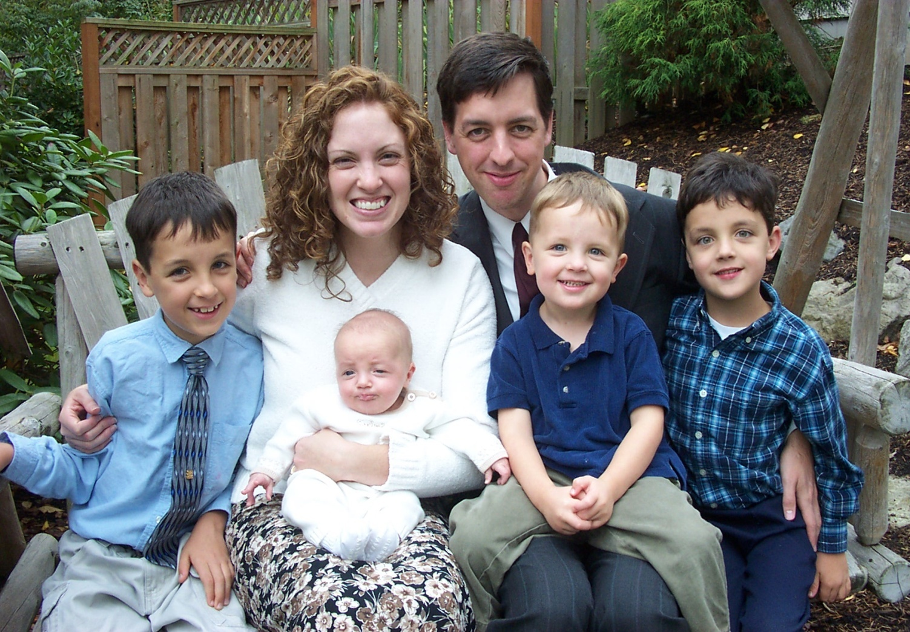
Motherhood
“A Divine Calling of God”
(Genesis 1:27-28)

Slide 2
Being a wife and mother is a high calling – I Timothy 5:14-15
Being a wife and mother is exalted through out Scriptures – Proverbs 31:10-31
Being a wife and mother is a great privilege – Matthew 15:4
Being a wife and mother is a great honor – Psalms 127-128

Slide 3

Strong Biblical Warnings
“There is a generation the curses their father and doth not bless their mother…”
“He that smites his father, or his mother, shall surely be put to death…”
“He that curses his father or his mother shall surely be put to death…”
“Whoso curses his father or his mother, his lamp shall be put out in obscure darkness…”
“The eye that mocks at his father, and despises to obey his mother, the ravens of the valley shall pluck it out, and the young eagles shall eat it…”

Slide 4
A Foolish Son or Daughter Refuses to Honor their Mother
Honor your mother by respecting her – “Despise not thy mother…”
Honor your mother by listening to her counsel and instruction – Proverbs 6:20-24
Honor your mother by obeying her – “Children obey your parents in the Lord for this is right…”
Honor your mother by expressing love and appreciation for her – “Her children shall rise up and call her blessed…”

Slide 5
The Ministry of a Mother
“Take heed to the ministry which thou hast received in the Lord and fulfill it.”
Ministry of child bearing – “She shall be saved through child bearing…”
Ministry of child training – “Train up a child…”
Ministry of serving – “By love serve one another…”
Ministry of love – “Love your children…”

Slide 6

Ministry of prayer – “Be careful for nothing, but in every thing by prayer and supplication with thanksgiving let your request be made known unto God.”
Ministry of being an example/influence – “As a mother, so is the daughter…”
Note: Example of a spirit filled life (Ephesians 5:18-21)
Joyfulness – vs. 19
Gratefulness – vs. 20
Submission – vs. 21

Slide 7

Ministry of guarding the home – “Keepers at home” (protect, defend, shield, to ward off attacks, to keep from harm or danger, watchman)
Ministry of guiding the home – “Guide the house…” (preside over, manage – “She looks well to the ways of her household…”
The ministry of building lives -
Proverbs 9:1
Proverbs 14:1
Proverbs 24:3

Slide 8

Seven Ways to Destroy your Home
(Proverbs 6:16-19)
Pride vs. Humility – “Pride goeth before destruction…”
Lying vs. Truth – “Speaking the truth in love…”
Death vs. Life – “Hands that shed innocent blood…” / “Be fruitful…”
Immorality vs. Holiness – “Heart that deviseth wicked imaginations…”
Mischief vs. Serving, helping, being a blessing – “If you want to be great in God’s Kingdom, learn to be the servant of all…”
Gossip (slander, backbiting, tattlers, busy bodies) vs. Edification – “Let all things be done unto edification…Let your speech always be with grace…”
Division vs. Unity – “How good and plesant it is for brethren to dwell together in unity…”

Slide 9


Seven Ways to Build Your Home
“Seven Pillars” (Proverbs 9:1)
James 3:13-18
Purity / Morality
Peace
Gentleness - “Easy to be entreated…” (willing to yield)
Mercy
No partiality
No hypocrisy
Righteousness

Slide 10

“He will regard the prayer of the destitute, and not despise their prayer.”
Psalms 102:17

