Slide 1
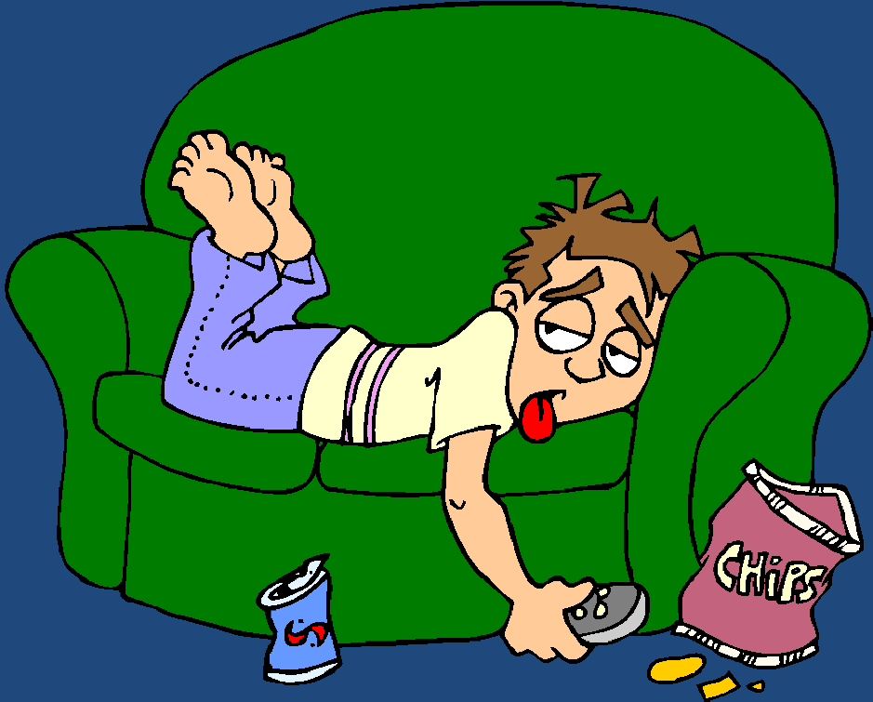
How Raise a Rebellious, Spoiled,
Lazy, Irresponsible, Immoral,
Good for Nothing, Brat!
“Ye are the salt of the earth: but if the salt have lost his savour, wherewith shall it be salted? it is thenceforth good for nothing, but to be cast out, and to be trodden under foot of men.”
(Matt. 5:13)

Slide 2



Never spank them as a child.
Make sure you give into their whining.
Give them whatever they want.
Make lots of idle threats, tell them 3 or 4 times to do something before making them obey.
Yell and scream a lot but don’t follow through on discipline.
Be inconsistent in your discipline.
Pamper them.
Be their friend not their parent.

Slide 3



Always stick up for them, especially against their authorities.
Blame others for their misbehavior.
Let them manipulate you to get what they want.
Let them throw temper tantrums.
Don’t hold them accountable.
Don’t teach them personal responsibility.
Never make the pay restitution.
Don’t make the fix or pay for things
they have broken.

Slide 4



Don’t make them work for the things they want.
Don’t teach them the value of hard work.
Never make them do chores.
Don’t make them clean up after themselves.
Don’t make them apply themselves in school.
Make sure they dress in all the latest styles.
Let them dress immodestly.
Make sure they have a cell phone.
Give them a computer, TV and stereo.
Allow them to have unlimited internet access.

Slide 5


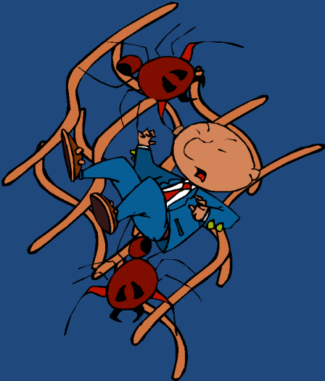

Slide 6

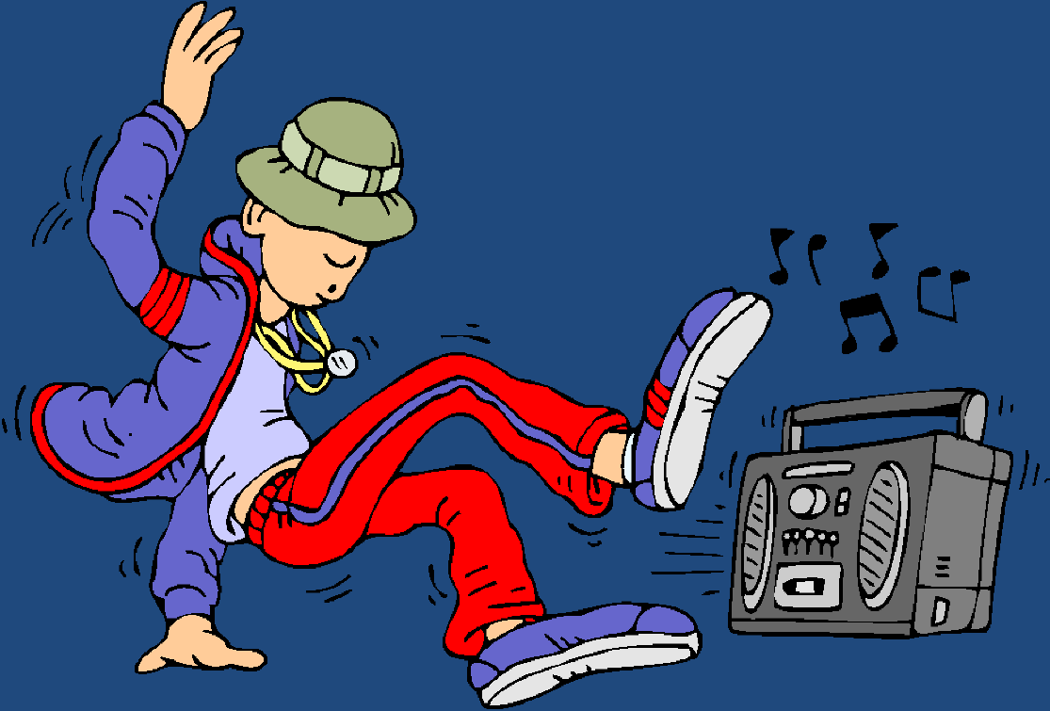

Allow them to listen to whatever music they want.
Don’t oversee what they watch on TV.
Let them watch whatever DVD’s the want.
Get them lots of video games.
Don’t sensor their reading material.
Allow them to go to movies.
Allow them to go to dances.
Allow them to hang out with unsaved and carnal friends.
Teach them that social drinking is ok.
Never read their e-mails.
Let them correspond with their friends on face book and my space.
Make sure they get a humanistic education.
Allow them to have exposure to the occult.

Slide 7
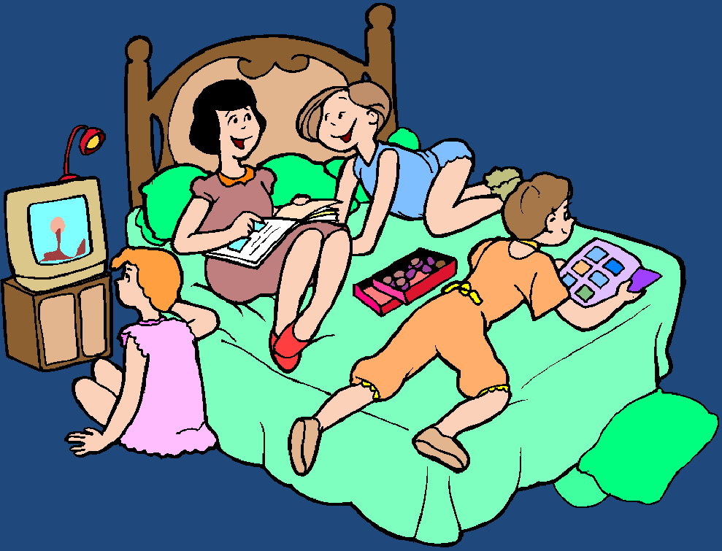

Excuse and support their disobedience to God.
Allow them to go to sleepovers.
Encourage them to date around.
Allow them to chose if they want to go to church or not.
Don’t make them have personal devotions.
Don’t talk about spiritual things or disciple them.
Don’t give them instruction from God’s Word.
Don’t instill in them Biblical convictions.
Have a materialistic view of life.
Make sure to criticize your pastor, his teachings, convictions and standards.
Don’t attend church faithfully.

Slide 8

Don’t become involved in your local church.
Don’t attend special meetings -
Bible conference
Mission conference
Revival meetings
Seminars
Never allow them see you humble yourself and walk the aisle.
Gossip about your brothers and sisters in Christ.
Criticize those who have Biblical convictions.
Don’t allow your children to be involved in the youth group.
Live a hypocritical life.

Slide 9





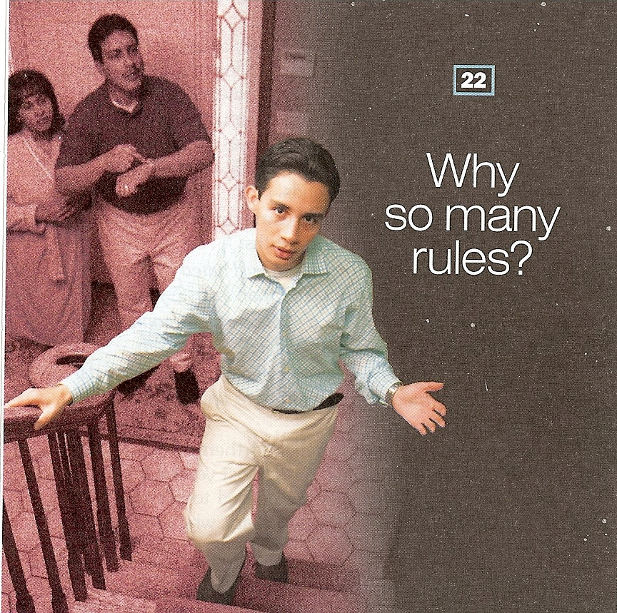
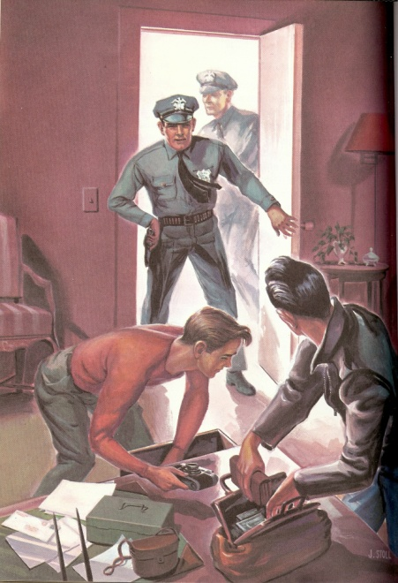






Slide 10
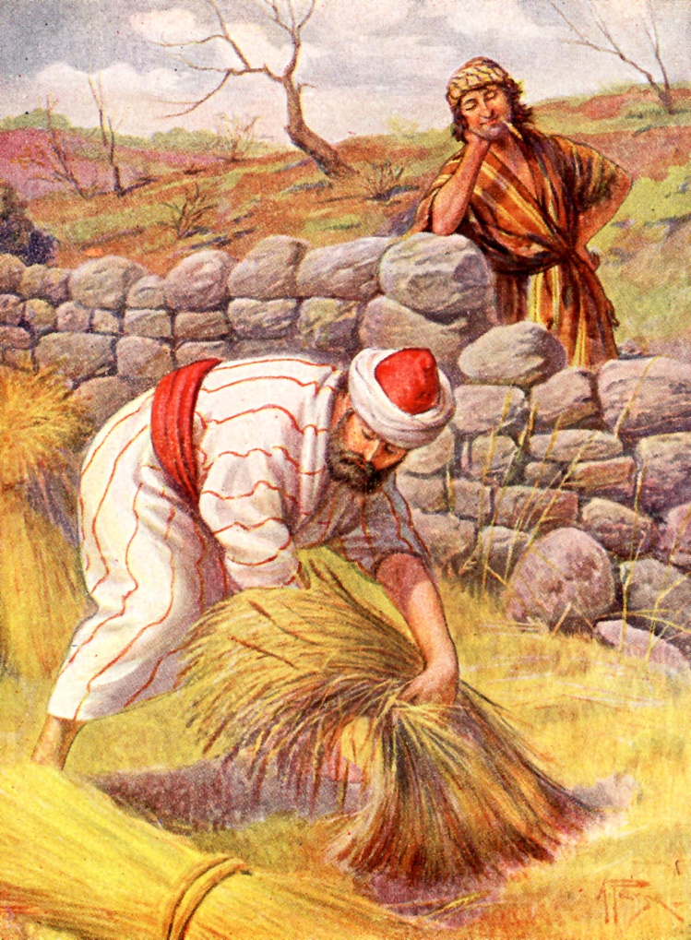
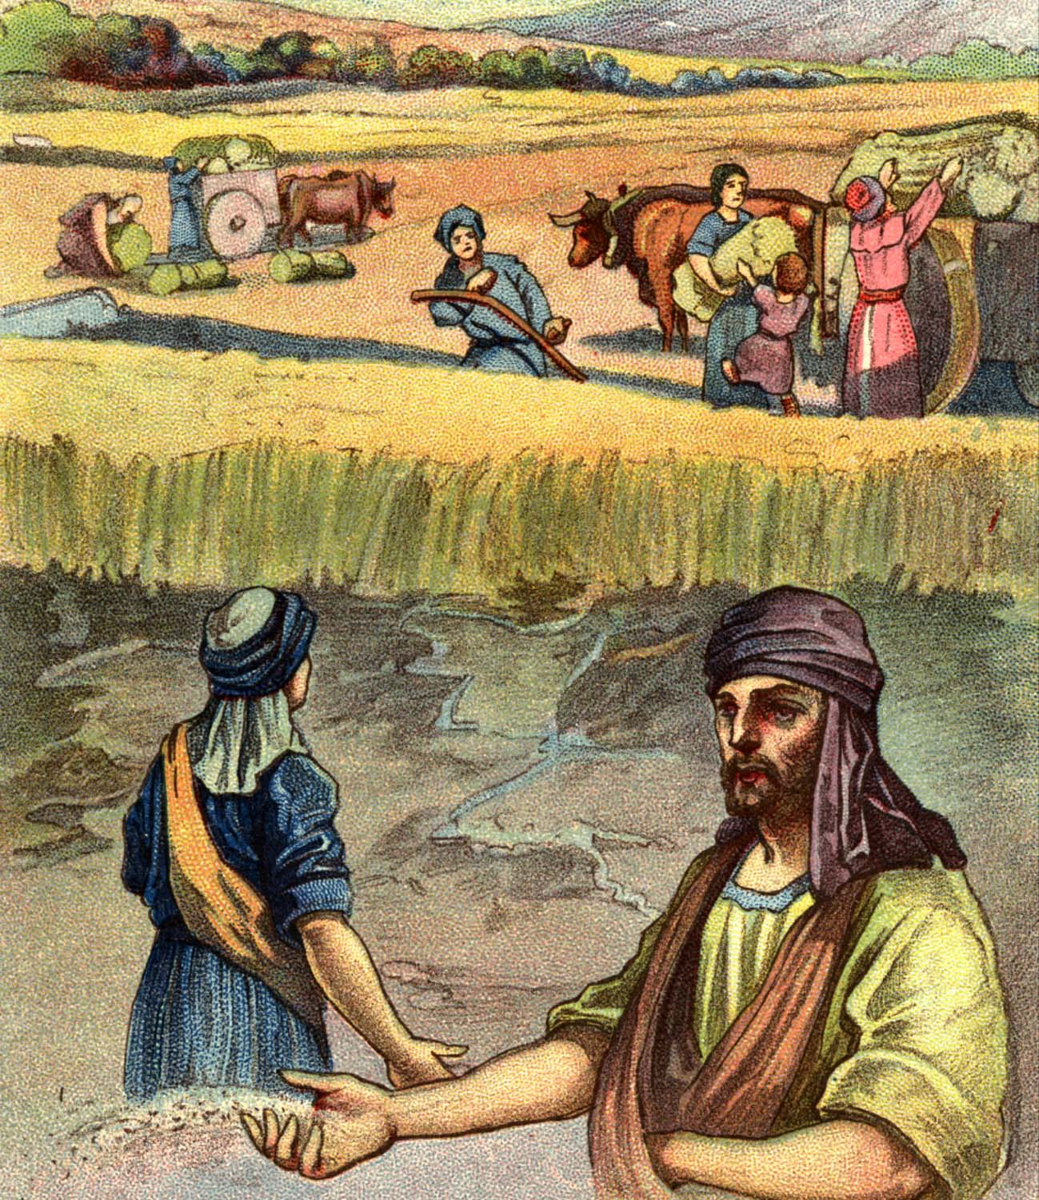
“Be not deceived; God is not mocked: for whatsoever a man soweth, that shall he also reap.”

Slide 11
Cause
Effect
When parents do not fulfill promises - Matthew 5:37
When parents do not admit they are wrong - James 5:6
When parents refuses to ask forgiveness - James 4:6-10
When parents are to strict in discipline - Galatians 6:1-2
Children get wounded spirits and fail to trust them
Children lose confidence in their leadership
Children react to their pride
Children have their spirits broken

Slide 12
When parents give too much freedom to their children - Proverbs 29:15
When parents neglect their parents - I Timothy 5:1-8
When parents put their parents in a nursing home for sake of convenience - I Timothy 5:8-14
When parents do not love one another - Ephesians 5:22-23
Children see freedom as a form of rejection
Children do not honor the counsel of their parents
Children are taught to disrespect their parents
Children take up offenses for their parents

Slide 13
When parents neglect God's Word –
II Timothy 2:15
When parents sacrifice their family for money or better retirement - Luke 12:13-34
When parents discipline in anger -
Ecclesiastes 7:9
When parents delegate their children's education to others -
Ephesians 6:3-4
Children reject the authority of God and the Bible
Children develop a temporal value system
Children have seeds of bitterness
His children cease to respect them as their teachers

Slide 14
When parents do not teach their children how to please them - Colossians 3:21
When parents focus on the outward beauty of themselves and others - Proverbs 5 - 7
When parents are impatient, displeased, and angry with their children - Galatians 5:22-23
When parents have inconsistent standards / double standards -Ephesians 4:14
Children feel frustrated, rejected, and stop trying to please their parents
Children feel inferior, rejected, and develop low self-worth
Children seek approval from friends
Children despise them

Slide 15
When parents try to warn his children only of the consequences of sin - Proverbs 1:8-33
When a father lets his wife assume spiritual leadership - I Corinthians 11:1-15
When parents do not have personal convictions - I Timothy 3; Titus 1
Children are challenged to be successful in avoiding the consequences
Children may regard religion as childish when they grow older
Children accept situational ethics and excuse in excess what their father allowed in moderation

Slide 16
“The eye that mocketh at his father, and despiseth to obey his mother, the ravens of the valley shall pick it out, and the young eagles shall eat it.” Prov. 30:17
“A foolish son is a grief to his father, and bitterness to her that bare him.” Prov. 17:25
“The rod and reproof give wisdom: but a child left to himself bringeth his mother to shame.”
Prov 29:15
“Whoso curseth his father or his mother, his lamp shall be put out in obscure darkness.”
Prov. 20:20
“He that gathereth in summer is a wise son: but he that sleepeth in harvest is a son that causeth shame.” Prov. 10:5
“He that wasteth his father, and chaseth away his mother, is a son that causeth shame, and bringeth reproach.” Prov. 19:26

Slide 17







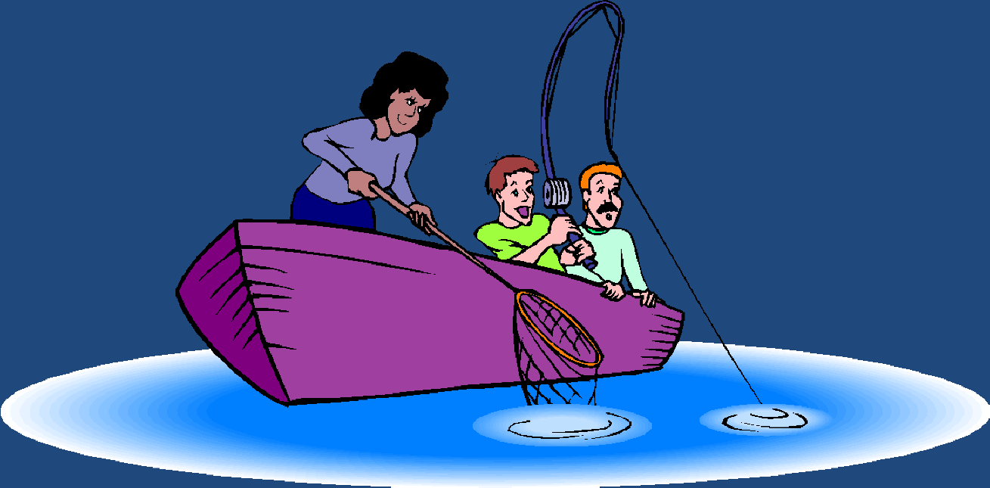
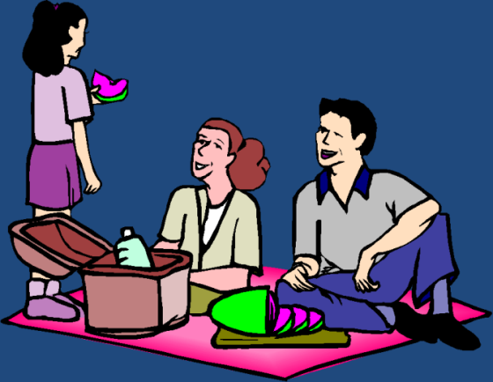
“Thy father and thy mother shall be glad, and she that bare thee shall rejoice.”

