Slide 1
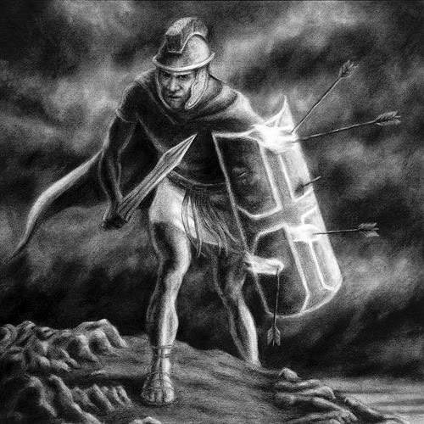
Spiritual Warfare

Slide 2
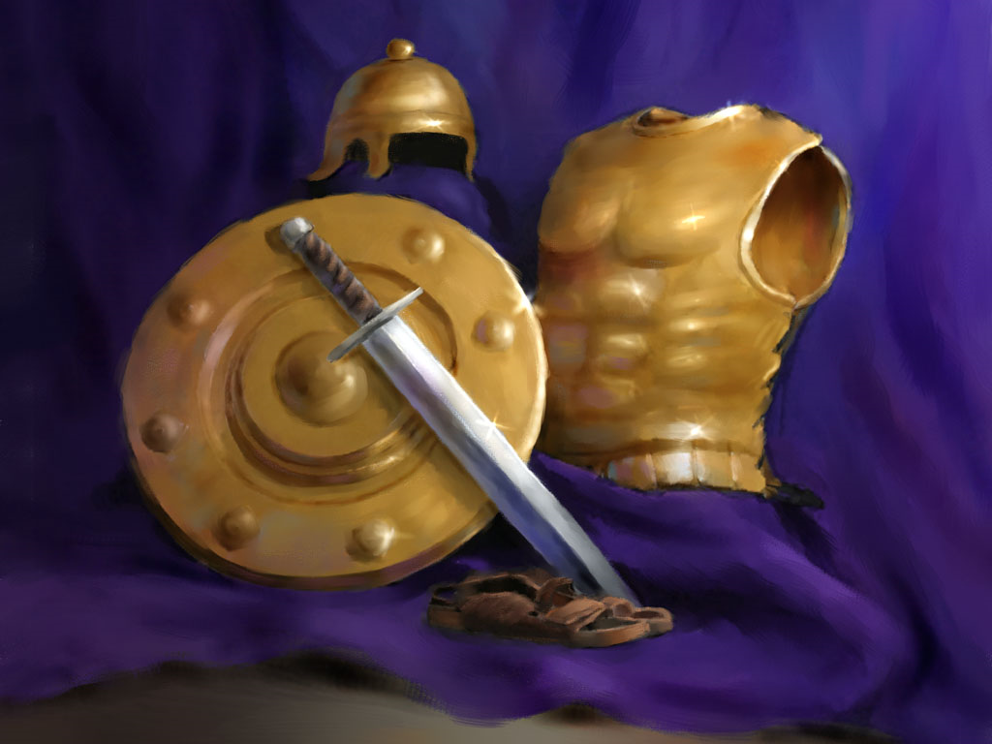

Slide 3
* Warfare (strateia) - To carry on hostilities; to engage in battle; to contend, to strive; to be in a state of hostile contention - II Corinthians 10:3-10; I Timothy 1:18; II Timothy 2:1-3
* Fight (agonizomai) - To gain control through struggle; to attempt to defeat; subdue or destroy in order to gain victory - I Corinthians 9:26; I Timothy 6:12; II Timothy 4:7
* Wrestle (pale) - To struggle in hand to hand combat with an opponent in an attempt to throw or force him to the ground - Ephesians 6:10-18

Slide 4
* Strive (sunathleo) - To make great effort to do ones best; strenuous exertion; earnest effort - I Corinthians 9:24-25
* Soldier (stratiotes) - One engaged in military service; one who fights for a specified cause - II Timothy 2:3-4
* Contend (epagonizomai) - To hold firm to the truth; to strive in debate - Jude 3-9
II Corinthians 2:11 “Lest Satan should get an advantage of us: for we are not ignorant of his devices.”

Slide 5
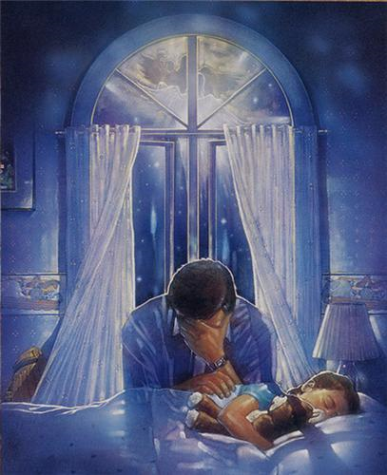

Slide 6


Slide 7


Slide 8

Seven Enemies of the Soul
Sensual Material
Alcohol
Computer Games
Carnal Music
Movies / DVD’s
Friends
Dating

Slide 9


Consequences when you read or view sensual material

Slide 10
You experience guilt by violating the moral laws that God wrote in your heart - Romans 2:15
You sow seeds of destruction to your flesh - Galatians 6:7
You promote the goal of humanism, which is to enjoy whatever pleasure lust suggests - Ephesians 5:6
You promote prostitution by engaging in lewdness for hire - II Peter 2:14
You dull your spiritual senses and grieve the Holy Spirit - Galatians 5:17
You damage your marriage by committing mental adultery - Matthew 5:28

Slide 11
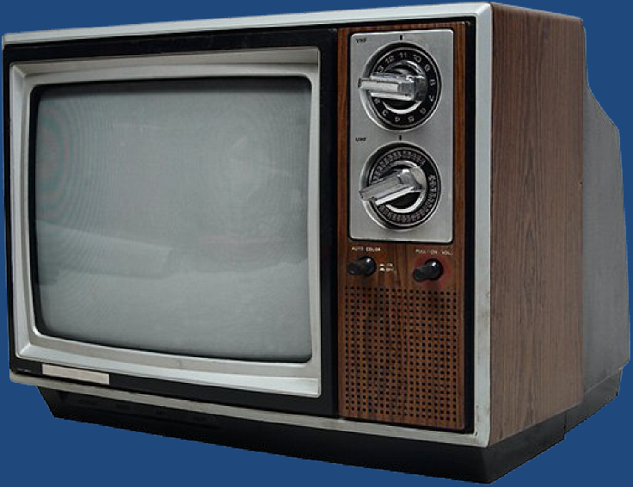




CONSEQUENCES WHEN YOU WATCH WORLDLY TELEVISION, MOVIES AND DVD’S

Slide 12
You establish the practice of tolerating evil in order to enjoy some good - Proverbs 8:13
You lower your resistance to evil - Proverbs 4:23
You have constant access to the world’s philosophy and false concepts - Colossians 2:8
You deaden your conscience and lose your love for the Lord - Matthew 24:12
You expose yourself to evil people who should not even be in our home - Proverbs 13:20; 14:7
You allow one of your most precious resources to be devoured (Time) - Psalms 90:12; Ephesians 5:17
You make yourself an enemy of God - James 4:4

Slide 13

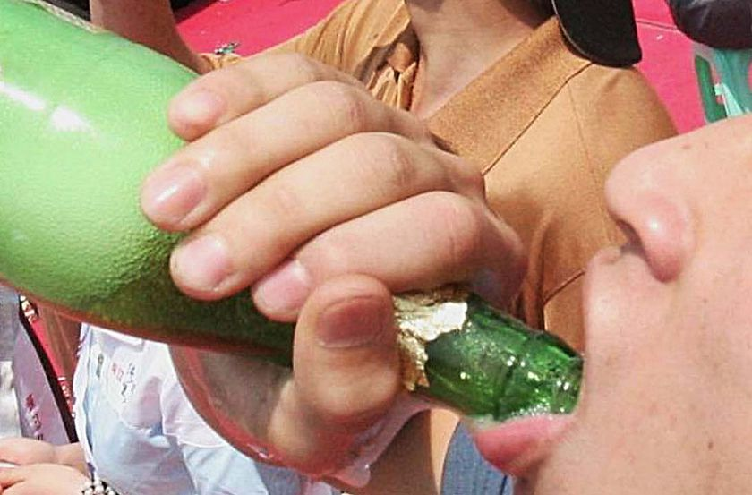


Consequences when you
consume alcohol

Slide 14
You bring destruction upon yourself - Proverbs 23:31-32
You lower vital inhibitions against evil - Proverbs 23:33
You expose yourself to the bondage of addiction - Habakkuk 2:15
You cause weaker Christians to stumble - Romans 14:21
You endanger the lives of your children - Ephesians 6:1-3
NOTE: What parents allow in moderation, their children excuse in excess.
You condemn yourself - Romans 14:22-23

Slide 15

75 Biblical Warnings

Slide 16
1. Genesis 9:20-26
2. Genesis 19:30-38
3. Genesis 27:25
4. Leviticus 10:9
5. Numbers 6:3
6. Deuteronomy 21:20
7. Deuteronomy 29:2-6
8. Judges 13:4, 7, 14
9. I Samuel 1:14-15
10. I Samuel 25:32-38
11. II Samuel 11:13
12. II Samuel 13:28-29
13. I Kings 16:8-10
14. I Kings 20:12-21
15. Esther 1:5-12
16. Job 1:18-19
17. Proverbs 4:17
18. Proverbs 20:1
19. Proverbs 21:17
20. Proverbs 23:21
21. Proverbs 23:29-30
22. Proverbs 23:31
23. Proverbs 23:32
24. Proverbs 23:33

Slide 17
25. Proverbs 23:33
26. Proverbs 23:34
27. Proverbs 23:35
28. Proverbs 23:35
Proverbs 31:4-5
Proverbs 31:6-7
31. Ecclesiastes 2:3
32. Ecclesiastes 10:17
33. Isaiah 5:11-12
34. Isaiah 5:22
35. Isaiah 22:13
36. Isaiah 24:9
37. Isaiah 28:1
38. Isaiah 28:3
39. Isaiah 28:7
40. Isaiah 28:7
41. Isaiah 28:7
42. Isaiah 28:7
43. Isaiah 56:9-12
44. Jeremiah 35:5,6,8,14
45. Ezekiel 44:21
46. Daniel 1:5, 8, 16; 10:3
47. Daniel 5:1
48. Daniel 5:2, 23
49. Daniel 5:3
50. Daniel 5:5-9, 25-28

Slide 18
51. Hosea 3:1
52. Hosea 4:11
53. Hosea 7:5
54. Joel 1:5
Joel 3:356.
Amos 2:8
57. Amos 2:12
58. Amos 4:1
59. Amos 6:6
60. Nahum 1:10
61. Habakkuk 2:5
62. Habakkuk 2:15
63. Habakkuk 2:16
64. Matthew 24:48-51
65. Luke 1:15
66. Luke 12:45
67. Luke 21:34
68. Romans 13:13
69. Romans 14:21
70. I Corinthians 6:10
71. I Corinthians 11:25
72. Galatians 5:12
73. Ephesians 5:18
74. I Thessalonians 5:7
75. I Timothy 3:3, 8, 11, 12

Slide 19







Slide 20




Consequences of having
carnal friends

Slide 21
You will be corrupted by their evil character - I Corinthians 15:33
You will develop their carnal ways of thinking - Philippians 3:15-19
You will follow their example - Proverbs 1:10-19
Your heart will be turned away from your parents - Proverbs 27:10
Your heart will be turned away from the Lord - I Kings 11:1-2
You will violate God’s principle of separation - II Corinthians 6:14-7:1
You will bring upon yourself God’s judgment - Proverbs 1:10,14, 25-33

Slide 22

The Danger of
Cell Phones

Slide 23






Slide 24
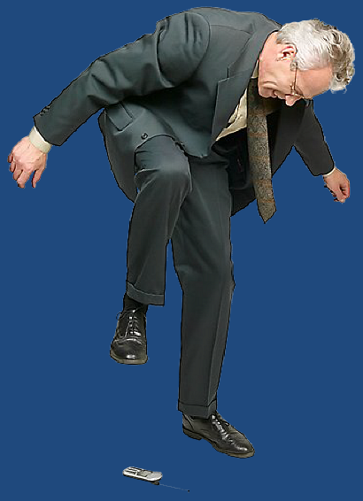

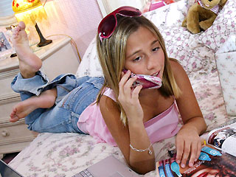
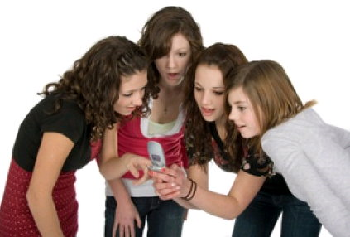



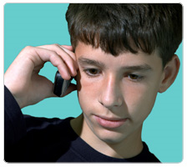
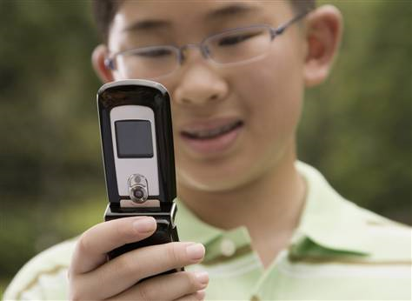

Slide 25

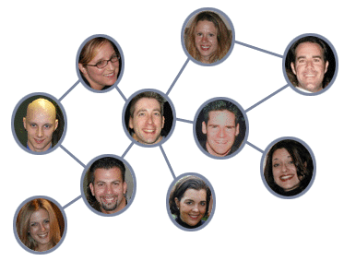
Danger of Social Networking

Slide 26



Face book
My space
Twitter

Slide 27

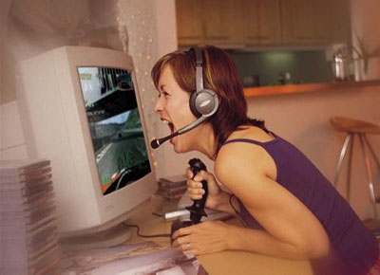


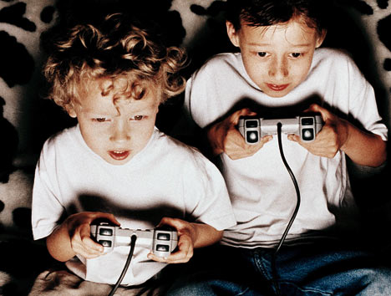
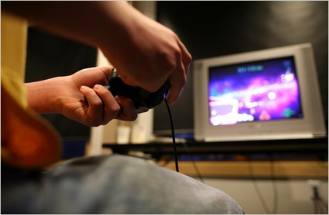
CONSEQUENCE OF PLAYING EVIL COMPUTER GAMES

Slide 28
You waste valuable time (unproductive) – Colossians 4:5
You become addicted – I Corinthians 6:12
You damage relationships – Ephesians 5:21-33
You develop a worldly philosophy of life – Colossians 2:8
You lose interest in spiritual and eternal things – II Corinthians 4:8
You expose yourself to Satan’s power and control – Ephesians 4:27
You run the risk of being destroyed by Satan – I Peter 5:8
You are used to influence others entangling them in Satan’s snare – II Peter 2:20

Slide 29





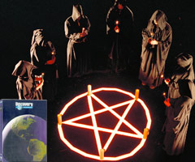


Slide 30



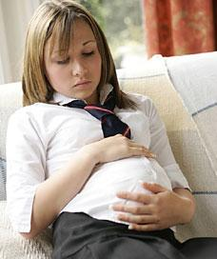

CONSEQUENCE OF DATING

Slide 31

Pressure to be normal – Daniel 1:8
Normal = Worldly (I Corinthians 3:1-3)
Normal = Sensual (being romantically attached – Proverbs 2, 5-7)
Repeated romantic attachments–James 1:13-16

Slide 32
The Characteristics of Dating
(Proverbs 2, 5-7)
Pursuing
Wooing
Time alone
Romance
Intimacy
Physical
involvement
Fornication
Guilt
Breaking up
Getting hurt
Bondage (sexual)
Anger
Bitterness
Emotional scars
Damaged testimony
Damaged relationships
Marriage conflicts

Slide 33


Flirting – James 4:1-6
Defrauding – I Thessalonians 4:1-8
Sensuality = (Jude 19)
Words – Proverbs 2:16, 5:3
Look (eyes) – Proverbs 6:25
Body language – Proverbs 7:10-12
Dress – Proverbs 7:10
Touching – I Corinthians 7:1-2
Kissing – Proverbs 7:13
Sexual immorality – I Corinthians 6:18-20

Slide 34


Dating distracts a young person from fully giving their heart to the Lord – Matthew 22:37-40
Courtship directs a young person into God’s perfect will for their lives – John 4:34, 5:30, 6:38

Slide 35
Preparation for Courtship
1. Must be old enough – I Corinthians 14:11
2. Must be mature enough – I Kings 2:2
3. Must be spiritually minded enough – Romans 8:6
4. Must be under authority - I Peter 5:5
5. Must be financially stable enough to provide for a family –
“If any provide not for his own…he hath denied the faith and is worse than an infidel…Prepare thy work without, and make it fit for thyself in the field; and afterwards build thine house.”

Slide 36


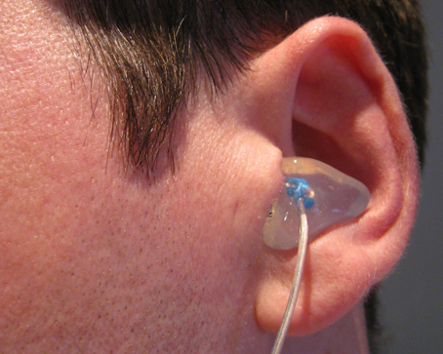
CONSEQUENCE OF LISTENING TO CARNAL MUSIC

Slide 37
It does not glorify God – I Corinthians 10:31
Contains words that are contrary to that which is decent and scripturally right – Ephesians 4:22-29
The rhythm, background beat, breathy sliding pitches and syncopation appeal to your lower impulses and excite the flesh – Romans 13:14
Violates the principle of not mixing light with darkness – II Corinthians 6:14-7:1
It’s addictive – I Corinthians 6:12
Hardens your heart toward the things of the Lord – Hebrews 3:8
Produces rebellion and sensuality – James 3:15-17

Slide 38
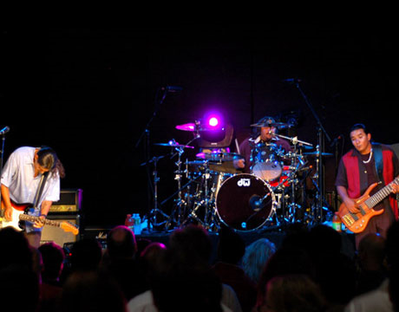
Drugs / Alcohol
Rebellion
Rock Music
Immorality

Slide 39
Seven Enemies of the Soul
Sensual Material
Alcohol
Computer Games
Carnal Music
Movies / DVD’s
Friends
Dating

