Slide 1
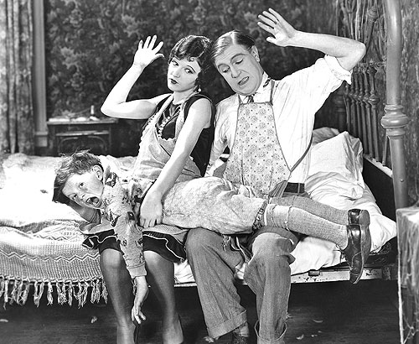
Training Children with the
Rod of Correction
How to use the Rod of
Correction Effectively

Slide 2
Disciplining Children
Using the rod is one of the most loving things you can do for your children – “He that spareth his rod hateth his son: but he that loveth him chasteneth him betimes.” - Prov. 13:24
Many believe that it is wrong to use the rod, but it is one of God’s methods of discipline – Heb. 12:6-7
It is sin not to use the rod in discipline – “Withhold not correction from the child: for if thou beatest him with the rod, he shall not die.” – Prov. 23:13

Slide 3
Proverbs 13:24 “He that spareth his rod hateth his son; but he that loveth him chasteneth him betimes.”
Proverbs 22:15 “Foolishness is bound in the heart of a child; but the rod of correction shall drive it far from him.”
Proverbs 23:13-14 “Withhold not correction from the child: for if you beatest him with the rod, he shall not die. Thou shalt beat him with the rod, and shalt deliver his soul from hell.”
Proverbs 26:3 “A whip for the horse, a bridle for the ass, and a rod for the fool’s back.”
Proverbs 29:15-17 “The rod and reproof give wisdom: but a child left to himself bringeth his mother shame. . . Correct thy son, and he shall give thee rest; yea, he shall give delight unto thy soul.”

Slide 4
ROD (Hebrew - shebet) =
Commonly denotes a rod, staff or scepter. It was used for beating cumin (Isaiah 28:27), as a weapon ( II Samuel 23:21), and as a shepherd’s implement either to muster or count sheep (Leviticus27:32; Ezekiel 20:37), or to protect them (Psalm 23:4; Micah 7:14).
The rod was also used as an instrument for either remedial or penal punishment. As a corrective instrument it was used for a slave (Exodus 21:20), a fool (Proverbs 10:13), and a son (Proverbs 13:24).

Slide 5
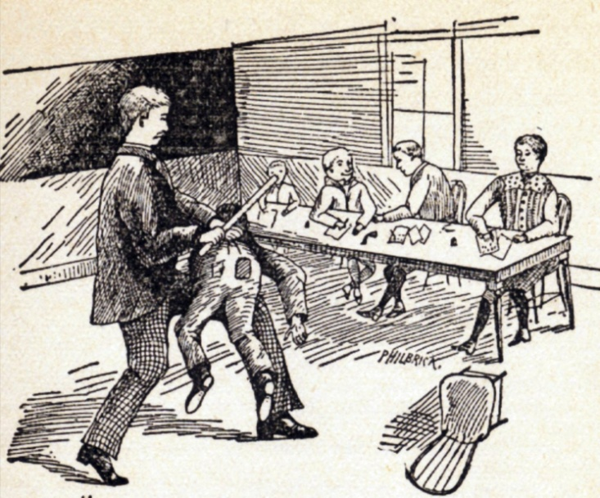
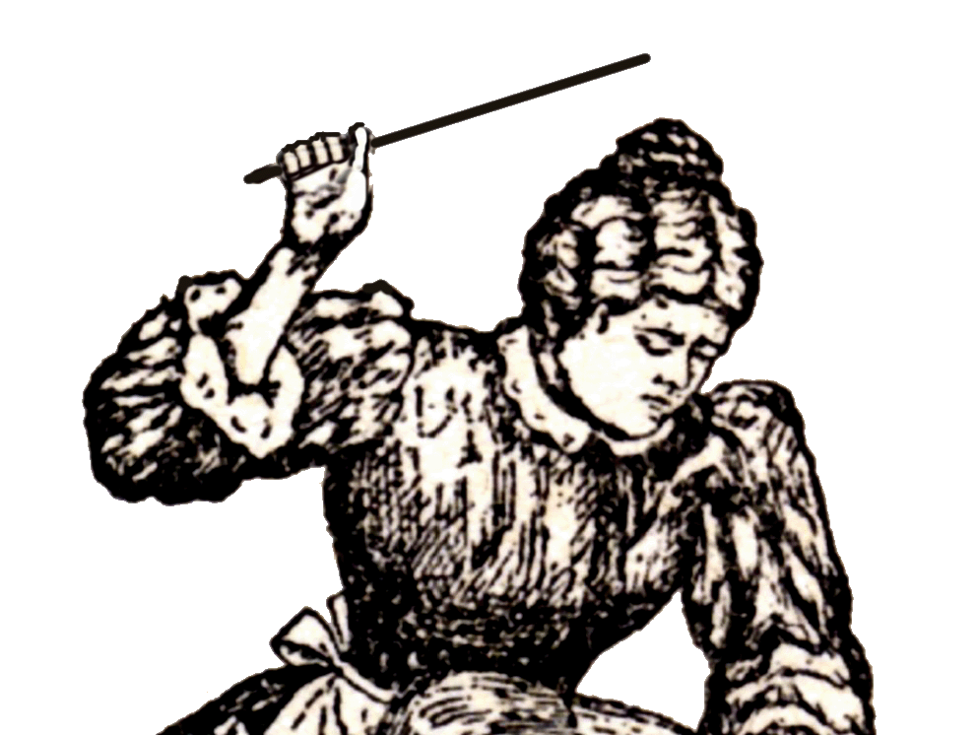
In Proverbs the rod is used as a “symbol” of discipline, and failure to use verbal rebuke and physical correction will end in the child’s death.

Slide 6
Proverbs 13:24 – Spare; Hateth; Loveth - chasteneth him betimes (often, diligently, over and over)
Proverbs 19:18 - While there is hope - spare not for his crying / Spank them while they are moldable
Proverbs 20:30 - Blueness (bruise) and stripes = cleanseth away evil
Proverbs 22:15 – Foolishness (out of control behavior) bound in the heart (can not get away) - The rod will drive it far from them and free them
Proverbs 23:13-14 - Withhold not / beat / will not die / save him from hell

Slide 7
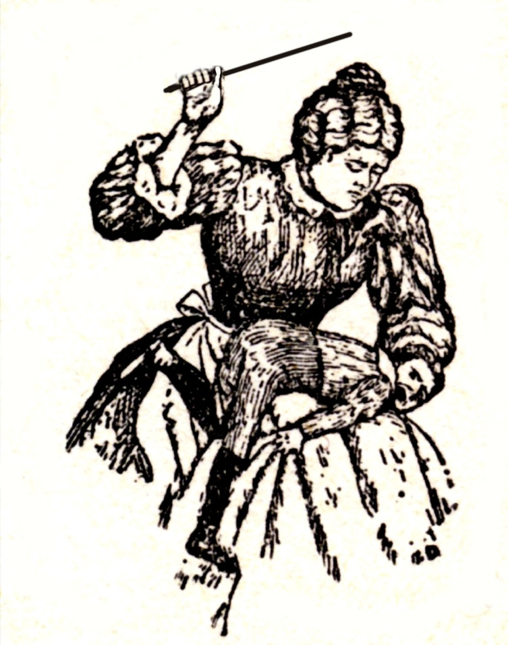
Man's part in salvation = Yielding his will to God
(Romans 3-6)
A child who has not had his will broken will most likely rebel
against God!

Slide 8
The rod can be used the wrong way - James 1:20
The rod must be used often (at early ages) - “He that spareth his rod hateth his son: but he that loveth him chasteneth him betimes.” - Prov. 13:24 “The rod and reproof give wisdom: but a child left to himself bringeth his mother to shame…Correct thy son, and he shall give thee rest; yea, he shall give delight unto thy soul.” - Prov. 29:15, 17

Slide 9
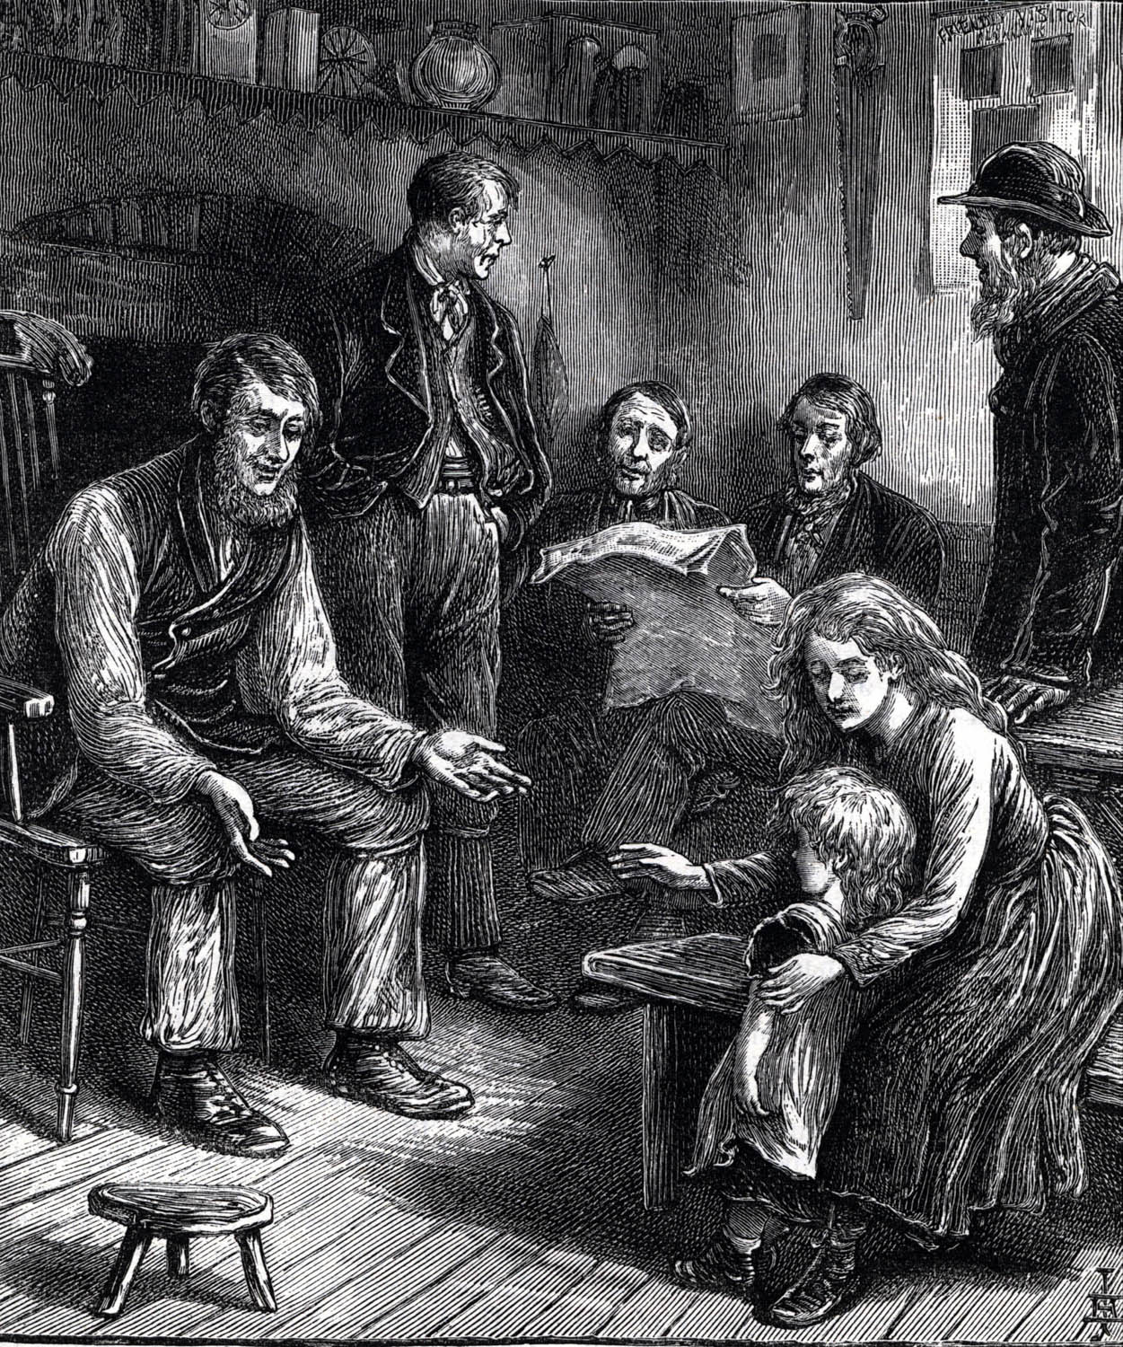
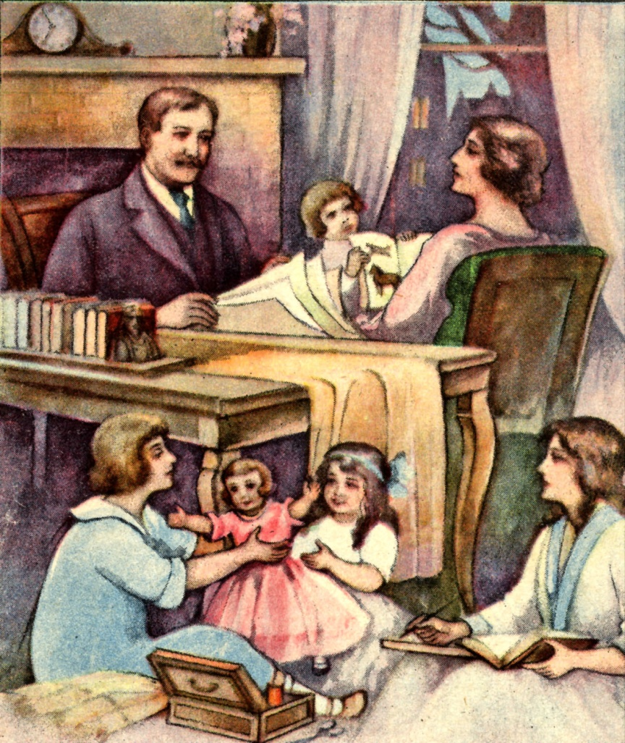
Children will Grow up to Honor Parents who uses the Rod in a Scriptural Way
(Eph. 6:1-4)

Slide 10
The Benefit of Using the Rod to Guide Your Children
Children will not like the spanking, but they will respond to the love afterwards - “Furthermore we have had fathers of our flesh which corrected us, and we gave them reverence.” - Heb. 12:9
Children will say thank you to parents who use the rod - Prov. 31:28
They will realize the rod is their friend - Prov. 3:11
They will realize that the rod is a positive form of discipline - Prov. 22:15

Slide 11
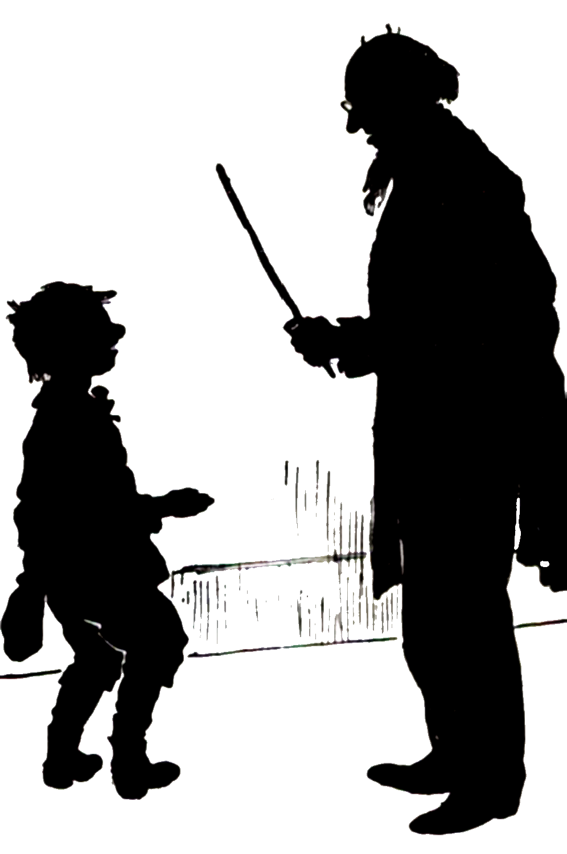
The rod of correction is a loving rod which when used properly will produce -
1. Order not confusion - I Cor. 14:33
2. Peace not turmoil - Heb. 12:11-14
Freedom not bondage - I Cor. 11:32
Zeal not apathy - Psalm 118:17-29
WHY CHRISTIAN PARENTS DO NOT USE THE ROD -
World's philosophy - Rom. 12:1-2; Col. 2:8
1. It’s cruel
2. It suppresses a child’s freedom of expression
3. It will produce bitterness and hatred
4. It will cause rebellion

Slide 12
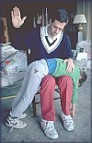
Note: Look at the result of the world's method of discipline - God's ways are not man's ways!
Time and effort are involved in proper discipline - Eph. 5:17
THE PROMISES OF GOD IF THE ROD OF CORRECTION IS USED PROPERLY -
A. Wisdom - Prov. 29:15
B. Drives away evil - Prov. 22:15
C. Expression of love - Prov. 13:24
D. Clear conscience - Produces bright / joyful countenance - Matt. 6:22-23

Slide 13
Keeps children from going to hell - Prov. 23:14
Calm and order - Prov. 22:15
G. Respond correctly to other authorities - Rom. 13
HOW TO USE THE ROD OF CORRECTION EFFECTIVELY -
Take time to Discipline - Eph. 5:17
1. Never spank in anger - Col. 3:8
2. Correct for future conduct - Heb. 12:11
3. Expect children to fail and look forward to times of discipline and instruction - Heb. 12:7
4. Know what you are going to do when discipline is needed - James 1:5

Slide 14
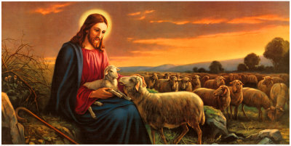
5. Spank your children the way God spanks you - Study The Book of Proverbs and Hebrews 12

Slide 15
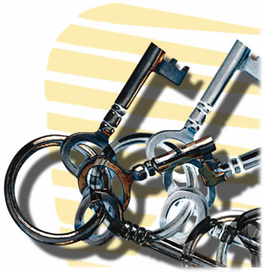
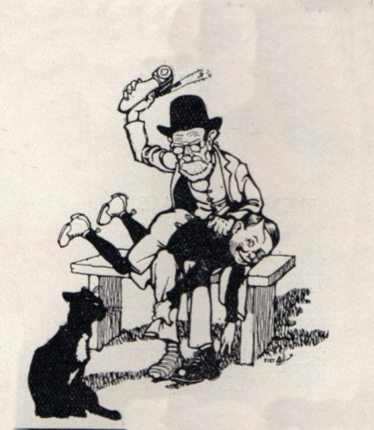
Proper method to use in discipline – This is the key!
Be consistent - Gal. 5:6-7
Calmly inform them that they have disobeyed.
Don’t raise your voice.
Never give repeated commands.
Go to a private room.
Love your children before disciplining them.
Have a time of instruction - Use the Bible
Explain why they are going to get a spanking (what have they done wrong)
Explain what they should have done - II Tim. 3:16-17

Slide 16
Do not spank them a certain number of swats - If you tell them the number they will hang on until it is over and the will, will not be broken.
Spank them so it hurts.
Spank them to produce a broken will (repentance).
Spank them to turn their heart to you - Luke 1:17
Make them lay still. . . if they do not, give them another spanking.
Praise your child – 10 parts praise / 1 part rebuke.
Pray with your child.
Have them ask for forgiveness.
Repeat (reinforce) instruction - Phil. 3:1; II Pet. 3:1

Slide 17
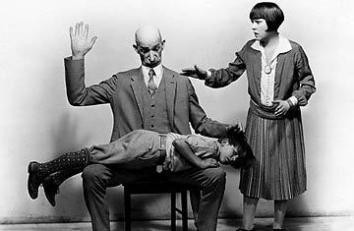
Wrong Methods of Discipline
To drive foolishness (out of control behavior) out of the heart of a child is not to:
Yell at it
Stand it in the corner
Talk nice to it
Give it reward
Slap it
Shake it
Only the rod of correction
will drive it far from him!

Slide 18
When the “Rod of Correction” is mentioned in Proverbs it usually refers to using it on a child - “Foolishness is bound in the heart of a child; but the rod of correction shall drive it far from him.”
Strong’s concordance = From the age of infancy to adolescence
NOTE: Only once is it used in reference to a son - “He that spareth his rod hateth his son: but he that loveth him chasteneth him betimes (often and early in life).”

Slide 19
If the “Rod of Correction” has been used effectively from childhood, by the time a son reaches manhood (Jewish culture 13 years of age) the use of the rod should no longer be necessary.
If a young person is going to act like child, perhaps they should also be treated like one. [see I Corinthians 13:11]
NOTE: Discipline at this time should come from the father - Eph. 6:4; Heb. 12:9

Slide 20
PRINCIPLES OF APPLICATION
Earn respect from your children.
Do not allow your children to back-talk.
Do not allow your children to negotiate their punishment.
Do not allow your children to argue with you.
Do not allow your children to pit parents against each other.
Parents must stick together, do not interfere when one is disciplining - If you disagree never allow your children to hear or see.

Slide 21
Teach your children to respect adults as the authority.
Do not allow your children to interrupt.
Give direct orders to children.
Do not allow your children to be slothful, lazy, or slow.
If you give any kind of command or order and your child says NO, discipline it immediately.
Do not put up with a nagging child, i.e. Daddy, Daddy, Daddy, Daddy
Discipline for abusing the house, their things, and the things of other people.

Slide 22
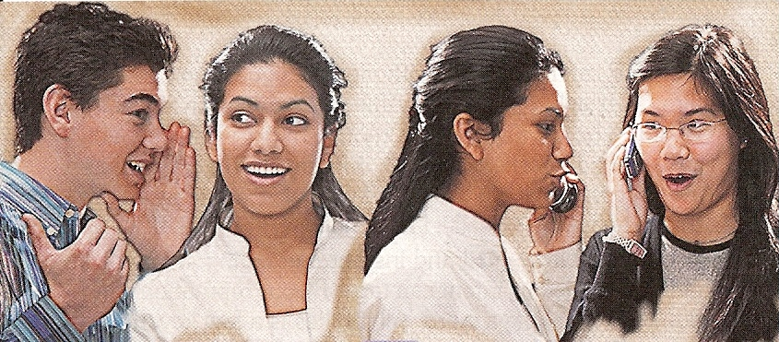

Discipline Teenagers
Teach them that there will be consequences for wrong decisions and actions – (Gal. 6:8)
Fathers need to be the main disciplinarian - “And, ye fathers, provoke not your children to wrath: but bring them up in the nurture and admonition of the Lord.” Eph. 6:4

Slide 23

Keep the heart of your child – Mal. 4:6
If you lose their heart find out when and why you lost it – Col. 3:19-21
Repent of losing their heart – “Repent, and turn yourselves from all your transgressions; so iniquity shall not be your ruin.” Ezek. 18:30
Humbly and sincerely seek forgiveness – Luke 1:17
Get their heart back - Prov. 23:26
Draw close to your child, do not reject them – Deut. 6:5-9

Slide 24
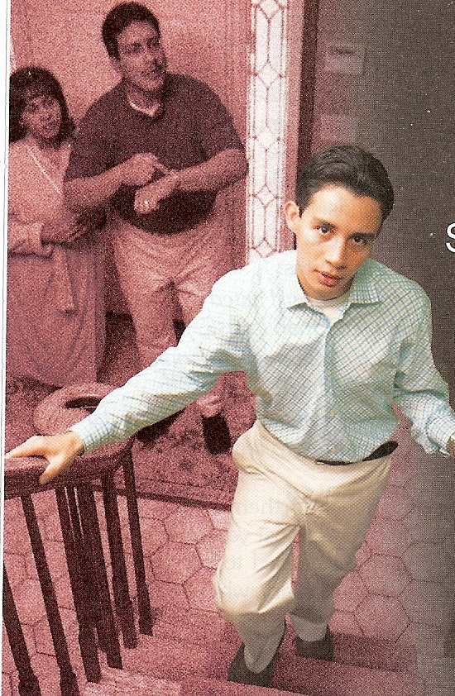
Teens need lots of love, praise and approval – I Peter 4:14
Failure to communicate love, praise and approval opens the door to Satan’s temptation to seek those things from peers – Prov. 1:10; Rom. 16:17-19
If you need to remove something bad, replace it with something good – II Tim. 2:22
If you need to separate them from negative influences, replace it with good positive influences – II Cor. 6:14-7:1

Slide 25

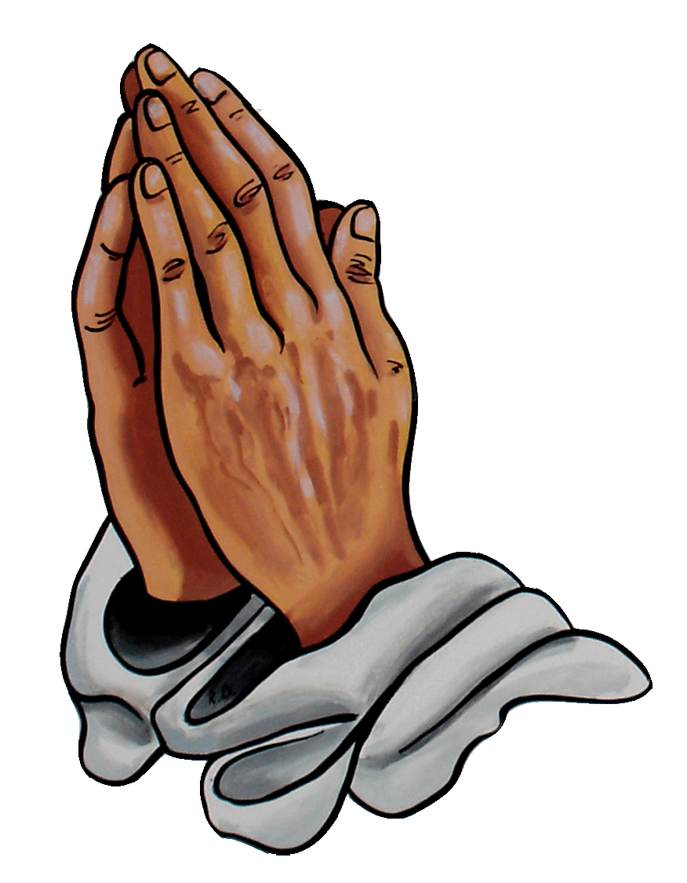
If you need to withdraw privileges, replace it with wholesome activity – I Tim. 6:11
Keep lines of communication open - Prov. 1:8
Teach them the principles of the Word of God - Prov. 19:27
Pray, pray, pray – James 5:16

