Slide 1

Sixteen necessary qualities for a successful marriage
“How to experience a oneness of spirit in your marriage”

Slide 2
“And Jesus knew their thoughts, and said unto them, Every kingdom divided against itself is brought to desolation; and every city or house divided against itself shall not stand.” Matt. 12:25
“Can two walk together, except they be agreed?” Amos 3:3

Slide 3
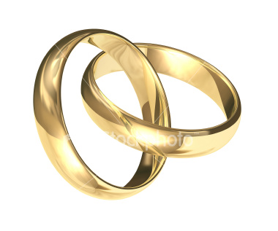
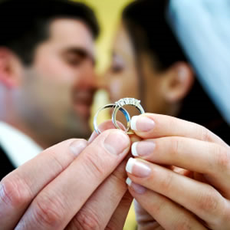
Commitment
(Romans 7:1-3)
Am I committed to stay married, regardless of my feelings or other circumstances, until separated by death?
Does my spouse know that I will never divorce them for any reason?
Next to my relationship with God, is my relationship with my spouse the highest priority in my life?
Do I faithfully pray for my spouse?

Slide 4

Serving
(Mark 10:44)
Do I put my spouses needs and desires ahead of my own?
Do I look for creative ways to please my spouse?
Am I content to serve, even when my spouse doesn’t seem to notice or appreciate my efforts?
Do I seek to help my spouse, especially when they are tried, sick or under pressure?

Slide 5
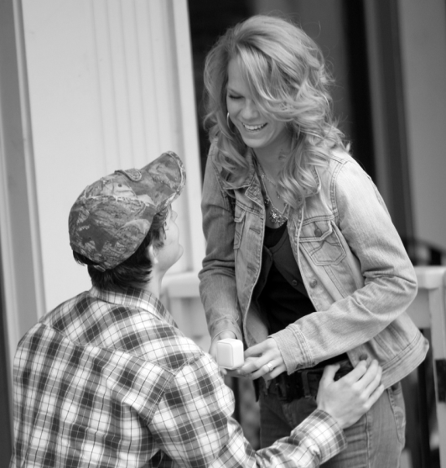
Yielding Rights
(Philippians 2:5-8)
Have I yielded all my expectations concerning my spouse to the Lord?
Do I trust God alone to meet all of my physical, emotional and spiritual needs?
Have I yielded to God my “right” to my own time, fulfillment of personal desires, possessions and independence?
How do I respond when I feel my rights have been violated (anger / impatience)?

Slide 6

Forgiveness
(Colossians 3:13)
Do I seek to resolve each conflict or misunderstanding as soon as possible?
Am I willing to “forgive and forget” past failures, and not hold it against them?
Am I quick to say – “I was wrong, will you please forgive me.”

Slide 7

Humility
(Philippians 2:3)
Do take the first step in reconciliation?
I am quick to admit my faults?
Am I content to not have the last word?
Am I willing to relinquish my right to be understood?
Do I always have to prove my point or be right in an argument?
Do I manipulate my spouse to get my own way?

Slide 8

Leadership (Husband)
(Ephesians 5:23)
Do I have a personal devotional life?
Do I have a prayer life?
I am I faithful in attending my Local Church?
Do I seek the Lord in decisions?
Am I a spiritual example to be followed?
Do I possess the qualities of a spiritual man?

Slide 9
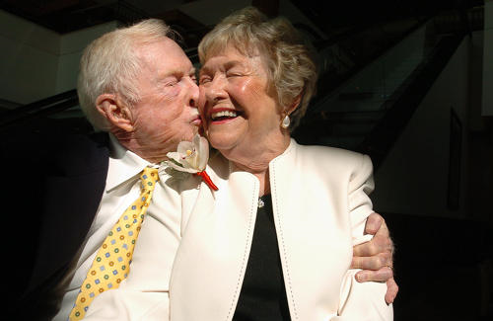
Submission (Wife)
(Ephesians 5:22-24)
Do I willingly yield to my husband’s authority in all things?
Do I communicate an attitude of submission, as well as submissive actions?
Do I seek my husband’s counsel?
Do I act independently of my husband?
Am I teaching our children and grandchildren, by my example and words, to honor and obey their father?

Slide 10

Patience
(I Corinthians 13:4)
Do I respond graciously to interruptions and irritations?
Am I willing to overlook imperfections in my spouse or do I express impatience and try to change them?
Do I take time to discuss various issues and decisions with my spouse?
Am I patience when my spouse is under emotional or physical pressure and stress?

Slide 11
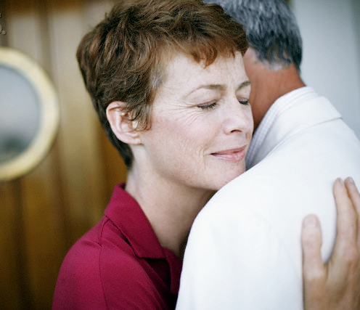
Sensitivity
(I Peter 3:7)
Do I sense when there is something wrong with my spouse?
Do I remember important days and special occasions?
Do I still court my spouse?
Before I speak, do I stop to think of how my words will affect my spouse?
I am sensitive to my spouses needs?

Slide 12

Communication
(Ephesians 4:25-29)
Is my spouse my closest confidant?
Do I always tell my spouse the truth?
Do I avoid sarcasm, hurtful remarks, public criticism or disagreement?
Do I regularly compliment my spouse?
Do I listen attentively when my spouse speaks to me?
Do I value my spouse’s opinion?
Do I avoid interrupting or contradicting my spouse?

Slide 13

Kindness
(Ephesians 4:32)
Do I treat my spouse as graciously as I would a guest?
Do I go out of my way to perform special acts of kindness for my spouse?
Am I well mannered at home and in public, or do I cause my spouse embracement?
Do I do unexpected things to show my spouse that I love them?

Slide 14

Moral Purity
(Ephesians 5:3-4)
Do I keep my mind free from books, magazines, internet, or entertainment that could stimulate fantasizing or thoughts that are not morally pure?
Wife – Do I dress modestly?
Husband – Do I look down and away when I see an immodestly dressed woman?
Do I avoid suggestive humor, conversation and behavior?

Slide 15

Gratitude
(Proverbs 31:10, 26-28)
Do I regularly express appreciation for my spouse?
Do I praise my spouse?
Do I regularly say thank you for _________?

Slide 16

Loyalty
(II Corinthians 13:7)
Do I speak well of my spouse to others?
Do I focus on my spouse’s successes and positive traits, rather than their weaknesses and failures?
Do I hold in confidence personal matters that my spouse shares with me?
Do I support my spouse even in times of personal failure?

Slide 17

Acceptance
(Romans 15:7)
Do I love, accept and admire my spouse?
Does my spouse feel that they have the freedom to fail, without fear of criticism or rejection?
Do I express unconditional love for my spouse?

Slide 18

Availability
(I Corinthians 7:3-5)
Does my spouse know that they have access to me, whenever they need me?
Do I ensure that my spouse and I have regular times alone together?
Am I willing to adjust my schedule to meet my spouse’s needs?
Am I willing to offer physical love, regardless of my personal feelings or desires?

Slide 19
Commitment
Serving
Yielding rights
Forgiveness
Humility
Spiritual leadership (Husband)
Submission (Wife)
Patience
Sensitivity
Communication
Kindness
Moral purity
Gratitude
Loyalty
Acceptance
Availability

Slide 20


Slide 21
