Slide 1
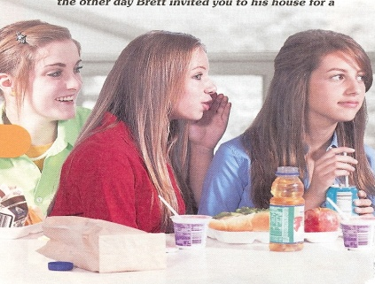
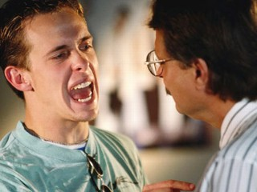
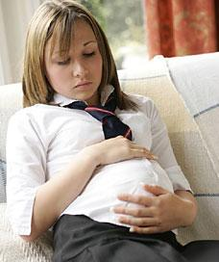
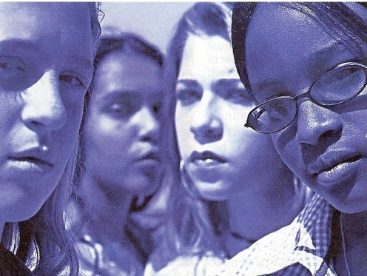
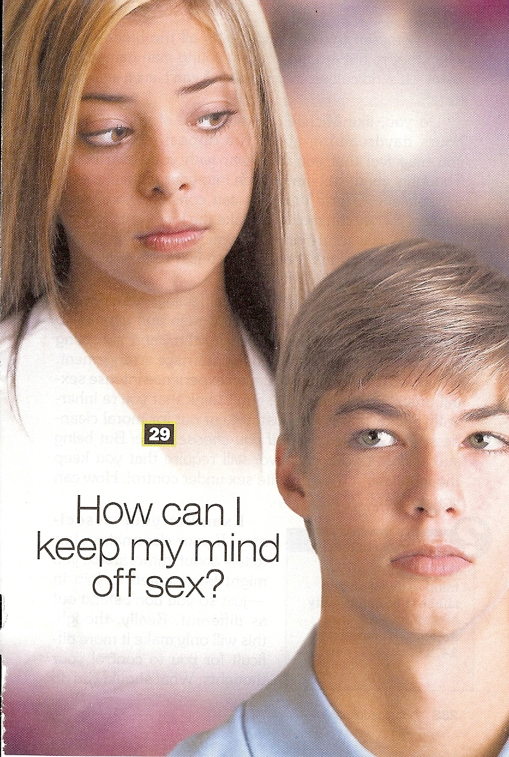
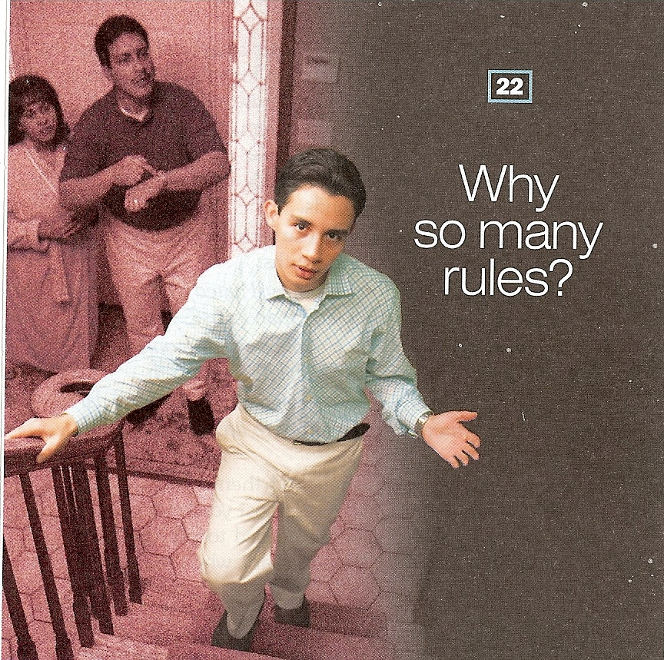
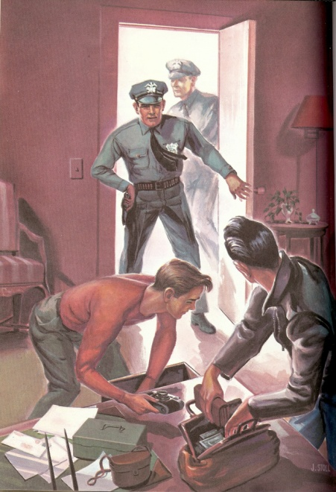
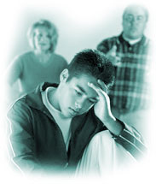
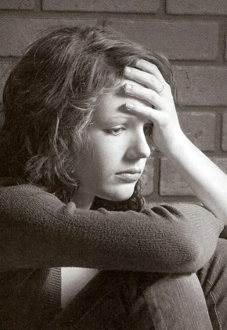
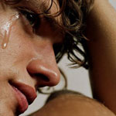
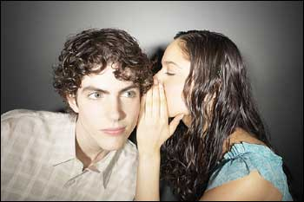
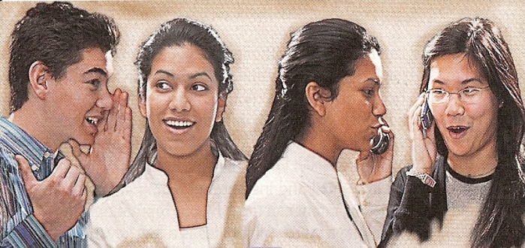

Slide 2
Cause
Effect
When parents do not fulfill promises - Matthew 5:37
When parents do not admit they are wrong - James 5:6
When parents refuses to ask forgiveness - James 4:6-10
When parents are to strict in discipline - Galatians 6:1-2
Children get wounded spirits and fail to trust them
Children lose confidence in their leadership
Children react to their pride
Children have their spirits broken

Slide 3
When parents give too much freedom to his children - Proverbs 29:15
When parents neglect their parents - I Timothy 5:1-8
When parents put their parents in a nursing home for sake of convenience - I Timothy 5:8-14
When parents do not love one another - Ephesians 5:22-23
Children see freedom as a form of rejection
Children do not honor the counsel of their parents
Children are taught to disrespect their parents
Children take up offenses for their parents

Slide 4
When parents neglect God's Word –
II Timothy 2:15
When parents sacrifice their family for money or better retirement - Luke 12:13-34
When parents discipline in anger -
Ecclesiastes 7:9
When parents delegate their children's education to others -
Ephesians 6:3-4
Children reject the authority of God and the Bible
Children develop a temporal value system
Children have seeds of bitterness
His children cease to respect them as their teachers

Slide 5
When parents do not teach their children how to please them - Colossians 3:21
When parents focus on the outward beauty of themselves and others - Proverbs 5 - 7
When parents are impatient, displeased, and angry with their children - Galatians 5:22-23
When parents have inconsistent standards / double standards -Ephesians 4:14
Children feel frustrated, rejected, and stop trying to please their parents
Children feel inferior, rejected, and develop low self-worth
Children seek approval from friends
Children despise them

Slide 6
When parents try to warn their children only of the consequences of sin - Proverbs 1:8-33
When a father lets his wife assume spiritual leadership - I Corinthians 11:1-15
When parents do not have personal convictions - I Timothy 3; Titus 1
Children are challenged to be successful in avoiding the consequences
Children may regard religion as childish when they grow older
Children accept situational ethics and excuse in excess what their parents allow in moderation

Slide 7
“The eye that mocketh at his father, and despiseth to obey his mother, the ravens of the valley shall pick it out, and the young eagles shall eat it.” Prov. 30:17
“A foolish son is a grief to his father, and bitterness to her that bare him.” Prov. 17:25
“The rod and reproof give wisdom: but a child left to himself bringeth his mother to shame.”
Prov 29:15
“Whoso curseth his father or his mother, his lamp shall be put out in obscure darkness.”
Prov. 20:20
“He that gathereth in summer is a wise son: but he that sleepeth in harvest is a son that causeth shame.” Prov. 10:5
“He that wasteth his father, and chaseth away his mother, is a son that causeth shame, and bringeth reproach.” Prov. 19:26

Slide 8
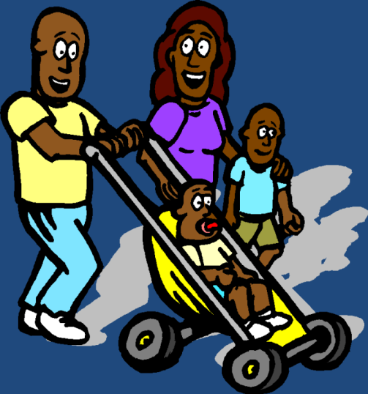

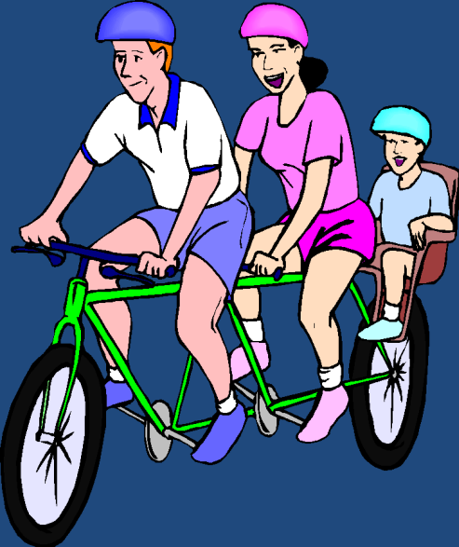
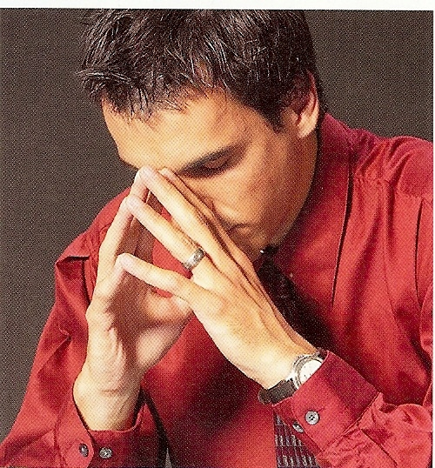



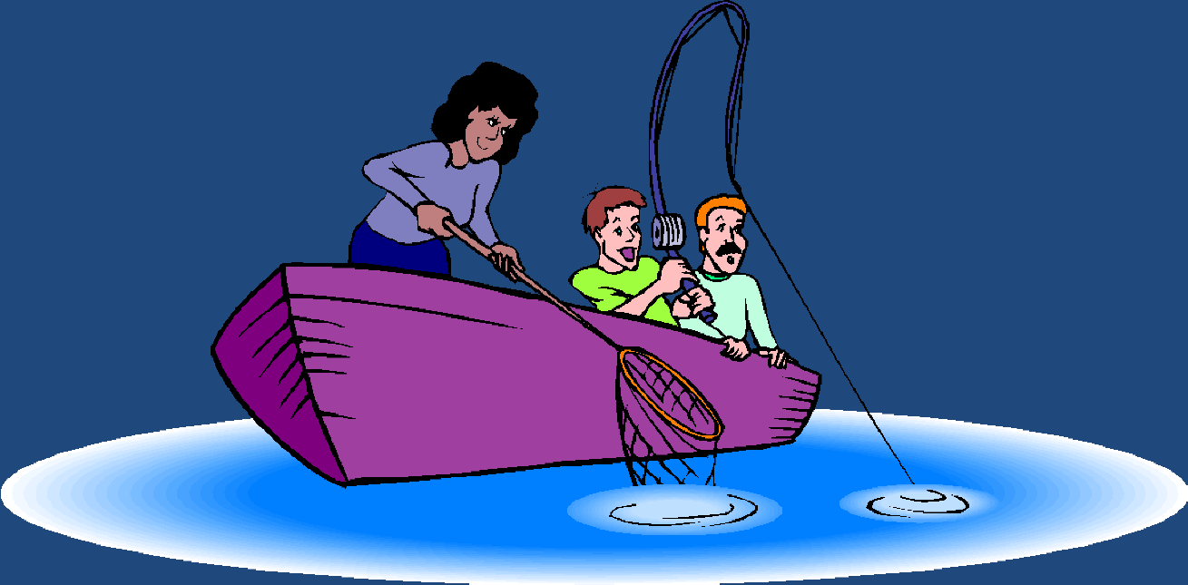
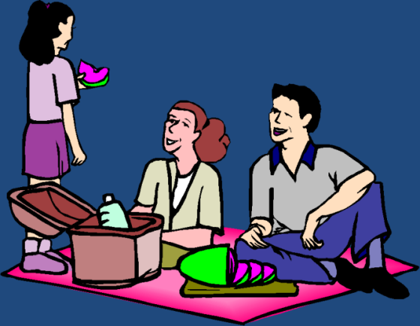
“Thy father and thy mother shall be glad, and she that bare thee shall rejoice.”

Slide 9
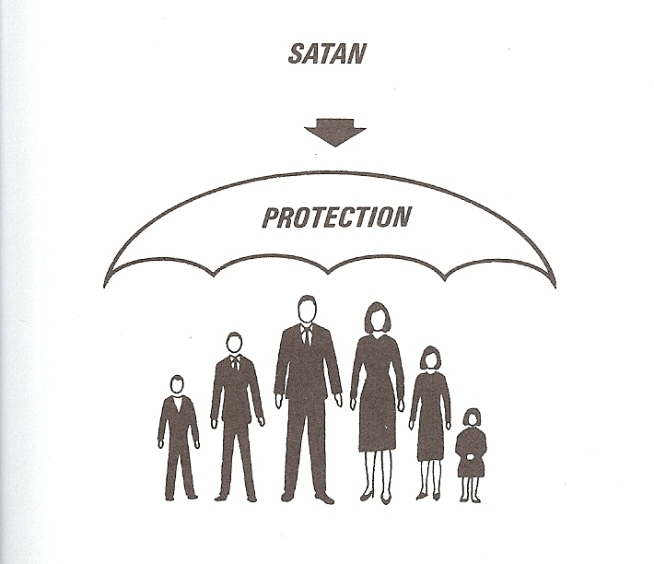
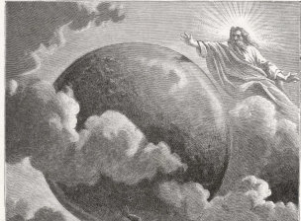
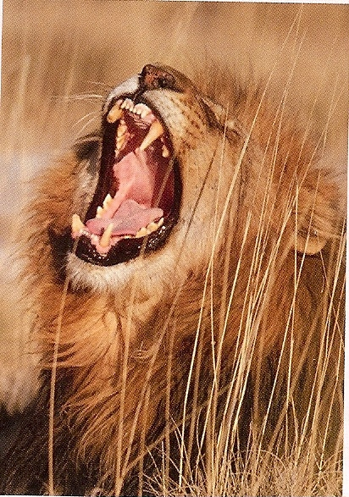
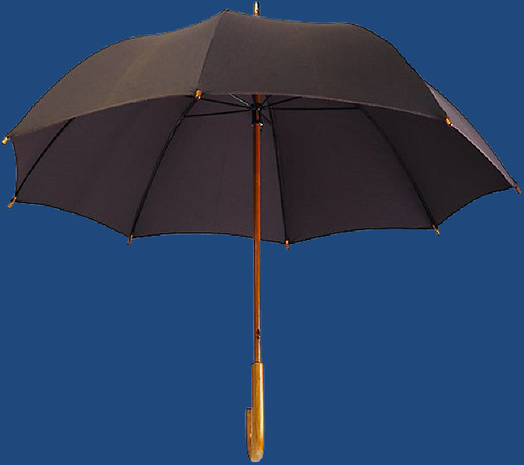
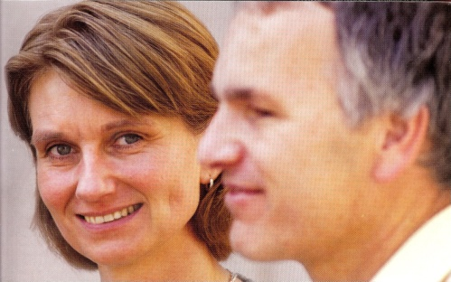
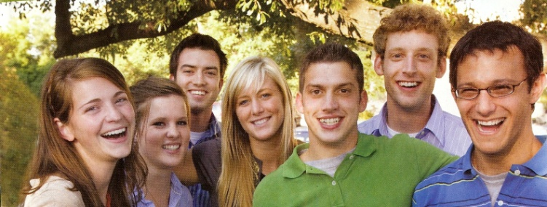
Satan
Destruction (John 10:10)
God Almighty
(I Timothy 6:15)
God Given
Authority
(Romans 13:1)
“Be sober, be vigilant; because your adversary the devil, as a roaring lion,
walketh about, seeking whom he may devour.” (I Peter 5:8)
Proverbs 6:20
Ephesians 6:1-4

Slide 10


The Rewards for Those
Who Get Under Authority
Things will go well for you - Ephesians 6:2-3
You will have a long life - Ephesians 6:1-3
You will bring delight to the Lord - Colossians 3:20
You will avoid the fear of condemnation - Romans 13
You will maintain a good conscience - Romans 13:5
You will obtain a good report - Hebrews 13:7
You will receive God’s inheritance - Colossians 3:23-24

Slide 11
You will receive the glory - I Peter 2:18-20
You will not blaspheme God or His Word - I Timothy 6:1
You will be given clear direction - Proverbs 6:20-22
You will be protected from evil people - Proverbs 6:23-24
You will gain discernment - Proverbs 15:5
You will receive God’s praise - I Peter 2:13-14
You will honor those whom God put over you - I Thessalonians 5:12-13
You will escape the destruction of pride - I Timothy 6:2-4

