Slide 1
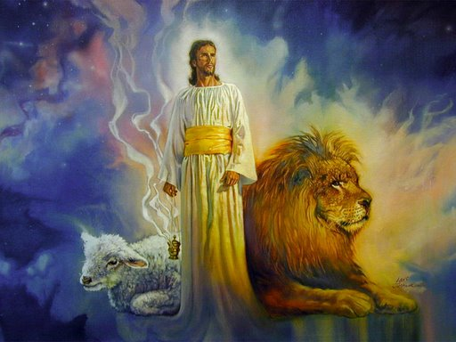
The Revelation of Jesus Christ
A study of the book
of Revelation

Slide 2
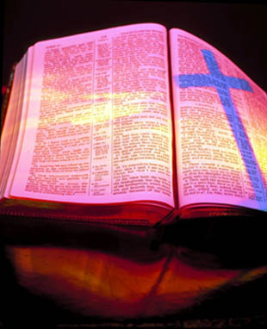
Revelation 13:11-18
“The False Prophet”

Slide 3
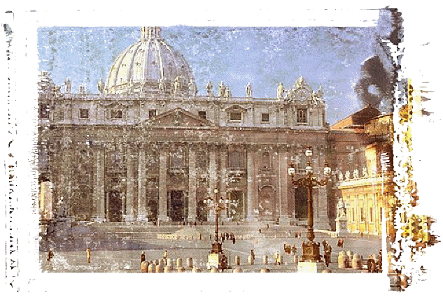
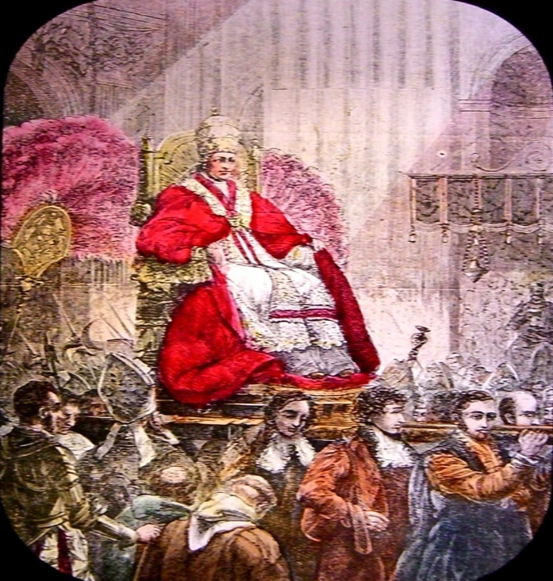
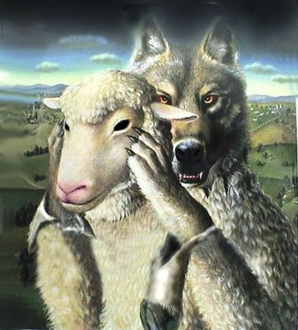
The Identity of the False Prophet
(Revelation 13:11-18)

Slide 4
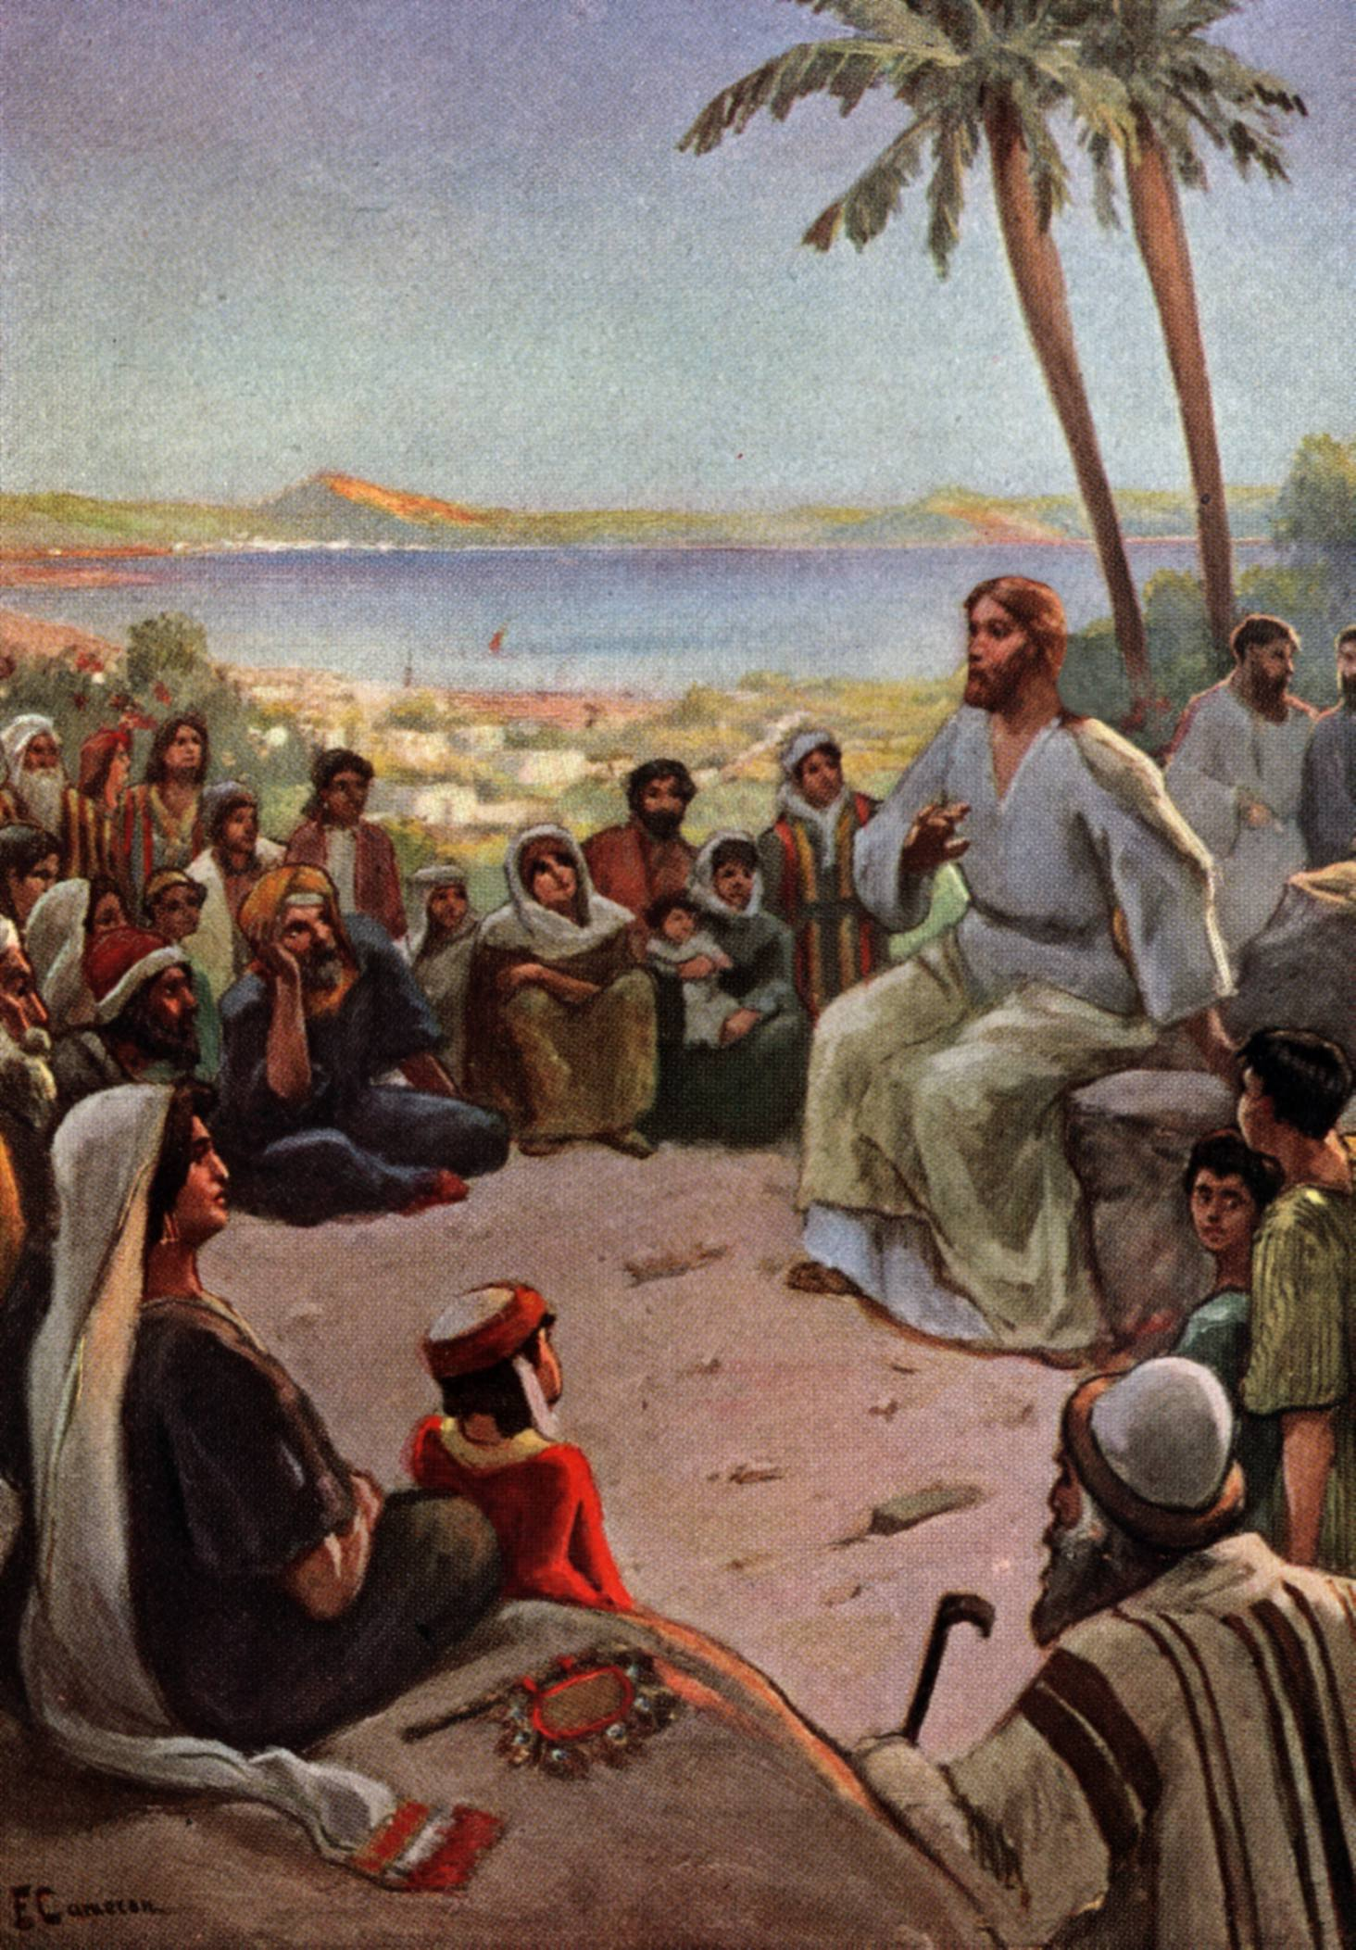
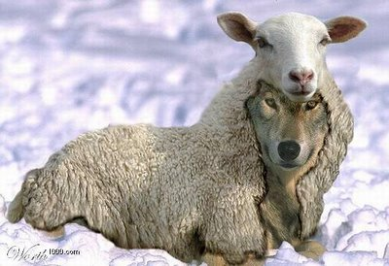
“Beware of false prophets, which come to you in sheep’s clothing, but inwardly they are ravening wolves.”
(Matthew 7:15)

Slide 5
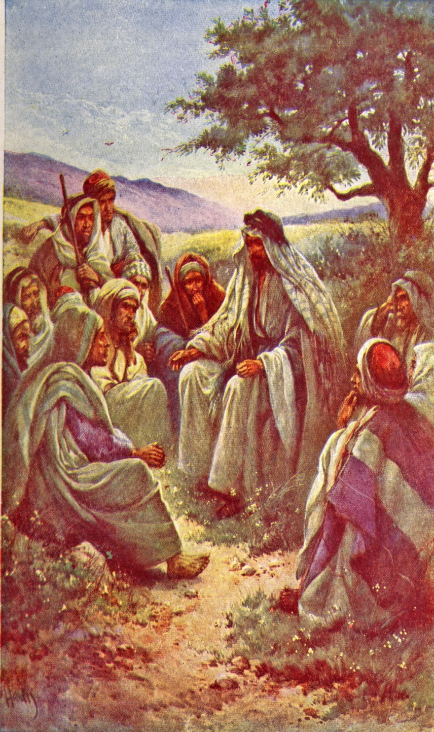
“And many false prophets shall arise and deceive many…for there shall arise false Christ’s, and false prophets, and shall shew great signs and wonders…believe it not.”
(Matthew 24)

Slide 6
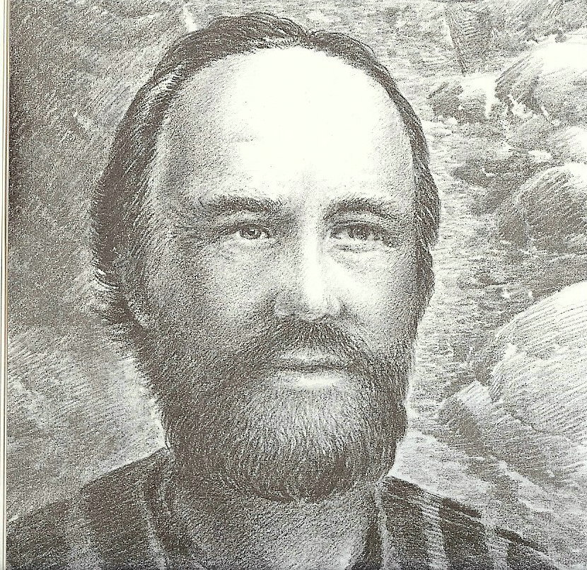
“For such are false apostles, deceitful workers, transforming themselves into the apostles of Christ. And no marvel; for Satan himself is transformed into an angel of light. Therefore it is no great thing if his ministers also be transformed as the ministers of righteousness.”
(II Corinthians 11:14-15)

Slide 7
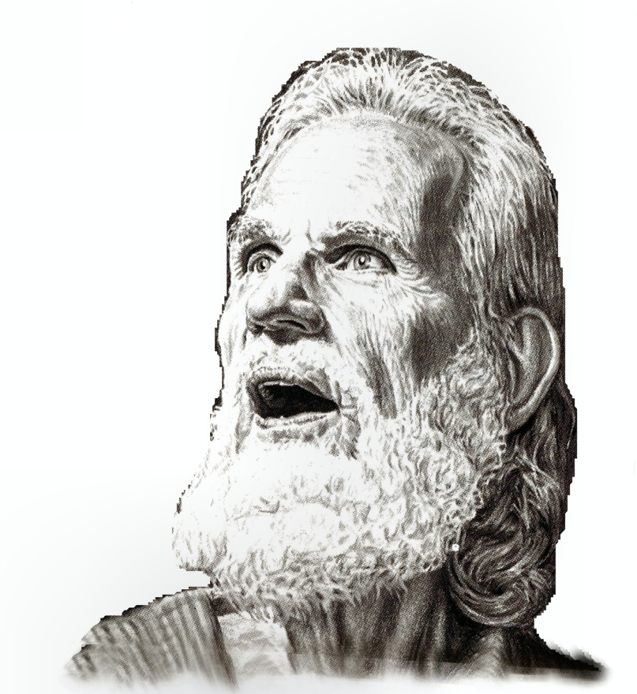
“Beloved, believe not every spirit, but try the spirits whether they are of God: because many false prophets are gone out into the world.”
(I John 4:1)

Slide 8
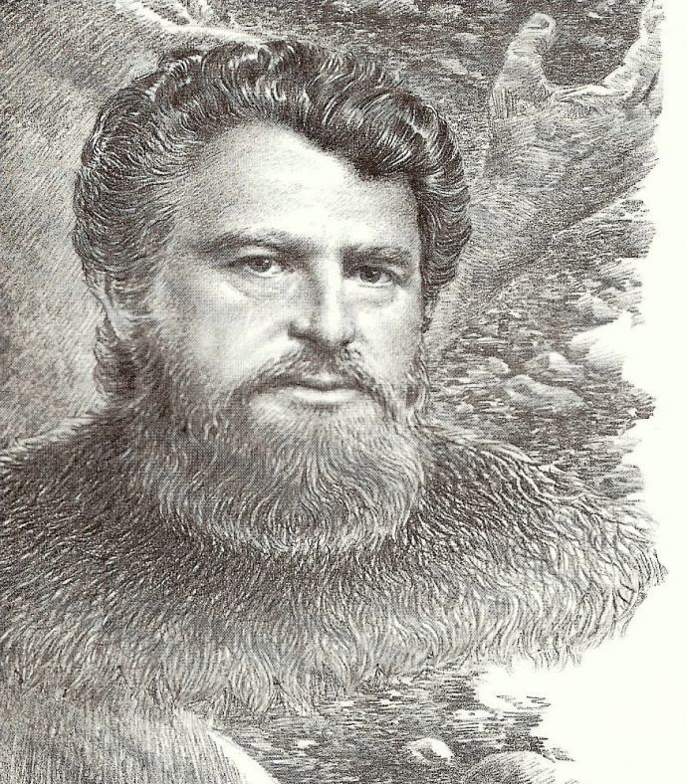
“But there were false prophets also among the people, even as there shall be false teachers among you.”
(II Peter 2:1)

Slide 9
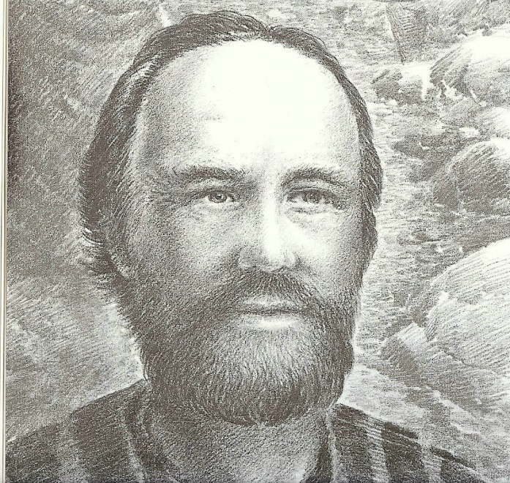
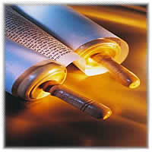
“They searched the scriptures daily, whether those things were so.” (Acts 17:11)

Slide 10
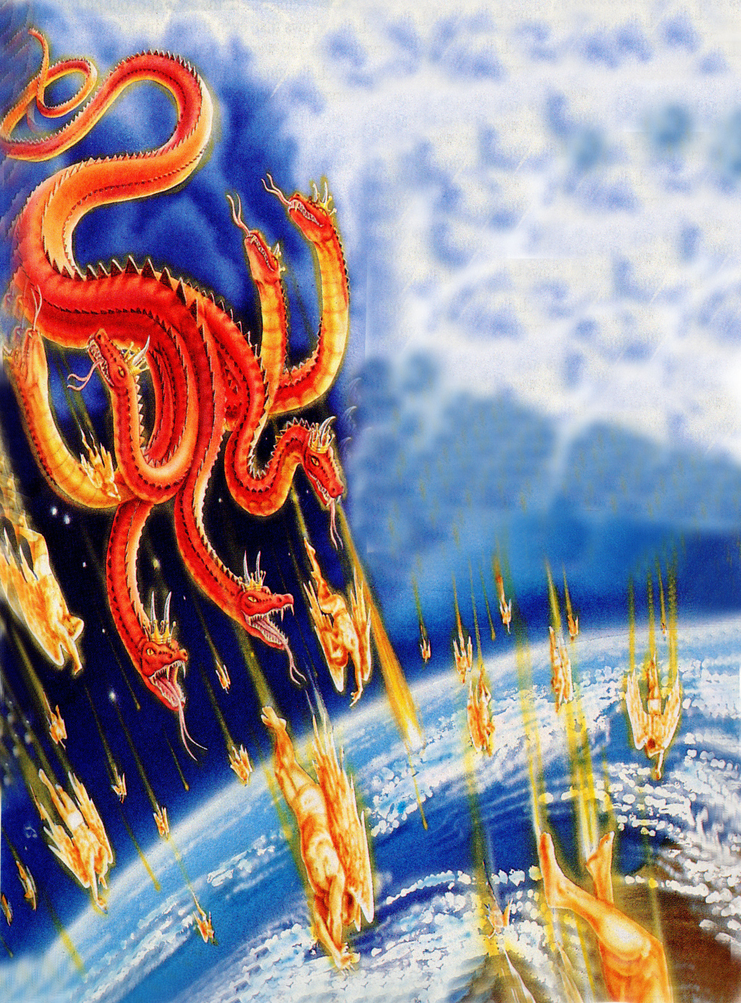
“And the great dragon was cast out, that old serpent, called the Devil, and Satan, which deceiveth the whole world: he was cast out into the earth, and his angels were cast out with him.” (Revelation 12:9)

Slide 11
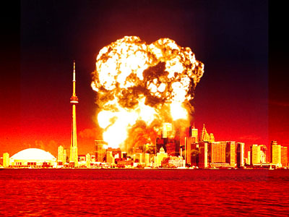
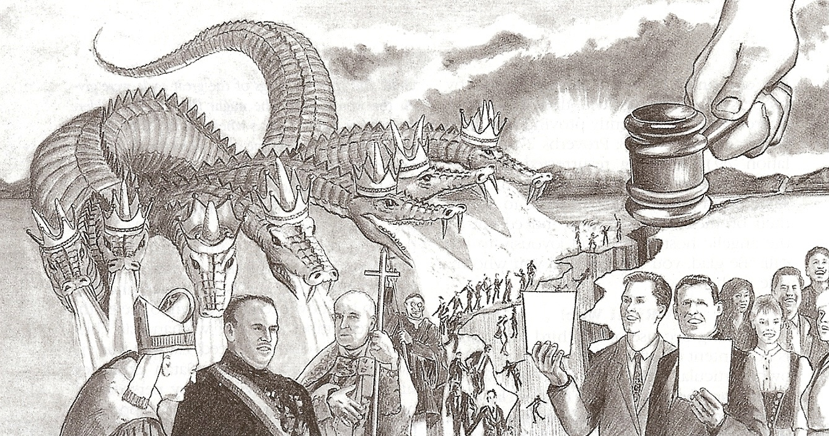
“Woe unto the inhabiters of the earth and of the sea! For the devil is come down unto you, having great wrath, because he knoweth that he hath but a short time.”
(Revelation 12:12)

Slide 12
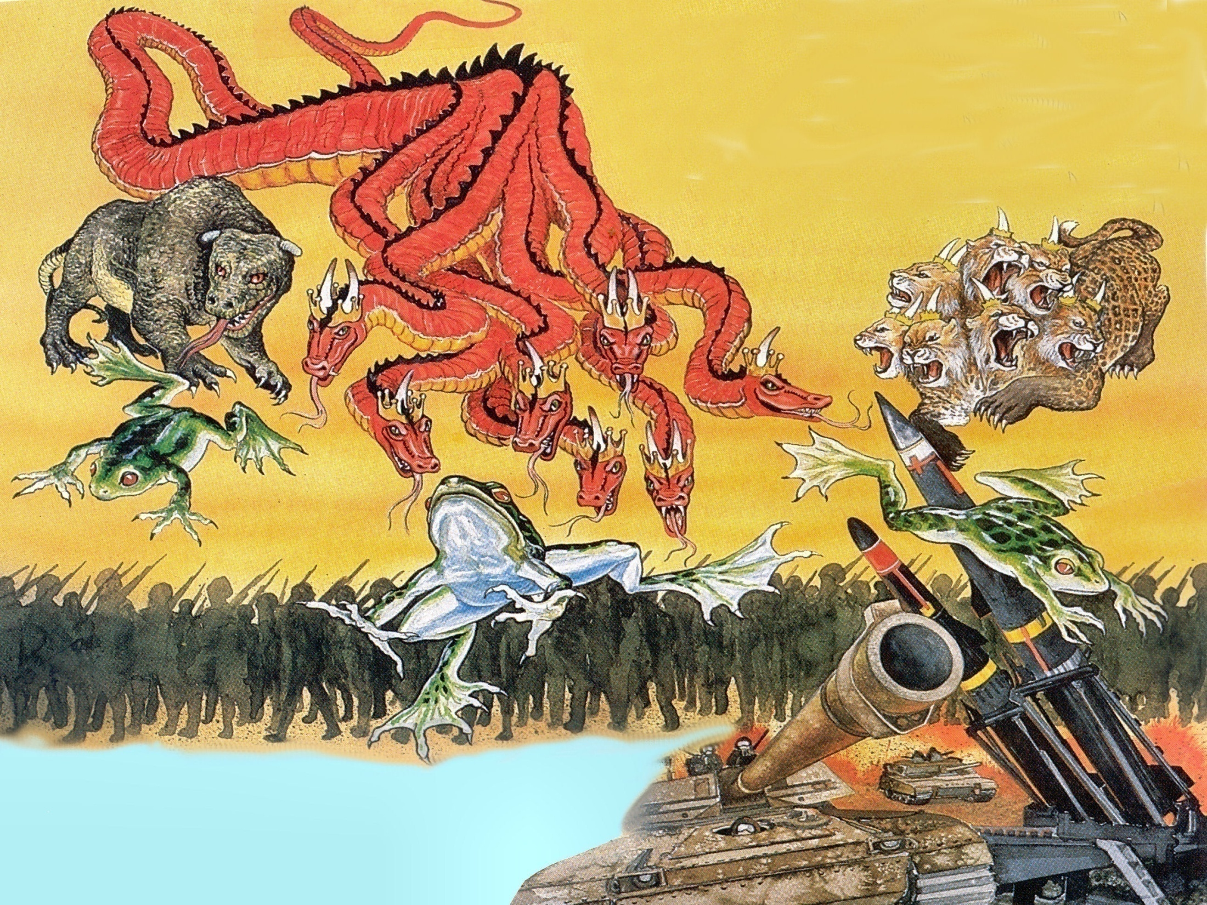
Revelation 16:13-15

Slide 13
“And I saw three unclean spirits like frogs come out of the mouth of the dragon, and out of the mouth of the beast, and out of the mouth of the false prophet. For they are the spirits of devils, working miracles, which go forth unto the kings of the earth and of the whole world, to gather them to the battle of that great day of God Almighty.”

Slide 15
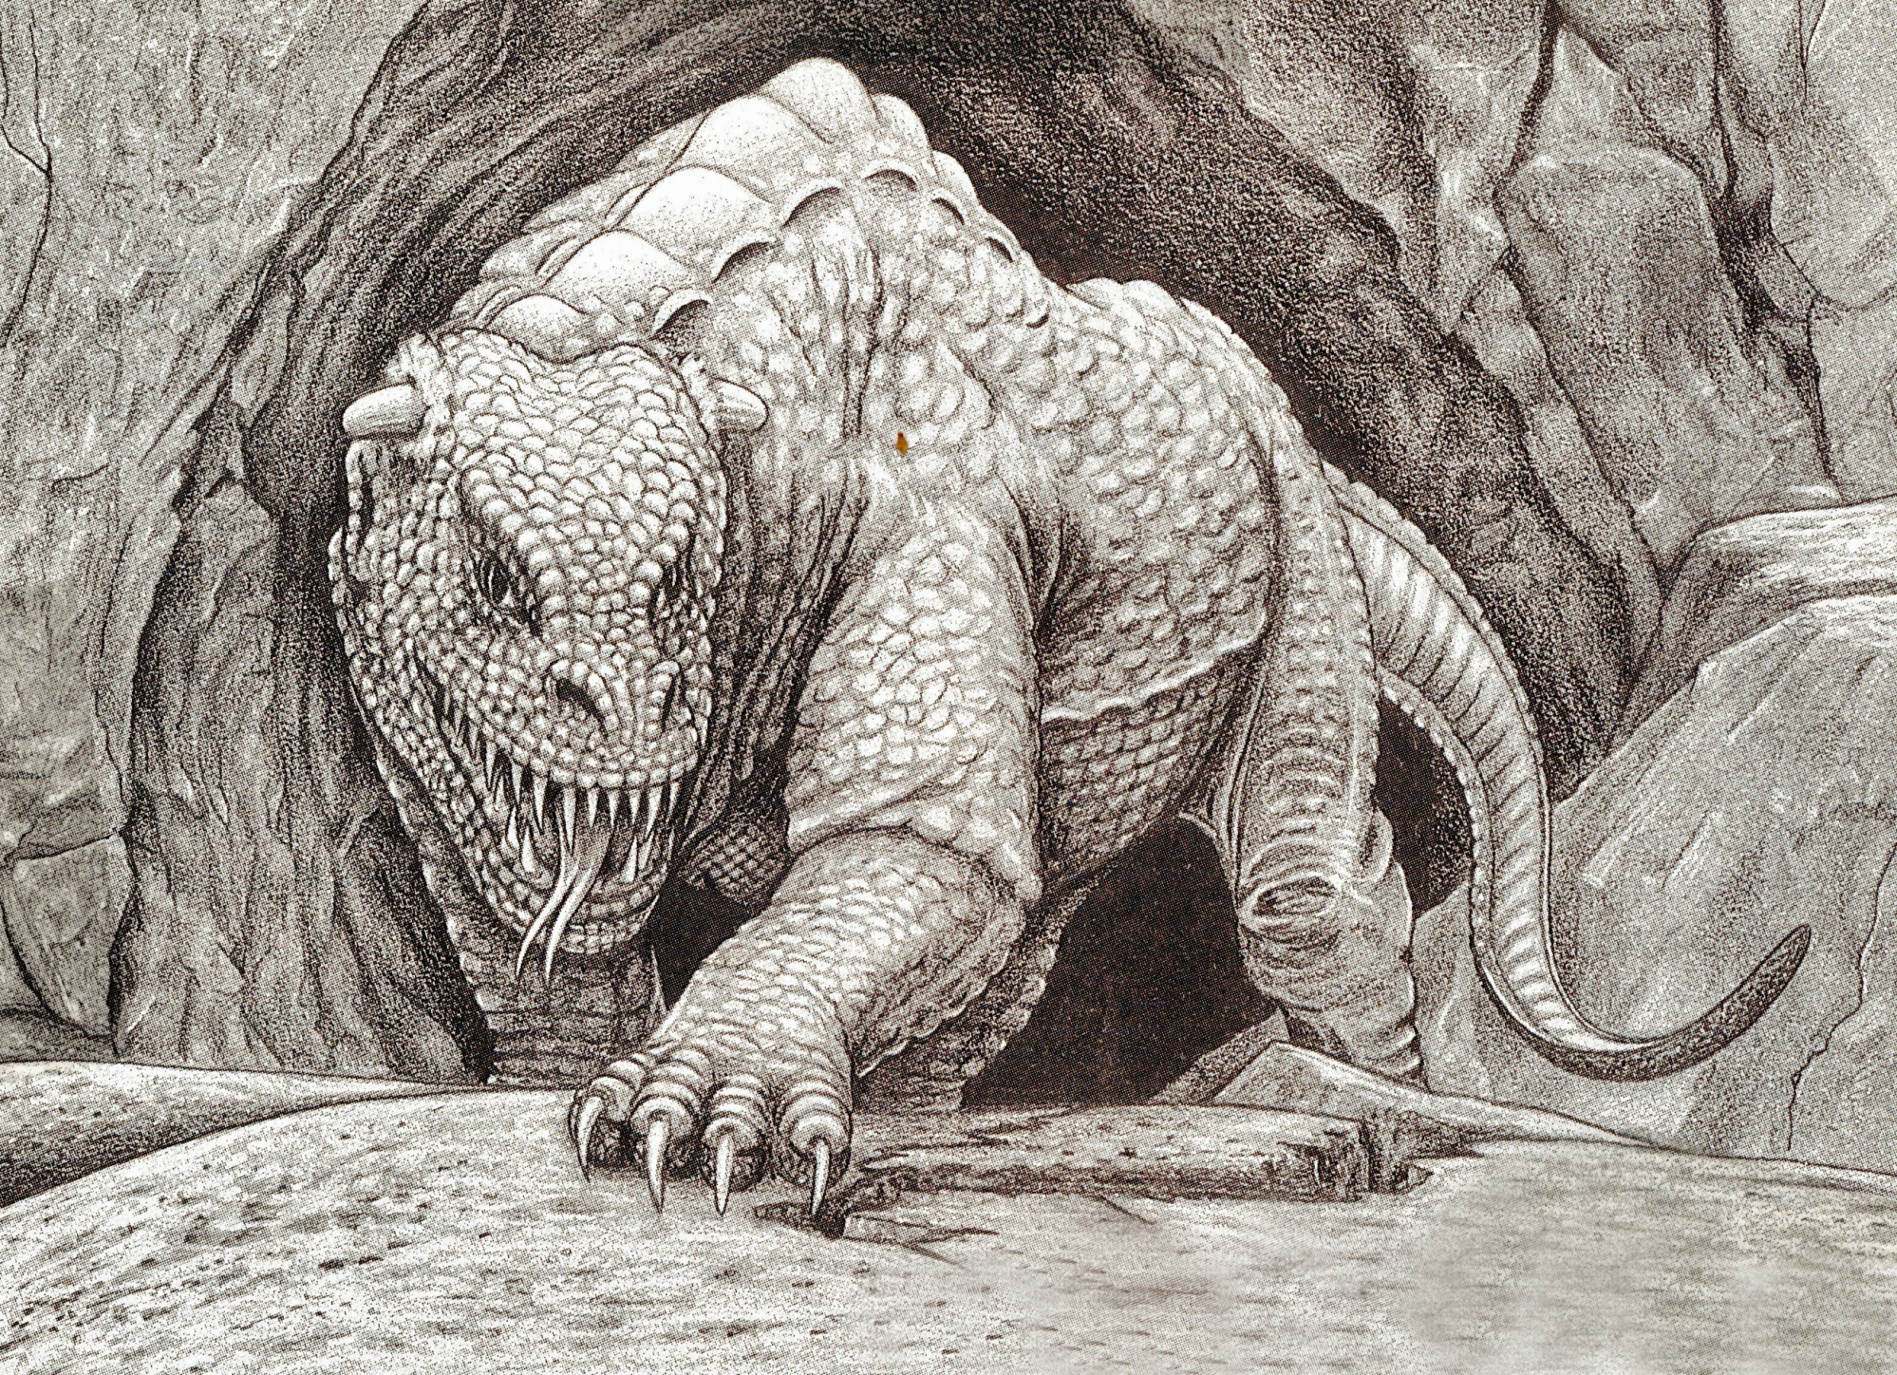
“And I beheld another beast coming up out of the earth; and he had two horns like a lamb, and he spake as a dragon.”

Slide 16
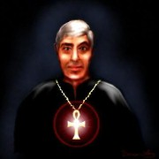
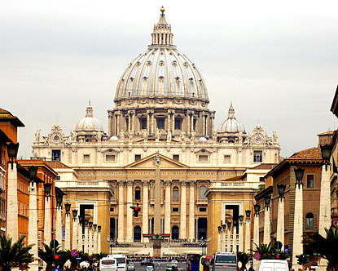
Revelation 13:11

Slide 17
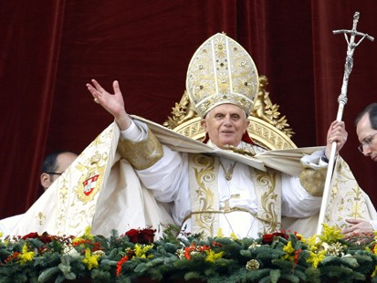
“And he exerciseth all the power of the first beast before him, and causeth the earth and them which dwell therein to worship the first beast, whose deadly wound was healed.”

Slide 18
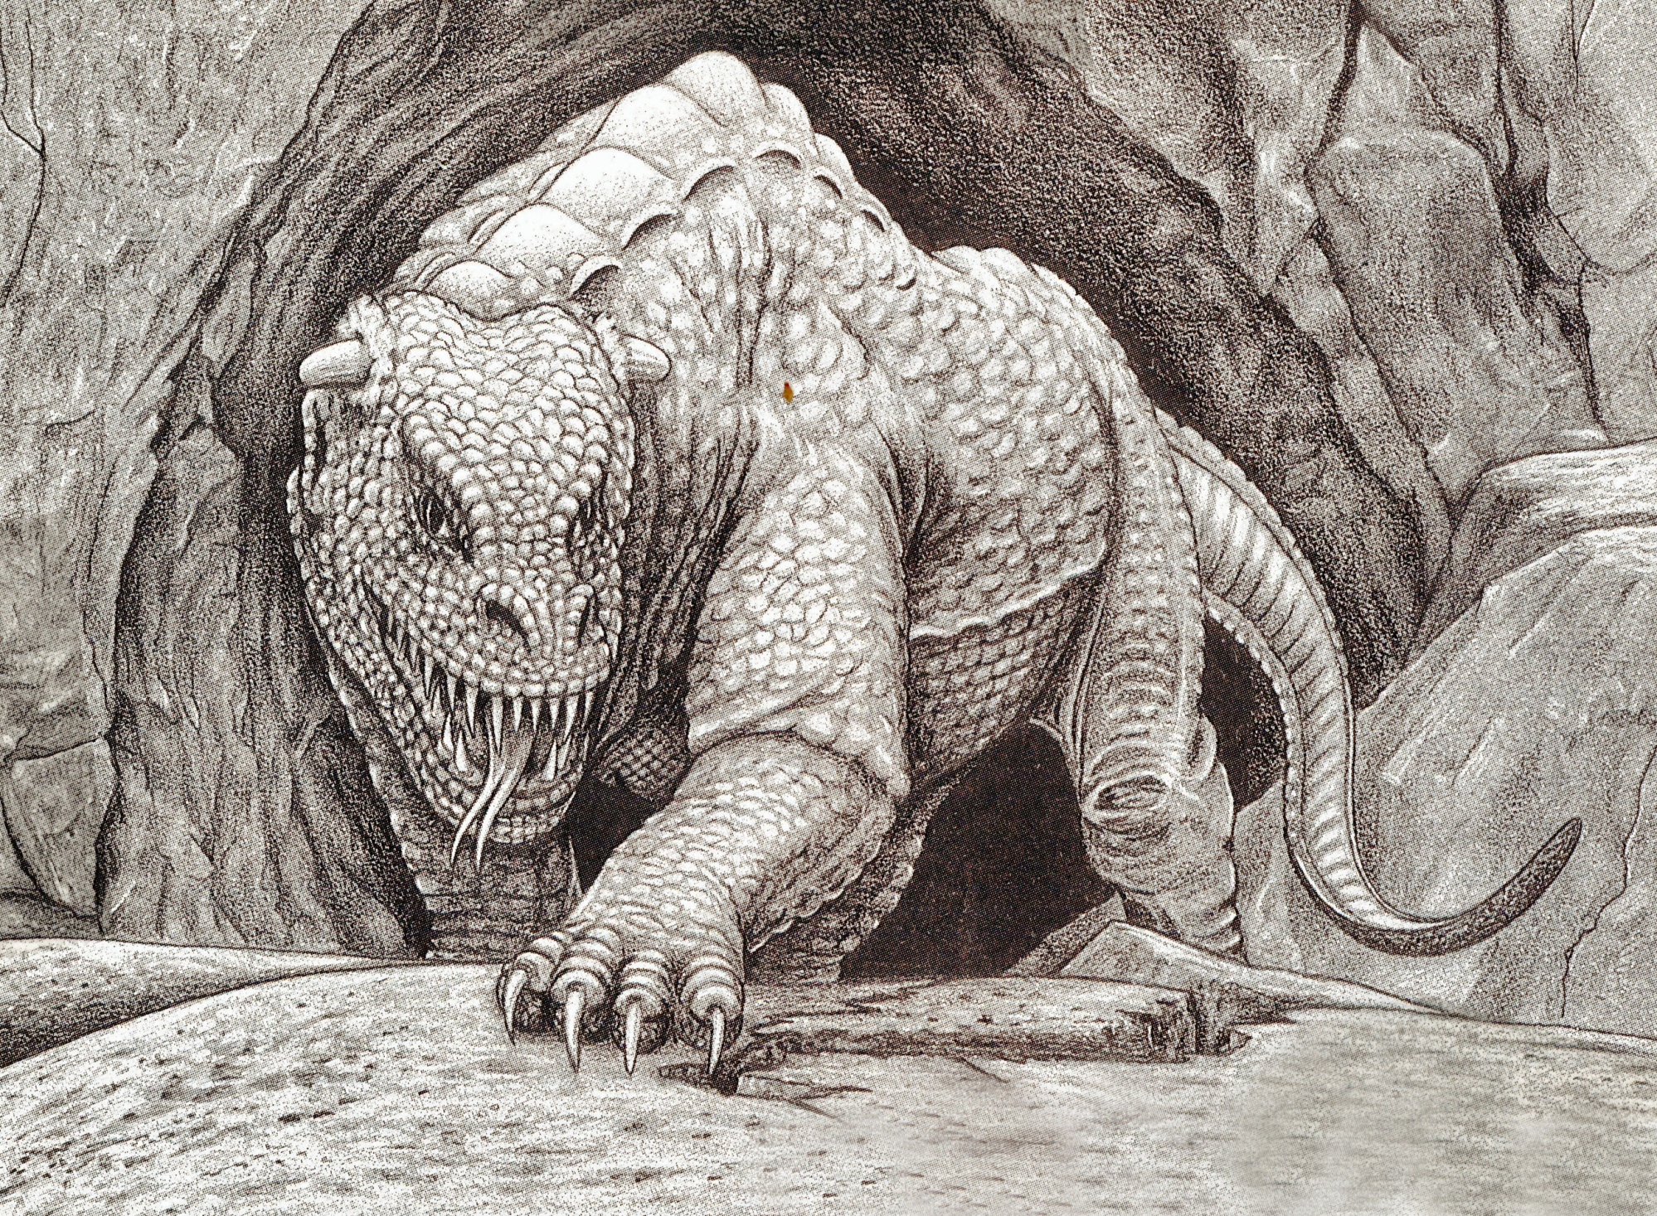
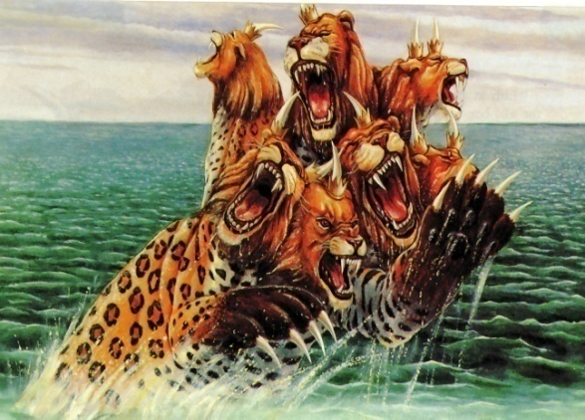
Revelation 13:12

Slide 19
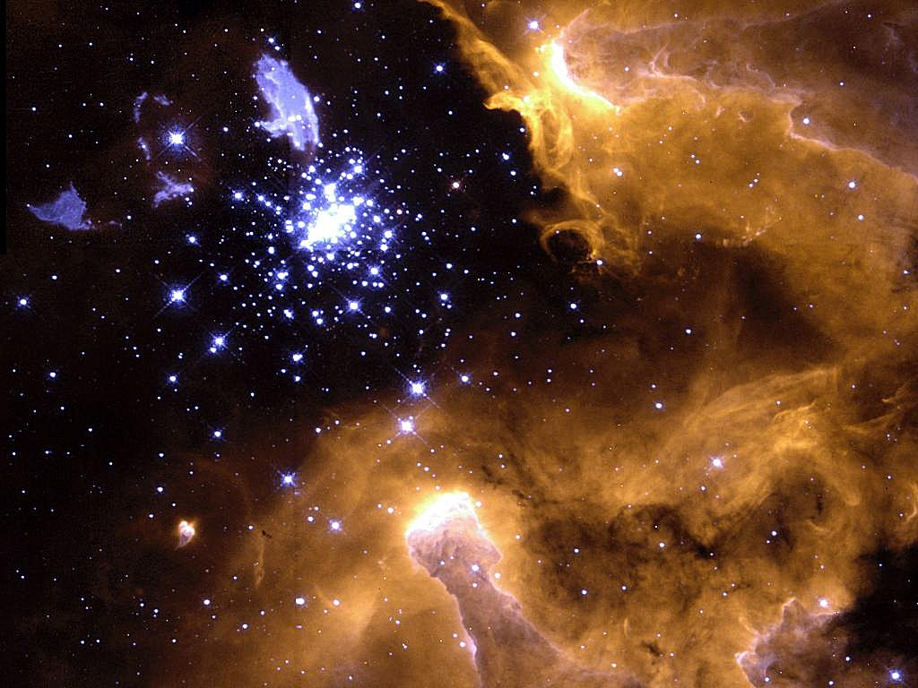
The Second Beast
False Prophet – Rev. 16:13; 19:20; 20:10
Role – bring people to worship the first beast (Anti-Christ) – Rev. 13:14
He is a deceiver – “With all deceivableness of unrighteousness.” II Thess. 2:10
He has two horns – represents his attempt to give the impression of being harmless and gentle.
He has all the power (authority) of the Anti-
Christ.
He priestly role identifies him as the most powerful (universal) religious leader.
He exercise all the power of the Anti-Christ who is the most powerful (universal) political leader.

Slide 20
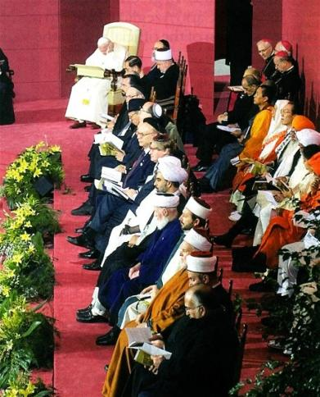
Pope with World religious leaders

Slide 21
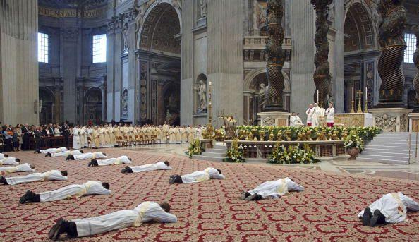
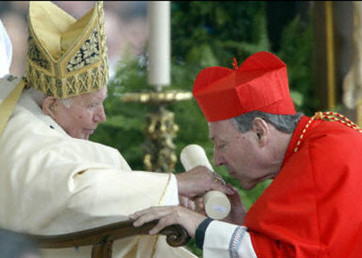
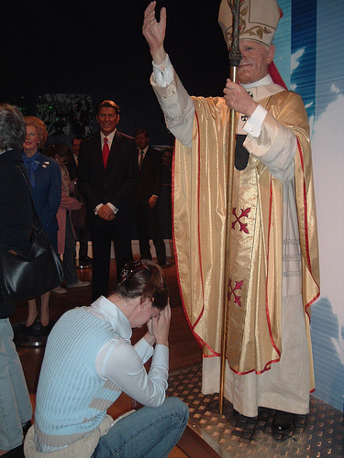

Slide 22
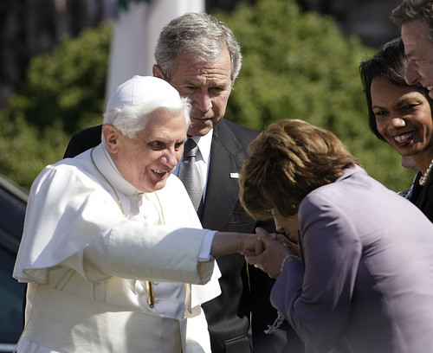
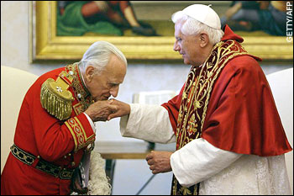
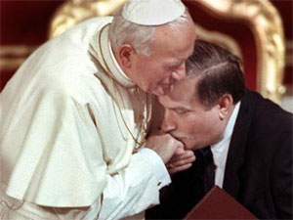
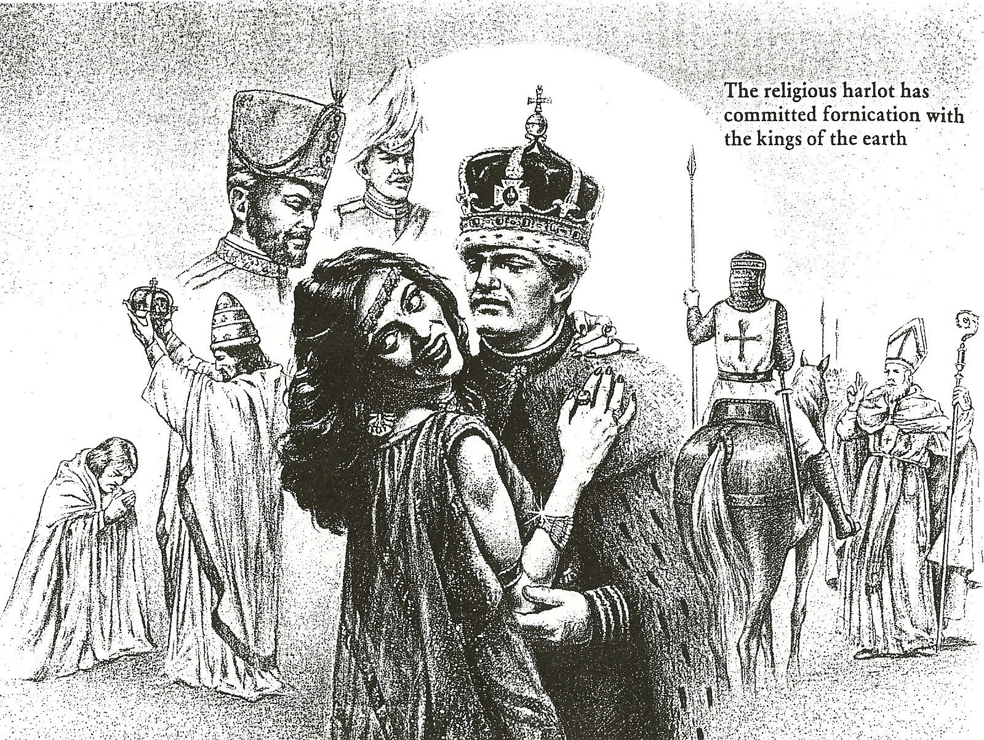
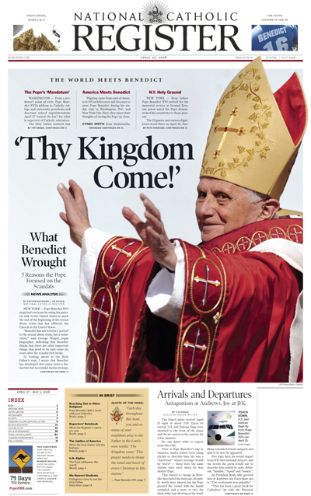
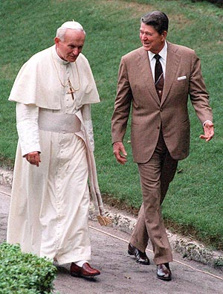
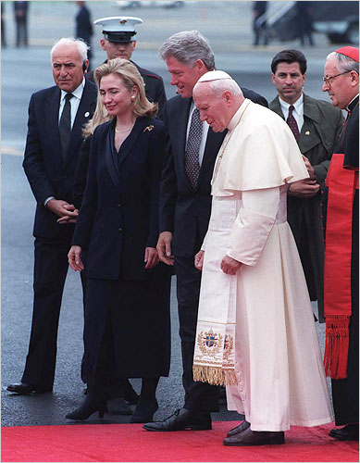
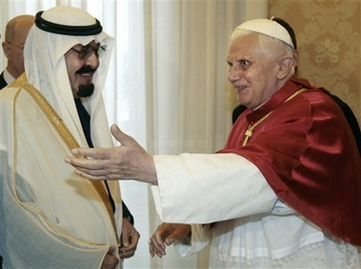
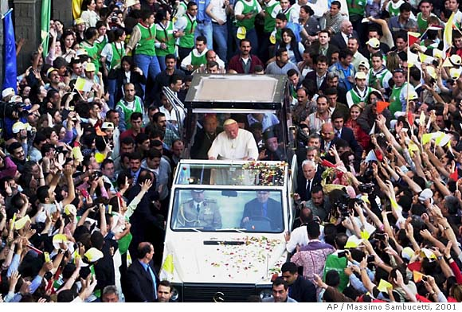

Slide 23
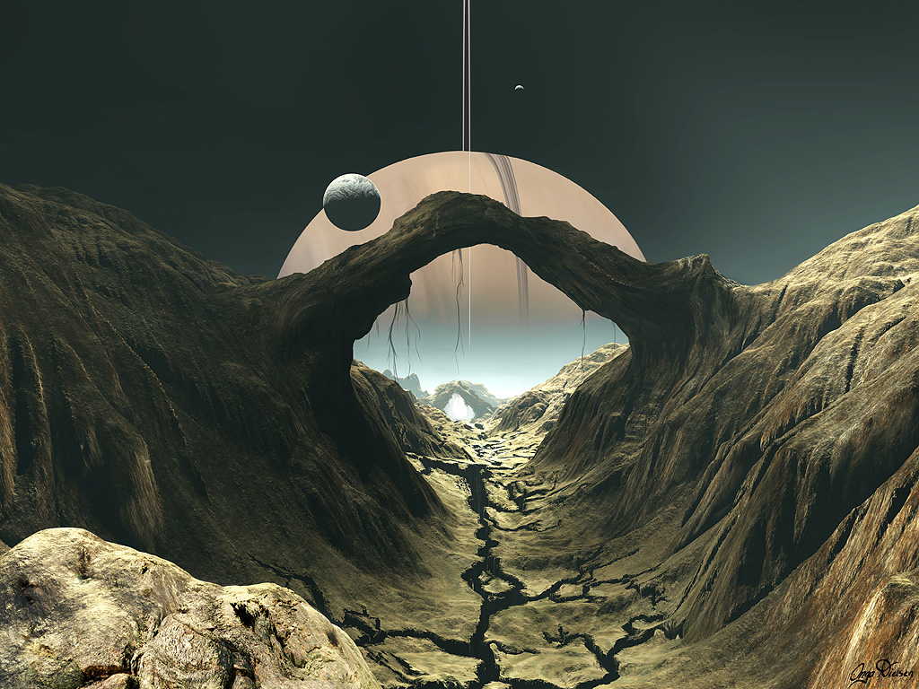
The Deception of the False Prophet
He deceives by means of wonders and miracles – Magic / Witchcraft – Deut. 13:1-5; Mark 13:22-23; II Thess. 2:9-10
His power is given to him by Satan the “Great deceive” - Rev. 12:9
Leads people in the worship of the false Messiah (Anti-Christ) - (Matt. 24:24)
He will produce the miracles of Elijah - (I Kings 18:28-39; II Kings 1:10)

Slide 24
“And he doeth great wonders, so that he maketh fire come down from heaven on the earth in the sight of men, and deceiveth them that dwell on the earth by the means of those miracles which he had power to do in the sight of the beast…”

Slide 25
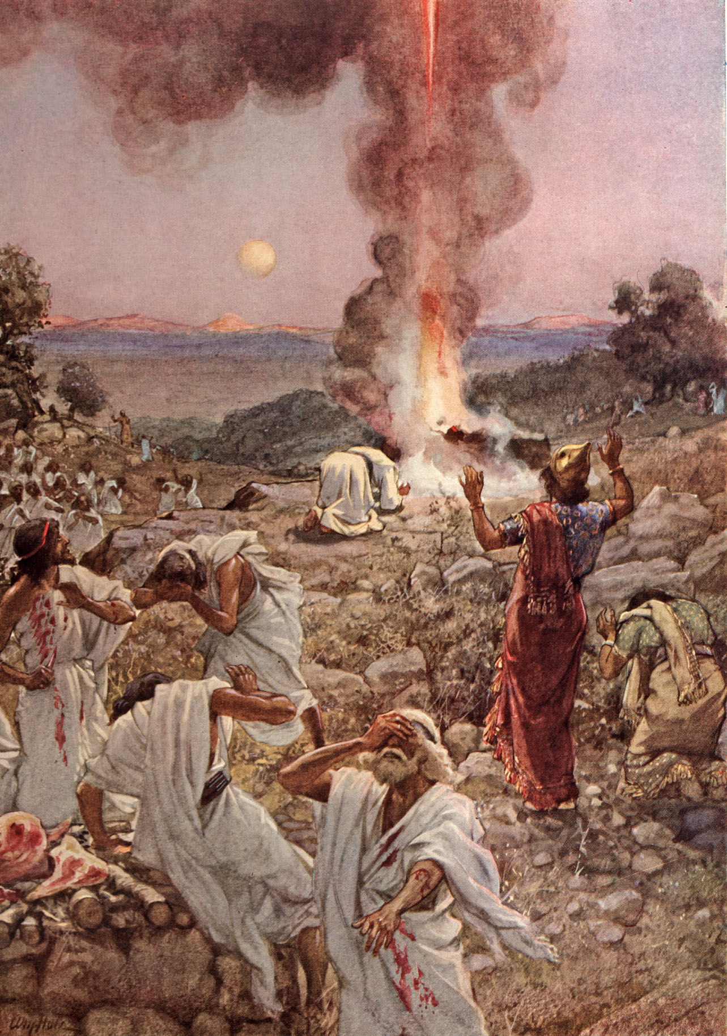
“The fire of the Lord fell, and consumed the burnt sacrifice, and when all the people saw it, they fell on their faces: and they said, The Lord he is God, the Lord He is God.”

Slide 26
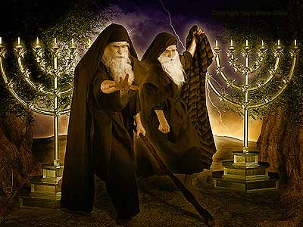
“Behold, I will send you Elijah the prophet before the coming of the great and dreadful day of the Lord.”
(Malachi 4:5)

Slide 27
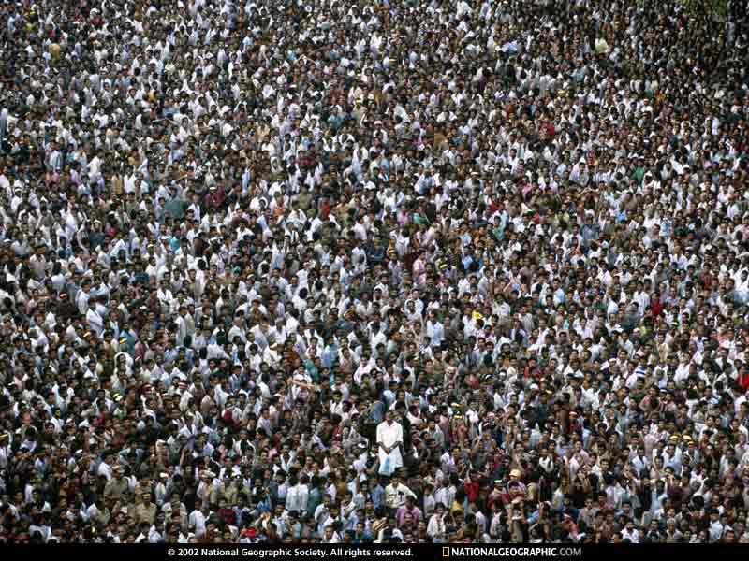
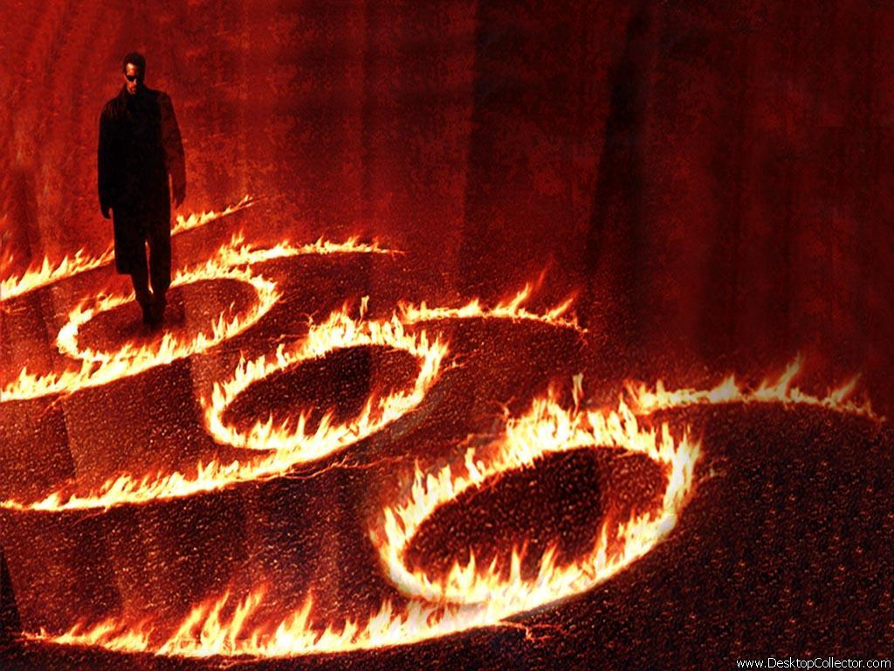

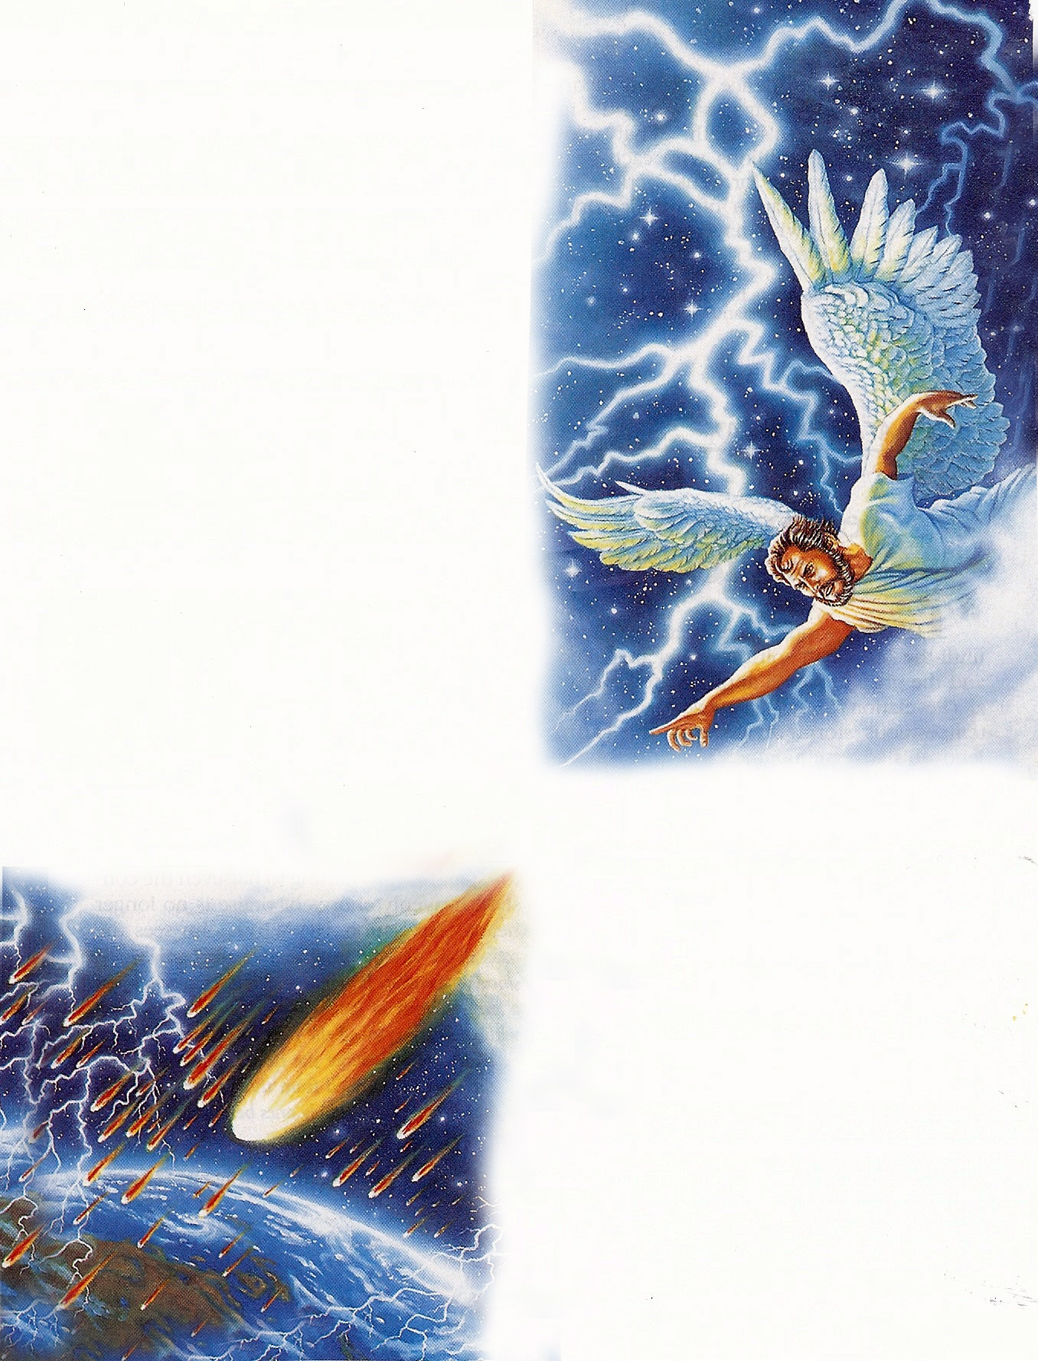
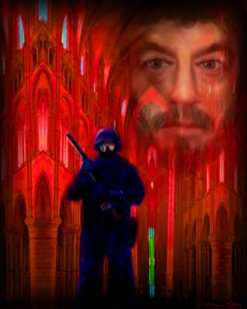
Revelation 13:12-13

Slide 28

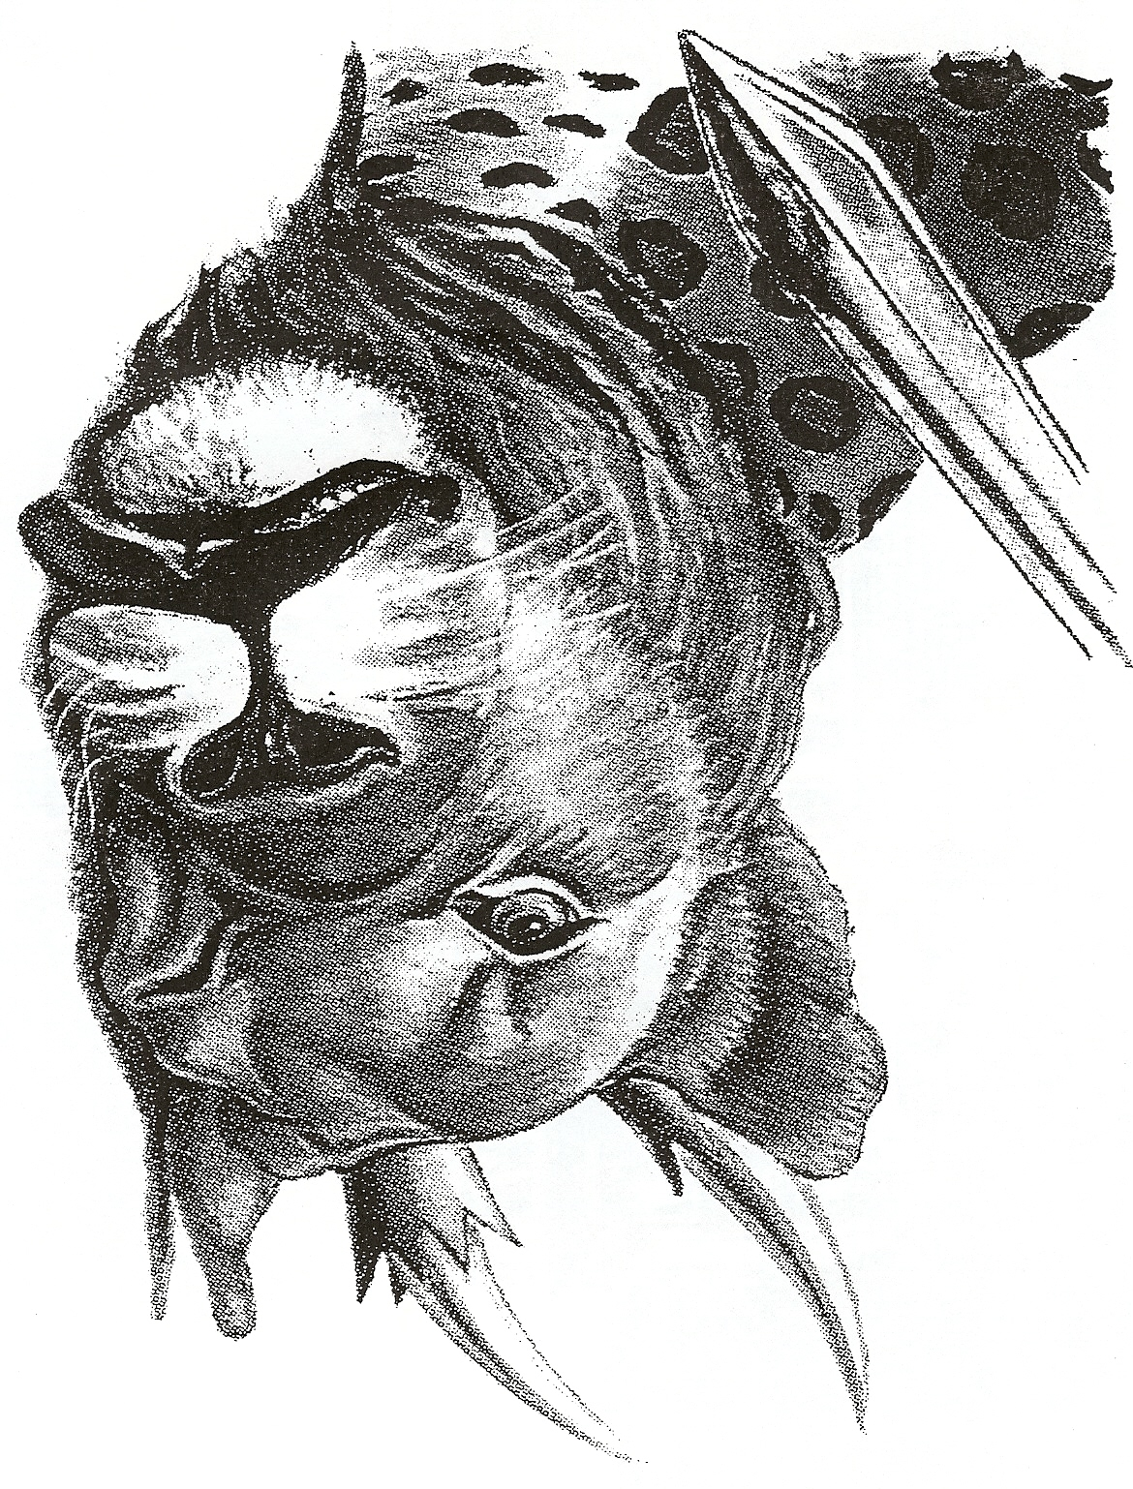
“(False Prophet) saying to them that dwell on the earth, that they should make an image to the beast, which had the wound by a sword, and did live.”

Slide 29
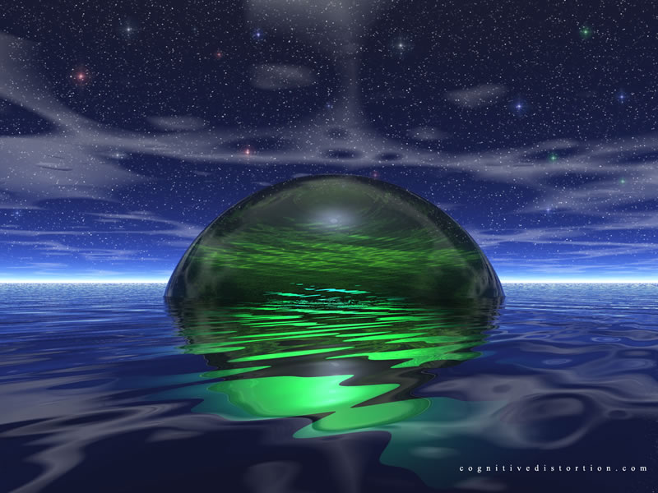
“And his deadly wound was healed: and all the world wondered (marveled) after the beast (Anti-Christ). And they worshiped the dragon which gave power unto the beast: and they worshiped the beast…”
(Revelation 13:3-4)

Slide 30
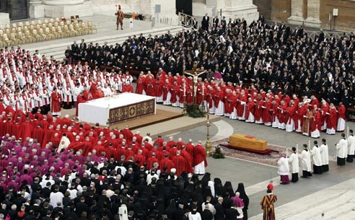

Slide 31
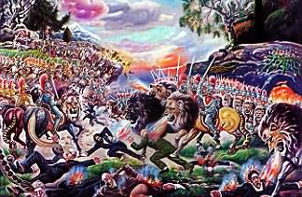
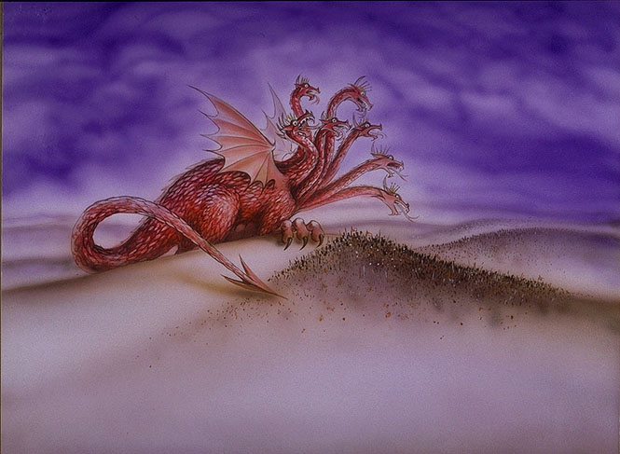
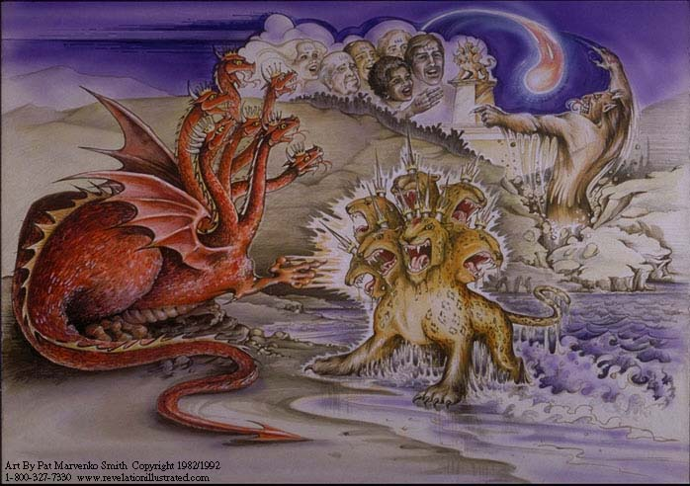


Slide 32

“He (false prophet) deceiveth them that dwell on the earth by the means of those miracles which he had power to do…saying to them…that they should make an image to the beast, which had the wound by a sword, and did live.”

Slide 33


Slide 34


Slide 35



Slide 36


666

Slide 37


Slide 38

“And he (false prophet) had power to give life unto the image of the beast, that the image of the beast should both speak…”
(Revelation 13:15)

Slide 39


Slide 40

“And he (false prophet) cause that as many as would not worship the image of the beast should be killed.”

Slide 41





Slide 42


Slide 43








Slide 44












“That no man might buy or sell, save he that had the mark.”
666

Slide 45

“Here is wisdom…”

Slide 46

“And that no man might buy or sell, save he that had the mark, or the name of the beast, or the number of his name. Here is wisdom. Let him that hath understanding count the number of the beast.”
He that had the mark – Mark = Image, stamp, brand, or other mark
or the name of the beast – his name
or the number of his name – 666 “For it is the number of man…”

Slide 47

“And he (false prophet) causeth all, both small and great, rich and poor, free and bond, to receive a mark in their right hand, or in there foreheads.”

Slide 48







Slide 49



Slide 50








Slide 51


“There shall arise false Christ, and false prophets, and shall show great signs and wonders…. believe it not.”

Slide 52

Do not take the mark!
“And the smoke of their torment ascendeth up for ever and ever: and they have no rest day or night, who worshiped the beast and his image, and whosoever receiveth the mark of his name.” (Revelation 14:11)

Slide 53

“And I saw the souls of them that were beheaded for the witness of Jesus, and for the Word of God, and which had not worshiped the beast, neigher his image, neither had received his mark upon their foreheads, or in their hands; and they lived and reigned with Christ a thousand years.”
(Revelation 20:4)

Slide 54

Revelation 19:20
And the beast was taken, and with him the false prophet that wrought miracles before him, with which he deceived them that had received the mark of the beast, and them that worshipped his image. These both were cast alive into a lake of fire burning with brimstone.

Slide 55

“He which testifieth these things saith, surely I come quickly. Amen. Even so, come, Lord Jesus.”
(Revelation 22:20)

