Slide 1

Understanding Strongholds
“Casting down imaginations, and every high thing that exalteth itself against the knowledge of God, and bringing into captivity every thought to the obedience of Christ; And having in a readiness to revenge all disobedience, when your obedience is fulfilled.”
(II Corinthians 10:3-6)
“For though we walk in the flesh, we do not war after the flesh: For the weapons of our warfare are not carnal, but mighty through God to the pulling down of strong holds.”

Slide 2
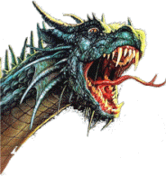
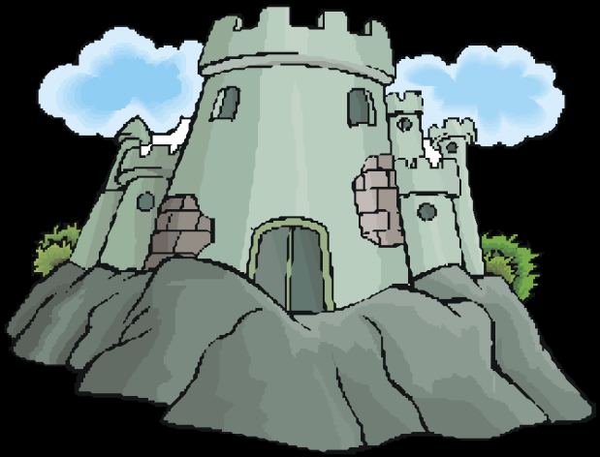
II Corinthians 10:3-6
Stronghold
“False Ideas” (John 8:44)
Ground
Surrendered (Eph. 4:27)
Pride of Life

Slide 3


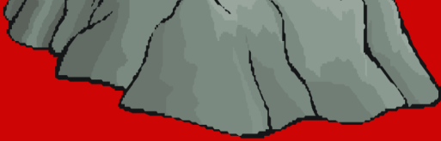
Three Ways “Ground” is Surrendered to Satan
Immorality
Temporal Values
Bitterness

Slide 4
II Corinthians 10:3-6
Stronghold
“False Ideas”
(John 8:44)
Ground
Surrendered
(Eph. 4:27)
Pride of Life
Immorality
(I Thess. 4:1-8)
Bitterness
(Heb. 12:15)
Temporal Values
(I Tim. 6:10)

Slide 5
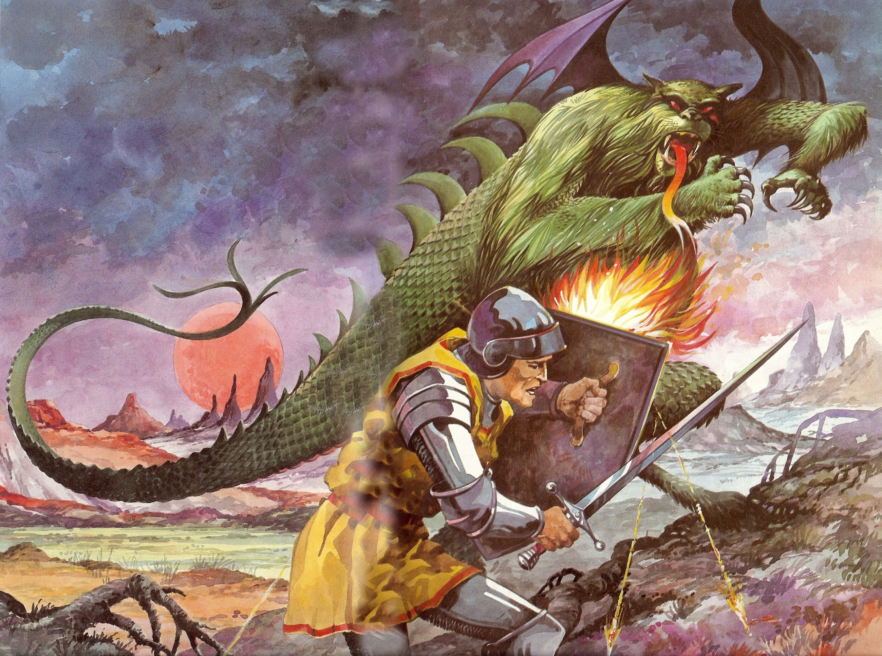
Spiritual Warfare

Slide 6
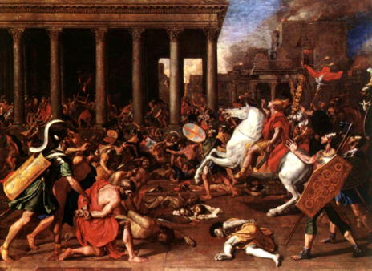
“Do not give place to the devil…”
(Ephesians 4:27)
Place = An area of jurisdiction.
Ground = Jurisdictional area in the soul.
Warfare = Opposing sides fight for jurisdictional area (ground). Whoever gains “ground” controls that area of the soul.
Command – “Do not surrender ground to the enemy (Satan).”

Slide 7
Warfare (strateia) - To carry on hostilities; to engage in battle; to contend, to strive; to be in a state of hostile contention - II Cor. 10:3-6; I Tim. 1:18; II Tim. 2:1-3; James 4:1-2; I Peter 2:11
Fight (agonizomai) - To gain control through struggle; to attempt to defeat; subdue or destroy in order to gain victory - I Cor. 9:26; I Tim. 6:12; II Tim. 4:7
Wrestle (pale) - To struggle in hand to hand combat with an opponent in an attempt to throw or force him to the ground - Eph. 6:10-18

Slide 8
Strive (sunathleo) - To make great effort to do ones best; strenuous exertion; earnest effort - I Cor. 9:24-25; II Tim. 2:5
Soldier (stratiotes) - One engaged in military service; one who fights for a specified cause - II Tim. 2:3-4
Contend (epagonizomai) - To hold firm to the truth; to strive in debate - Jude 3-9

Slide 9
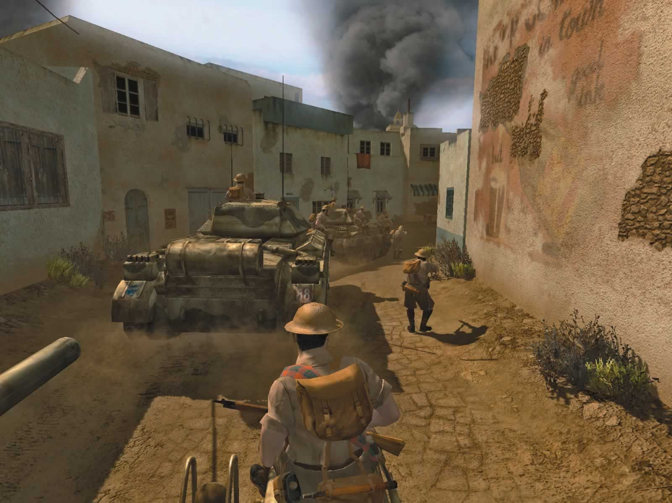
Strongholds
(Ephesians 4:19, 28, 31)
Immorality – “They have given themselves over unto lasciviousness…”
Temporal values – “…to work all uncleanness with greediness…Let him that stole steal no more…”
Bitterness – “…let all bitterness, be put away from you…”
4. Surrendered ground – “Do not give place (ground) to the devil…”

Slide 10
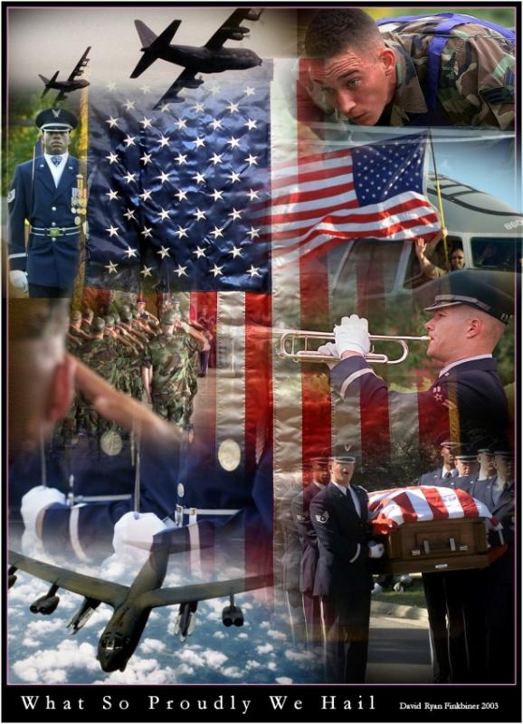
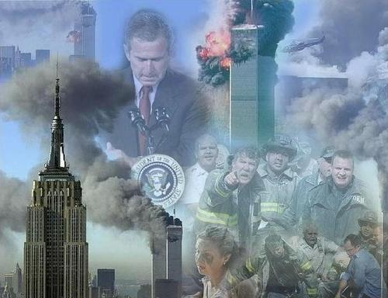

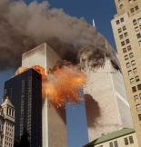
Three Enemies
“And you hath he quickened, who were dead in trespasses and sins; Wherein in time past ye walked according to the course of this world, according to the prince of the power of the air, the spirit that now worketh in the children of disobedience: Among whom also we all had our conversation in times past in the lusts of our flesh, fulfilling the desires of the flesh and of the mind; and were by nature the
children of wrath, even as others.”
(Ephesians 2:1-3)

Slide 11

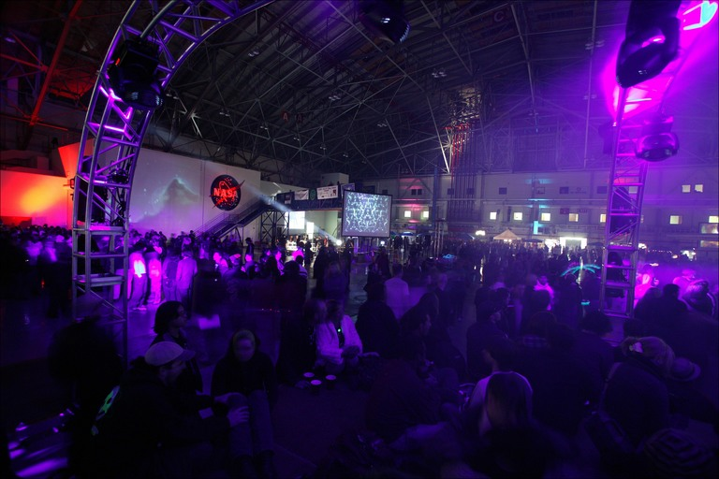
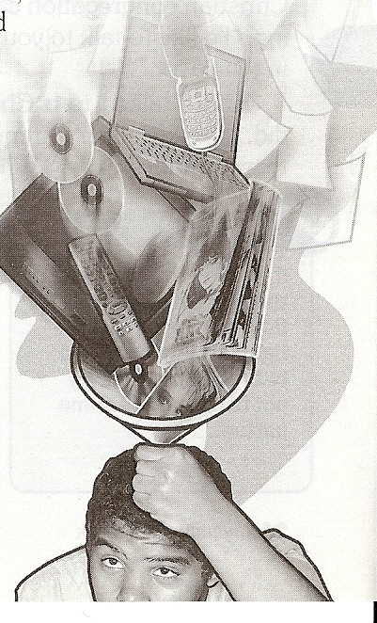

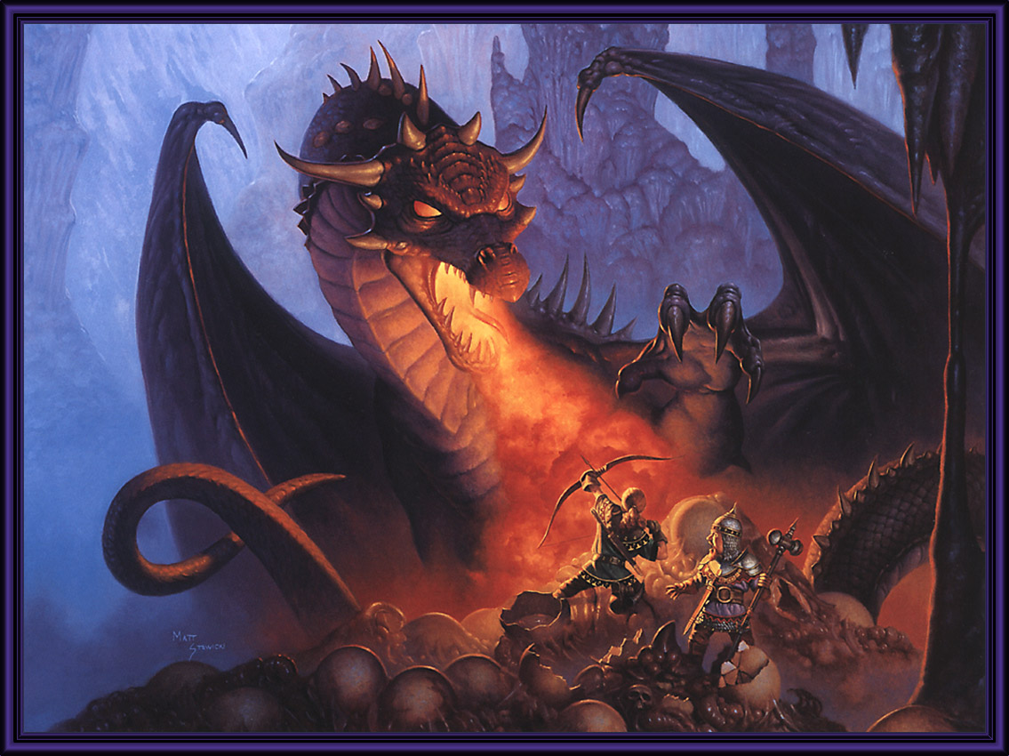





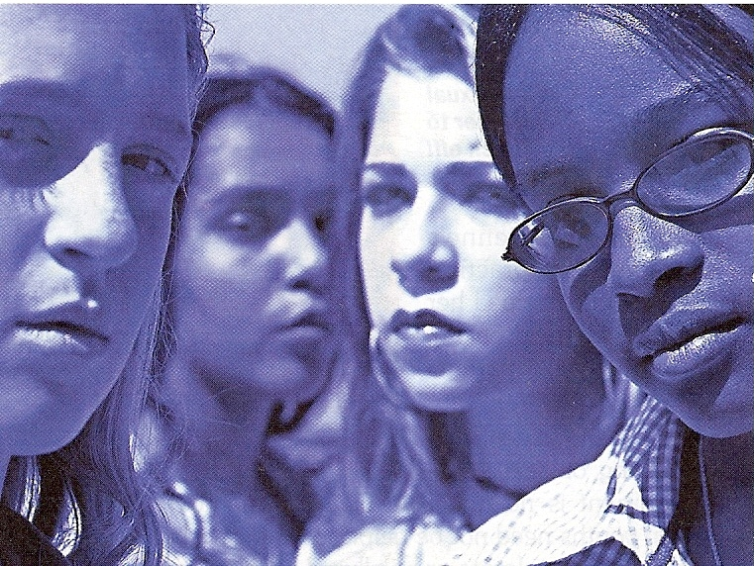

World
“For we wrestle not against flesh and blood, but against principalities, against powers, against the rulers of the darkness of this world, against spiritual wickedness in high places.”
Devil
Flesh

Slide 12
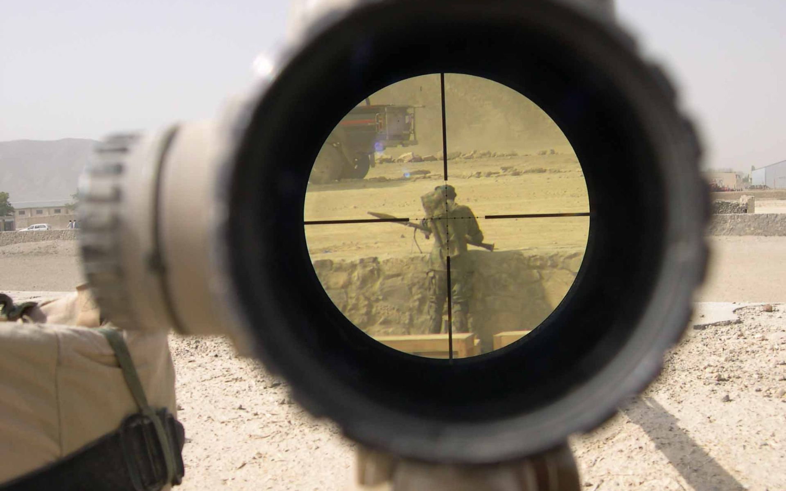
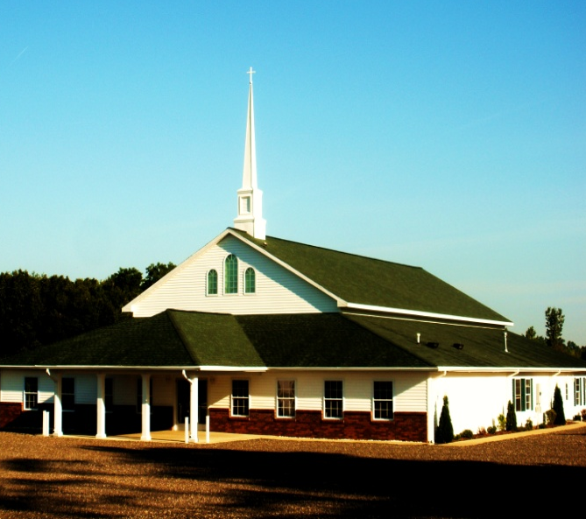
“Love not the world, neither the things that are in the world. If any man love the world, the love of the Father is not in him. For all that is in the world, the lust of the flesh, and the lust of the eyes, and the pride of life, is not of the Father, but is of the world. And the world passeth away, and the lust thereof: but he that doeth the will of God abideth for ever.”
(I John 2:15-17)

Slide 13

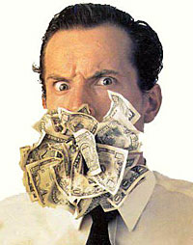

Lust of the flesh = Immorality (I Tim. 5:1-2, 22; II Tim. 2:22; Prov. 2, 5-7)
Lust of the eyes = Temporal values (Exod. 20:17; I Tim. 6:10; Heb. 13:5; Col. 3:1-2)
Pride of life = Bitterness (Prov. 13:10; Heb. 12:15; I Tim. 2:13-14)

Slide 14
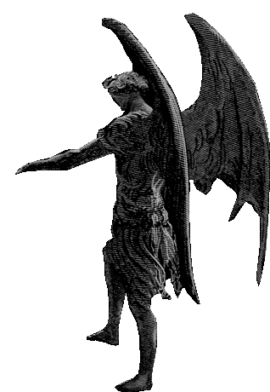
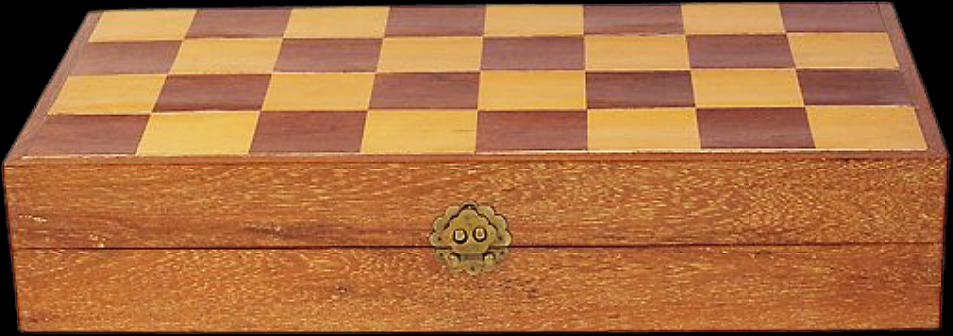
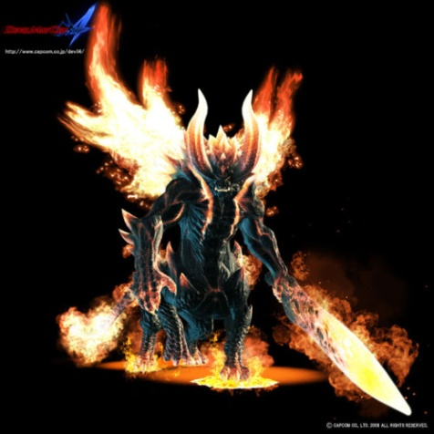
Principality
(Eph.6:12)
Stronghold
“False Ideas”
(II Cor. 10:3-6)
Ground
Surrendered
(Eph. 4:26-27)
Immorality
Bitterness
Temporal Values
Strife
Music
Discontent
Dress
Friends
Judging
Lying
Anger
Money
Depression
Worry
Drugs
Jealousy
Stealing
Fear
Hurt
Rebellion
Lust
Tormentors – Matthew 18:34

Slide 15
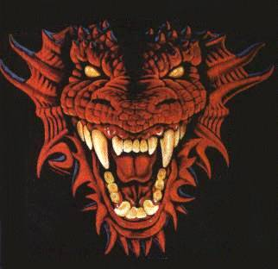
Satan’s Greatest Weapons
Deception – Rev. 12:9
Temptation – I Thess. 3:5
When we believe Satan’s lies and yield to his temptations we give him ground (place in our soul) upon which he builds his strongholds.
From “Strongholds” Satan seeks to conquer and control every area of our soul.

Slide 16
Will
(Hebrews 10:26)
Mind
(Romans 8:7)
Soul
(Hebrews 4:12)
Emotion
(II Corinthians 6:11-13)

Slide 17
Steps to Regain Surrendered Ground
Confess each sin of surrendered ground that God brings to your mind – Prov. 28:13
Claim the blood of Christ for cleansing and victory over those sins – I John 1:9; Rev. 12:9
Ask God to take back the ground surrendered to Satan – Ps. 23:3; Rom. 6
Tear down strongholds (false ideas) with the truth of Scripture – II Cor. 10:4-5; John 17:17

Slide 18
5. Transform your mind with the truth of God’s Word – Rom. 12:1-2
6. Fully forgive your offenders – Matt. 6:10-15
7. Revenge all disobedience – II Cor. 10:6-7
Clear your conscience – Acts 24:16
Make restitution – Luke 19:1-10
Ask forgiveness – “Forgive me this wrong…” (II Cor. 12:13)

Slide 19
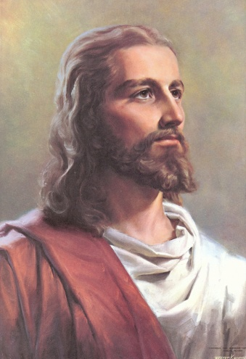
Stronghold
“Truth of Scripture”
(John 17:17)
Romans 6-8
Ground
Surrendered
(Rom. 6:16-19)
Humility
Holiness
(I Thess. 4:1-8)
Forgiveness
(Matt. 6:14)
Sacrificial Giving
(Luke 6:38)

Slide 20
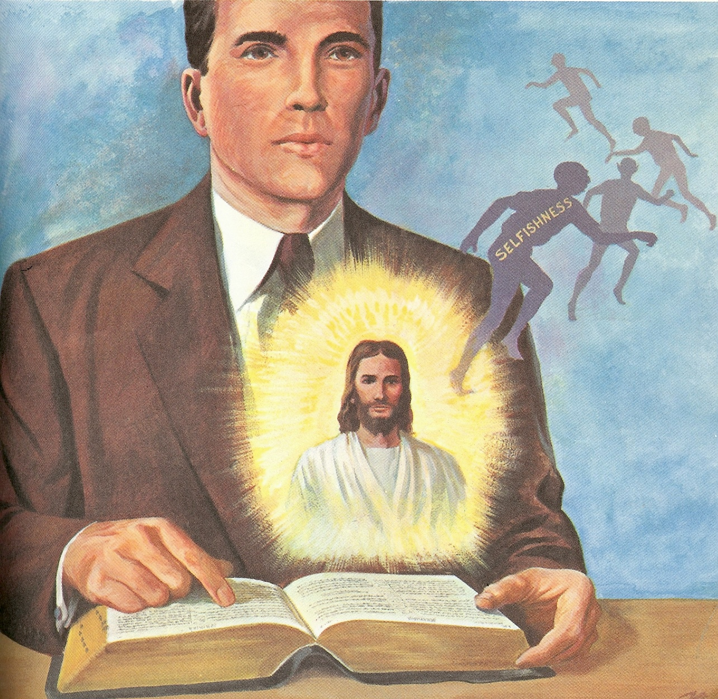
“…to whom ye yield yourselves servants to obey, his servants ye are to whom ye obey…”

