Slide 1
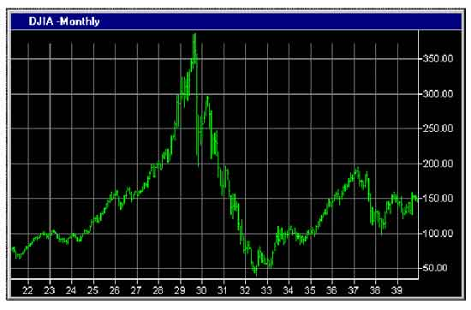
Financial Freedom
(Part 14)
What does it mean to be
financially free?
“And ye shall know the truth and the truth shall make you free.” (John 8:32)

Slide 2

Review:
Biblical principles of stewardship
What the Bible teaches about borrowing
The sting of interest
Establishing scriptural convictions
Developing a giving spirit
What it means to be financially free

Slide 3
Importance of living on a budget
Making a choice to serve God rather
than money or material possessions
Reasons for lack of funds
Establishing the tithe as a weekly
reminder that everything we have
belongs to God
Giving to meet the needs of others
Knowing who not to give money to
The Law of the Harvest

Slide 4
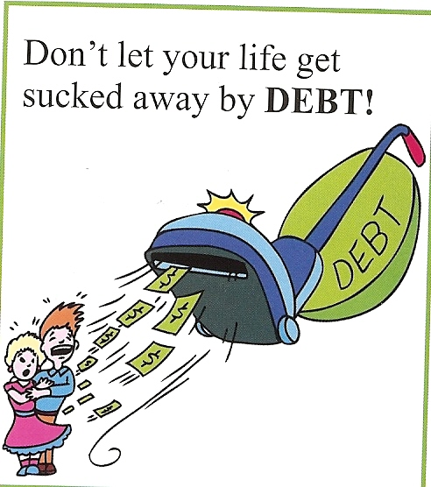
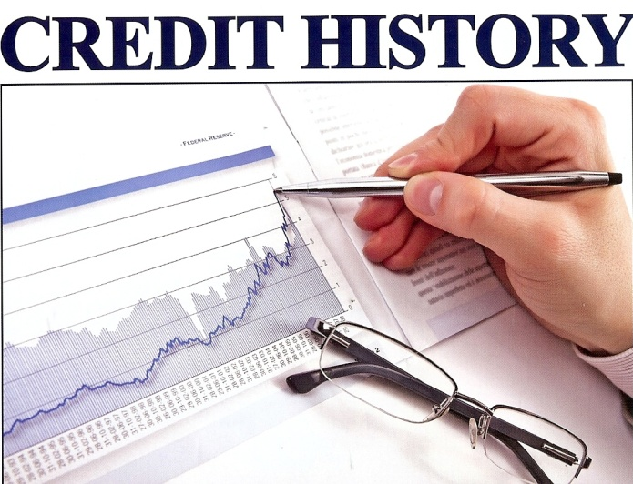
Gambling – Right or Wrong?
Violation of God’s Word results in financial loss – (Proverbs)
The Wisdom of Solomon concerning finances – (Proverbs)
Learning to live within your income -

Slide 5
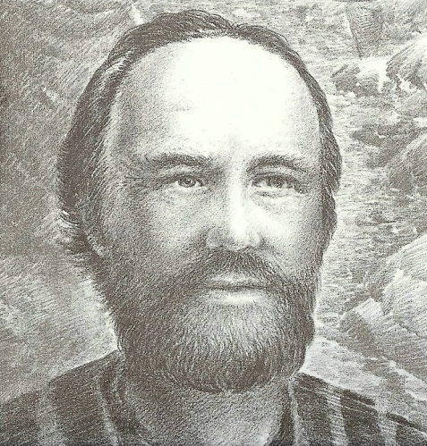
Learn to live within your income
“Not that I speak in respect of want: for I have learned, in whatsoever state I am, therewith to be content. I know both how to be abased, and I know how to abound: every where and in all things I am instructed both to be full and to be hungry, both to abound and to suffer need.” (Philippians 4:11-12)

Slide 6

The key to living within your income
“Being content with such things as ye have.”
(Hebrews 13:5)
Life is full of ever changing circumstances – “I know both how to be abased, and I know how to abound: every where and in all things I am instructed both to be full and to be hungry, both to abound and to suffer need.”
Contentment is discovering the secret of living triumphantly above changing circumstances -
“Now thanks be unto God, which always causeth us to triumph in Christ.” (II Corinthians 2:14)

Slide 7
The financial cycles of life
God does not view abundance or need as permanent conditions in an individual,
family, church, or nation!
“Charge them that are rich in this world, that they be not highminded, nor trust in uncertain riches, but in the living God, who giveth us richly all things to enjoy; That they do good, that they be rich in good works, ready to distribute, willing to communicate.” (I Timothy 6:17-18)

Slide 8

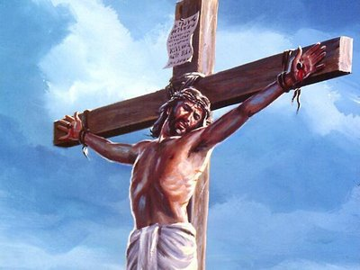
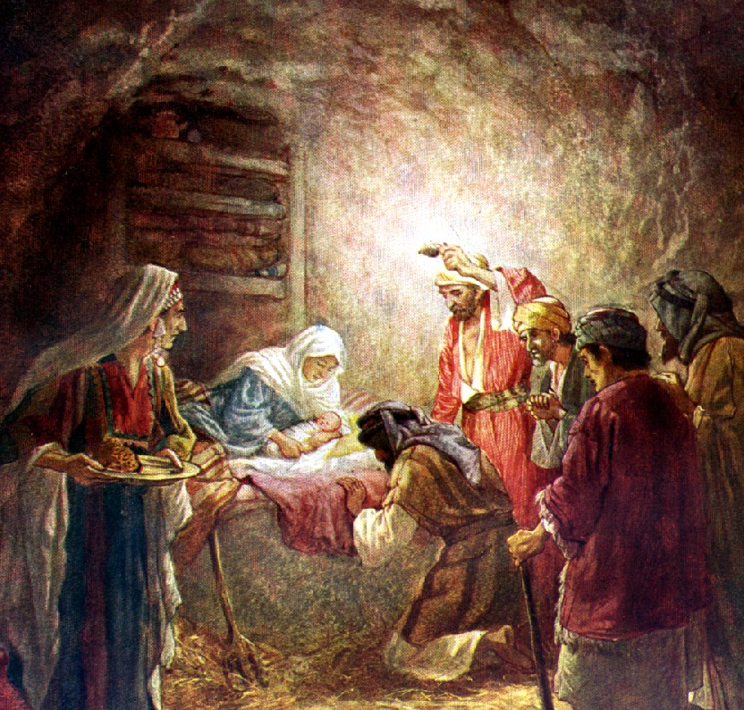
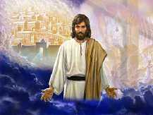
Abundance and need are related to God’s higher purposes
“For ye know the grace of our Lord Jesus Christ, that, though he was rich, yet for your sakes he became poor, that ye through his poverty might be rich.” (II Corinthians 8:9)
“That ye may know, the riches of the glory of his inheritance in the saints.”

Slide 9
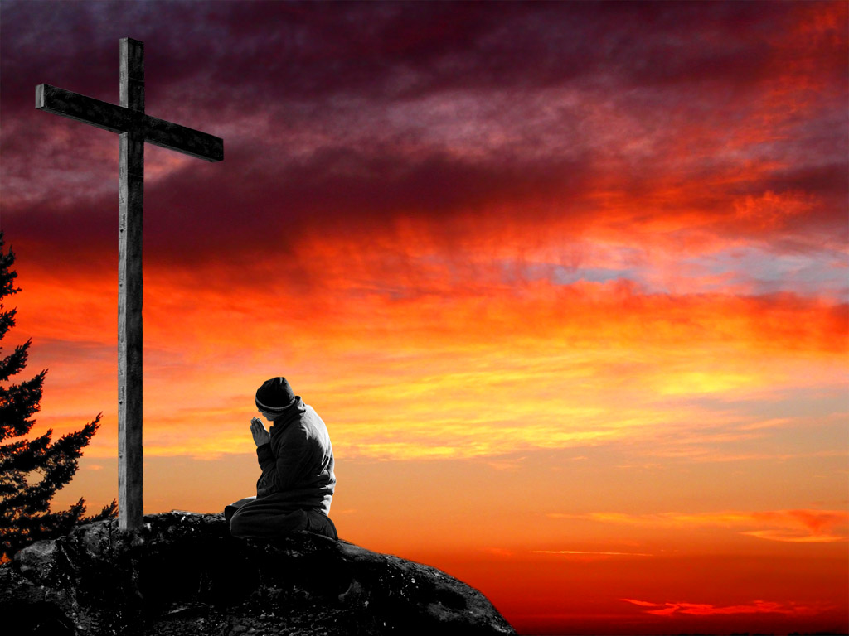
“In whom we have redemption through his blood, the forgiveness of sins, according to the riches of his grace.” (Ephesians 1:7)

Slide 10
Abundance (ability, opportunity, wealth, etc.) – “But thou shalt remember the LORD thy God: for it is he that giveth thee power to get wealth, that he may establish his covenant which he sware unto thy fathers, as it is this day.” – Deuteronomy 8:18
Test (dedicate wealth to God, use your wealth for God’s purposes, give to those in need, etc.)
“If riches increase, set not your heart upon them.” (Psalms 62:10)

Slide 11
Need (unwise investments, violation of the “Law of the harvest”, acts of God, etc.) –
“And said, Naked came I out of my mother's womb, and naked shall I return thither: the LORD gave, and the LORD hath taken away; blessed be the name of the LORD. In all this Job sinned not, nor charged God foolishly.” Job 1:21-22
Faith (claim God’s promises, set affections on things above, pray for provisions, etc.)
“Hearken, my beloved brethren, hath not God chosen the poor of this world rich in faith, and heirs of the kingdom which he hath promised to them that love him?” James 2:5

Slide 12
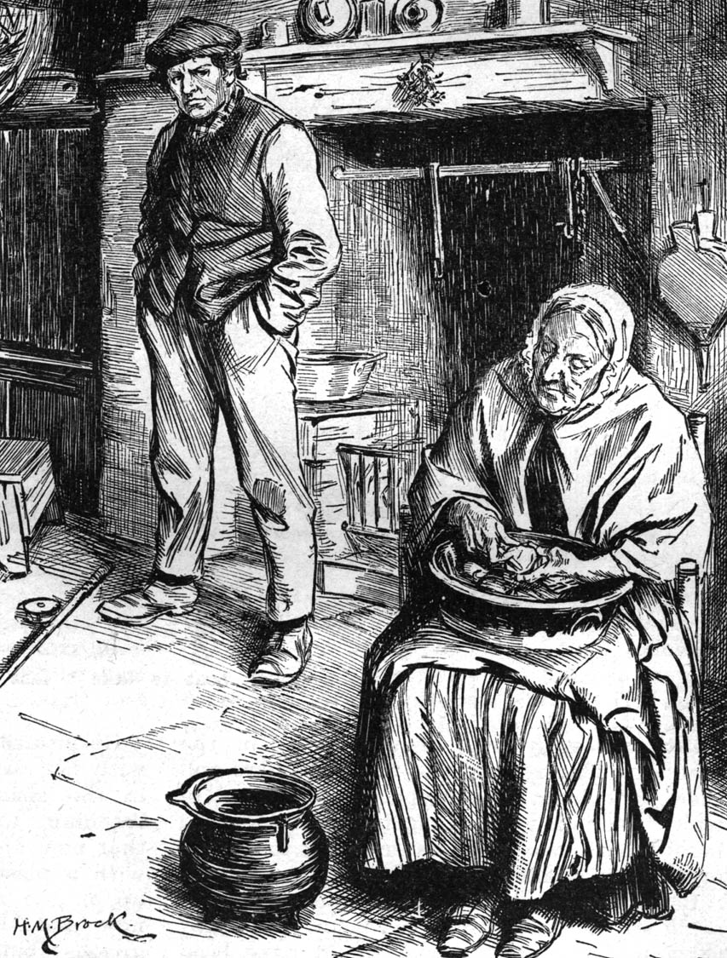
Abundance
Faith Test
Need

Slide 13

What is contentment?
Contentment is realizing that God has given you every thing you need for your present happiness!

Slide 14
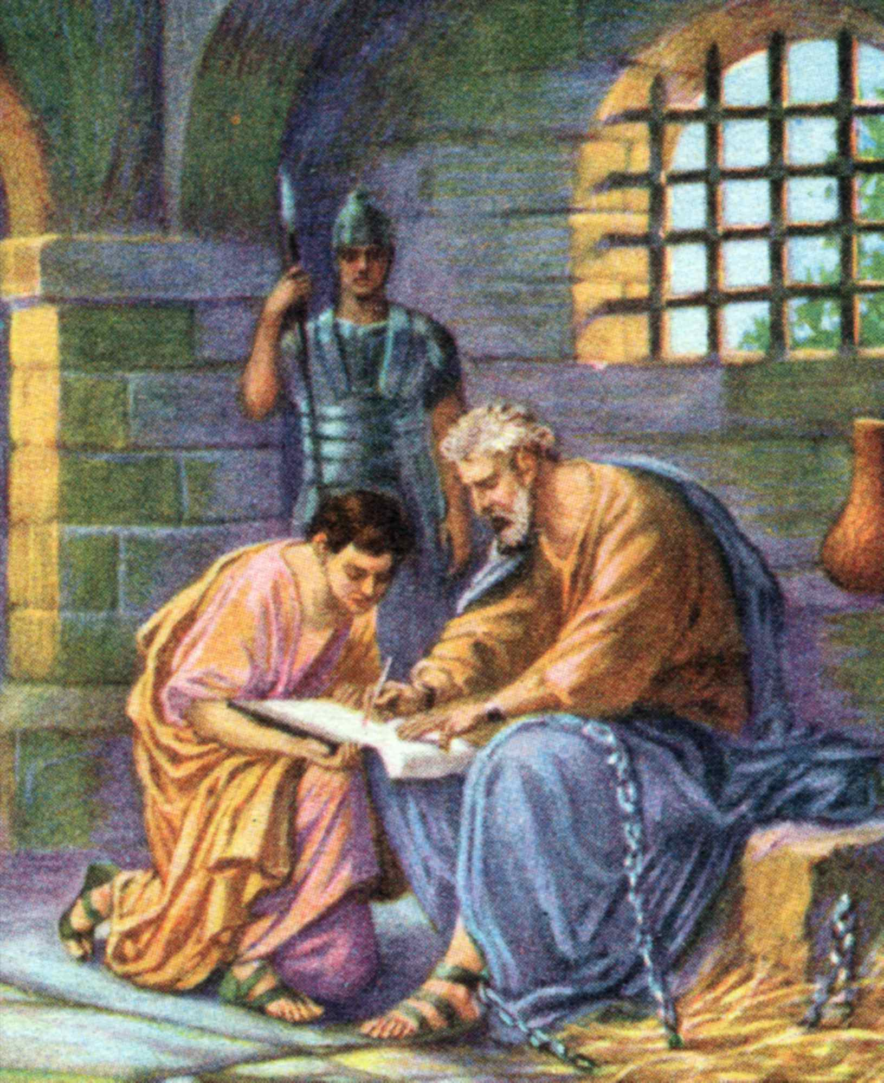
Many things can steal your joy, peace and
happiness if you allow them.
Paul was sitting in prison accused of treason against the Roman Government. His sentence if convicted would be the death penalty and yet he is expresses “contentment”.
He had learned contentment through the experience of life.
When writing to the church at Philippi, he penned the following words -

Slide 15
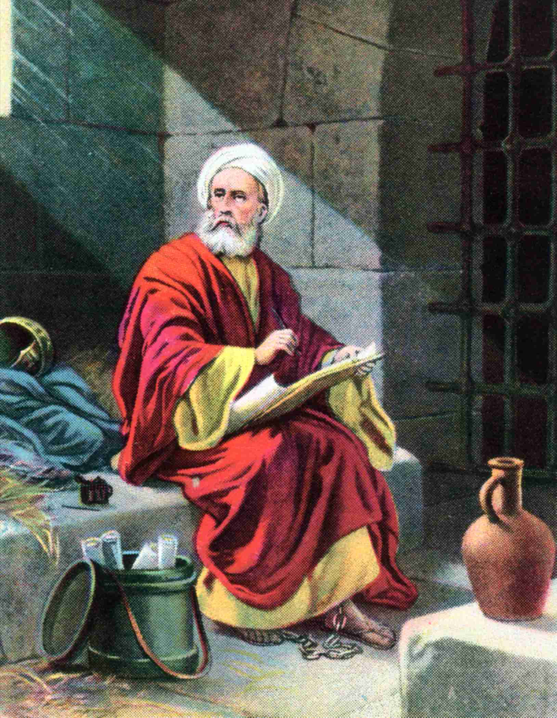
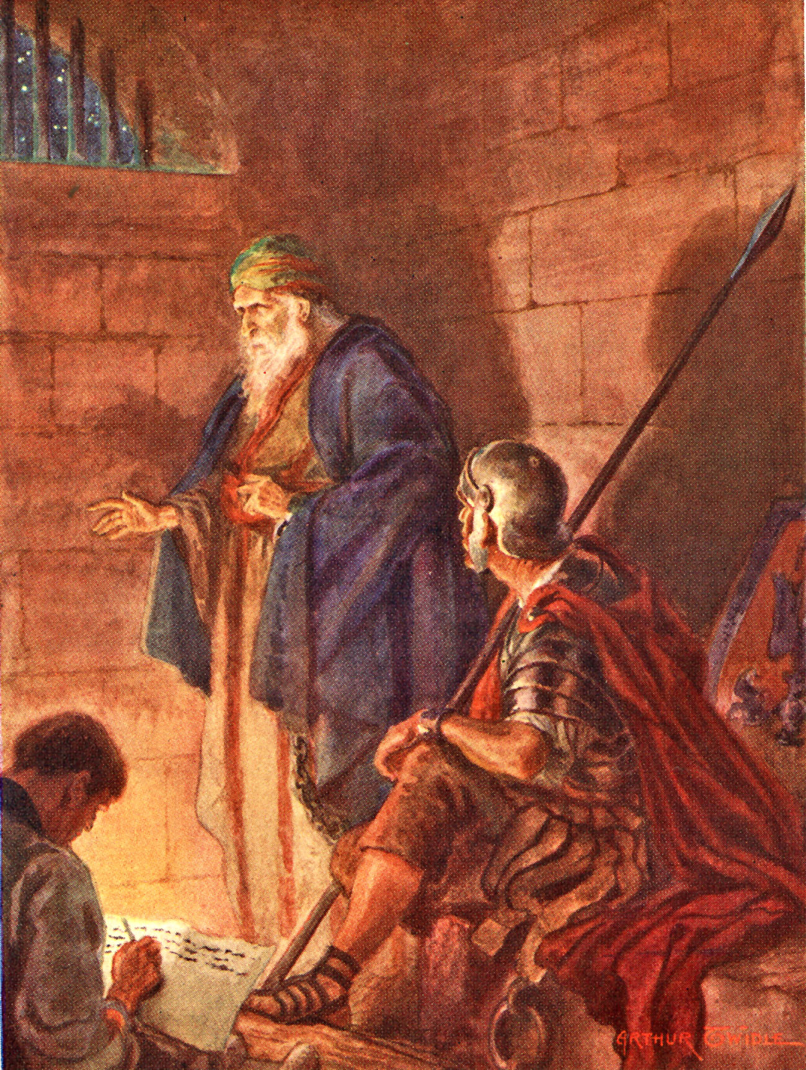
“Be careful for nothing (don’t worry about anything) but in every thing by prayer and supplication with thanksgiving let your request be made known unto God. And the peace of God, which passeth all understanding, shall keep your hearts and minds through Christ Jesus…I know how to be abased, and I know how to abound: every where and in all things (all circumstances) I am instructed both to be full and to be hungry, both to abound and to suffer need…I have learned in whatsoever state I am in (even in prison) therewith to be content…”

Slide 16
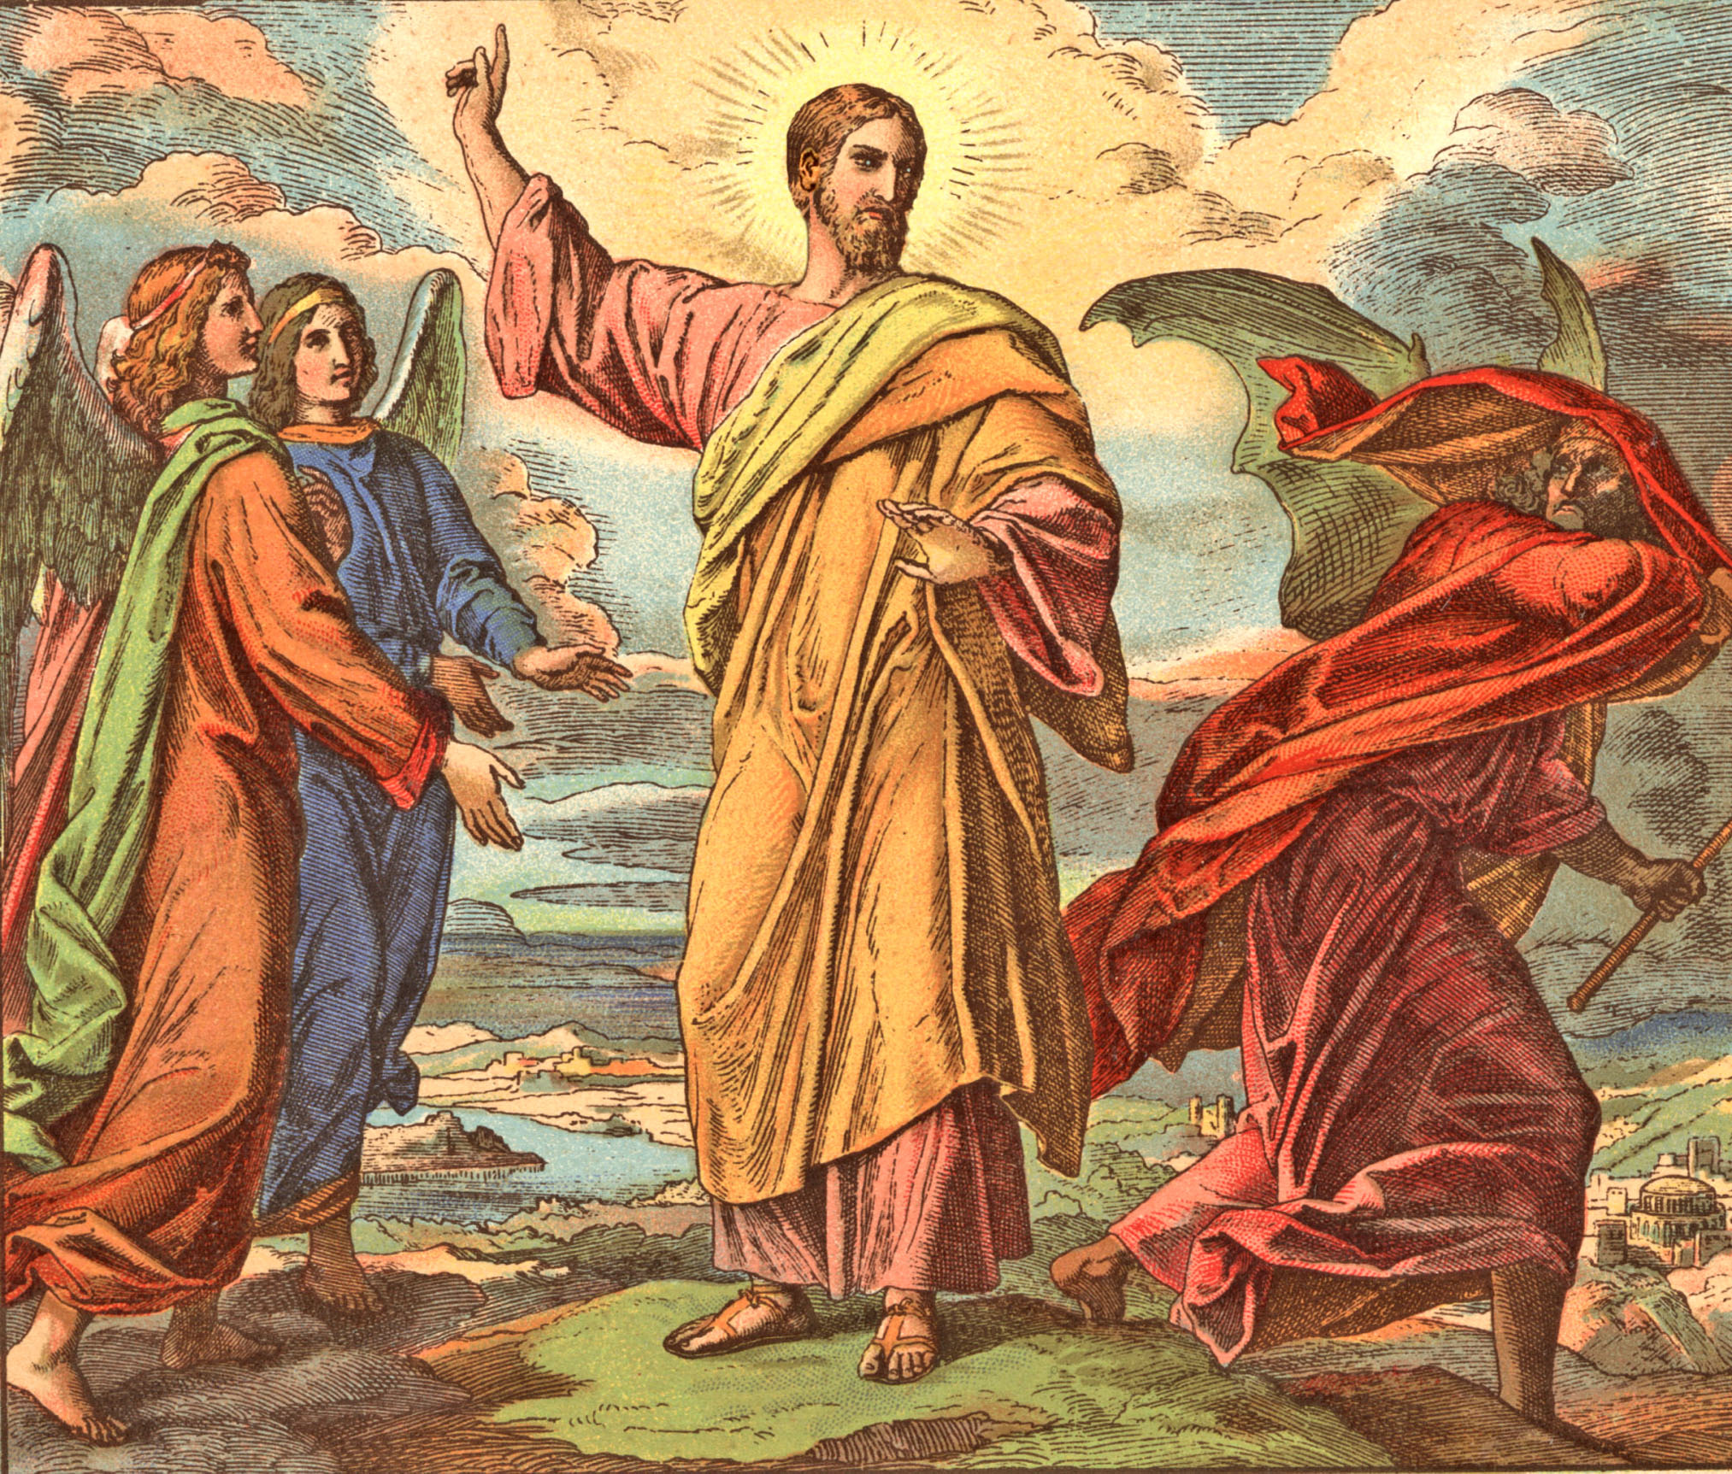
Satan’s temptation to be “discontent”
must be resisted
“Resist the devil and he will flee from you…Resist steadfast in the faith…”

Slide 17
Learning Contentment
Abundance
Need
Be grateful for what you have
Enjoy what you have
Make wise use of your material things
Appreciate physical comforts
Use your abundance for God’s glory
Invest in the Lord’s work
Be silent about your needs
Let your request be made known unto God
Learn to get along with out material things
Learn to live with out physical comforts
Be cheerful when in need
Trust God to meet your needs

Slide 18
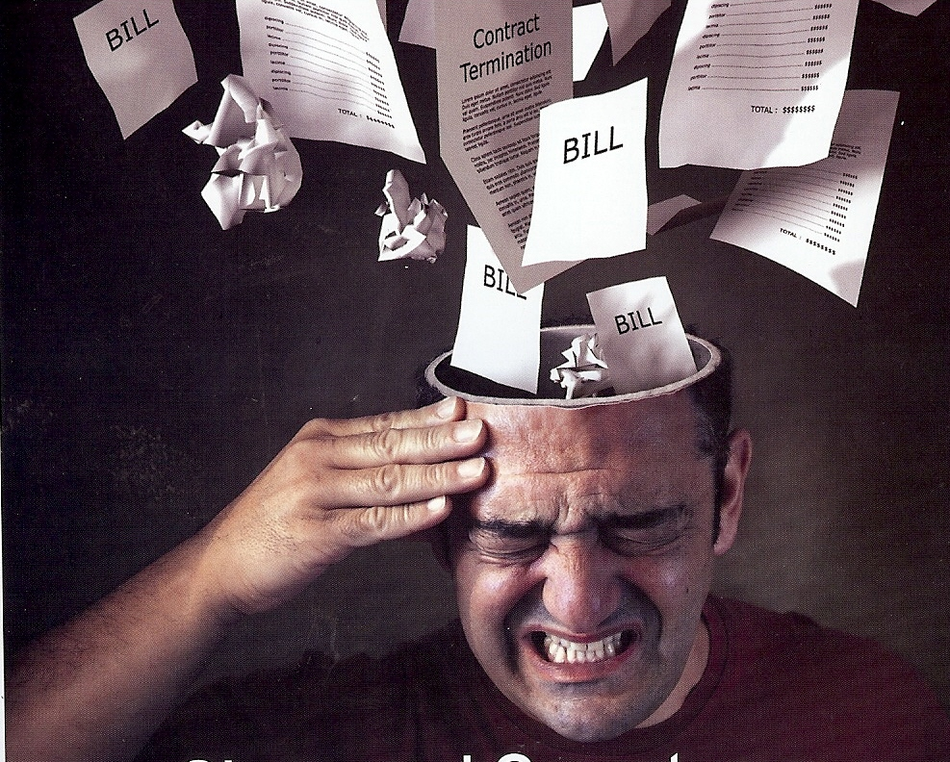
Reduce your bills and improve the quality of your life

Slide 19
Learn to do things yourself instead of paying for them to be done
Get rid of subscriptions you do not need – magazines, newspapers, books, cable TV, etc.
Cut down on long distance phone calls
Get rid of cell phones (teens do not need phones)
Cancel internet
Reduce the number of times you eat out
Plan your meals and shop wisely
Drink water
Eat less

Slide 20
Sell items that you do not need
Get rid of high-depreciating items
Reduce your heating and electrical bill
Practice preventive medicine to avoid high medical cost
Cut down on driving
Do not spend excessive amounts of money on hobbies
Avoid spending money on entertainment
Conquer expensive habits
Reduce vacation cost

Slide 21
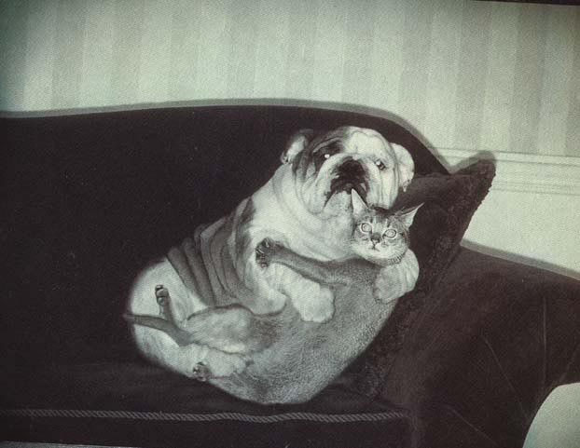
Get rid of family pets

Slide 22
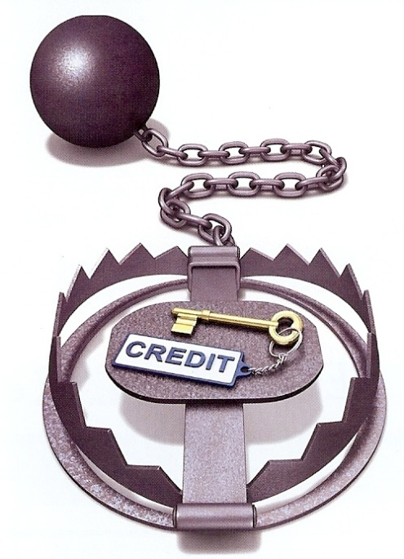
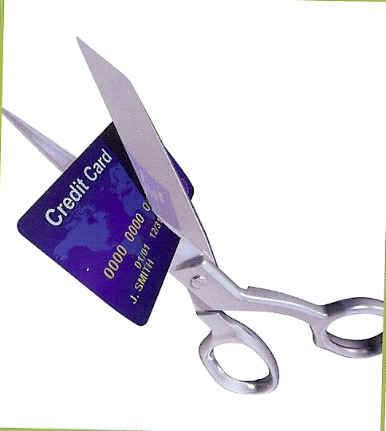
Avoid impulse buying (wait and pray before buying an item)
Shop around for the best price
Relate purchases to the amount of time worked
Garden
Buy good used cars
Live on a budget
Avoid bowering money
Pay off credit cards
Cut up your credit cards

Slide 23

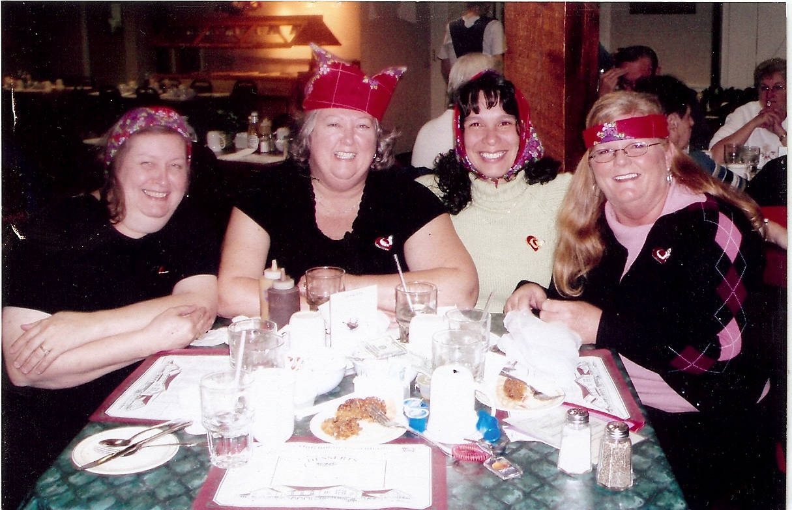
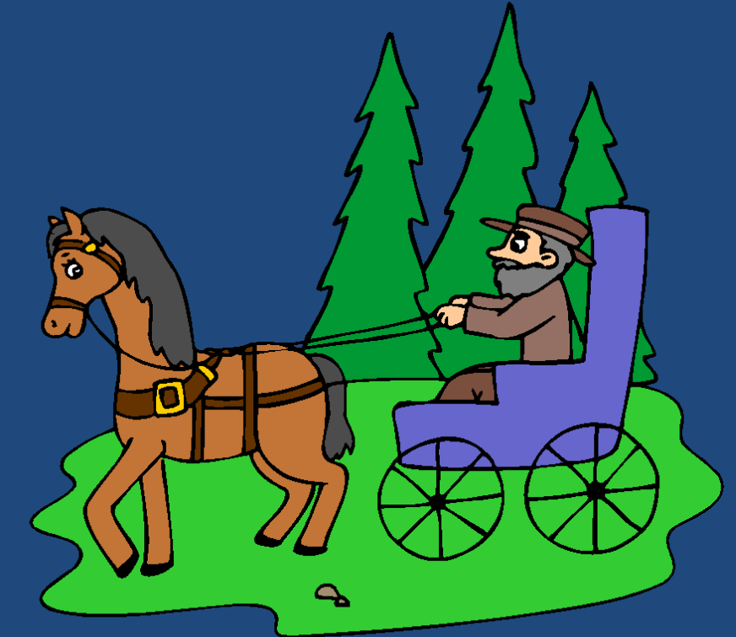
Do not allow your wife to go to Shipshewanna with the credit card

