Slide 1
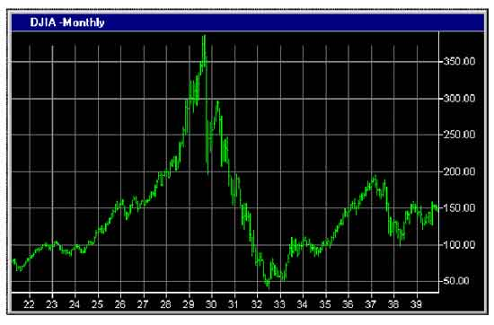
Financial Freedom
(Part 3)
What does it mean to be
financially free?
“And ye shall know the truth and the truth shall make you free.” (John 8:32)

Slide 2

Financial Freedom is Recognizing and Rejecting False Financial Concepts
(II Corinthians 10:5; Isaiah 55:8)
Myth: If you think, act, and look successful, you will become successful.
Truth: God alone gives the power to get wealth – (Deuteronomy 8:17-18)

Slide 3
Myth: There is no reason for a person to be poor.
Truth: “The rich and poor meet together: the Lord is the maker of them all.” (Proverbs 22:2)
Failure to tithe (robbing God) – (Malachi 3:6-11)
Poor stewardship – (Luke 16:10-13)
Debt/interest – (Proverbs 22:7)
Sins of the father – (Exodus 20:5)
Laziness – (Proverbs 24:30)
Chastisement of the Lord – (Hebrews 12:11)
Trust in riches – (I Timothy 6:17; James 5:1-5)
Co-signing – (Proverbs 6:1-3)
Economic downturn – (Matthew 5:45)

Slide 4
Excessive spending – (Galatians 5:22-23)
Widows – (I Timothy 5:16)
Fatherless – (Psalm 82:3)
Sickness – (Matthew 25:23)
Refusing counsel – (Proverbs 13:8)
Unbiblical partnerships – (Amos 3:3)
Worldly living (pleasure) – (Proverbs 21:17)
Immorality – (Proverbs 5:8-11)
Failure to give to the poor – (Proverbs 21:13)
Trials and testings – (Job; James 5:10-11)
Sacrificial giving – “There is he that maketh himself rich, yet hath nothing: there is he that maketh himself poor, yet hath great riches.”

Slide 5
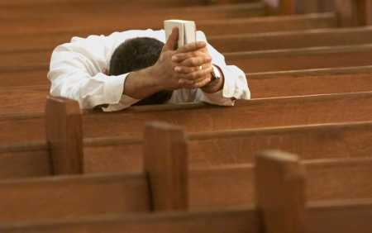
Missing Wednesday Evening Bible Study on Financial Freedom

Slide 6
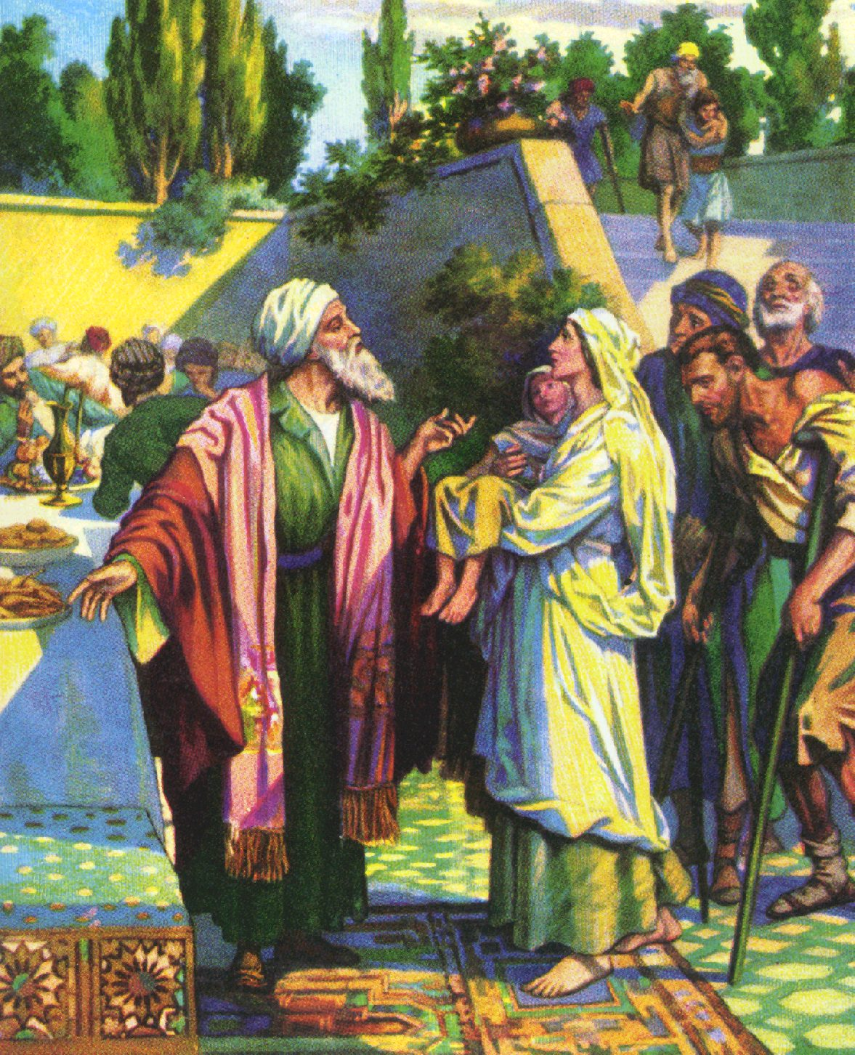
“If there be among you a poor man, thou shalt not harden thine heart, nor shut thine hand from the poor brother. For the poor shall never cease out of the land: therefore I command thee, saying, Thou shalt open thine hand wide unto thy brother, to the poor, and to the needy, in the land.” (Deuteronomy 15:7, 11)

Slide 7
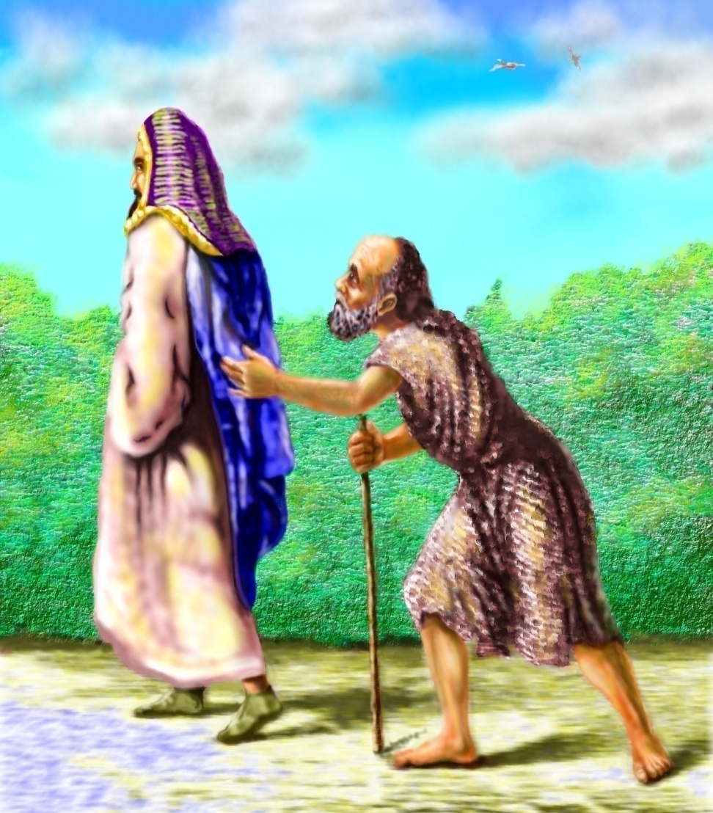
“He that hath pity upon the poor lendeth unto the Lord; and that which he hath given will He pay him again…He that giveth unto the poor shall not lack: but he that hideth his eyes shall have many a curse.”

Slide 8
Myth: There is no benefit in being poor.
Truth: “Christ was rich, yet for our sakes He become poor that we through His poverty might be rich.” (II Corinthians 8:9)
Keeps you humble.
Keeps you dependant upon the Lord.
Keeps you from trusting in riches.
Keeps you on your knees.
Keeps you from many temptations that the rich face.
Keeps you from being wasteful.
Keeps you from being judgmental.
Keeps you compassionate.

Slide 9
Myth: Every person can determine his own financial destiny.
Truth: This idea causes a man to be self-centered rather than God-centered – (Proverbs 10:22; Psalm 16:4; James 5:13-15)
“Ye that say, today or tomorrow we will go into such a city, and continue there a year, and buy and sell, and get gain. Whereas ye know not what shall be on the morrow. For what is your life? It is but a vapor, that appeareth for a little time, and then vanisheth away. For that ye ought to say, if the Lord will, we shall live, and do this, or that.”

Slide 10
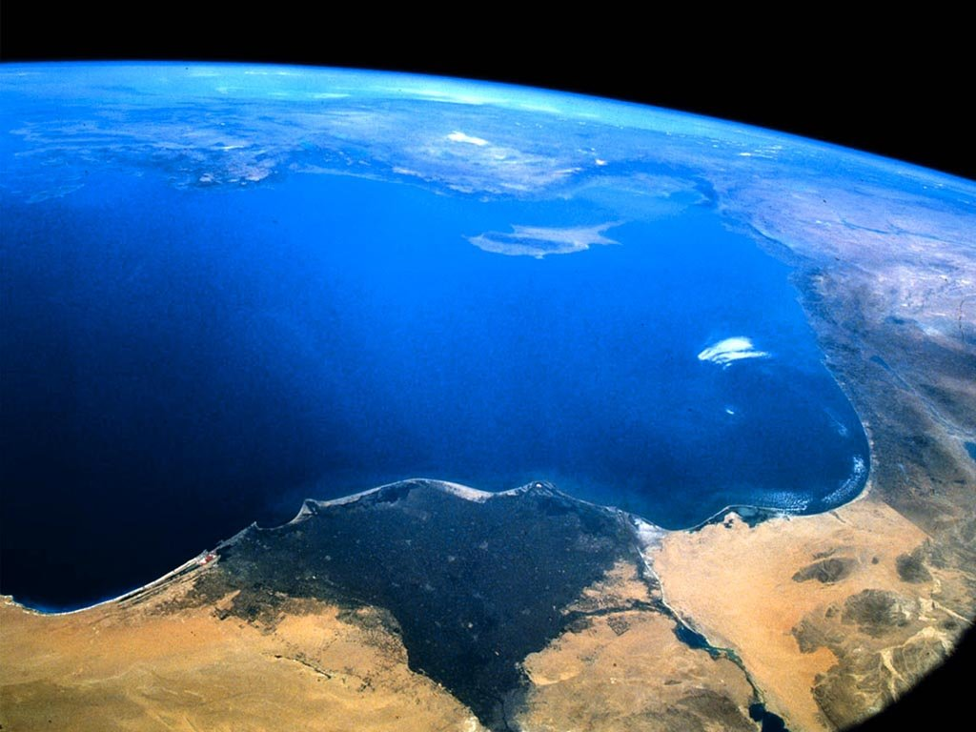





Slide 11


Myth: You can achieve whatever you set your mind to.
Truth: Places confidence in human reasoning and ability rather than giving proper recognition to God – (Romans 8:7-8, 13-14)

Slide 12


Myth: You should make it your goal in life to be financially independent.
Truth: God does not want us to develop an independent spirit – (I Timothy 6:7, 17; II Corinthians 8:14)
“Walk by faith and not by sight”
“Trust in the Lord with all your heart.”
“Lord what wilt thou have me to do.”
“If the Lord will, we shall live, and do this, or that.”
“No my will but thine be done.”

Slide 13
Myth: The material things that I can provide for my family will make up for any sacrifices that my job requires – (Luke 12:15; Malachi 4:6)
Truth: If a man’s wife and children feel that his job is more important than they are, then they will despise him in their hearts.
The real need of a family is not material things but spiritual leadership – (Ephesians 5:23)
No amount of money can restore time and relationships that are lost because of wrong priorities – (Titus 1:6)

Slide 14

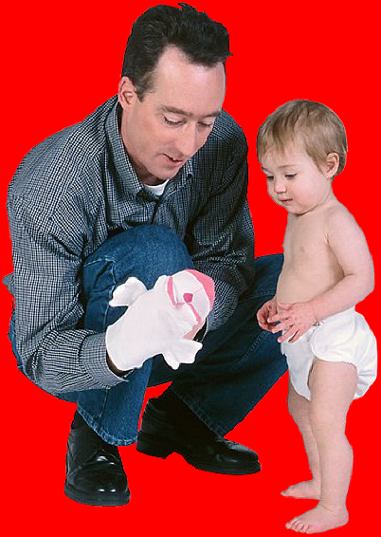




Slide 15
Myth: A person can borrow his way to financial success.
Truth: The borrower becomes the servant to the lender – (Proverbs 22:7)
Violates the clear warnings of Scripture – (Deuteronomy 15:6, 28:12; Romans 13:8)
Based on the false assumption that things will be better tomorrow than they are today – (James 4:13-14)
Financial success is not measured by assets, but freedom from greed, worry, and bondage – (Deuteronomy 5:21; Philippians 4:10; II Peter 2:19)

Slide 16


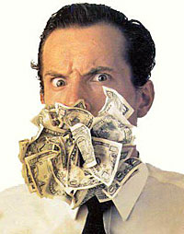
Greed
Worry
Bondage

Slide 17
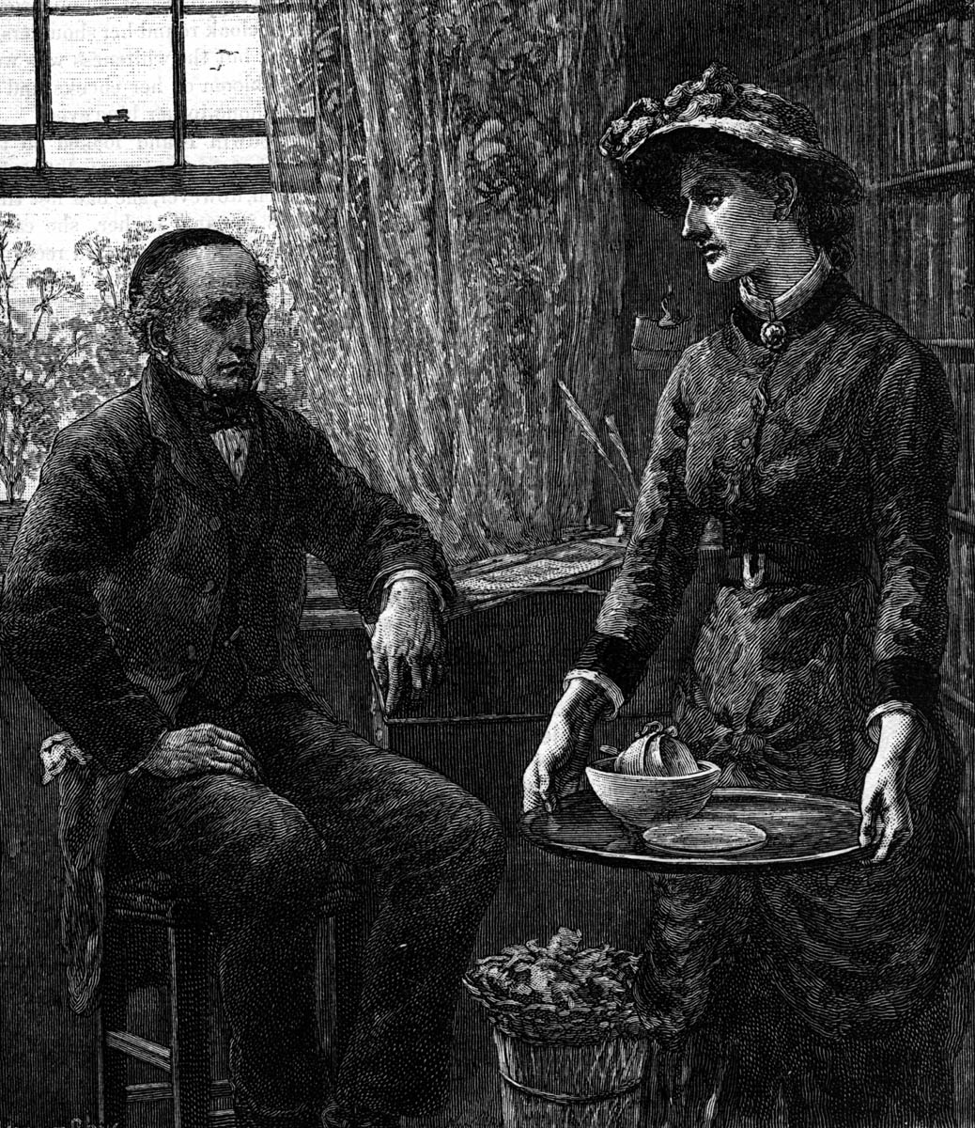
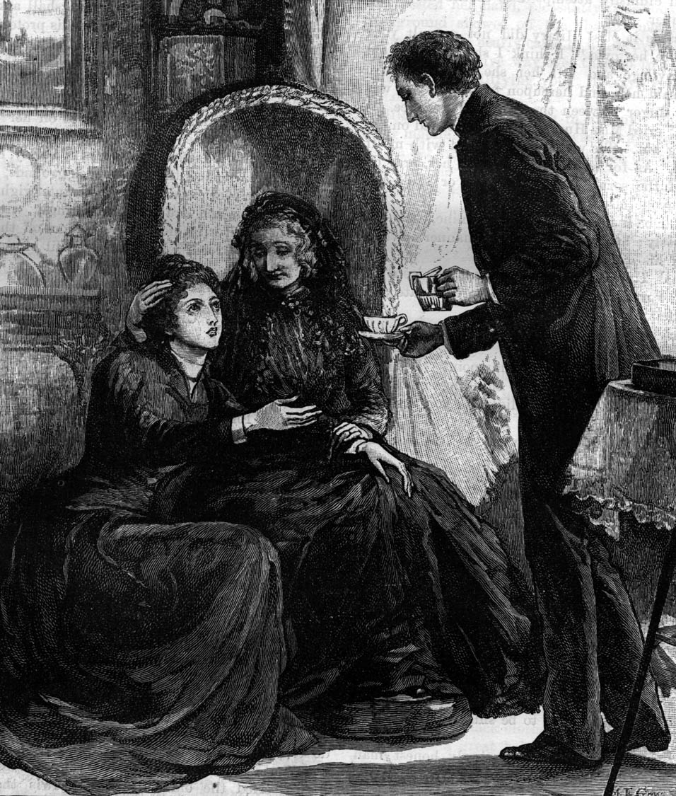
Myth: Make it your financial goal to be your own boss.
Truth: The Christian’s goal is not to become the “boss” but to become the servant of all – (Matthew 23:11-12)
When your focus is on serving, it may well lead to promotion or ownership – (I Peter 5:6)
Focus on helping others become successful – (Psalm 75:6)

Slide 18
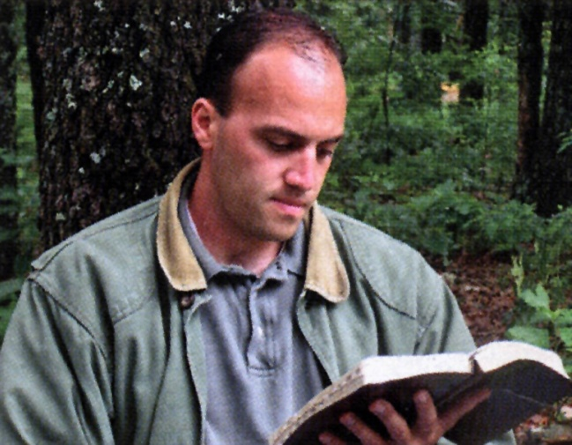
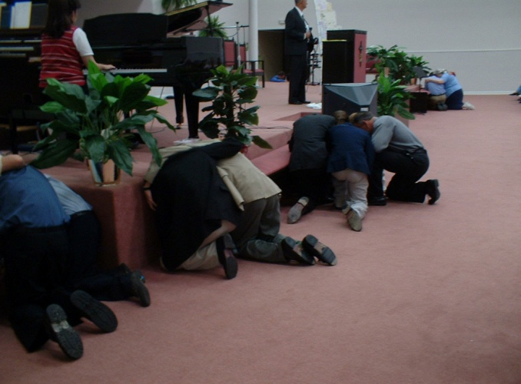
Myth: You have the right to decide how you will spend the money you earn.
Truth: The money we have does not belong to us – (I Corinthians 6:20)
We are stewards of that which God has entrusted to us – (I Peter 4:10)
We demonstrate Biblical stewardship through obedience to God’s Word – (Exodus 19:5)

Slide 19




Myth: In order to become successful you must overcome every obstacle that stands in the way of your financial goals.
Truth: God wants us to recognize that some obstacles are given by Him as reproofs – (Proverbs 1:23)
These obstacles are designed to turn us from our ways and follow His direction – (Proverbs 13:8)

Slide 20
Myth: You can build a successful business with a good advertising program.
Truth: A successful business is build upon a good reputation – (Ecclesiastes 10:1)
Focus on establishing a good name – (Proverbs 22:1)
Word-of-mouth is the best promotion – (Proverbs 27:2)
“Let another man praise thee, and not thine own mouth; a stranger and not thine own lips.”

Slide 21

Myth: Your success in life is determined by the amount of money you earn.
Truth: This is the false assumption that…
Peace
Security
Happiness
Acceptance
Fulfillment
will be met through money.
These needs are only met through a right relationship with God – (I Timothy 6:10)
If we expect to gain from money the things that only God can give, we make money our god – (James 1:11)

Slide 22

Myth: Those who reach the top of the ladder of success are self-made people.
Truth: This prideful idea totally overlooks the fact that it is God who “…putteth down one, and setteth up another.”
Discounts the investments of parents, friends, loved ones and others.
Pride is believing that I have achieved what in reality, God and others have done for me – (I Corinthians 15:10)

Slide 23
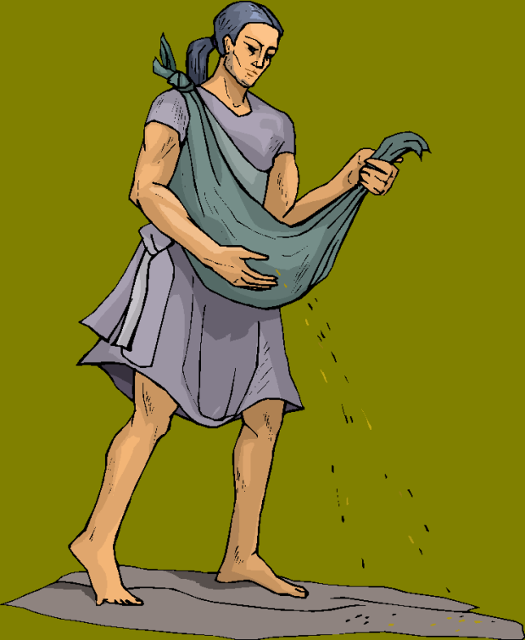
Myth: You must be willing to compromise if you want to succeed in the business world.
Truth: Just the opposite is true.
If you compromise for financial gain your success will be short-lived – “What you sow you reap…”

Slide 24
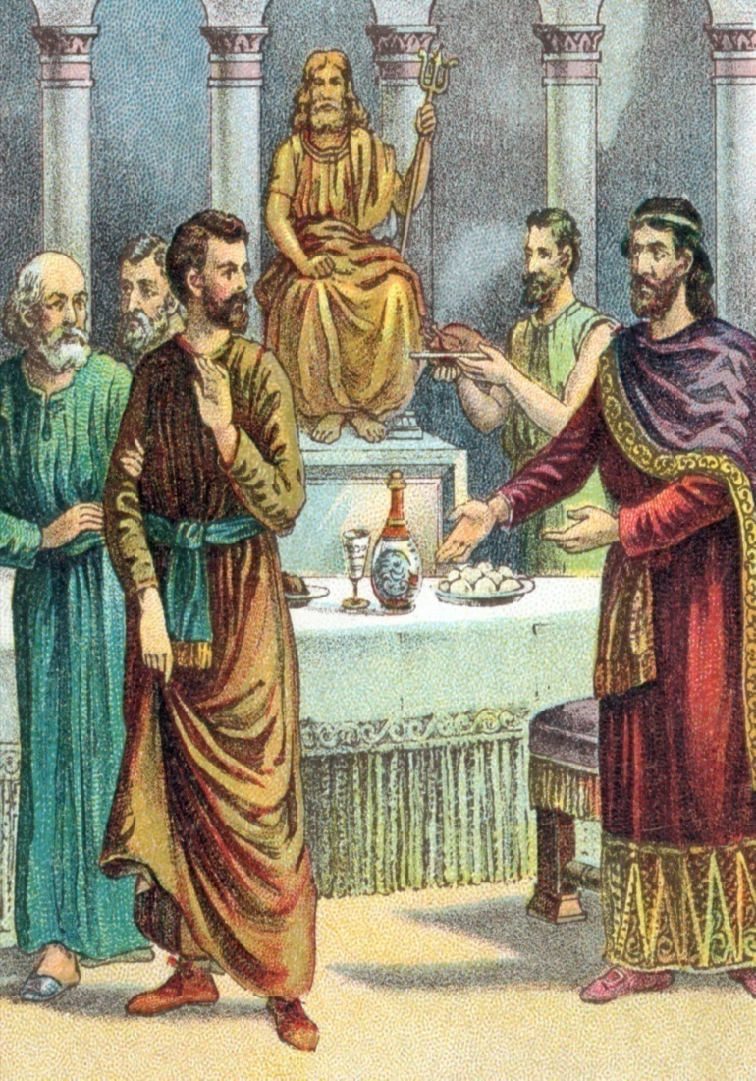
Daniel refused to compromise
(Daniel 1:8) -
Daniel became wiser than all the
wise men of Babylon.
The King made Daniel a great man.
Daniel was given great riches.
Daniel was made chief of the
governors over all the wise men.
The King commanded that all
Babylon worship the God of Daniel.
Daniel was the chief counselor
to King Nebuchadnezzar, Belshazzar,
Darius and Cyrus.

Slide 25


Myth: In order to be promoted in business it’s not what you know but who you know.
Truth: The quality of your work and diligence will gain the attention of the right people.
“Seest thou a man diligent in his business? He shall stand before kings.” (Proverbs 22:29)
Trying to gain favor or influence with the rich is condemned by God – (Proverbs 23:1-8)

Slide 26
We are stewards of all God has entrusted
to us - “My money is a trust (stewardship)
from God and must be earned and
managed according to Biblical principles.”
We are responsible to manage God’s
resources according to His Word –
Personal Commitment
“I will purpose to work towards gaining and maintaining financial freedom according to Biblical principles.”

