Slide 1
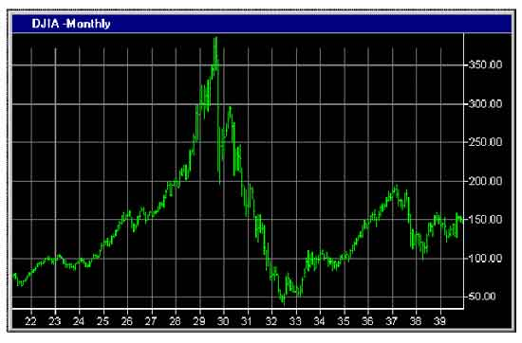
Financial Freedom
(Part 4)
What does it mean to be
financially free?
“And ye shall know the truth and the truth shall make you free.” (John 8:32)

Slide 2
Review:
Stewardship
We are stewards of all God has entrusted to us
“My money is a trust (stewardship) from God and must be earned and managed according to Biblical principles.
Personal Commitment
“I will purpose to work towards gaining and maintaining financial freedom according to Biblical principles.”

Slide 3
Debt
Creates a relationship of servitude.
Violates Scripture.
Constitutes the judgment of God.
Gives a false impression of wealth and independence.
Interferes with God’s provision.
Demonstrates a lack of contentment.
Removes God’s protective barriers.
Devours resources through interest payments.
It is poor stewardship.

Slide 4
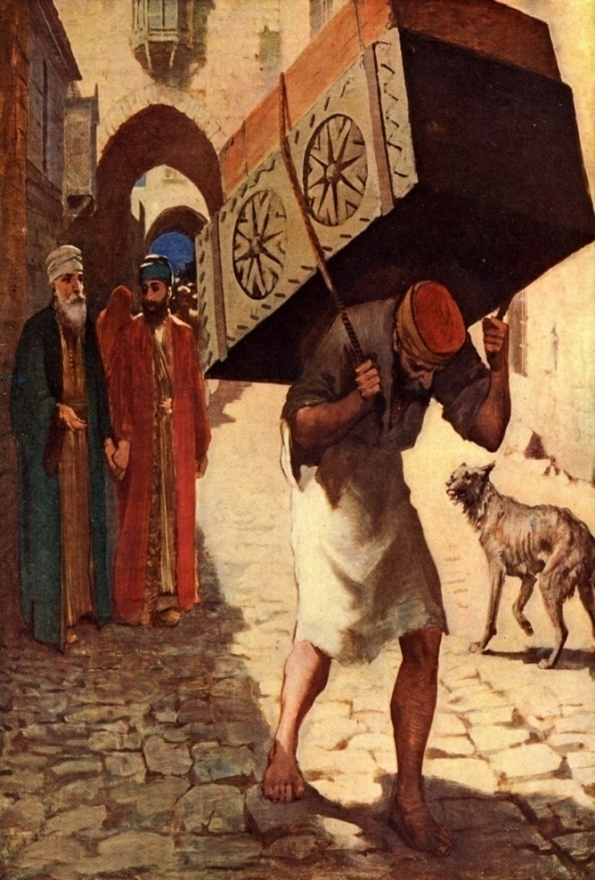
Hinders resourcefulness.
Promotes impulse buying.
Causes over spending.
Can damage God’s reputation.
Weakens personal faith.
Can lead to bankruptcy.

Slide 5

Financial Freedom
(Part 1-3)
Developing Biblical convictions.
Financial bondage
Mismangement
How to manage money according to Biblical principles.
Developing a giving spirit.
Loaning money to friends of family members.
Cosigning.

Slide 6
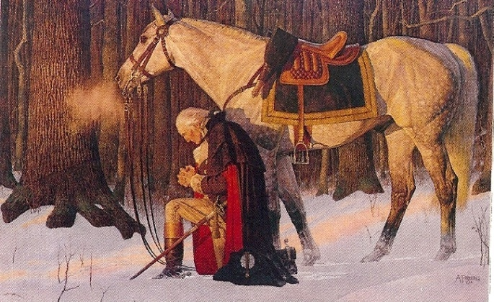
A how to receive provision from the Lord.
God’s purpose in money.
Reason’s for lack of funds.
Do godly Christians ever suffer financial loss or need?
Benefits in suffering financial need.
Recognizing and rejecting false financial concepts.

Slide 7

Financial Freedom
“Recognizing that all Wealth is Ultimately in God’s Hands.”
God controls all wealth – “But thou shalt remember the Lord thy God: for it is He that giveth thee power to get wealth.”
God alone is sovereign – (Acts 15:18; Psalm 135:6; Proverbs 16:4; Ephesians 1:11)
God is the chief being in the universe.
God’s power is supreme.
God has a plan which is all-inclusive.

Slide 8
God may allow certain events to happen according to natural laws which He has ordained.
God however is in complete control of all things which ultimately brings Him praise and glory – (Revelation 4:11)
The rewards of understanding this truth –
Produces true security – (Philippines 4:19)
Causes our focus to be on true riches (eternal) – (Luke 16:11)
Creates a relationship with your heavenly Father – (Matthew 7:7-11)

Slide 9
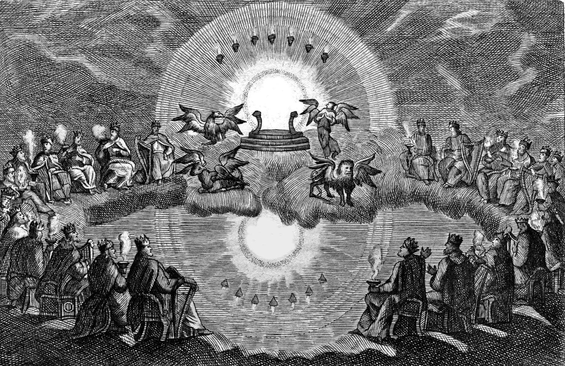
The Almighty God

Slide 10
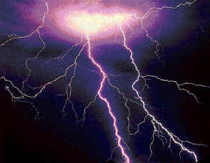
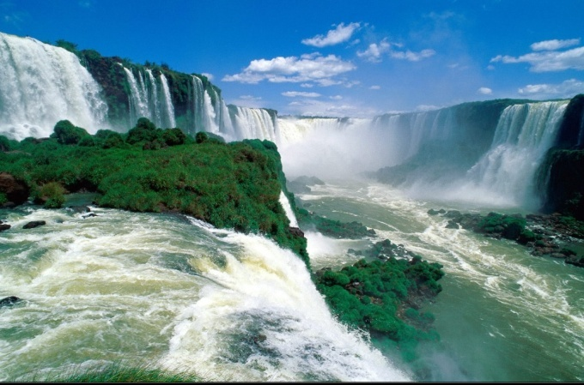


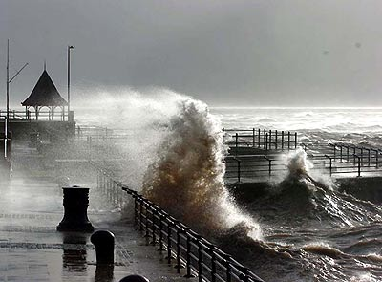



God Created
“Natural Resources and Natural Laws”
(Genesis 1:1)

Slide 11



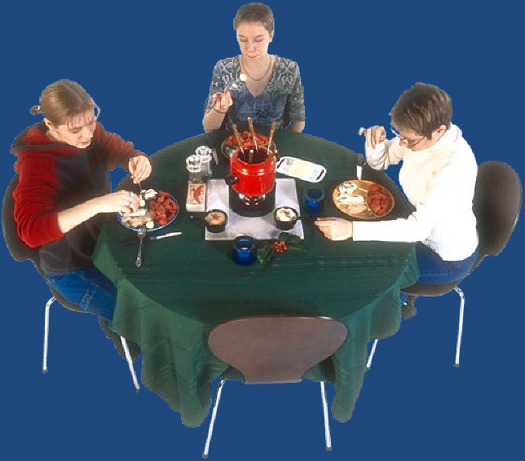




God Designed
“Human Needs”
(Matthew 6:32)

Slide 12




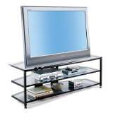





God Gives
“Wisdom and Creative Ability”
(Proverbs 8:12)

Slide 13



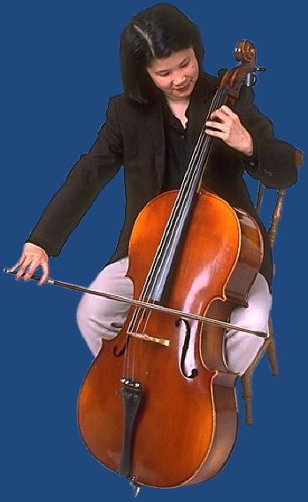


God Gives and Sustains
“Human Life, Health, Strength and Ability”
(Acts 17:28)

Slide 14
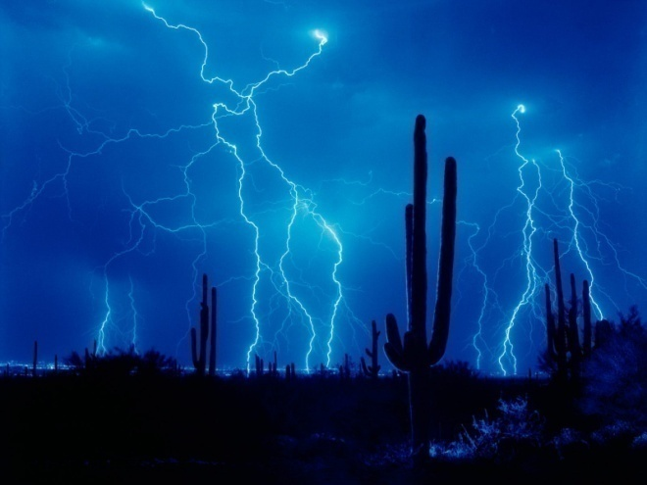




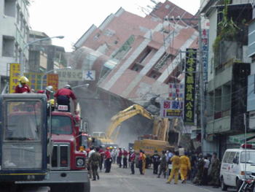

God Controls
“Circumstances”
(Haggai 1:9)

Slide 15

Wrong Philosophy
(Colossians 2:8)
Wealth comes from -
Natural resources
Human wisdom
Man’s ability
Personal talents
Human creativity
Successful business model
Your trust will be misplaced – (Isaiah 31:1)
Your priorities will be out off balance – (Matthew 6:33)
You will become disillusioned – (Ecclesiastes 1-2)

Slide 16
Financial Success
God’s Way Man’s Way
Focus on submission
Emphasis on personal responsibility
Desire to meet the needs of others
Concern for lasting achievement
Yearning for the approval of God
Focus on power and position
Emphasis on rights and freedom
Desire to gain for self
Concern for immediate fulfillment
Yearning for the praise of men

Slide 17
Aspiration to serve others
Patience
Striving to follow the Lord
Cooperation
Motivation for God’s glory
Aspiration to be served
Pushing ahead
Striving to lead men
Competition
Motivation for self-glorification

Slide 18

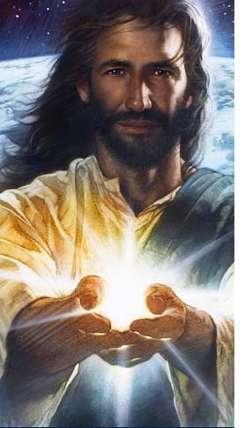

Personal Commitment
“I hereby acknowledge that any funds that I have or will receive are from God’s hand and must be earned and managed according to the principles of His Word.”

